Slide 1
Coding and Billing in
Emergency Medicine: The Basics
Kimberly Sokol, MD, MS, MACM(c)
Kaweah Delta Department of Emergency Medicine

Slide 2
Coding and Billing: The Basics

Slide 3
Session Objectives
By the end of the didactic session, learners will be able to
  Define the term “E/M code”.
  Determine the potential E/M code of a patient’s emergency department visit based on the severity of their presenting problem.
  State the required components of the 5 different E/M codes in terms of history, physical exam, and medical decision making.

Slide 4
What are E/M Codes?
E/M = Evaluation and Management
E/M Codes are determined by the level of risk the presenting problem poses to the patient (1 is the lowest level of risk, and 5 is the highest)
Providers’ charts determine the E/M Code in three ways: History, Physical, and Medical and Decision Making (MDM).
Bottom line: The patient’s presenting problem will determine the potential code, but the provider’s chart has to provide sufficient evidence to fulfill that code.

Slide 5
Translating Chart Level → E/M Code
Level 1 = 99281
Level 2 = 99282
Level 3 = 99283
Level 4 = 99284
Level 5 = 99285
Least Severe
Most Severe

Slide 6
Step-Wise Approach to Coding Charts
Choose your E/M Code based on your patient’s presenting problem.

Slide 7
Level 1 = 99281
Presenting problem: Minor, self-limited
Examples:
  Suture removal
  Immunizations
  Medication refills

Slide 8
Level 2 = 99282
Presenting problem: Low to moderate severity
Examples:
  Painful sunburn
  Impetigo localized to the face of a child
  Minor traumatic injury of an extremity
  Red, swollen cystic lesion on the back of an otherwise healthy patient

Slide 9
Level 3 = 99283
Presenting problem: Moderate severity
Examples:
  Sexually active female presenting with vaginal discharge, normal vital signs, no abdominal pain
  Well-appearing child with fever and diarrhea, no signs of dehydration
  Inversion-type ankle injury, unable to bear weight on the injured foot/ankle

Slide 10
Level 4 = 99284
Presenting problem: High severity, require urgent evaluation by physician, but do not pose immediate threat to life
Examples:
  Child with head injury and brief loss of consciousness, but neurologically intact
  Elderly female with right hip pain after a mechanical fall
  Patient with flank pain and hematuria
  Sexually active female with vaginal discharge AND abdominal pain

Slide 11
Level 5 = 99285
Presenting problem: High severity, require urgent evaluation by physician AND pose an immediate threat to life/physiologic life
Examples:
  Complicated overdose
  New-onset rapid heart rate requiring IV therapy
  Active upper GI bleed
  Patient presenting after a motor vehicle collision with concerns for intraabdominal, intrathoracic, and/or multiple extremity injuries
  Cardiac ischemia
  Pulmonary embolus

Slide 12
Step-Wise Approach to Coding Charts
Choose your E/M Code based on your patient’s presenting problem.
Once you’ve chosen your E/M Code, determine the level of History needed to fulfill the requirements for that code, as determined by Centers for Medicare and Medicaid Services.

Slide 13
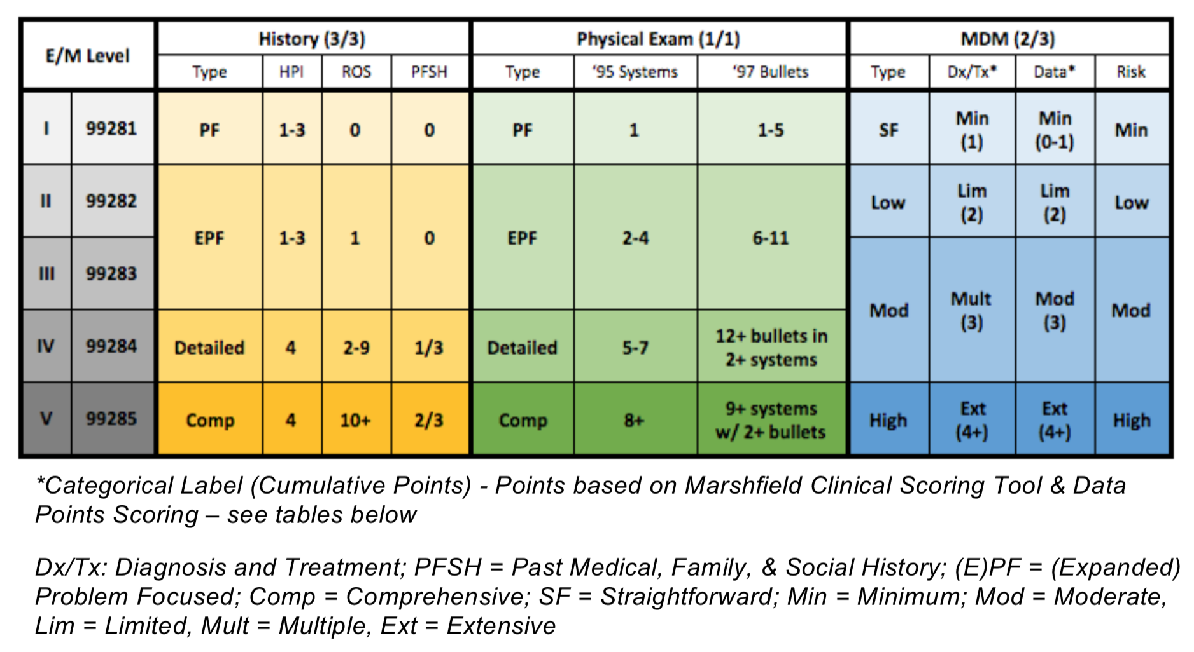
Notes:
Burkhardt J, Watsjold B, Fan T, Dyer S. Emergency department charting: Evaluation and management (E/M) Levels. https://www.aliem.com/pv-card-ed-charting-and-coding/. Published August 15, 2016. Accessed March 6, 2020.

Slide 14
History

Slide 16
Chief Complaint
Required in all patients, regardless of the level of severity
This is a concise statement that describes the reason for the encounter
Stated in the patient’s own words
Examples:
  “My head hurts”
  “Chest pain”
  “I was in a car accident”

Slide 17
History of Present Illness/Injury (HPI)
Location – area of body, localized, radiation of pain
Quality – sharp/dull, throbbing/stabbing, acute/chronic
Severity – pain scale (1-10), functional status
Associated Signs and Symptoms – includes persistent positives and negatives
Timing – constant/intermittent, time of day, onset
Context – when the symptoms occur, description of events leading up to injury
Duration – when did symptoms start, how long ago
Modifying Factors – aggravating or alleviating factors

Slide 18
Notes:
For a Level 1-3 chart, you need 1-3 components of the HPI
For Levels 4-5, you need 4 components.

Slide 19
Review of Systems (ROS)
Constitutional
Eyes
Ears, nose, mouth and throat
Cardiovascular
Respiratory
Gastrointestinal
Genitourinary
Allergic/Immunologic
Musculoskeletal
Integumentary (skin and/or breast)
Neurological
Psychiatric
Endocrine
Hematologic/Lymphatic

Slide 20
Review of Systems (ROS)
Can state “All other systems reviewed and are negative” for billing purposes
  But this may not be medicolegally sound!
Examples of UNACCEPTABLE ROS statements:
  ROS – Noncontributory
  ROS – All negative

Slide 21
Notes:
For Levels 1-3 - < 2 systems
For Level 4 – 2-9
For Level 5 – 10+ ROS

Slide 22
Past, Family and Social History
Past History: Possible Components
  Prior major illnesses and injuries
  Prior surgeries
  Prior hospitalizations
  Current medications
  Allergies (i.e. drug and food)
  Age appropriate immunization status
  Age appropriate feeding/dietary status

Slide 23
Past, Family and Social History
Family History: Possible Components
  Health status or cause of death of parents, siblings, and children
  Specific diseases related to problems identified in the chief complaint, HPI, or ROS
  Diseases of family members which may be hereditary or place the patient at risk
  Cannot say “non-contributory”

Slide 24
Past, Family, and Social History
Social History: Possible Components
  Marital status/living arrangements
  Current employment
  Occupational history
  Use of drugs, alcohol and/or tobacco
  Level of education
  Sexual history
  Other relevant social factors

Slide 25
Notes:
For Levels 1-3 – you don’t need any PFSH
For Level 4 – you need 1/3
For Level 5 – you need 2/3

Slide 26
Acuity Caveat
If you are unable to obtain a complete history, a level 5 chart can still be obtained, but you need to document the reason why
Examples:
  “The patient is unresponsive and cannot provide any history.”
  ”Patient is in extreme distress and required immediate care.”
  “Unable to obtain history due to language barrier despite my attempts to obtain an interpreter.”

Slide 27
Step-Wise Approach to Coding Charts
Choose your E/M Code based on your patient’s presenting problem.
Once you’ve chosen your E/M Code, determine the level of History needed to fulfill the requirements for that code, as determined by Centers for Medicare and Medicaid Services.
Now that you have your history level, determine the level of Physical Exam necessary to fulfill the requirements for that code.

Slide 28
Physical Exam

Slide 30
Physical Examination
Can be done in terms of body areas OR organ systems
Number of required components can be a mix of body areas and organ systems

Slide 31
Physical Exam (Body Areas)
Head, including the face
Neck
Chest, including breasts and axilla
Abdomen
Genitalia, groin, buttocks
Back
Right arm
Left arm
Right leg
Left leg

Slide 32
Physical Exam (Organ Systems)
Constitutional (vitals, general condition)
Eyes
Ears, nose, mouth and throat
Cardiovascular
Respiratory
Gastrointestinal
Genitourinary
Musculoskeletal
Skin
Neurologic
Psychiatric
Heme/lymph/immune

Slide 34
Step-Wise Approach to Coding Charts
Choose your E/M Code based on your patient’s presenting problem.
Once you’ve chosen your E/M Code, determine the level of History needed to fulfill the requirements for that code, as determined by Centers for Medicare and Medicaid Services.
Now that you have your history level, determine the level of Physical Exam necessary to fulfill the requirements for that code.
Complete the MDM per CMS coding standards.

Slide 35
MDM

Slide 37
3 Components of MDM
Diagnosis/Treatment: Number of possible diagnosis and/or management options considered
Data: Amount and/or complexity of medical records, diagnostic tests, and/or other information that must be obtained, reviewed, and analyzed
Risk: Risk of significant complications, morbidity, and/or mortality, as well as comorbidities, associated with the patient’s presenting problem(s), the diagnostic procedure(s) and/or the possible management options

Slide 38
Step-Wise Approach to Coding Charts
Choose your E/M Code based on your patient’s presenting problem.
Once you’ve chosen your E/M Code, determine the level of History needed to fulfill the requirements for that code, as determined by Centers for Medicare and Medicaid Services.
Now that you have your history level, determine the level of Physical Exam necessary to fulfill the requirements for that code.
Complete the MDM per CMS coding standards.
  Determine the level of risk of the patient.

Slide 39
Notes:
Add up all those points from the previous slides to see the “Type” of MDM you are in based on Data.

Slide 40
Risk | Presenting Problems | Diagnostic(s) Ordered | Management Options
Minimal | 1 self-limited or minor problem | Labs, CXR, EKG, UA, ultrasound | Rest, gargles, elastic bandages, superficial dressings
Low | 2 or more self-limited or minor problems | Physiologic tests not under stress | Over the counter drugs, minor surgery with no risk factors, PT, OT, IV fluids without additives
Moderate | 1 or more chronic illnesses with mild exacerbation | Physiologic test under stress | Minor surgery with risk factors, elective major surgery with no risk factors, Rx drugs, Closed treatment of fracture/dislocation
High | 1 or more chronic illnesses with severe exacerbation | CV imaging studies with contrast, diagnostic endoscopies | Elective major surgery with risk factors, emergency major surgery, drug therapy requiring intensive monitoring for toxicity, decision not to resuscitate or deescalate care due to poor prognosis

Slide 41
Risk
The overall risk is determined by the highest level of risk in any ONE category from the previous slide.

Slide 42
Step-Wise Approach to Coding Charts
Choose your E/M Code based on your patient’s presenting problem.
Once you’ve chosen your E/M Code, determine the level of History needed to fulfill the requirements for that code, as determined by Centers for Medicare and Medicaid Services.
Now that you have your history level, determine the level of Physical Exam necessary to fulfill the requirements for that code.
Complete the MDM per CMS coding standards.
  Determine the level of risk of the patient.
  Once you determine the risk severity, review the other two components of the MDM, knowing that 1/2 must meet or exceed that level.

Slide 43
3 Components of MDM
Diagnosis/Treatment: Number of possible diagnosis and/or management options considered
Data: Amount and/or complexity of medical records, diagnostic tests, and/or other information that must be obtained, reviewed, and analyzed
Risk: Risk of significant complications, morbidity, and/or mortality, as well as comorbidities, associated with the patient’s presenting problem(s), the diagnostic procedure(s) and/or the possible management options

Slide 44
Problem Categories | Points
Self-limited or minor (max of 2) | 1
Established problem; stable or improved | 1
Established problem; worsening | 2
New problem; no additional workup planned (max 1) | 3
New problem; additional workup planned | 4

Slide 45
Notes:
Add up all those points from the previous slides to see the “Type” of MDM you are in based on dx/tx.

Slide 46
3 Components of MDM
Diagnosis/Treatment: Number of possible diagnosis and/or management options considered
Data: Amount and/or complexity of medical records, diagnostic tests, and/or other information that must be obtained, reviewed, and analyzed
Risk: Risk of significant complications, morbidity, and/or mortality, as well as comorbidities, associated with the patient’s presenting problem(s), the diagnostic procedure(s) and/or the possible management options

Slide 47
Type of Data | Points
Review and/or order clinical lab tests | 1
Review and/or order tests from radiology section of CPT | 1
Review and/or order tests from medicine section of CPT (i.e. EKG) | 1
Discuss test results with performing physician | 1
Independent visualization of image, tracing, or specimen | 2
Obtain old records and/or obtain history from someone other than patient | 1
Review and summarize old records and/or discuss case with another provider | 2

Slide 48
Notes:
Add up all those points from the previous slides to see the “Type” of MDM you are in based on data.

Slide 49
Step-Wise Approach to Coding Charts
Choose your E/M Code based on your patient’s presenting problem.
Once you’ve chosen your E/M Code, determine the level of History needed to fulfill the requirements for that code, as determined by Centers for Medicare and Medicaid Services.
Now that you have your history level, determine the level of Physical Exam necessary to fulfill the requirements for that code.
Complete the MDM per CMS coding standards.
  Determine the level of risk of the patient.
  Once you determine the risk severity, review the other two components of the MDM, knowing that 1/2 must meet or exceed that level.
Review the chart from start to finish, ensuring it is complete.

Slide 50
Notes:
Burkhardt J, Watsjold B, Fan T, Dyer S. Emergency department charting: Evaluation and management (E/M) Levels. https://www.aliem.com/pv-card-ed-charting-and-coding/. Published August 15, 2016. Accessed March 6, 2020.

Slide 51
Questions?

Slide 52
References
Burkhardt J, Watsjold B, Fan T, Dyer S. Emergency department charting: Evaluation and management (E/M) Levels. https://www.aliem.com/pv-card-ed-charting-and-coding/. Published August 15, 2016. Accessed March 6, 2020.
Carter KA, Dawson BC, Brewer K, Lawson L. RVU ready? Preparing emergency medicine resident physicians in documentation for an incentive-based work environment. Academic Emergency Medicine. 2009 May;16(5):423-8.
Counselman FL, Babu K, Edens MA, Gorgas DL, Hobgood C, Marco CA, Katz E, Rodgers K, Stallings LA, Wadman MC, 2016 EM Model Review Task Force, Beeson MS, Keehbauch JN. The 2016 model of the clinical practice of emergency medicine. Journal of Emergency Medicine. 2017 Jun;52(6):846-849.
Emergency department: Clinician coding and documentation reference. Vituity. https://medamerica.okta.com/. Published 2019. Accessed March 6, 2020.
Evaluation and management services guidelines. Dept of Health and Human Services: Centers for Medicare and Medicaid Services. https://www.cms.gov/Outreach-and-Education/Medicare-Learning-Network-MLN/MLNProducts/Downloads/eval_mgmt_serv_guide-ICN006764TextOnly.pdf. Published August 2017. Accessed March 6, 2020.
Nicks BA, Nelson D. Emergency department operations and management education in emergency medicine training. World J Emerg Med. 2012;3(2):98-101.
Schnapp B, Sanders S, Ford W. Improving emergency medicine documentation training: A needs assessment. West JEM. 2016;July:S58.
Watase T, Yarris LM, Fu R, Handel DA. Educating emergency medicine residents in emergency department administration and pperations: Needs and current practice. J Grad Med Educ. 2014 Dec;6(4):770-3.

