Slide 1
Physician Liability Insurance
Stacy Marshall, MD

Slide 2
Objectives
Liability Insurance
  What does is cover?
  Understanding the basics of policies
  Types of policies
  Tail coverage
  Insurance companies
Asset Protection
Umbrella Insurance

Slide 3
What does liability insurance cover?
Liability or malpractice insurance covers
  the costs of any resulting verdicts or settlements
  the costs of investigating the claim and defending the insured
  up to the maximum amount for a single a claim
Does not cover gross negligence or procedures performed that are generally considered to be out of their scope of practice
  Scope of practice is typically based on surrounding community consensus

Slide 4
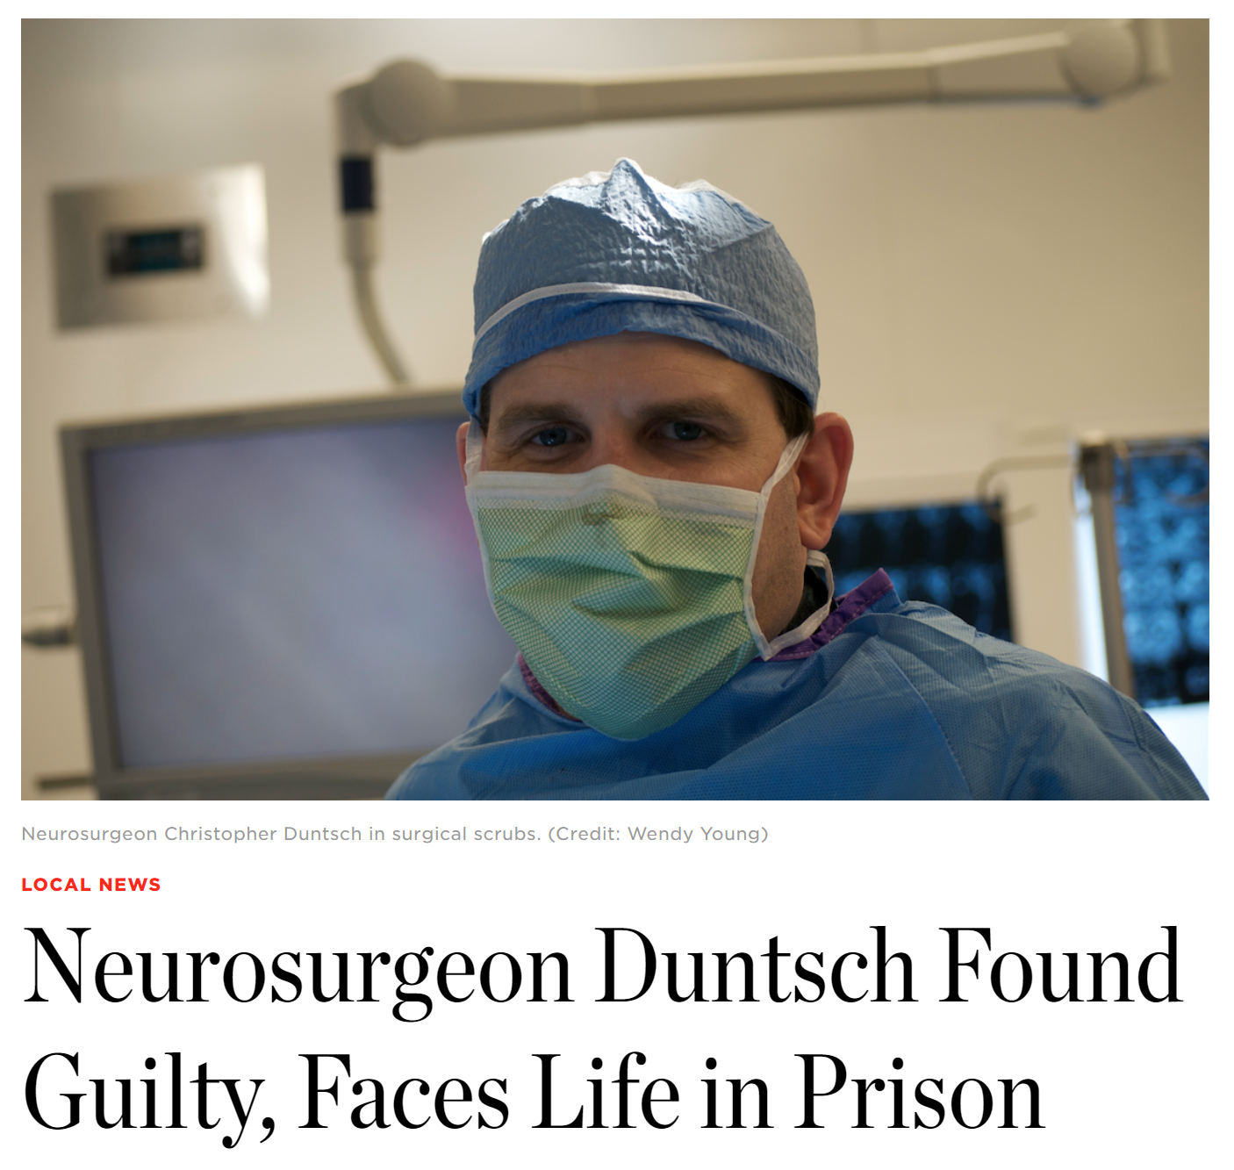
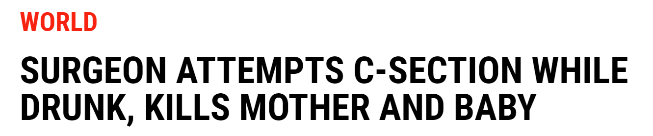
Gross Negligence
Conscious and voluntary disregard of the standard of care and is likely to cause foreseeable grave injury or harm to a person
Extreme of negligence (a mere failure to exercise reasonable care)
Gross negligence is NOT covered under liability insurance.

Slide 5
Why is liability insurance needed?
If a physician does not have liability insurance, the physician is personally responsible for the amount of a lost claim or settlement
Most insurance policies provide representation which is often a benefit

Slide 6
Self-Insurance
So why not “go bare” or go without insurance?
  Avoid insurance premiums
  Less of a “target”
  However…
    Most states require insurance as a condition of licensure
    Most hospitals require it as a condition of employment
    Few states have homestead exemptions – meaning the physician’s home is at risk for seizure
  Most importantly…
    Often viewed as unethical
    Seriously injured patients may be deprived of any real means of compensation

Slide 7
Consent to Settle
Outlined in the contract
Most physician-owned insurance companies will not settle a claim without a physician’s consent
Commercial-owned insurance companies often include a clause that compels physicians to agree to settle when “deemed expedient”
All settlements must be reported to National Practitioners Data Bank

Slide 8
Understanding Liability Insurance
Coverage is described with 2 or 3 numbers
  Ex. 1 million/3 million/10 million
    First number → maximum amount to be paid for a single claim
    Second number → maximum amount to be paid over 1 year for one individual
    Third number → maximum amount to be paid over 1 year for a group (only present for group policies)

Slide 9
Types of Policies
Claims Made Policy
Group Claims Made Policy
Occurrence Policy

Slide 10
Claims Made Policy
Most common type
1 million/3 million is a common policy
Only covers claims made while the policy is being enforced
  Example: Dr. Jones worked had a policy from January 2013 until January 2017
    Claim made in April of 2014 for an event that occurred in February of 2013 (both during policy) = COVERED
    Claim made in March of 2018 (after he left) for an event that occurred in March of 2016 = NOT COVERED
  Important to consider tail coverage when leaving a practice

Slide 11
Group Claims Made Policy
Same concept as an individual claims made policy but it covers a group
1 million/3 million/10 million
Yearly cap is often estimated based on the number of patients the group sees
No claims will be covered after the cap is reached
Individuals often invest in a secondary individual policy as well as tail coverage

Slide 12
Occurrence Policy
Uncommon policy
Covers any claim made on an event that occurred during the period in which the policy was enforced
  Ex: Dr. Jones worked at a practice between January 2013 and January 2015.
  Claim was made in 2016 on an event that occurred in January of 2014.
  Under an occurrence policy, this event will be covered regardless of when the claim is made
Essentially claims made policy with inherent tail coverage

Slide 13
Tail Coverage
Purchased after claims made policy has ended
Covers future claims made on events that occurred while that insurance policy was being enforced
Often costs 1.5x the previous year’s premium
  Claims made premium of $50,000 → tail coverage insurance would often cost around $75,000
Short time frame to purchase after stopping an insurance policy (around 30 days)
High risk to leave a practice without tail coverage insurance in emergency medicine

Slide 14
Amount of Coverage
Median award is $111,749 (Jena, 2011)
Average award is $274,887 (Jena, 2011)
Rare for an award to be greater than 1 million
  Claims involving high earning patients with legitimate injury/negative outcome
Important to have high enough maximum on single claim to be able to settle the majority of cases if needed
  1 million is often reasonable
  Plaintiff is more likely to refuse a settlement of $100,000 where as few would refuse a settlement of $1 million

Slide 15
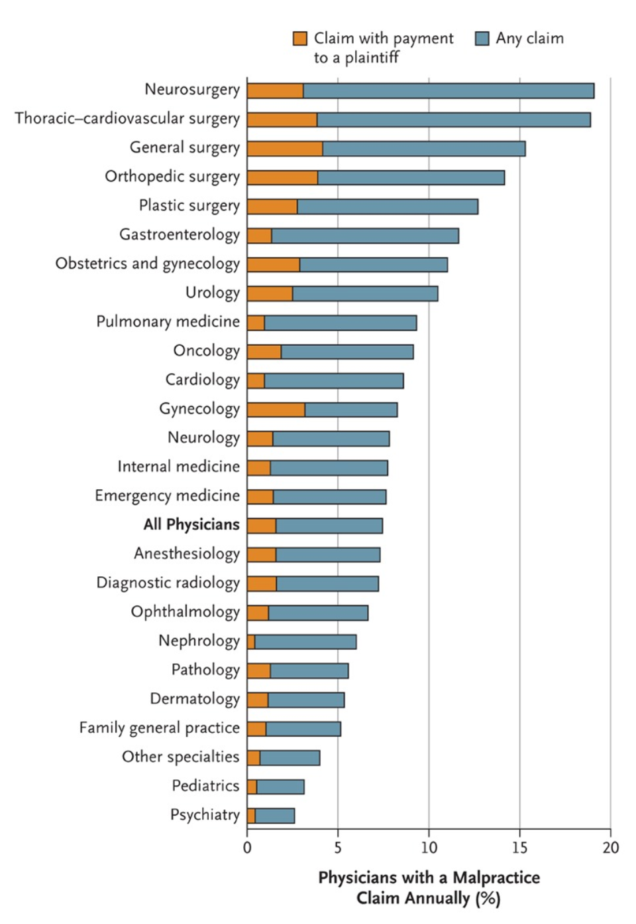
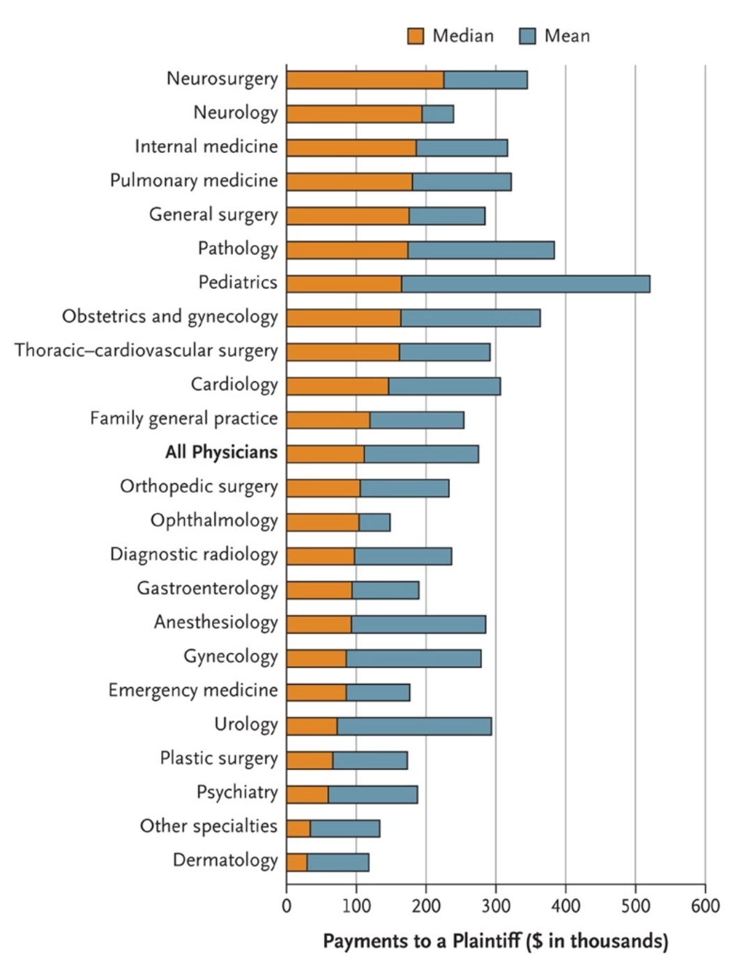
(Jena, 2011)

Slide 16
Insurance Company
Solvent and reliable
Preferably admitted to the state in which you are practicing
  Company that is licensed to do business in that state as an insurance company
  Protections afforded to the policyholder by the state’s guaranty fund
    If that company becomes insolvent or defaults on the benefit payments, the fund protects the policyholders of that insurance company
Often provides own attorney
Consent to settle

Slide 17
Bottom Line
Best policy is likely to be an individual policy from a reliable, domestic company that is admitted to the state in which you practice with a single claims cap that is sufficient to settle the vast majority of claims.

Slide 18
What happens if a lost claim exceeds my coverage maximum?
Dr. A has a 3 million claim that he lost. His liability insurance has a $1 million per claim cap.
Dr. A is now personally responsible for the remaining $2 million of that claim.
Assets are now vulnerable to seizure by creditors.

Slide 19
Asset Protection
Protecting assets from creditors in the event of a claim
Often thought of as “tax evasion”
Assume that legitimate creditors will track down assets
Commonly exempt assets (although will vary by state)
Trust funds
Foreign assets

Slide 20
Commonly Exempt Assets
Employee Base Retirement Funds e.g. 401(k)
  ERISA (Employee Retirement Income Security Act)
  Individual retirement plans are not covered by ERISA
IRA Funds (state dependent)
Life Insurance (state dependent)
Annuities (state dependent)
  Provide a fixed stream of payments to an individual
  Primarily used to provide income to a retiree
Personal Residence (state dependent)

Slide 21
Personal Residence Protection
Variable based on state
Protective cap
  Amount depends on state
Florida and Texas → residences are protected from claims
Tenancy by the Entirety
  1/3 of states
  Joint ownership of a property between spouses
  Neither party may sell his/her share of the property without the other’s permission
  The property is also protected from claims involving either spouse

Slide 22
Trust Funds
Protected from claims if the money is intended for another and are unable to be revoked
  Trustee cannot send money back to him/herself
  Only irrevocable funds are protected

Slide 23
Foreign Assets
Be wary of companies offering creation of offshore/foreign assets
Uniform Fraudulent Transfer Act
  Cannot create assets or sell/give away assets in an attempt to evade or frustrate creditors
  Includes foreign assets created prior to when a claim was made
  All about perceived intention
Judge has power to incarcerate an individual until the money is transferred back to the United States

Slide 24
Example 1
Dr. A decided to cancel his malpractice insurance and move all of his money to off shore bank accounts thinking that if a law suit was brought against him and he lost, creditors would not be able to collect on. He lives in Texas.
A claim is brought against him and he lost.
  Home is protected because he lives in Texas
  Foreign assets would not be protected under the Fraudulent Transfer Act
  Judge may have the power to incarcerate him until he transfers the money back to the United States.

Slide 25
Example 2
Dr. B created a spend thrift trust for his disabled son
The fund is irrevocable, meaning that once the money is transferred to the account, the money is no longer available to Dr. B.
The trust fund would likely be protected from creditors because creditors cannot take assets away from family members.

Slide 26
Bottom Line
Good asset protection starts with good insurance i.e. are there sufficient funds to tempt a settlement in the majority of cases and added umbrella insurance

Slide 27
Example
Dr. A has a 3 million claim that he lost. His liability insurance has a $1 million per claim cap. Dr. A is now responsible for the remaining $2 million of that claim.
Umbrella insurance can cover the remainder of that claim.

Slide 28
Added Umbrella Insurance
Extra liability insurance that protects assets from major claims and lawsuits
  Occupation and non-occupation related liability
Covers remaining amount of a claim that is not covered under professional liability insurance.
Can typically add on to homeowner’s insurance for relatively cheap

Slide 29
Financial Catastrophes
Death → life insurance
Disability → disability insurance
Illness or Injury → health insurance
Destruction of expensive property → homeowner’s insurance
Non occupation related liability → automobile insurance, homeowner’s insurance and umbrella insurance
Occupation related liability → professional liability insurance and umbrella insurance

Slide 30
Umbrella Insurance
Suggested to purchase between $1-5 million in added umbrella insurance policy
  Depends on the value of your assets
Total liability coverage should equal the amount of your assets
  Making it unlikely that a lawsuit will exceed that amount
Added benefit of likely providing a specialized lawyer to help defend you for free
  Insurance company doesn’t want to pay the claim
  Aligned interests
Cheaper if you bundle with automobile and homeowner’s

Slide 31
Summary
Good insurance starts with good medicine, but insurance is necessary.
Best policy is likely to be an individual policy from a reliable, domestic company that is admitted to the state in which you practice with a single claims cap that is sufficient to settle the vast majority of claims.
Avoid gaps in coverage and research tail coverage before ending a policy.
Good asset protection starts with good insurance and consider umbrella insurance for additional asset protection.

Slide 32
Resources
AAEM. (2013, March 04). Episode 2: Key Contract Terms. Emergency Physician Advocates: Medical legal issues in emergency medicine. Retrieved from https://www.aaem.org/UserFiles/WoodPodcast1edited.mp3
AAEM. (2013, May 08). Episode 4: Asset Protection. Emergency Physician Advocates: Medical legal issues in emergency medicine. Retrieved from https://www.aaem.org/UserFiles/media/aaem-podcast-episode-4.mp3
AAEM. (2013, July 07). Episode 6: Liability Crisis. Emergency Physician Advocates: Medical legal issues in emergency medicine. Received from https://www.aaem.org/UserFiles/media/aaem-epa-podcast-episode-6.mp3
Jena, A, et. al. (2011). Malpractice Risk According to Physician Specialty. New England Journal of Medicine. 365:629-636.
American College of Legal Medicine. (2007) The Medical Malpractice Survival Handbook. Philadelphia, PA: Elsevier inc.

