Slide 1
Risk Mitigation
Medical Errors, Disclosure, and the Patient-Physician Relationship
Elizabeth Harmon, MD

Slide 2
Learning Objectives
Describe the three types of medical errors
Understand the difference between patient and physician perspectives regarding medical error disclosure
Describe apology laws and the two main types.
Understand the importance of the patient-physician relationship in reducing litigation
Demonstrate how to disclose a medical error
Notes:
By the end of this lecture, you should be able to...

Slide 3
Medical Errors

Slide 4
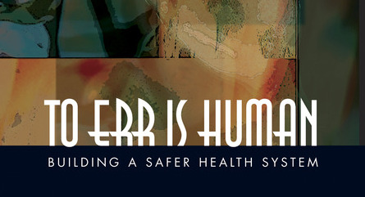
The Institute of Medicine released a report in 1999 revealing the extent of medical errors and calling for safer healthcare systems
Notes:
Kohn LT, Corrigan JM, Donaldson MS, eds. Committee on Quality of Healthcare in America, Institute of Medicine. To Err is Human: Building a Safer Health System. Washington, DC: National Academy Press, 2000

Slide 5
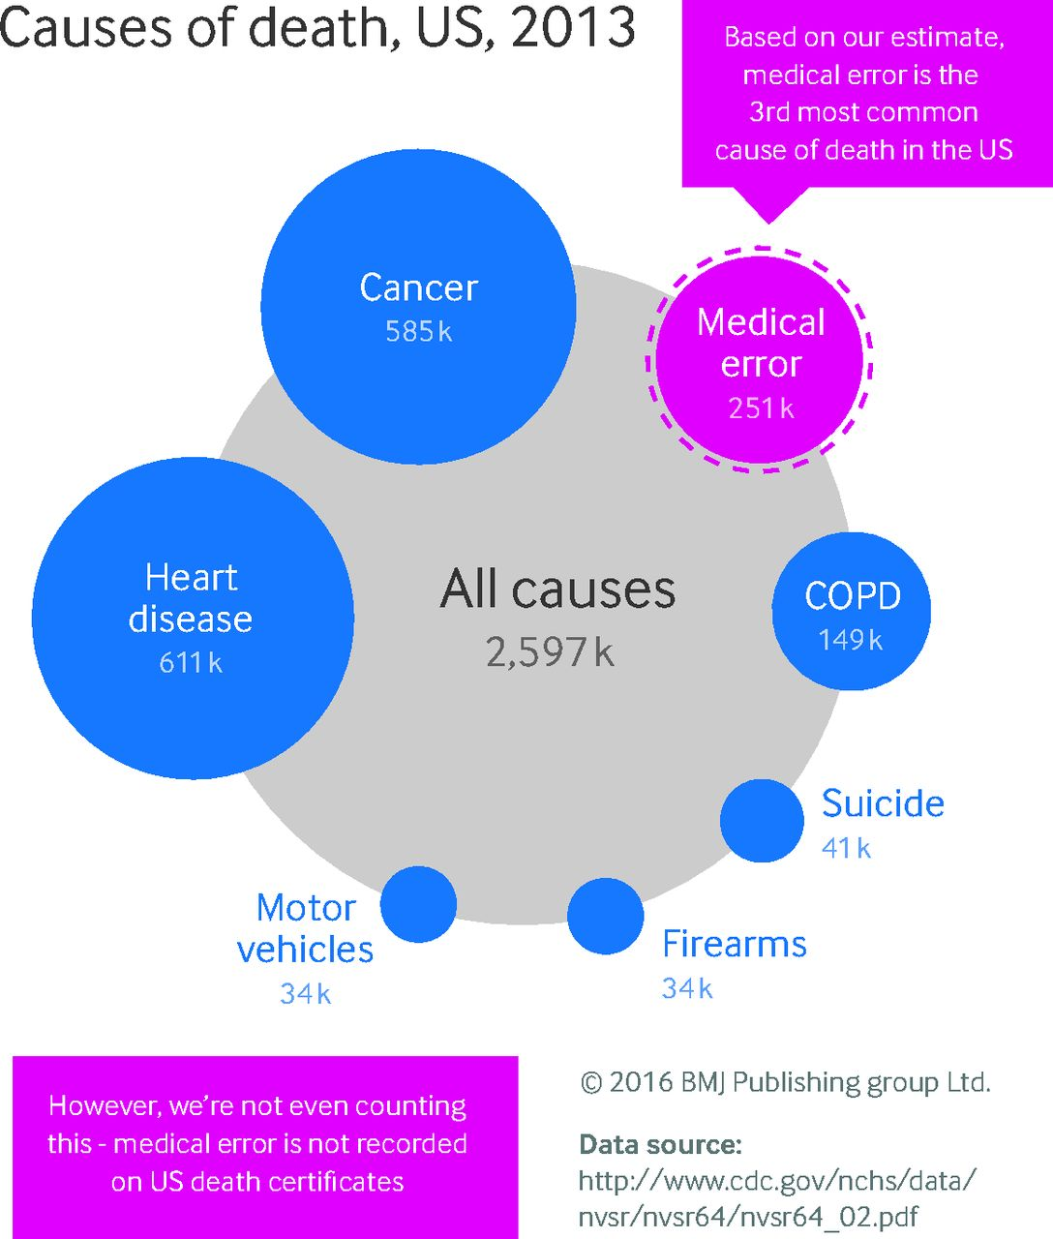
Notes:
Medical errors are estimated to be the third leading cause of death.
2016 John Hopkins Study published in BMJ. Makary, M, Daniel, M. “Medical Error – the third leading cause of death in the US.” Depart of Surgery, Johns Hopkins University School of Medicine, Baltimore, MD, May 2016. BMJ 2016;353:i2139.
For this study, the authors used data from several sources on medical error: Institute of Medicine, Harvard Medical, Utah and Colorado Studies on medical error; Agency of Health Care Quality and Research Patient Safety Indicators of the Medicare Population; US Department of Health and Human Services Office of Inspector General Analysis of medical errors of inpatient hospitals; and other studies.
They took this data and calculated the mean rate of death from medical error using these studies and then extrapolated this to the total number of US hospital admissions in 2013. Ultimately they estimated approximately 251,000 deaths per year from medical error. .

Slide 6
Medical Error
Reaches Patient
Does not reach patient
Causes Harm = Harmful Error
Does not cause harm = Non-harmful error
Near Miss
Notes:
Three types of medical errors:
Harmful error: reaches patient, causes harm
Non-harmful error: reaches patient, no harm caused
Near Miss: Does not reach patient

Slide 7
Medical Error Disclosure
Patient vs. Physician Attitudes
Notes:
Gallagher, T, Waterman A, Ebers, A, et al. Patients’ and Physicians’ Attitudes Regarding the Disclosure of Medical Errors. JAMA. 2003;289;1001-1007.
Focus groups with patients and physicians aimed at understanding their attitudes on medical errors and disclosures.

Slide 8

Patient Perspective
Broad definition of error
Want to know about all errors that cause harm
Some want to know about near misses
Tell everything
Want acknowledgement of pain and suffering
Apology
Notes:
Broad definition of errors
Want to know about all harmful errors. As for missed errors: mixed.
Tell everything: How it happened. Why it happened. When it happened. How it will be corrected. How future errors will be prevented.
Also wanted to ensure that that they wouldn't’ suffer economic/financially from the error.
As for being upset/angry, many said would be in more distress if explanations of error were incomplete or evasive.
Reassurance that recurrences will be prevented.

Slide 9

Physician Perspective
Narrow definition of error
Harmful errors, except when harm is trivial
Not near misses
Choose words carefully
An apology may create liability
Notes:
Narrow definition = deviation from accepted standard of care.
Harmful errors, but not those that are trivial
Not near misses.
Choose words carefully = Committed to being truthful but wanted to put the most positive spin on the event or the best light. In addition many would mention adverse event but not explicitly state an error had occurred.
All wanted to apologize. Most worried that by doing so would create liability for them.
Patients were very surprised to hear that medical errors caused such problems with physicians; many wished physicians would share how upset and emotional they are.

Slide 10

Patient
Broad definition of error
Want to know everything
Want an apology
Physician
Narrow definition of error
Choose words carefully
Afraid to apologize
Notes:
In summary, this study showed that both agreed disclosure of medical errors that cause harm should occur. They disagreed about what to disclose and how to disclose.

Slide 11
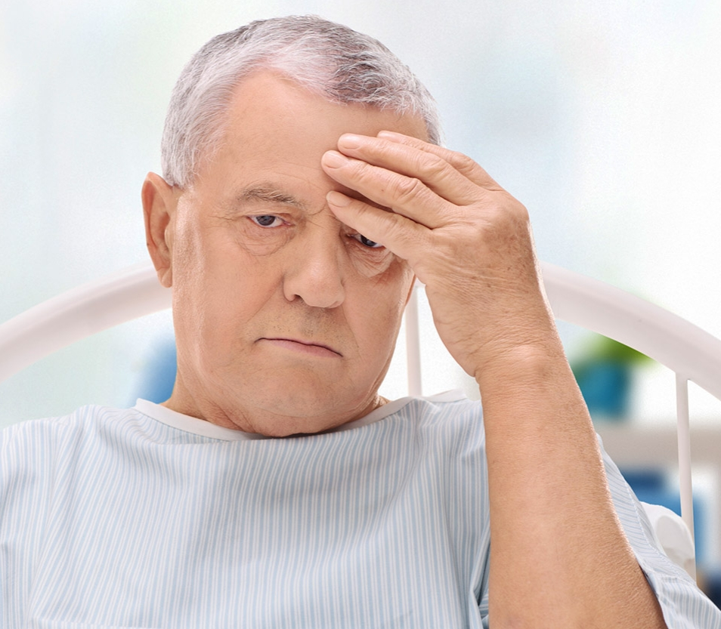
Why patients sue
They want an explanation.
It was the only option for finding out what happened
Disclosure was absent or inadequate
They want to prevent future similar events
Notes:
Vincet C, Young M, Phillips A. Why do people sue doctors? Lancet. 1994;343:1609-1613.
Shapiro RS, Simpson DE, Lawrence SL, et al. A survey of sued and nonsued physicians and suing patients. Arch Intern Med. 1989;149:2190-2196.
Hickson GB, Clayton EW, Githens PB, Sloan FA. Factors that prompted families to file medical malpractice claims following perinatal injuries. JAMA. 1992;267;1359-1363.

Slide 12

Patient-Physician Communication
Poor communication is a leading cause of litigation
Patients who feel well cared for and have an amicable relationship with their doctors rarely sue
Statements of empathy reduce litigation
Notes:
Smith DD, Kellar J, Walters EL, Reibling ET, Phan T, Green SM. Does emergency physician empathy reduce thoughts of litigation? A randomized trial. Emerg Med J. 2016;33:548-552

Slide 13

Apology Laws
Laws that allow for expression of sympathy without admission of guilt. Cannot be used against you in court.
2 types of apology laws, protecting statements of:
Sympathy only
“I’m sorry this happened to you.”
Sympathy and admission of fault
“I’m sorry this happened. We made an error.”
Check your state’s specific apology law

Slide 14
Tips for Error Disclosure
Do
Be prepared
Contact Risk Management
Be timely
Allow time for questions
Be empathetic
Don’t
Use medical jargon
Speculate on causality if unknown
Assign blame to other providers

Slide 15
Disclosure Statements:
5 components
Explicit statement that an error occurred
Basic explanation of what happened and how
Apology
Description of next steps in the patient’s care to minimize effects of the error
Explanation of future steps to prevent error recurrence

Slide 16
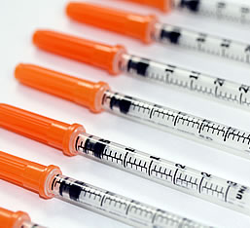
Scenario A
A patient presents with hyperglycemia and you accidentally order 100 units of insulin instead of 10 units.
The patient becomes severely hypoglycemic and loses consciousness. He is resuscitated and admitted to the MICU.
How would you disclose this error to the patient and family?
Notes:
Break down into pairs and role play. Take turns being the patient and the provider in scenario A and B (next slide). Disclose the error using all 5 components of good disclosure statements.

Slide 17
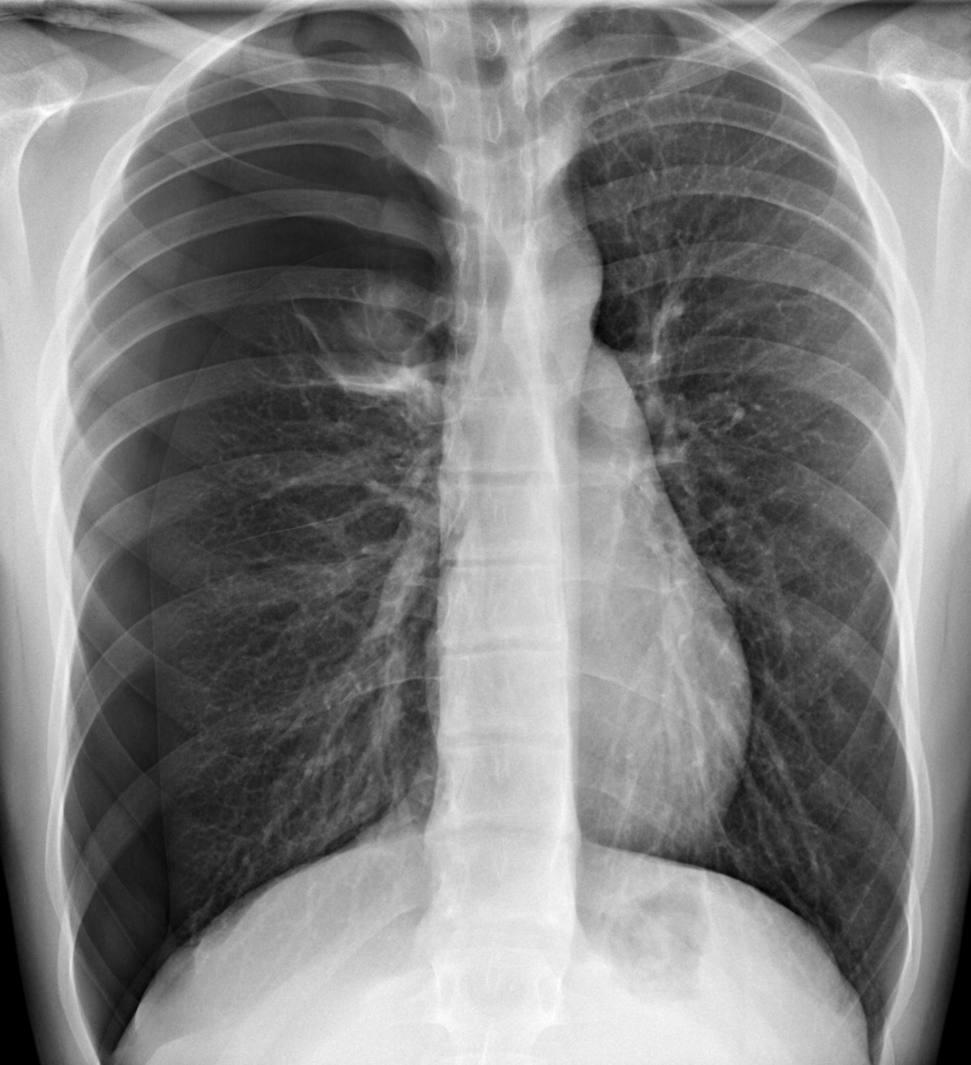
Scenario B
After placing a subclavian central line, your patient becomes hypotensive and hypoxic, and is found to have a pneumothorax on side ipsilateral to the subclavian. Chest tube is placed urgently and the patient’s vitals improve.
How would you disclose this error to the patient and family?
Notes:
Break down into pairs and role play. Take turns being the patient and the provider. Disclose the error using all 5 components of good disclosure statements.

Slide 18

Questions for small groups
Would you disclose a harmful error? A non-harmful error? A near miss? Why or why not?
Tell about a time you witnessed or were involved in a medical error. How did you feel?
Did you disclose the error or witness a disclosure? What was done well? What could be done better?

Slide 19
Summary
Three types of medical errors include near misses, non-harmful errors, and harmful errors
Physician and patient perspectives differ. Both agree disclosure of harmful events should occur, but disagree about what and how to disclose.
Physicians choose words carefully because they are afraid of being sued. Ironically, a primary reason many patients sue is because they want an explanation.

Slide 20
Summary
Poor communication between physicians and patients is a leading cause of litigation.
Apology laws vary among states and can include expressions of sympathy only or expressions of sympathy and fault.
A proper disclosure is timely and includes an apology and an explicit statement that an error occurred with a description of what, why, and how such will be prevented in the future.

Slide 21
References
Kohn LT, Corrigan JM, Donaldson MS, eds. Committee on Quality of Healthcare in America, Institute of Medicine. To Err is Human: Building a Safer Health System. Washington, DC: National Academy Press, 2000
Makary, M, Daniel, M. “Medical Error – the third leading cause of death in the US.” Depart of Surgery, Johns Hopkins University School of Medicine, Baltimore, MD, May 2016. BMJ 2016;353:i2139.
Gallagher, T, Waterman A, Ebers, A, et al. Patients’ and Physicians’ Attitudes Regarding the Disclosure of Medical Errors. JAMA. 2003;289;1001-1007.
Vincet C, Young M, Phillips A. Why do people sue doctors? Lancet. 1994;343:1609-1613.
Shapiro RS, Simpson DE, Lawrence SL, et al. A survey of sued and nonsued physicians and suing patients. Arch Intern Med. 1989;149:2190-2196.
Hickson GB, Clayton EW, Githens PB, Sloan FA. Factors that prompted families to file medical malpractice claims following perinatal injuries. JAMA. 1992;267;1359-1363.
Smith DD, Kellar J, Walters EL, Reibling ET, Phan T, Green SM. Does emergency physician empathy reduce thoughts of litigation? A randomized trial. Emerg Med J. 2016;33:548-552
McDonnell WM, Guenther E. Narrative review: do state laws make it easier to say “I’m sorry?” Ann Intern Med. 2008;149:811-816. Wei M. Doctors, apologies, and the law: an analysis and critique of apology laws. J Health Law 2006.

