Slide 1


I have written eleven books, but each time I think, ‘Uh oh, they’re going to find out now. I’ve run a game on everybody and they’re going to find me out.
Notes:
Lead with a personal anecdote about the last time you felt like a fraud.
I thought I was totally alone in feeling like this but it turns out, I’m not. This feeling of being found out as a fraud is actually a well-documented phenomenon amongst many high-achieving individuals.
For example, someone once said “I have written eleven books, but each time I think, ‘Uh oh, they’re going to find out now. I’ve run a game on everybody and they’re going to find me out.” She was just Pulitzer Prize nominee and Grammy award winner Maya Angelou, whose also won a Presidential Medal of Honor for her poetry.

Slide 2


I’d wake up in the morning before going off to a shoot, and think, I can’t do this; I’m a fraud.
Notes:
Here’s another such individual: “I’d wake up in the morning before going off to a shoot and think ‘I can’t do this, I’m a fraud’”
Shortly after giving this quote, Kate Winslet won an Oscar for Best Actress.

Slide 3
Imposter Syndrome
Angela Chen
PGY-3
Department of Emergency Medicine
Icahn School of Medicine at Mount Sinai
Notes:
It turns out this phenomenon has a name and it’s been well studied for over 3 decades. It’s known as Imposter Syndrome and it’s what I’ve here to talk to you about today. By the end of this lecture, I hope that you’ll be able to walk away with a sense of what imposter syndrome is, decide if it’s something that’s affecting you and if yes, what strategies you can employ to prevent imposter syndrome from affecting your work.

Slide 4
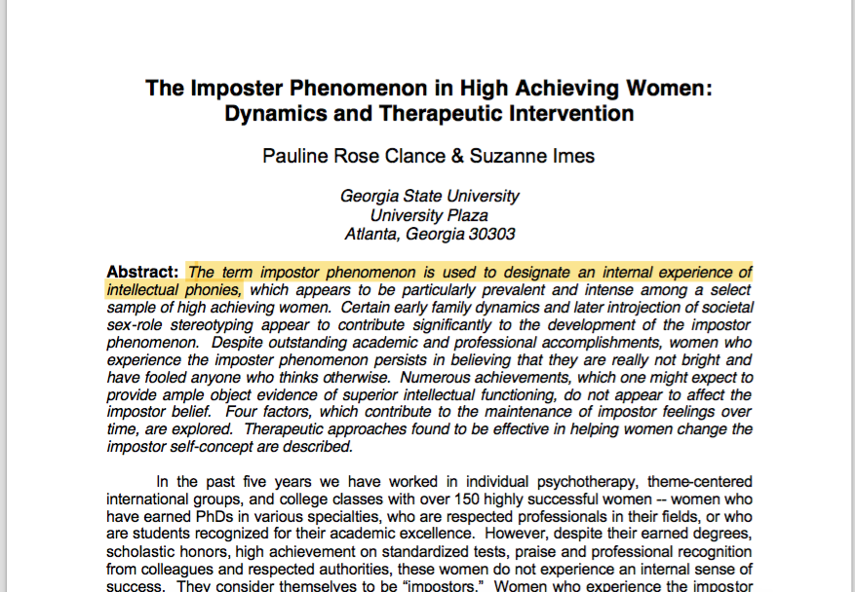
What is imposter syndrome?
Notes:
First of all, what is imposter syndrome?
It’s the term used to designate an internal experience of intellectual phoniness.
It was first coined by clinical psychologists Pauline Clance and Suzanne Imes in 1978. While working with over 150 successful women, they noticed a trend. These women were unable to internalize their accomplishments and had a persistent fear of being exposed as a fraud. These women were all what we’d consider to be high achieving individuals with great standardized test scores, continued academic excellence and a demonstrated record of leadership but they all expressed fears that they just “weren’t good enough”
Clance and Imes noted that despite external evidence of their competence, those who exhibited what they deemed imposter syndrome remain convinced they were frauds and undeserving of the success they have achieved. When presented with proof of their success, it was dismissed as luck, timing or the result of deceiving others into thinking they are more intelligent and competent than they believe themselves to be.
It’s not classified as a psychiatric disorder and it’s not in the DSM 10. Initially perceived to be an ingrained personality trait, now we recognize that it’s a reaction to certain situations that can be unhealthy.

Slide 5
The viscious cycle of imposter syndrome
Notes:
Let me introduce you to the vicious cycle that is imposter syndrome. When faced with any new challenge, the “imposter” is convinced they are incapable of meeting the challenge. They rise to the occasion and upon self-reflection, realize they were able to achieve this discrete goal. However, and this is the crucial component – they can’t internalize that achievement for future challenges they might face.
There’s a few characteristics that those afflicted with imposter syndrome have and all these components make it harder for people to overcome imposter syndrome.
First, imposter syndrome sufferers tend to be diligent because they feel like they have to work really hard to prevent people from discovering they’re a fraud. Their diligence leads to more achievements, but these achievements only cause them to feel like more of a fraud. They’re often good at reading people and are good at knowing what people want to hear but because of their not confident in their worth, give the answers they think people want rather than their true opinions. This further perpetuates feelings of being a fraud.
They’re charming but even this is detrimental because they feel like the praise they receive is based on their charm rather than their ability.
Finally, people with imposter syndrome avoid displaying confidence because believing in their abilities creates another situation for rejection. This perpetuates imposter syndrome because that lack of self-confidence is internalized.

Slide 6

Who gets imposter syndrome?
Notes:
So who gets imposter syndrome? There are certain characteristics and life experiences that make people more prone to imposter feelings, or to experience them more intensely.
These self-identified imposters are often in professions different from the rest of their family. They’re first generation college students. They’re the first to attend professional school. Their career orientation is different from their parents. Basically, they’re the black sheep of their families and they’re doing something drastically different from what they were “expected to do”
While we once thought imposter syndrome to be more common in women who are successful in their careers, it’s now been shown to occur equally in men, particularly minority men. This may be because women, minorities and other disenfranchised individuals are socialized in many realms to exist at the base of the power hierarchy. You’re more likely to believe you’re undeserving of your success if you’ve been subconsciously told by society you’re undeserving.

Slide 7

Why does it matter?
Notes:
Many people have asked me who cares if you have imposter syndrome? It sounds better than the alternative: thinking I’m great when I’m actually terrible at my job. The problem with imposter syndrome is that well first, constantly feeling like you’re a fraud is exhausting.
Secondly, it makes it so that you’re unable to take pride in your work and this can lead to burnout since an important component to preventing burnout is the ability to find satisfaction in your work. Constantly feeling like a fraud makes it so that you have trouble recognizing your achievements and internalizing your success.

Slide 8

Why does it matter?
Notes:
Here are other ways that imposter syndrome is detracting from your job satisfaction. Because you never believe in your capabilities, you’re incapacitated by the fear of failure. You end up not taking on new opportunities because it’s just another stage for you to be exposed.
Of course, it’s normal to be fearful of failure but the problem arises when we give those fears the power to keep us from taking the actions to achieve our goals and highest aspirations.
If this adorable puppy had imposter syndrome he wouldn’t be able to take a leap and giving this us the wonderful gif.

Slide 9
What can I do about it?
Talk about it!
Make a list of your achievements
It’s a process
Self acceptance
Notes:
So imposter syndrome is a problem. You might be asking yourself, what can I do about it? Am I doomed to be terrified for the rest of my life, hoping to not be found out?
This is where I like to remind myself that imposter syndrome isn’t a personality trait, but a reaction to certain situations. And because it’s a reaction, you can teach yourself to adapt or at least modulate your reactions so that you’re no longer held back by this nagging thought that you’re a total fraud.
The most important thing to combat imposter syndrome – talk about it! Recognize that imposter syndrome is a real feeling which affects many people. It’s totally normal and the next time you feel like you’re a fraud, just remind yourself you’re actually in excellent company. I can’t tell you how many times when I talk about being a giant fake, the conversation turns into a chorus of “Me too!”s. It turns out everyone is just waiting for someone to talk about it and it might as well be you.
Next, make a list of your accomplishments. Remind yourself that every single individual has things that they are good at, and regardless of how trivial they are, you should practice taking pride in them. Remind yourself of the skills you have, but also the skills you want to develop. This gives you a much more realistic perception of your achievements. For example, when I was in my second year of medical school, I felt like a complete idiot, that I was incapable of learning all this absurd amount of medical information. To make myself feel better, I made a list of things that I knew I was good at. Sure, maybe I’d never be able to memorize the coagulation cascade, but I knew, without a doubt, that I was very good at moisturizing.
Recognize that life is a process. In fact, there’s something to be said for not being an expert in something. Often being a novice in something gives you a fresh perspective and that just because you don’t know everything certainly doesn’t mean you can’t still contribute to the conversation
The final step requires an element of self-acceptance and this is definitely the hardest part. It’s coming to terms with the fact that you don’t have to attain perfection or mastery to be worthy of the success you’ve achieved. Instead of reaching for an impossible bar, reset your own expectations for yourself to a realistic level that doesn’t leave you forever striving and feeling inadequate.

Slide 10

“The beauty of the impostor syndrome is you vacillate between extreme egomania and a complete feeling of: ‘I’m a fraud! Oh God, they’re on to me! I’m a fraud!’ So you just try to ride the egomania when it comes and enjoy it, and then slide through the idea of fraud.”
Notes:
I don’t know if I’ll fully be able to get over my imposter feelings. In fact, I felt like a little bit of an imposter giving this lecture.
In my greatest moments of self-doubt I try to remember the words of fellow imposter syndrome sufferer Tina Fey: “The beauty of imposter syndrome is you vacilitate between extreme egomania and a complete feeling of I’m a fraud. Oh God, they’re onto me. I’m a fraud!” So you just try to ride the egomania when it comes and enjoy it and slide through the idea of fraud.
Hopefully, now you’ll be equipped to make that ride a little smoother

Slide 11
http://paulineroseclance.com/pdf/IPscoringtest.pdf
Notes:
Encourage audience to take the Clance Imposter Phenomenon Scale
If the total score is 40 or less, the respondent has few Impostor characteristics; if the score is between 41 and 60, the respondent has moderate IP experiences; ascore between 61 and 80 means the respondent frequently has Impostor feelings; and a score higher than 80 means therespondent often has intense IP experiences.

