Slide 1

“You are Not Alone”
Recognizing and Responding to the Second Victim
Presented by the Mental Health Task Force
Resilience Committee
Council of Residency Directors (CORD) Emergency Medicine
Angie Carrick, D.O., Jennifer Mitzman, M.D., Alicia Pilarski, D.O., Ramin Tabatabai, M.D.

Slide 2
Notes:
Jennifer starts her story. Describes the events and then the following emotions and reactions. Recounts her support and lack of support.

Slide 3
Second Victim Syndrome: “Those who suffer emotionally when the care they provide leads to patient harm.”
Notes:
The first victim in this case is the patient who died.
The second victim in this case is the physician who cared for the patient. Second Victims are health care providers who are involved in an unanticipated adverse patient event, in a medical error and/or a patient related injury and become victimized in the sense that the provider is traumatized by the event.
The term Second Victim Syndrome was coined by Dr. Albert Wu (a professor at Johns Hopkins) in 2000.
A second victim refers to any provider who is involved in the care of the patient (a nurse, an advanced practice provider, student, resident, medics, etc).

Slide 4
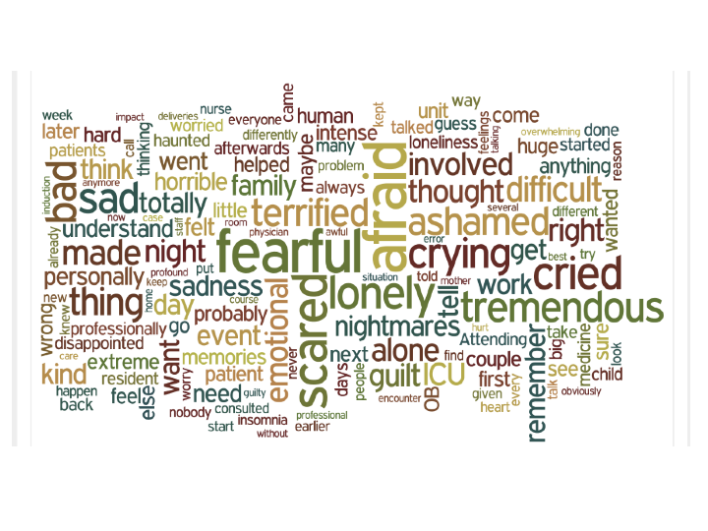
Notes:
At this moment, each one of you is recalling a time when you were involved in a similar situation. We can all related to this case scenario and what is happening to that 2nd victim. A wide array of emotions and responses could be occur… Feelings of: blame, guilt, insecurity about your knowledge and skills, depression, anxiety, inadequacy, thoughts of leaving, even thoughts of suicide.
You lose trust in yourself.
I believe many of us know the sickening feeling when you realize you made a big mistake. You don’t know what to do…should you tell someone?
What should you say? You analyze the details of the event and replay them over and over in your mind. You beat yourself up thinking “I can’t believe I did that. I’m the worst doctor ever!”
And if you have not yet had an experience like this, you will. Healthcare systems and providers are not perfect. Errors occur for multiple reasons (system failures, lack of communication, human error, etc), and as expected we focus our energy in our own institutions and departments to try and limit these errors as much as possible for the safety of our patients. But, when patient harm occurs, in addition to addressing the first victim, the second victim deserves and requires support as well.

Slide 5
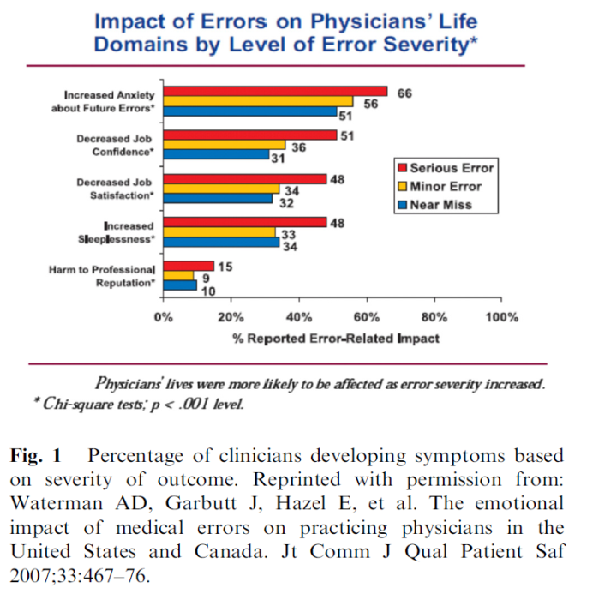
1 in 7
>50%
60%
81%
Notes:
Despite our best attempts to prevent them, mistakes and errors will still occur.
1 out of 7 Medicare patients experiences a serious adverse event and over half of those events are preventable. Consider how many providers are involved in the care of those patients.
>50% of physicians report being involved in a serious adverse event in the last year.
60% of physicians recall an event in which they would describe themselves as a second victim
A survey of more than 3100 physicians from the USA and Canada found that 81% of those who had been involved in a clinical event (serious error, minor error or near miss) experienced some degree of emotional distress.
Even those involved in near miss events expereinced some level of distress.
Symptoms reported include increased anxiety about future errors, decreased job confidence, decreased job satisfaction, sleep disturbance, and professional reputation damage have all been reported.
Other impacts on providers include isolation of staff, limited communication, negative impact on teamwork, low morale, impaired job performance, prolonged clinician suffering, negative personal and professional impact, and possibility that the staff leave their position or even their profession.
Studies have also shown that after a patient safety event, second victims have been noted to have a higher risk of committing another medical error [9].
Failure to address second victim syndrome can actually result in a vicious cycle of error with involvement in medical error leading to depression/burnout resulting in further medical errors (Fig 1). This amplifies the need to have a support system in place for these second victims since it has a direct effect on future patient care.

Slide 6

Notes:
As we have identified this as a significant issue, how do we address it and provide the support our colleagues deserve?
A majority of nearly 200000 respondents to the Agency for Healthcare Research and Quality (AHRQ) Hospital Survey on
Patient Safety Culture believed that their organization responds to clinician error in a punitive and non-supportive way.
Further Studies show that only 35% of providers involved in an event who were experiencing symptoms received any form of support from their organization or institution.
In addition, as debriefing sessions are utilized in hospitals, staff who attended a debriefing were more likely to feel personally responsible,
blamed, depressed, anxious, or to experience sleeplessness, fear of litigation, fear of judgment, reliving of the event and anger.

Slide 7

Identifying a Second Victim
Emotional | Cognitive | Behavioral
Fear | Confusion | Crying
Guilt | Disorientation | Yelling/Screaming
Shock | Poor concentration | Silence
Panic | Inattention | Withdrawal
Depression | Inability to recall event | Pacing
Agitation |  | Hollow glare
Intense anger |  | Agitated movement
Anxiousness |  | Retarded movement
Notes:
Is my friend or coworker struggling in the aftermath of an event?
Ask them- call, send an email.
If you are the residency director, don’t wait for someone to come to you.

Slide 8
Second Victim Recovery Trajectory
Chaos & Accident Response
Intrusive Reflections
Restoring Personal Integrity
Enduring the Inquisition
Obtaining Emotional First Aid
Moving On
Thriving
Surviving
Dropping Out
Impact Realization
  Scott, S. D., Hirschinger, L. E., Cox, K. R., McCoig, M. M., Brandt, J., & Hall, L. W. (2009). The natural history of recovery for the healthcare provider second victim after adverse patient events. Journal of Quality and Safety in Health Care, 18, 325-330.
Notes:
Stage 1: Recognize there is a problem.
In the case of an error, may need to continue to treat the patient.
Confusion, self-doubt, helplessness
What/why/how did this happen?
Stage 2: Repetitive thoughts of the event, difficulty sleeping, loss of confidence
Can manifest as isolation or depressive symptoms
What did I miss? What did I do wrong?
Stage 3: Professional re-integration. Often aided by a mentor or mental health assistance
Facing the rumor mill.
Often a very scary time for providers.
Will my partners still trust me? What do people really think of me?
Stage 4: Concern about institutional investigation.
Often accompanied by anxiety and associated physical and psychological symptoms.
Concern about licensure, malpractice risk, job security.
How much trouble am I in? What next? Who can I talk to?
Stage 5: Seeking professional help
Receiving support from co-workers, family members and superiors.
Why do I feel this way? Do I need help? Where can I get help?
Stage 6:Drop out
Transfer to another location
Leave medicine altogether
Is this the job for me? Do I really have what it takes?
SVS also has direct operational and economic repercussions at the institutional level: absenteeism and turnover intensions. In one study, implementation of an SVS Program influenced a decrease in turnover from 25.3% to 10.5% over a two year period.[2] Fortunately, the same study demonstrated that organizational support can significantly decrease absenteeism as well.
Survive
Coping, but with intrusive thoughts at times
Persistent sadness
Try to learn something from the situation
How could I have prevented this? Why do I still feel so awful
Thrive
Achieve life-work integration
Gain perspective but don’t practice based on an event
Advocate for patient improvements
How can I learn from this? Make things better? Improve safety

Slide 9

Management of second victim syndrome
Prevention | Reduce errors Promote physician wellness Create a “Just culture” environment
Mitigation | Institutional “acute response teams” Immediately available emotional “first aid” Break from professional responsibilities
Support | “No blame” institutional support programs Customized long term counseling Strict confidentiality
Notes:
Just culture = a shift away from the blame game. Recognizes that medicine is practiced by humans and humans make mistakes

Slide 10

Notes:
Sue Scott et al. described the development and implementation of a three-tiered clinician support program at University of Missouri. Their ForYou Team responds to all patient safety events focused specifically on the providers involved in the case. Several other programs across the country have also adopted similar models.
The first tier that is the most important includes local managers, supervisors, departmental chairs or colleagues. These leaders are given basic understanding of the second victim and simple steps to help clinicians after an event. Approximately 60% of clinicians recovered well if local support simply made sure they were recognized (‘‘Are you OK?’’).
30-35% of clinicians develop more intense emotional reactions to adverse events and require more in-depth support. The second tier group was trained to be formal peer supporters. These supporters provide ongoing one-on-one support, mentor second victims and identify additional emotional support resources when needed. These supporters were specifically aimed in helping clinicians through the investigation process and any future legal actions.
Tier three (5–10%) consists of formal emotional support such as psychological services, clergy and employee assistance programs. The peer supporters were trained to identify specific criteria for referral to tier three. The program also provides emotional support and mentoring to the peer supporters.

Slide 11

What are the most important first steps?
Notes:
So, what are the most important first steps and how can you make a difference today?

Slide 12
I can’t imagine what this was like for you. Do you want to talk about it?
You are a great provider and our environment is so complex.
How are you doing?
Tier 1
“Local” (Department/Unit) Support
Notes:
First, Bring awareness to your department by educating your colleagues about SVS.
Second, be a peer supporter within your department.
Simply asking how the person is doing goes a long way. Allow them a chance to talk about their feelings.
“I cannot imagine what that was like for you. Would you like to talk about it?”
Normalize the situation in terms that we have all been in similar situations and can relate.
“You’re a good doctor/nurse/ pharmacist working in a complex environment.”
Studies show that providers (up to 98% reported) who are involved in an unanticipated adverse outcome want PEER SUPPORT. This form of support was the preferred over support from a friend, spouse or supervisor.
Having the ability to discuss the case in a confidential manner, with someone who understands the provider’s profession, who can offer insight and empathy, has been shown to be highly effective in lessening the effects of SVS.
Peer support benefits include credibility of peers, immediate availability, voluntary access to support, confidentiality, emotional first aid (not therapy), and ability to recommend or facilitate higher level of support as needed.

Slide 13
Assistance Utilization Triggers
Unexpected patient death
Preventable harm to a patient
First patient death
Death of a staff member
Notification of pending litigation
#1 cause was unanticipated event involving a pediatric patient
Notes:
Impact on asking about cases, recognizing the emotions that a colleague might be feeling from the type of case they were involved in

Slide 14


Steps in developing a SVS program
Scan current support systems
Survey staff
Develop champions
Formalize error reporting
Develop protocols
Notes:
Multiple hospitals (including John’s Hopkins, Bringham & Women’s Hospital, U of Missouri, U of Illinois.) have developed large, formal Second Victim Support Programs
The usual steps to establish a SVS program take about 4 years. These are clearly laid out for you on the mitss.org website.
These are the following:
1. Scan of the support systems already in place (chaplains, social work, psychiatry, EAP)
2. Survey of the staff to assess for awareness and prevalence of SVS.
3. Work with leadership on buy-in and develop champions who can organize the start up of a formal program.
4. Formalize how medical errors will be handled with risk management. This is part working through adverse events but patient information must be protected and the doctor needs legal protection is handling error disclosure.
5. Develop a formal operation for the program with protocols for activation and for training the peer supporters.

Slide 15
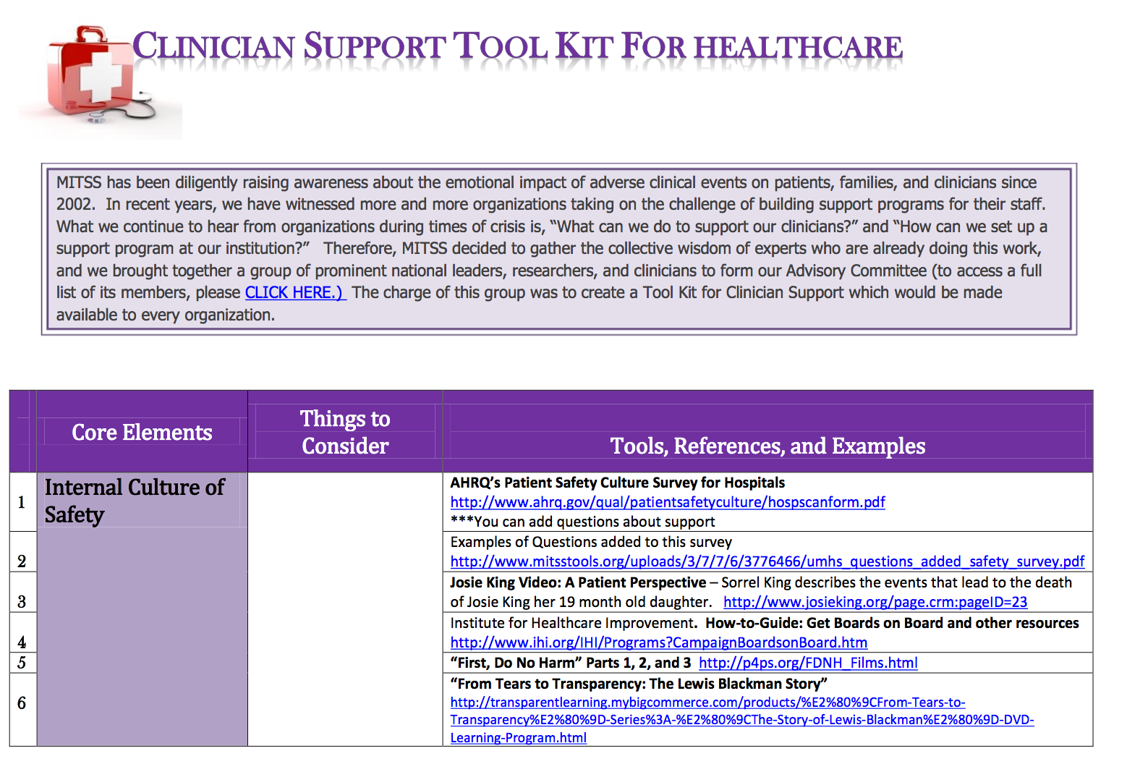

Notes:
Because the formal hospital programs proved successful and widely utilized, the experts such as Sue Scott who have developed successful programs came together on a panel and developed a downloadable toolkit for hospitals to use to develop their own program. The goal of the kit was to share strategies and tactics that have been successfully deployed in the U.S.
The toolkit includes 3 modules including literature on emotional support, the panelists’ existing program and experience, and healthcare leadership literature on effecting cultural change within health care organizations.
It is basically a comprehensive list of online resources divided by topic and includes websites, videos, survey questions, etc.

Slide 16

Notes:
Jennifer wraps up story and discussed surviving and thriving

Slide 17

Be supportive
Notes:
So where do we start??
1st is just awareness. We can begin teaching others about SVS at your hospital. Remember the 1st tier of the pyramid. Everyone needs to know how to recognize a provider at risk for SVS and what to do about it. Do a short slide show (such as this one) at department meetings, grand rounds or residency didactics. Use resources such as the Missouri ForYou Program and the MITSS toolkit. There are programs like this workshop that train providers on SVS and how to be a peer supporter.
2nd we will need to begin discussion on forming our own SVS program at our own hospital. Various toolkits have ideas and resources on how to begin finding peers for support and training them as well as speaking to our hospital leaders about the importance of this program. We will have to speak with risk management about keeping patient information confidential but still being able to debrief and discuss adverse events.
It will be a culture change, but YOU can be a part of this important initiative in your department and within your hospital.

Slide 18

In Conclusion
It is up to us to support our colleagues and recognize the emotions that are associated with medical errors
Consider being a champion for your department/institution to help create a Second Victim Syndrome Program
Break the silence and talk about your own experiences to help others realize they are not alone
Contact CORD Resilience Committee and the Mental Health Task Force for further resources as needed

Slide 19
References
*Chen MC, Fang SH and Fang L. The effects of aromatherapy in relieving symptoms related to job stress among nurses. Intl J Nurs Pract. 2015 Feb; 21(1): 87-93.
*Denham CR. TRUST: The five rights of the second victim. J Patient Saf. 2007;3:107-119.
*ISMP Medication Safety Alert. December 2009
*ISMP Medication Safety Alert. July 2011
*James J A new evidence-based estimate of patient harms associated with hospital care. J Pat Saf 2013; 9(3): 122-128.
*Krzan KD, Merandi J, Morvay S and Mirtallo J. Implementation of a “second victim” program in a pediatric hospital. Am J health syst pharm. 2015 Apr; 72(7):563-7.
*Marmon L and Heiss K. Improving surgeon wellness: The second victim syndrome and quality of care. Sem Ped Surg 2015;24:315-318.

Slide 20
References continued
*Scott SD, Hall LW et al. The natural history of recovery for the healthcare provider “second victim” after adverse patient events. Qual Safe Health Care. 2009;18(5):325-330.
*Scott SD, Hirshinger LE, Cox CR et al. Caring for our own: deploying a systemwide second victim rapid response team. Jl Comm J Qual Pat Saf. 2010; 36(2):135-162.
*Seys D and Vanhaecht K et al. Supporting involved health care professionals following an adverse health event: a literature review. Intl J of Nursing.ˆ2013 May; 50(5): 678-687.
*Short A and Ahern N. Evaluation of a systematic development process: Relaxing music for the emergency department. Aus Journal of Music Ther. 2009;20:3-26.
*Stiegler MP. What I learned about adverse events from Captain Sully: It’s not what you think. JAMA 2015;313(4):361-2.
*Wu AW. Medical error: the second victim. The doctor who makes the mistake needs help too. Br Med J 2000; 320:726-727.

Slide 21
References continued
*United States. Dept. of Health and Human Services. Office ofInspector General. Office of Evaluation and Inspections. Adverse events in hospitals national incidence among Medicare beneficiaries. Washington (DC): U.S. Dept. of Health and Human Services,Office of Inspector General; 2010
*Waterman AD, Garbutt J, Hazel E, et al. The emotional impact of medical errors on practicing physicians in the United States and Canada. Jt Comm J Qual Patient Saf 2007;33:467–76
*Perez G and Park E et al. Promoting resiliency among palliative care clinicians: stressors, coping strategies and training needs. J Pall Med. 2015 Aprl 18(4): 332-337.

