Slide 1


September 17, 2022
Notes:
It is estimated that 400 physicians die by suicide every year in the United States. Many believe this number is underestimated.
If this number is true, it means that one million Americans lose their doctors to suicide each year.
In order to address the issue of physician suicide, the Council of Emergency Medicine Residency Directors (CORD), in collaboration with AAEM, ACEP, ACOEP, EMRA, RSA, RSO and SAEM have come together to annually dedicate the 3rd Monday in September as National Physician Suicide Awareness (NPSA) Day

Slide 2
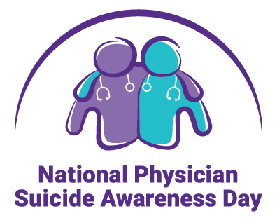
Breaking the Silence Around Physician Death By Suicide:
Shine a Light. Speak its Name.

Slide 3

Physician Suicide: A Personal Tragedy
A resident returns home from a shift at the hospital to find her house filled with gas fumes
She enters the garage to find her fiancé and fellow resident dead next to his motorcycle
His death was ruled suicide by asphyxiation due to carbon monoxide
Notes:
Personal story…
A true story, but just the facts.
The loss is only one life but the impact is much greater.
What happens to his fiancée – also a resident, their families, colleagues, and others left behind?
How far does the ripple effect spread?

Slide 4
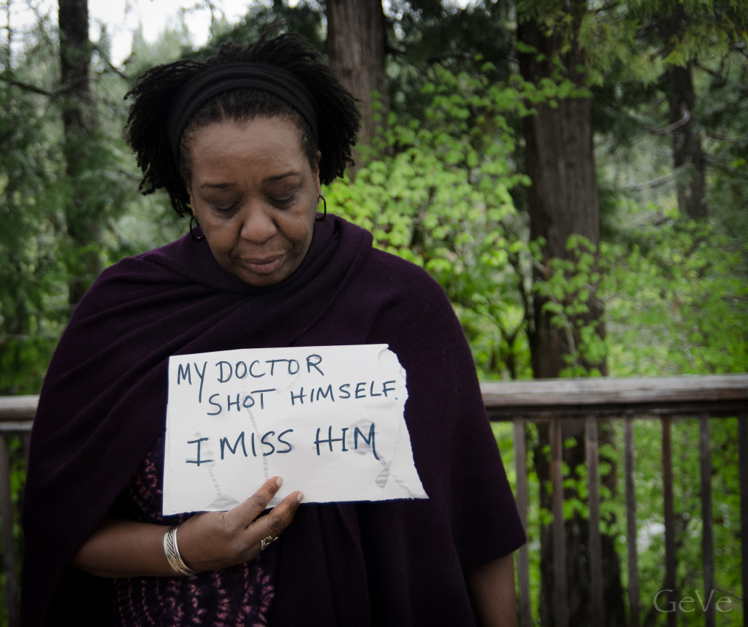
Physician Suicide: A Social issue
A Physician’s death by suicide has far reaching impact
Family members of doctors who have killed themselves have a higher risk of death by suicide
Colleagues grieve but often do not have a forum to speak about the loss
Patients lose their physician
Notes:
Think about someone you’ve lost due to suicide.
Clearly that person’s family and friends suffer and grieve. Their lives will never be the same. Family members have an increased risk of suicide. Many survivors of suicide loss do not seek help until long after their loss.
Colleagues also suffer and often have difficulty processing the loss. They wonder if they could have done something to prevent the death, if they missed warning signs, etc. Often the health care environment (hospitals, clinics, office, etc.) do not support or create a safe environment for physicians to talk about the loss due to the stigma surrounding suicide. Frequently, at the hospital or clinic, a physician death by suicide is kept quiet and creates a space for rumors. One survivor of suicide loss, Janae Sharp stated, “Physicians dying is bad press. It is kind of like a medical error.” (pause).
Patients are also deeply impacted. Many lose a trusted care provider. As already mentioned it is estimated that 1 million patients lose their physicians due to death by suicide. In an a time of increasing physician shortages, many consider this a public health crisis.

Slide 5
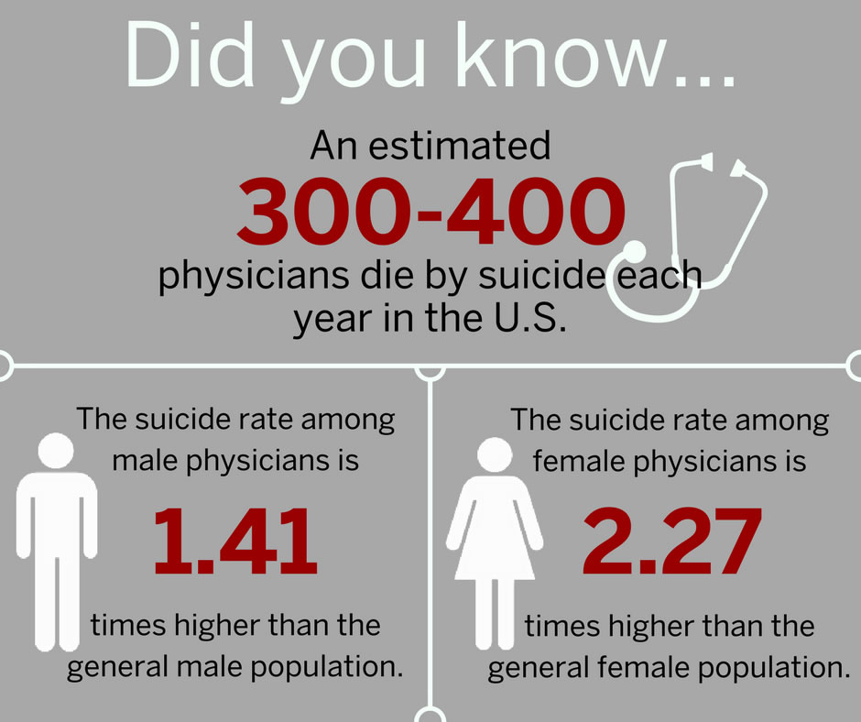
Physician Suicide: Just the Stats
Annual Data
Practicing Physicians
Trainees
Notes:
Recently published data has gained publicity by showing that from 1999 through 2014, the age-adjusted suicide rate in the United States increased 24%, from 10.5 to 13.0 per 100,000 population, with the pace of increase greater after 2006.
While celebrity deaths by suicide typically call attention to the issue of suicide raise awareness and outreach which is critically important, a special spotlight must be placed on a high risk group, who have an even higher rate of death by suicide than celebrities – physicians.
Lesser known outside of a small sect of our medical community - A recent systematic literature review indicates the suicide rate among doctors is somewhere between 28 to 40 per 100,000 — or more than twice that of the overall population. Among white male physicians, the rate is 1.41 times higher that the average American and even more drastic is the rate among white female physicians is 2.27 times higher.
Physicians also have a higher rate of suicide completion than the general population and more access to lethal means.
To shed light on the magnitude and causes of resident deaths, the ACGME reviewed nearly 400,000 physicians who entered its accredited programs from 2000 through 2014.
The results of the study, published in Academic Medicine in 2017, found that resident though death rates were lower than in the age- and gender-matched general population, suicide was second most prevalent cause of resident death (66; 51 men, 15 women).
However, suicide is the leading cause of death in male residents, and the second most common for female residents. Most suicides (49 of 66; 74 percent) occurred during the first two years of training.

Slide 6
Physician Suicide: What are contributing factors?
Multifactorial
Burnout
Compassion Fatigue
Depression
Substance Abuse
Notes:
There is no one thing that leads to the death of a physician by suicide but there are experiences that physicians face at an increased rate than cohorts of non physician.
Burnout is a cumulative process marked by emotional exhaustion and withdrawal associated with increased workload and institutional stress. Multiple studies have shown that many practicing physicians experience symptoms of burnout, on average 50 %. Some specialties have increased rates (EM, IM, FP, Critical Care).
Compassion fatigue is an emotional residue or leftover state from exposure of working with others in distress. Compassion fatigue can presents similar to burnout with emotional exhaustion but it can also present similar to PTSD with intrusive thoughts, nightmares, and hypervigilance.
When looking at rates of depression and other mood disorders, those in the medical profession such as medical students, residents and physicians are higher when compared with the general population. And unfortunately, a majority of these physicians suffering from mood disorders will not seek professional help.
One study in 2016 looking at medical students, revealed that 27 % experiences depressive symptoms and more than 11 % reported having suicidal thoughts. Of those with depressive symptoms only 15 % sought help.
Substance abuse rates are also higher in physicians that the general population. Physicians report a substance abuse rate of up to 15 % compared to the general population at 9 %. Some specialties have higher rates (Anesthesiology, EM).

Slide 7
Physician Suicide: Who is at risk?
Females
Those identifying as LGBTQ
Those with history of mental/physical illness or substance abuse
Perfectionists
Certain specialties:
  Anesthesia
  Psychiatrists
Vulnerable
  Inadequate support systems
  Those who are in transition
    completing medical school, seeking residency, nearing retirement
Notes:
When reviewing literature to identify those at risk in our field, we’re given this long list of risk factors that are likely obtained on retrospective assessments, however, what do we do with this information?
You can certainly be aware of it, but they aren’t the most actionable items.
However…

Slide 8
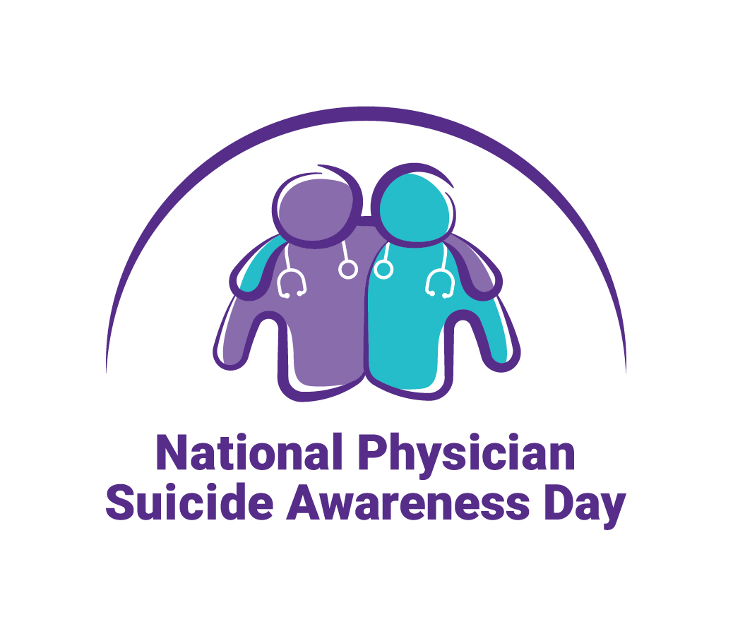
Warning Signs
Notes:
There may be warning signs….
With MAY be the key word here…
There are not always warning signs that someone is going to take there own life and physicians, especially as we are often masters of disguise.
However, there are some common warning signs to be aware of.

Slide 9
Warning signs: Talking
Talks about self-harm, not having a reason to live
Hopelessness
Feeling like a burden to others
Feeling trapped
Unbearable pain
Notes:
*****I wonder if Loice would be willing to have us share her story “nothing that a vial of insulin wouldn’t cure.”
A person might be suicidal if he or she exhibits behavioral changes. This is of greatest concern if the new or changed behavior is related to a painful event, loss or change. People who take their lives exhibit one or more warning signs, either through what they say or what they do.

Slide 10
Warning signs: Behavior
Increased use of alcohol or drugs
Looking for a way to end their lives
Withdrawing from activities
Isolating from family and friends
Visiting or calling people to say goodbye
Sleeping too much or too little
Giving away prized possessions
Aggression
Fatigue
Notes:
Some are vague but some are more concerning such as calling to say good bye. In the digital age can also happen through group texts “Love you guys, Sorry.”
Looking for ways to end their lives such as looking up methods on the internet

Slide 11
Warning signs: Mood
Depression
Anxiety
Loss of interest
Irritability
Humiliation/shame
Agitation/anger
Relief/sudden improvement
Notes:
Increased depression or anxiety can lead to increase thoughts of suicide
Loss of interest and withdrawal is always concerning
In a person who has been suffering from a mood disorder, a sudden improvement may be a good sign but it might also signal that they have come to terms with the idea of ending their own life.

Slide 12
What Can We Do?

Slide 13
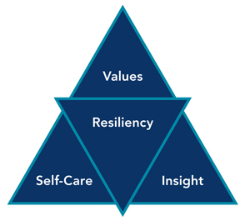
What can we do personally? Build Resilience
Learn mindfulness
Learn to self-monitor emotions
Learn to set limits
Create connection with patients, colleagues and loved ones
Practice compassion
Notes:
A publication in Academic Medicine in 2013 by Epstein and Krasner highlighted some attributes of resilient physicians that advise on how to practice self-care - mindfulness, self monitoring and limit setting.
Other studies have demonstrated the power of connection and compassion. We are social beings by nature and feeling like we have meaningful relations is important.

Slide 14

What can we do for our colleagues?
Monitor for warning signs
Be kind and compassionate to each other
Check-in and spend time with each other
Emphasize self-care
Notes:
May not be enough as some individuals do not demonstrate warning signs

Slide 15
What can we do in the house of medicine?
Increase awareness
Erase Stigma
Change culture
Improve work environments
Start Peer Support Groups
Mentorship
Debriefs
Incorporate wellness and resiliency training into medical education
Improve and streamline access to mental healthcare
Notes:
We must - Shine a light. Speak its name.
We must approach this problem from many angles.
We must increase awareness and decrease the stigma around suicide and the mood disorders that can contribute to it. There’s no shame in depression – we all sacrifice so much of ourselves to do what we do, then are exposed to so many heartbreaking circumstances. Though we have demonstrated our strength to achieve our positions, we not immune to human frailties.
We must change the health care culture to it more conducive to wellness for ourselves and our patients.
We must make concerted efforts create better work environments clinicians both operationally and emotionally by provide support groups, mentoring opportunities and debriefs after difficult cases.
We must increase education on resiliency and self care in UME and GME.
And
We must ensure mental health services easily and readily available to physicians with no barriers to access the care with full confidentiality and no reporting requirements.

Slide 16
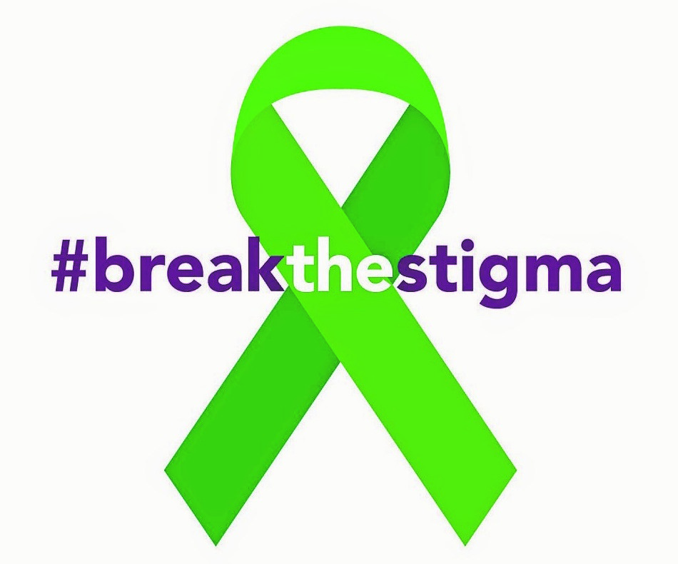
What can we do in our nation?
Suicide rates have drastically increased for all Americans
It needs to be a public health priority
  We need to study it, understand and find solutions
Mental health care must be a focus
Partnering with existing groups is important
Notes:
As a nation, we must do a better job of understanding suicide, increase awareness and prevention as a national priority
We need to study it, understand it and find solutions, just as if we were trying to find the cure for cancer
We need to TRULY improve our mental health infrastructure and reduce the stigma around it the serves a barriers for all people to seek help (Great Britian has has a great recent campaign)
There are many great groups out there, nationally and locally, working on this problem (Survivors of suicide loss, American Association of Suicidology, etc.). We need to increase collaboration.

Slide 17
Vision Zero Suicide in Medicine:
A challenge and a goal
Notes:
Where do we go from here?
It’s simple to state, but a challenge in reality.
We challenge you as individuals and as parts of broader communities, institutions and larger organizations to make the needed changes to reach zero physician suicides.
It can be as simple as saying “Are You OK?” and showing kindness to a colleague who is looking down.

Slide 18
Brought you by CORD in association with:
AAEM
ACEP
ACOEP
RSO
EMRA
RSA
SAEM
Notes:
Thank you to all who have shown support in our first year and we look forward to any and all other organizations who are interested in joining our movement in the future.

Slide 19
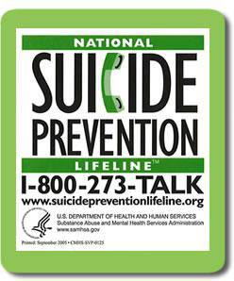
Resources:
If your program/hospital/school has resources, please share them with your group on this slide
www.cordem.org/npsa
https://www.suicidology.org/
https://suicidepreventionlifeline.org/
Crisis Text Line:
Rather text than talk on the phone?
You can contact the Crisis Text Line by
texting HOME to 741741
anywhere in the United States 24/7.
Notes:
Thank you to all who have shown support in our first year and we look forward to any and all other organizations who are interested in joining our movement in the future.

