Slide 1

Large Group Teaching
Seth Lotterman, MD
2/19/2021

Slide 2
Objectives
Engaging a large audience
Body language
Morbidity and Mortality conference

Slide 3

Tell a story
Humans have told stories for thousands of years
We listen and tell stories from an early age
Stories engage the audience
Strong opening, interesting middle, powerful resolution
Image from Pexels.com
Notes:
“We are wired to tell and receive stories from an early age. We have been telling stories for thousands of years, passing the oral tradition from clan to tribe to family. This tradition has fallen to the way side with modern lectures. Stories engage the audience and allow them to activate prior knowledge and prior experience. A presentation, like a good story, should have a strong opening, interesting middle with some conflict, and resolution with a powerful finish.”
-Emcases podcast 80

Slide 4
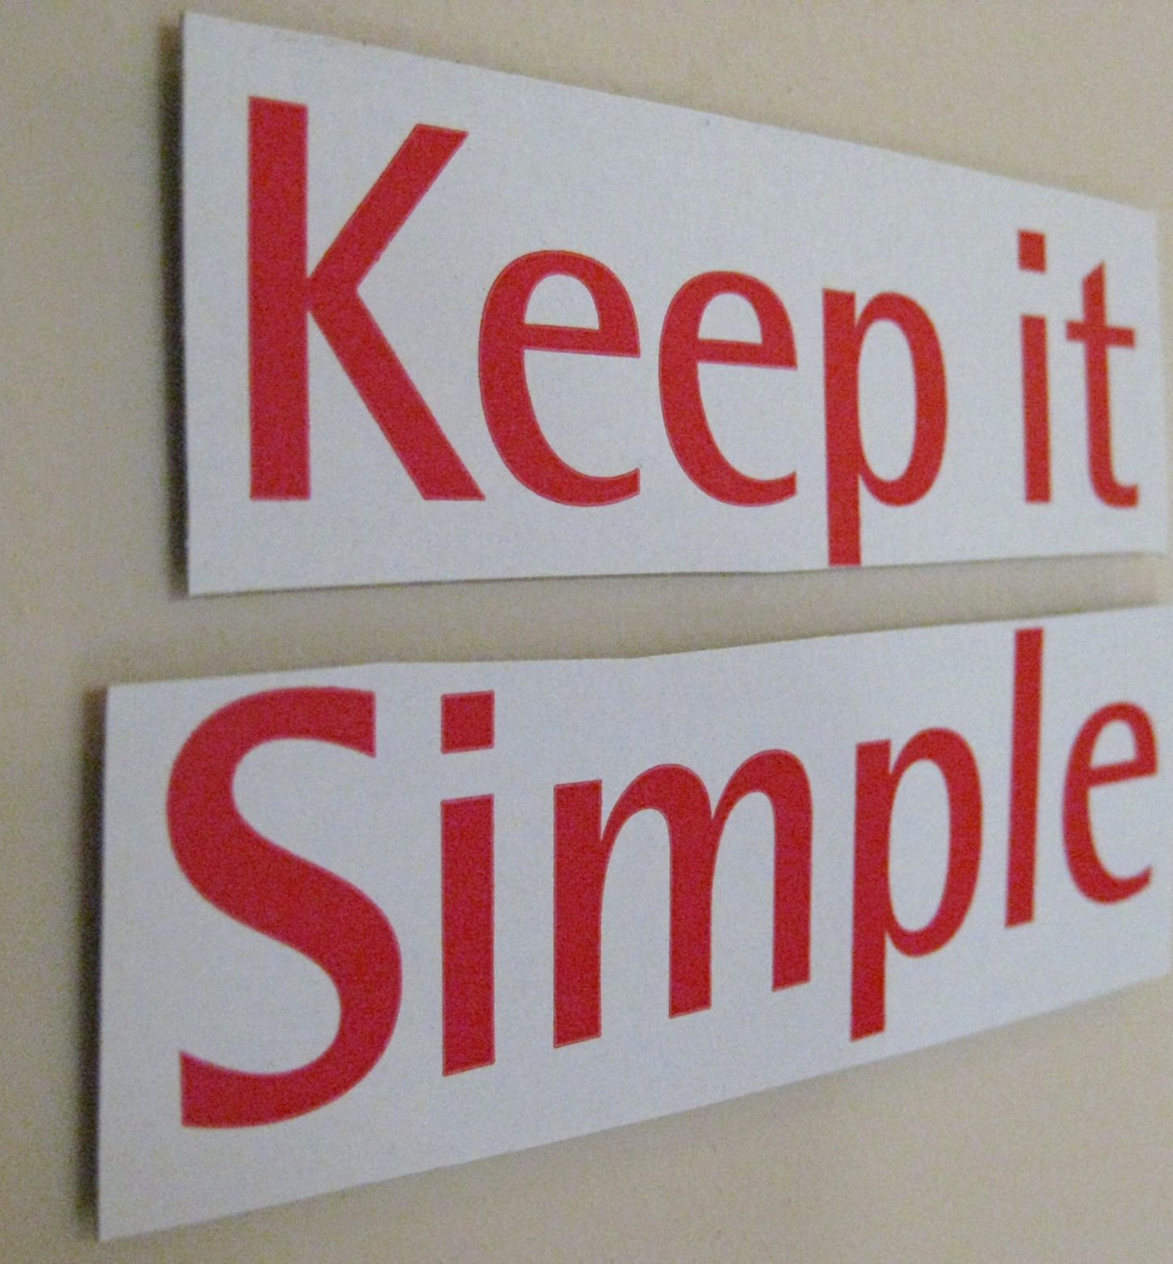
Keep it simple
Aim for 3 take home points
  State them in your introduction
  Repeat the points during your talk
  Repeat them at the end
Image from Wikimedia
Notes:
“Keeping your presentation simple applies to the content of your entire presentation as well as your slides. A rough guide is to deliver no more than three take home points that you state in your introduction, repeat in the body of the talk with sub-points, embellishments, stories, examples and analogies to illustrate your points, and then again repeat your take home points in your closing remarks.
Repetition is vital to learning.”
-Emcases podcast 80

Slide 5

Know your transitions, aka,
“Manage your flow”
Storyboard your presentation
Manage the flow of your presentation
Rehearse the presentation
Body language
Image from pexels.com
Notes:
AKA “Manage your flow” during your presentation
Rehearse your presentation
Body language

Slide 6


Body language
What audiences remember:
  58% body language
  38% voice (how it was said)
  7% verbal content (what was said)
Way before presentation – practice body movements
Just before presentation – settle nerves (power pose, meditate, visualize)
During presentation – eye contact, control mannerisms, move around stage
Notes:
Albert Mohrabian, PhD, published a study discussing what an audience will remember: verbal content (things said) 7%, voice (tonal quality—how it was said) 38%, Body language (presentation style of lecturer) 58%

Slide 7

M&M
Choose a case
  Consider “themes” or inviting other departments
Know the case and understand the issues
Avoid blame, focus on systems issues
Involve the audience (ex. who would intubate the patient now?)
EM pertinent teaching points
  Cover epidemiology, DDx, treatment/management
  Review “landmark” articles or recent review articles on the topic
Notes:
Choosing a case: consider cases with diagnostic or management dilemmas and decision-making issues or consider a “theme” based conference
-Consider inviting EM colleagues from other system hospitals or combined conference with another specialty
Know the case, all the details, timeline, vital signs, labs, consultations, imaging, etc
Understand the issues – was there an error, if so, what type: misdiagnosis, missed information, missed differential, etc; what is the teaching/learning point of the case; education about the missed condition – pearls for diagnosis/treatment in the ED
Consider focusing on systems issues
“useful to discuss the many unique aspects of our practice environment that predispose to medical mis- takes. These include multi-tasking, frequent interruptions during shifts,3 inadequate communication and continuity during shift change, varying availability of diagnostic studies, patient volume, and over-reliance on consultants for decision-making and disposition”
Avoid placing blame (presenting anonymously can enhance teaching and avoid shame), can be helpful to get input from the clinicians involved while putting together the conference
Ask questions of the audience to make them commit to a course of action (ex. who would intubate the patient now?)
Brief and EM pertinent teaching points, covering the epidemiology, differential diagnosis, treatment/management (review recent or “landmark” articles)

