Slide 1

Small Group Teaching
Danielle Castagneri, MD
Notes:
Image attribution: <a href='https://www.freepik.com/vectors/people'>People vector created by pch.vector - www.freepik.com</a>

Slide 2
Objectives
To create a framework for small group teaching
To establish pros and cons of small group teaching and flipped classrooms
To learn and practice techniques to increase engagement in small group learning

Slide 3
Advantages of teaching in small groups
Encourages active learner engagement
Promotes an open and safe learning environment
Promotes community bonding within a residency

Slide 4
Ways to incorporate small group teaching
Pause Procedures
Flipped classroom
Problem-Based Learning
Case-Based learning
Team-Based learning
Ethics discussions
Simulation

Slide 5
What is a flipped classroom?
Learners pre-view materials that might formerly have been used as didactic lecture, and use class time to engage in student-centered learning activities
(Moraros et a, 2015)
Example:
Pre-class preparation may include a brief 15-20 minute video lecture, podcast, or textbook reading
During class, students may take a brief (5 minute) formative quiz to gauge understanding
Questions and misconceptions may briefly be addressed (5-15 minutes)
Students use the remainder to engage in discussion, problem-solving, or performance to apply the skills learned
Notes:
Flipping for success: evaluating the effectiveness of a novel teaching approach in a graduate level setting. Moraros J, Islam A, Yu S, Banow R, Schindelka B BMC Med Educ. 2015 Feb 28; 15():27. https://www.ncbi.nlm.nih.gov/pmc/articles/PMC4363198/

Slide 6
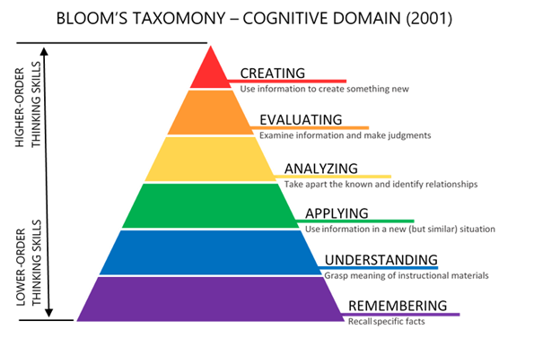
Pros and cons: Flipped Classroom and Small Groups
PRO
Increased engagement
Adult learners tend to prefer flipped classrooms and small groups over didactic lectures (Moraros et al 2015)
Promotes long term retention
Allows for the practice of clinical applications (King et al 2017)
Flexibility of content
Promotes higher level cognitive skills
Notes:
Image source: https://citt.ufl.edu/resources/the-learning-process/designing-the-learning-experience/blooms-taxonomy/)
1. King AM, Mayer C, Barrie M, Greenberger S, Way DP. Replacing Lectures with Small Groups: The Impact of Flipping the Residency Conference Day. West J Emerg Med. 2018;19(1):11-17. doi:10.5811/westjem.2017.10.35235 https://www.ncbi.nlm.nih.gov/pmc/articles/PMC5785176/
2. Flipping for success: evaluating the effectiveness of a novel teaching approach in a graduate level setting. Moraros J, Islam A, Yu S, Banow R, Schindelka B BMC Med Educ. 2015 Feb 28; 15():27. https://www.ncbi.nlm.nih.gov/pmc/articles/PMC4363198/

Slide 7
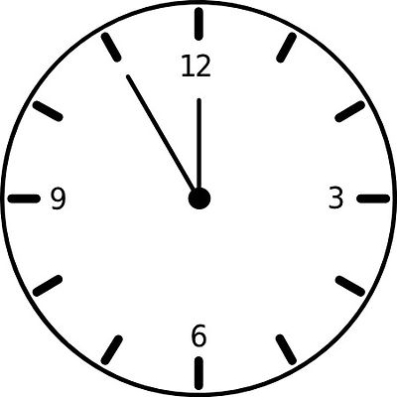
Pros and cons: Flipped Classroom and Small Groups
CON
Increased time requirements from both instructors and learners
Increased staffing requirement (higher learner-to-facilitator ratio)
Difficulties in ensuring learner accountability if preparation is required
Technology integration
Burden of lesson planning can be higher
Notes:
Image attribution: http://clipart-library.com/clipart/pc7KrnaRi.htm

Slide 8
General best practices
Prioritize active learning in small groups
Rapid-fire case discussions with targeted learning points have been highly rated by students (King et al 2017)
Incorporate “pause procedures” to allow for internal active processing
Consider allowing open (self-chosen) resources for pre-class preparation for adult learners
Keep pre-meeting preparation materials short (<20 minutes)
The learners should lead, not the facilitator
Exemplar Resources:
Podcasts and video lectures
  LITFL
  EmCrit
  EM Cases
  EKG Weekly
  CORDem
  SonoSpot
  The POCUS Atlas
  5- minute Sono
Textbooks (Tintinalli, Rosen)
Notes:
1. King AM, Mayer C, Barrie M, Greenberger S, Way DP. Replacing Lectures with Small Groups: The Impact of Flipping the Residency Conference Day. West J Emerg Med. 2018;19(1):11-17. doi:10.5811/westjem.2017.10.35235 https://www.ncbi.nlm.nih.gov/pmc/articles/PMC5785176/
2. Flipping for success: evaluating the effectiveness of a novel teaching approach in a graduate level setting. Moraros J, Islam A, Yu S, Banow R, Schindelka B BMC Med Educ. 2015 Feb 28; 15():27. https://www.ncbi.nlm.nih.gov/pmc/articles/PMC4363198/

Slide 9
Pitfalls
Is this truly a “flipped classroom” or just a lecture with pre-reading?
Avoid the “double lecture” mistake
How to assess success? ITE may not be sensitive enough a tool (King et al 2017)
Inadequate time to prepare-- for residents AND facilitators
·
HINT: Multimedia choices for preparation such as podcasts, video lecture, or a multimedia textbook that required less than <30 min to complete increased compliance with prework (King et al 2017)
Notes:
King AM, Gottlieb M, Mitzman J, Dulani T, Schulte SJ, Way DP. Flipping the Classroom in Graduate Medical Education: A Systematic Review. J Grad Med Educ. 2019;11(1):18-29. doi:10.4300/JGME-D-18-00350.2

Slide 10
Practice
The following examples are from:
Not Another Boring Lecture: Engaging Learners with Active Learning Techniques
Wolff, Margaret et al.
Journal of Emergency Medicine, Volume 48, Issue 1, 85 - 93
(Prereading)
We will apply the knowledge obtained from our pre-reading to practice writing our own learning objectives and example lesson planning prompts for a different topic chosen by the group.

Slide 11
Example topics
Advanced airway techniques
Advanced cardiac ultrasound
Empiric antibiotic coverage in immunocompromised patients
Building differential diagnosis for “X” chief complaint
Ethics topics
EKG review
Case-based: Choosing RSI medications for specific indications
Journal Club

Slide 12
Think-Pair-Share
After a discussion of the management of febrile neonates with fever:
THINK: ask the group to silently choose an antibiotic regimen for a febrile neonate.
PAIR: instruct learners to pair with a neighbor to discuss answers
SHARE: instructor randomly calls on pairs to share with the group.
Examples from:
Not Another Boring Lecture: Engaging Learners with Active Learning Techniques
Wolff, Margaret et al.
Journal of Emergency Medicine, Volume 48, Issue 1, 85 - 93
Allows learners who may be unwilling to speak up in larger groups to practice answers and come to a consensus in a safe learning environment

Slide 13
One-minute paper
Example: After a discussion of the management of febrile neonates with fever, ask learners to list microorganisms implicated in neonatal infections
Pause procedure that allows for private processing
Notes:
Not Another Boring Lecture: Engaging Learners with Active Learning Techniques
Wolff, Margaret et al.
Journal of Emergency Medicine, Volume 48, Issue 1, 85 - 93

Slide 14
Commitment activities
After a discussion of the management of febrile neonates, ask learners to choose an appropriate antibiotic regimen from a list of choices and text their response using Poll everywhere. Review as a group.
Anonymous web-based reporting has higher engagement than identified reporting (Wolff et al)
Multiple free modalities allow for free-response answers, which may lead to richer discussion
Allows for active engagement and formative assessment of learner understanding

Slide 15
Team Based Learning
An obvious application: Simulation Lab
After completing prework, learners apply their knowledge in a clinical setting with hands-on simulation
Exemplar resources for simulation cases:
  https://emsimcases.com/
  https://www.acep.org/tox/sim-cases.html
  https://www.healthysimulation.com/780/emergency-medicine-sim-case-library/
A common way to conduct a flipped classroom, in which learners complete pre-class preparation and are then challenged to apply core content to scenarios as a team

Slide 16
Jig Saw
A topic is broken into smaller, interrelated pieces and assigned to individual learners. Each learner prepares in advance, and then teaches their portion to their small group. There can then be a performative or summative assessment of understanding
A type of cooperative learning that allows learners to become teachers

Slide 17
Problem-based learning
Exemplars:
Wolff M, Pomeranz E, Carney M. Febrile young infant learning module. MedEdPORTAL. 2013. Available at: www.mededportal. org/publication/9568.
Denson K, Manzi G, Crowe C, Rehm J. TBL: navigating delirium, polypharmacy and home care services with an elderly emergency department patient. MedEdPORTAL. 2013. Available at: www. mededportal.org/publication/9599.
Koestler J, Waite E, Chietero M, et al. Problem-based learning (PBL): abdominal pain in a pregnant woman. MedEdPORTAL. 2009. Available at: www.mededportal.org/publication/517.
Case-based learning in small groups

Slide 18
References
Denson K, Manzi G, Crowe C, Rehm J. TBL: navigating delirium, polypharmacy and home care services with an elderly emergency department patient. MedEdPORTAL. 2013. Available at: www.mededportal.org/publication/9599
King AM, Mayer C, Barrie M, Greenberger S, Way DP. Replacing Lectures with Small Groups: The Impact of Flipping the Residency Conference Day. West J Emerg Med. 2018;19(1):11-17. doi:10.5811/westjem.2017.10.35235 https://www.ncbi.nlm.nih.gov/pmc/articles/PMC5785176/
Koestler J, Waite E, Chietero M, et al. Problem-based learning (PBL): abdominal pain in a pregnant woman. MedEdPORTAL. 2009. Available at: www.mededportal.org/publication/517
Moraros J, Islam A, Yu S, Banow R, Schindelka B. Flipping for success: evaluating the effectiveness of a novel teaching approach in a graduate level setting. BMC Med Educ. 2015 Feb 28; 15():27. https://www.ncbi.nlm.nih.gov/pmc/articles/PMC4363198/
Wolff, Margaret et al. Not Another Boring Lecture: Engaging Learners with Active Learning Techniques. Journal of Emergency Medicine, Volume 48, Issue 1, 85 - 93
Wolff M, Pomeranz E, Carney M. Febrile young infant learning module. MedEdPORTAL. 2013. Available at: www.mededportal.org/publication/9568

