Slide 1
Atraumatic Back Pain
John Kiel DO/MPH
Assistant Professor of emergency medicine
University of Florida CoM - Jacksonville

Slide 2
epidemiology

Slide 3

Low back pain related disorders caused 2.63 million annual ED visits in the US (Friedman, 2010)

Slide 4
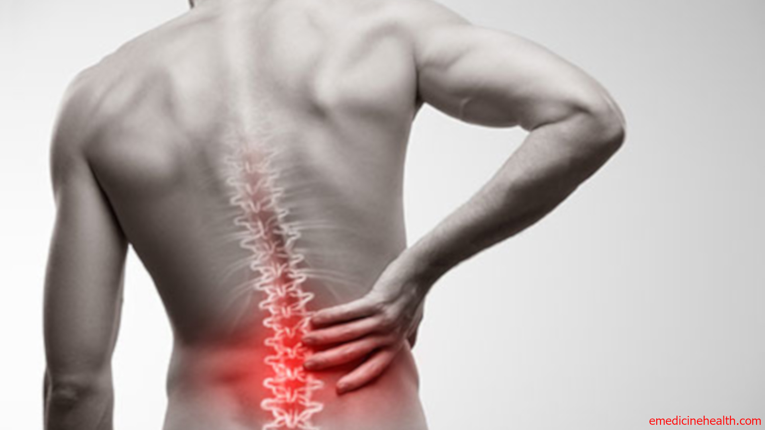
Lifetime prevalence of low back pain as high as 84% (Belagoue, 2012)

Slide 5
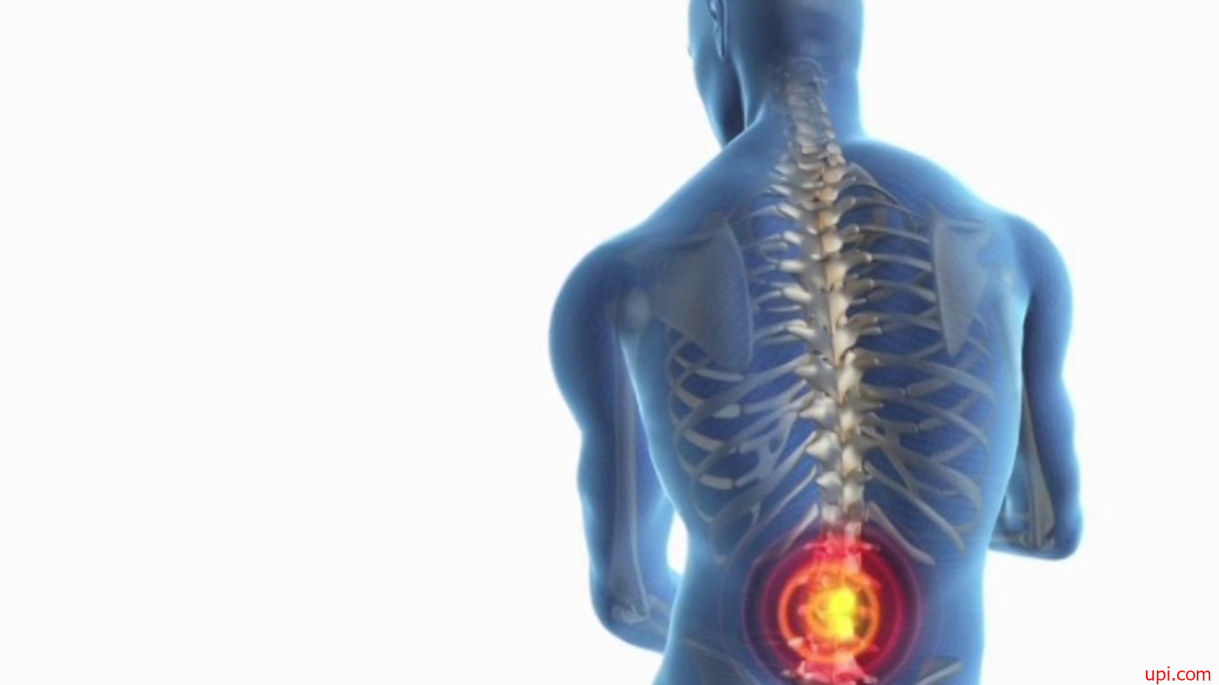
Chronic low back pain (23%)
Population disabled due to back pain (11-12%)

Slide 6

60% higher per capita medical costs than patients without back pain (Airaksinen 2006)

Slide 7
Anatomy

Slide 8
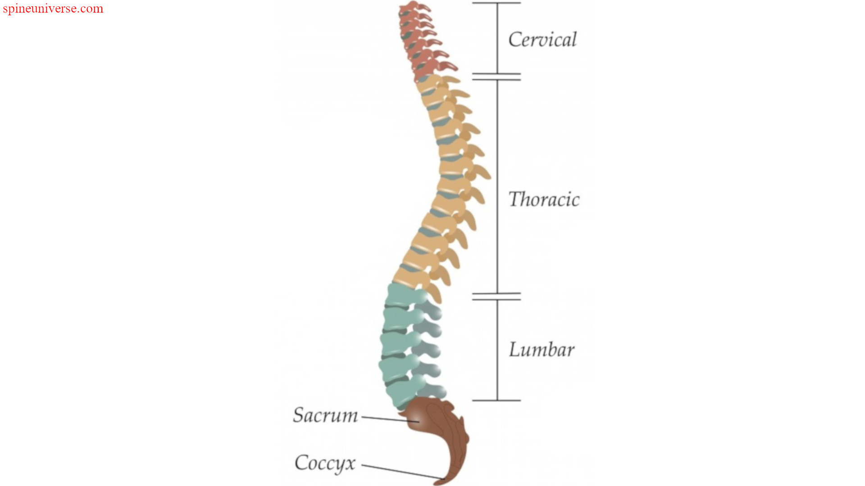
Notes:
Commentary: mention distinction between C, T, L and S spine. Most people mean lumbar back when they say back pain but important to be specific.

Slide 9
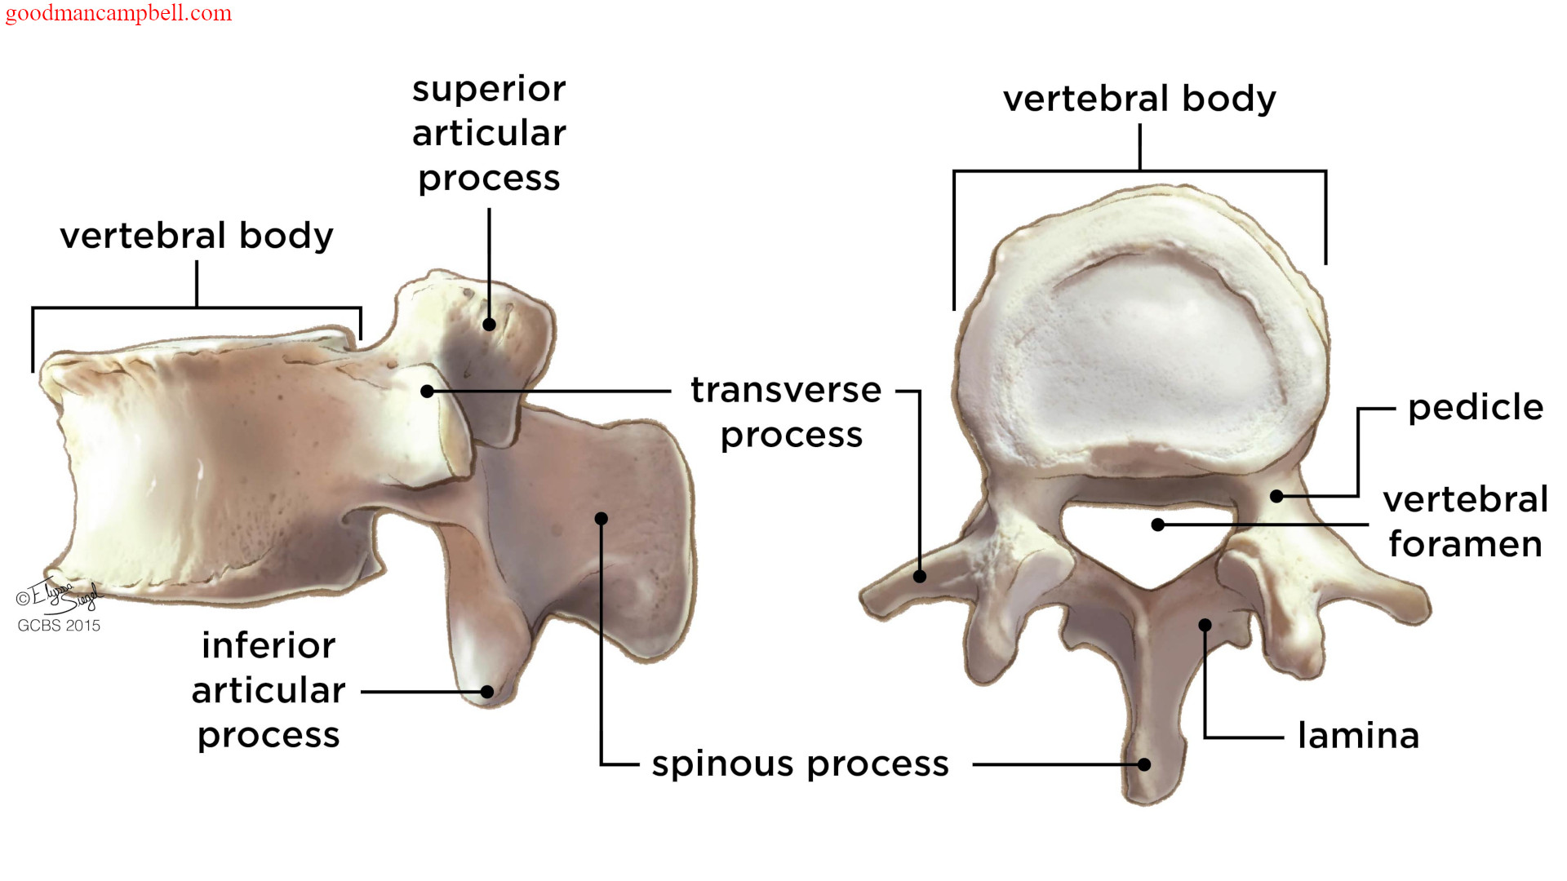

Slide 10
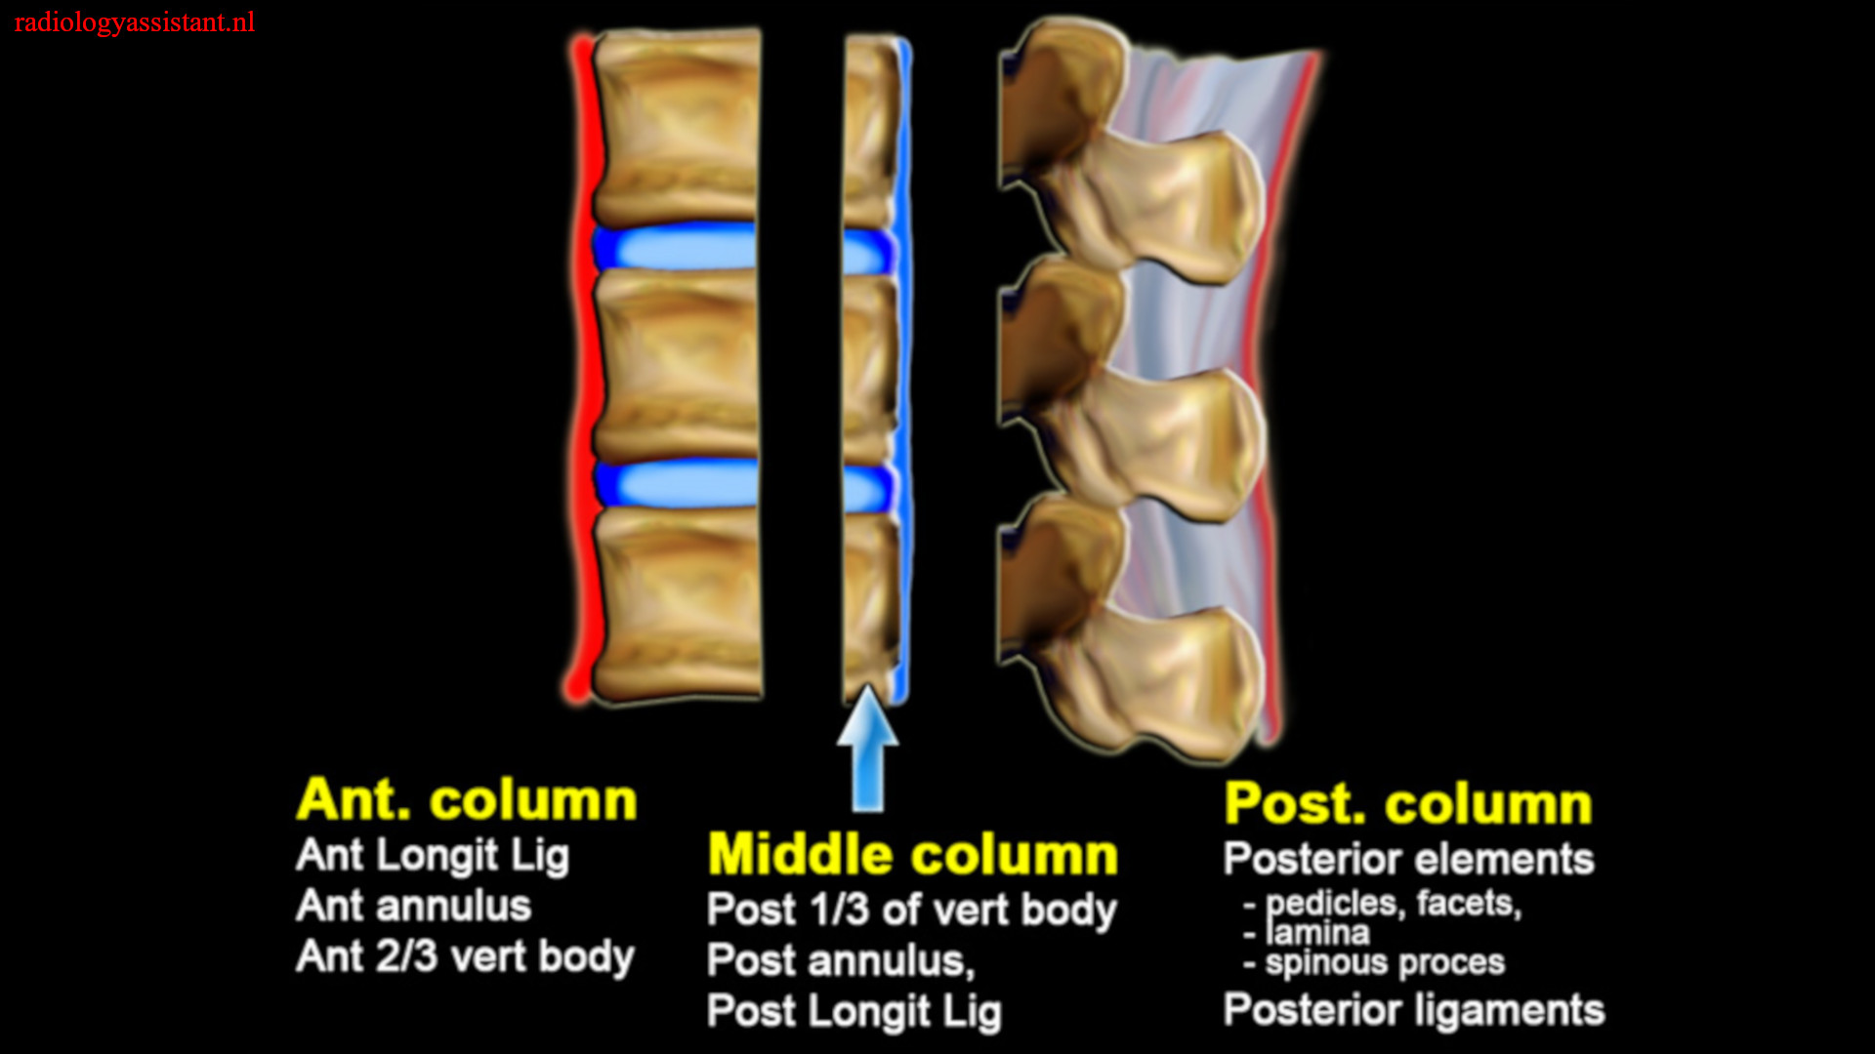
Notes:
Commentary: 3 columns in trauma are important for stability. 1 column stable, 2 column or 3 column unstable and surgical

Slide 11
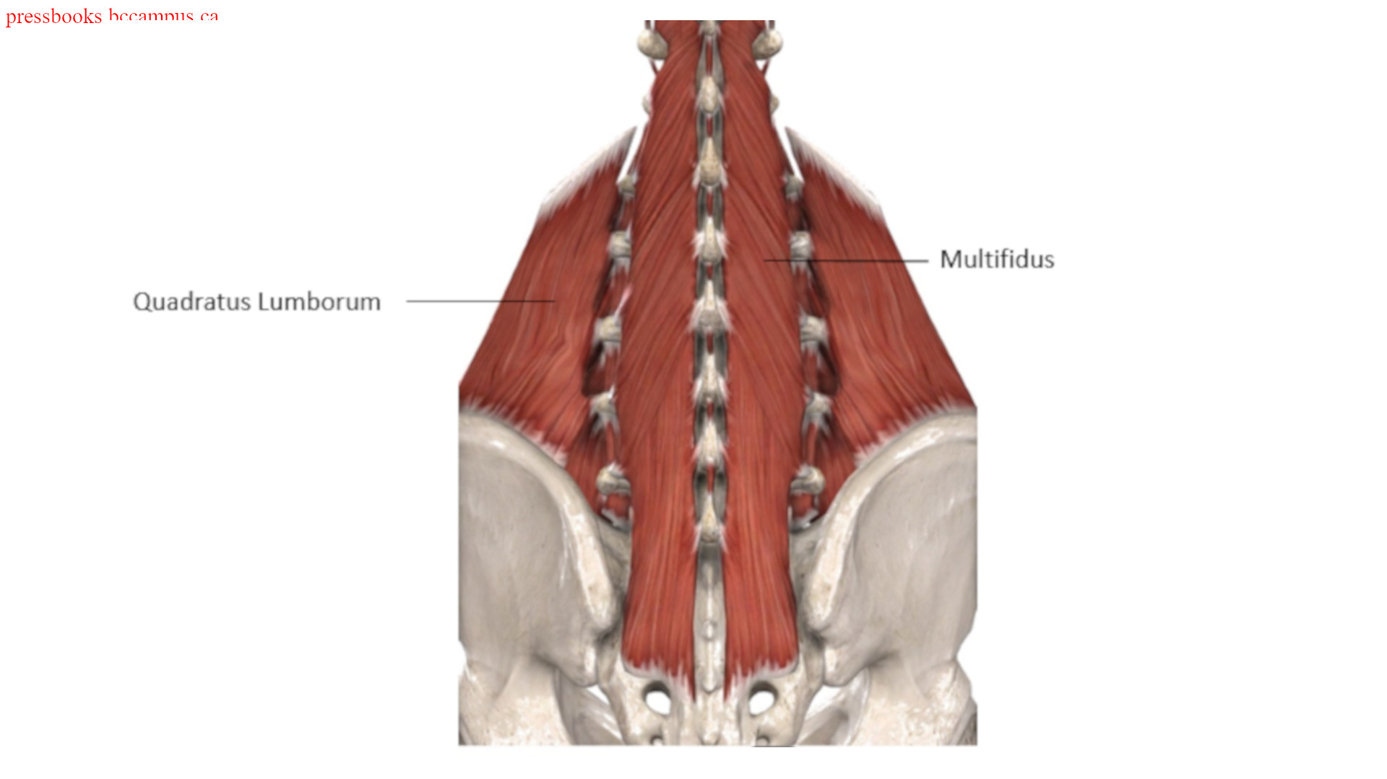
Notes:
Commentary: major muscles of back

Slide 12
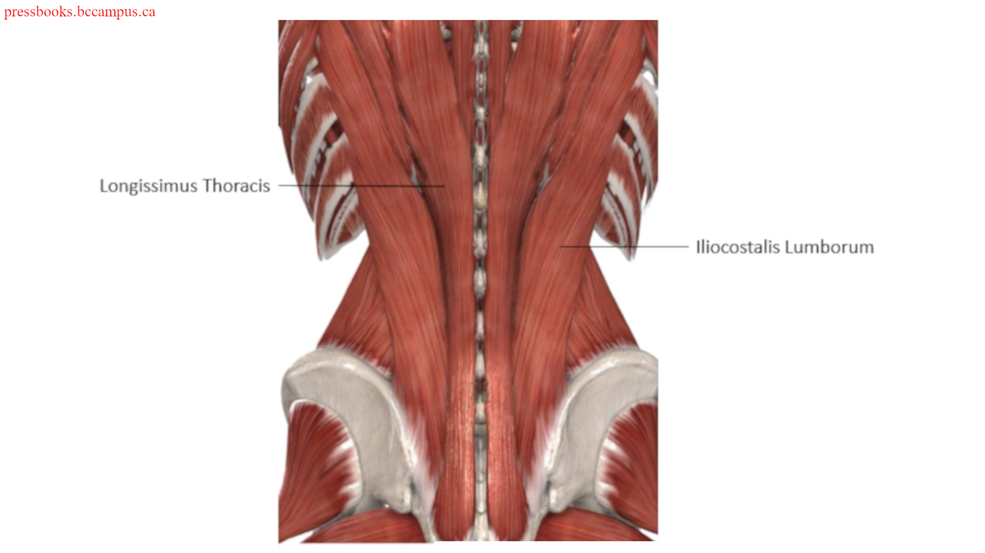
Notes:
Commentary: major muscles of back

Slide 13
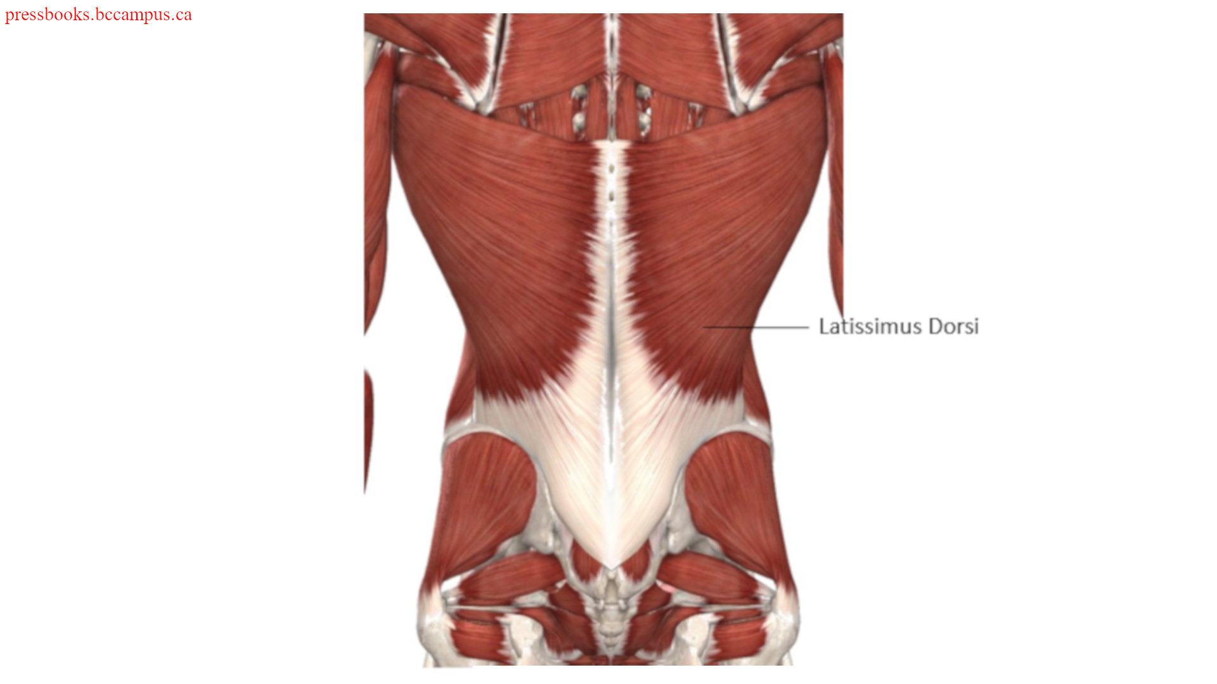
Notes:
Commentary: major muscles of back

Slide 14
Physical exam

Slide 15
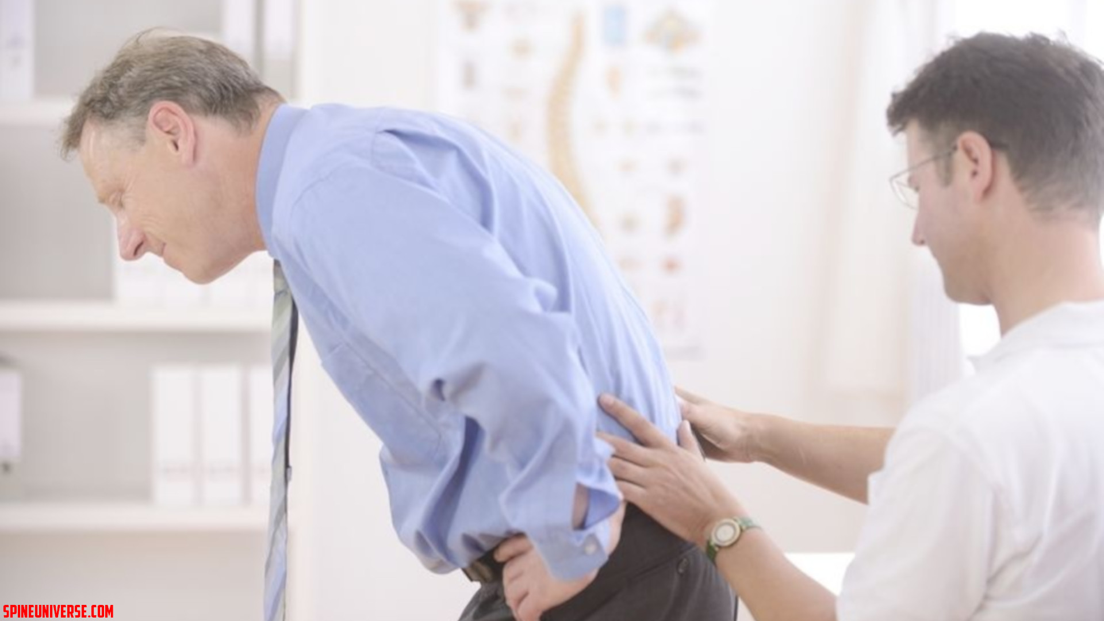
Notes:
Commentary: just to prompt discussion about physical exam

Slide 16
IPPASS
Inspection
Palpation
Passive Range of Motion
Active Range of Motion
Strength and Neurovascular
Special Tests
https://wikism.org/Physical_Exam_Back
Notes:
Commentary: this is the method all residents should be taught and is largely agreed upon by the EM/SM faculty

Slide 17
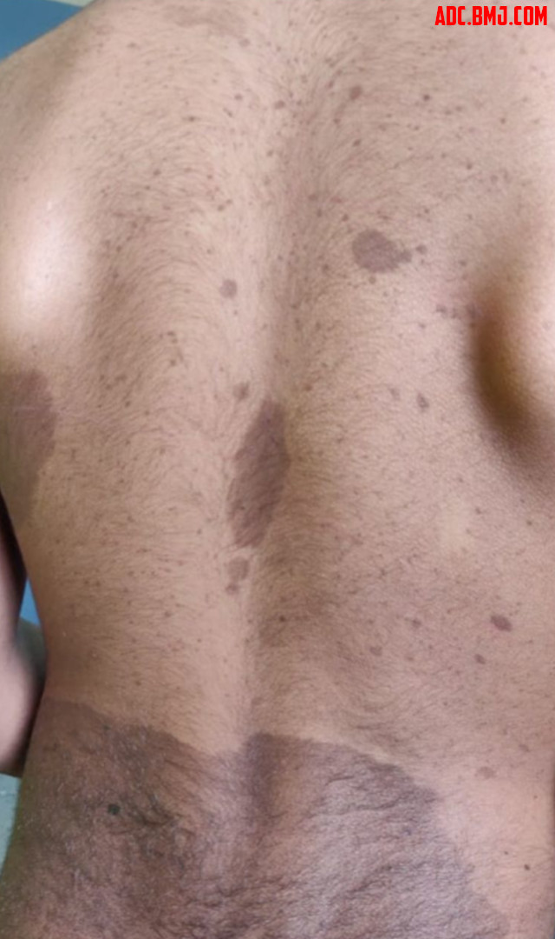
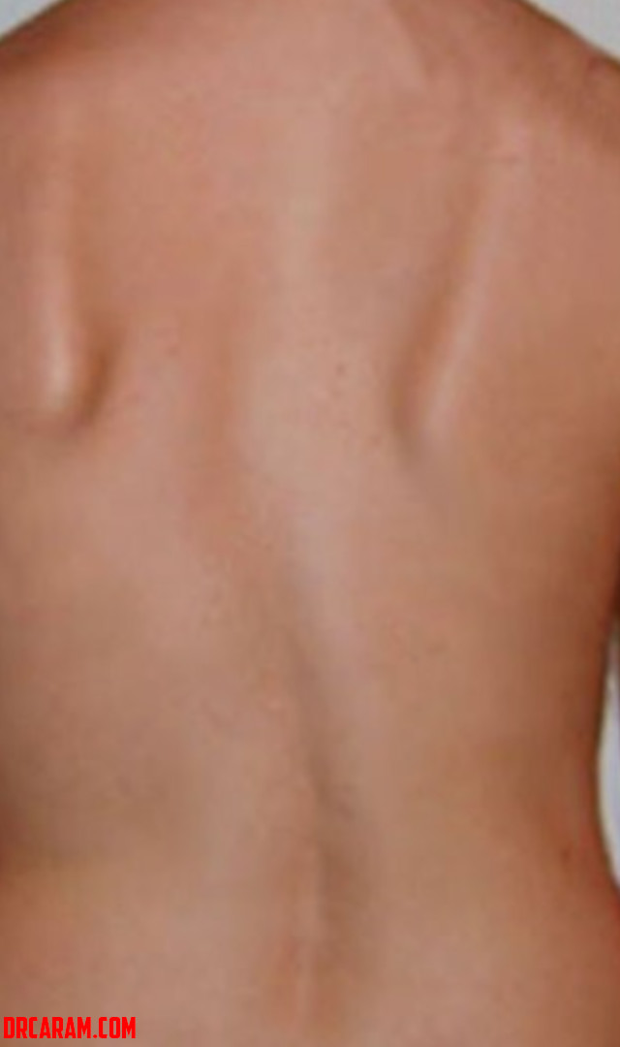
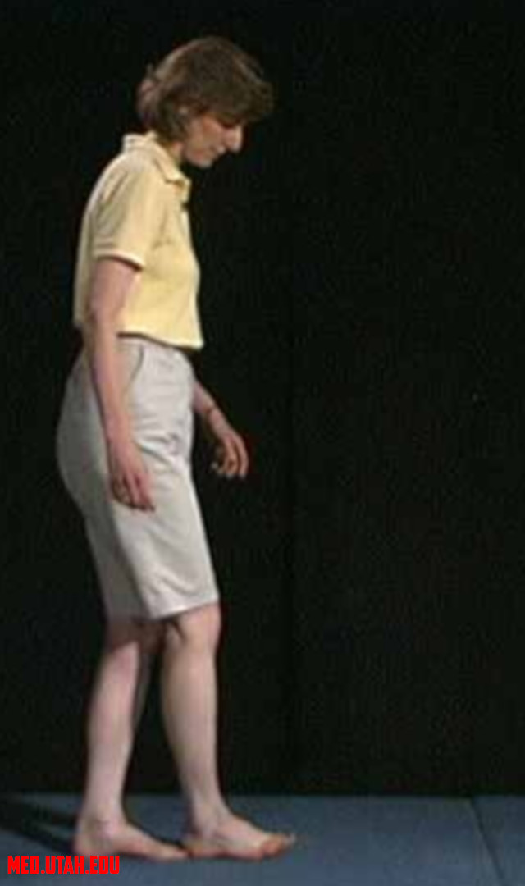
Notes:
Commentary: inspection, what do you see? Skin, MSK and gait are all important

Slide 18
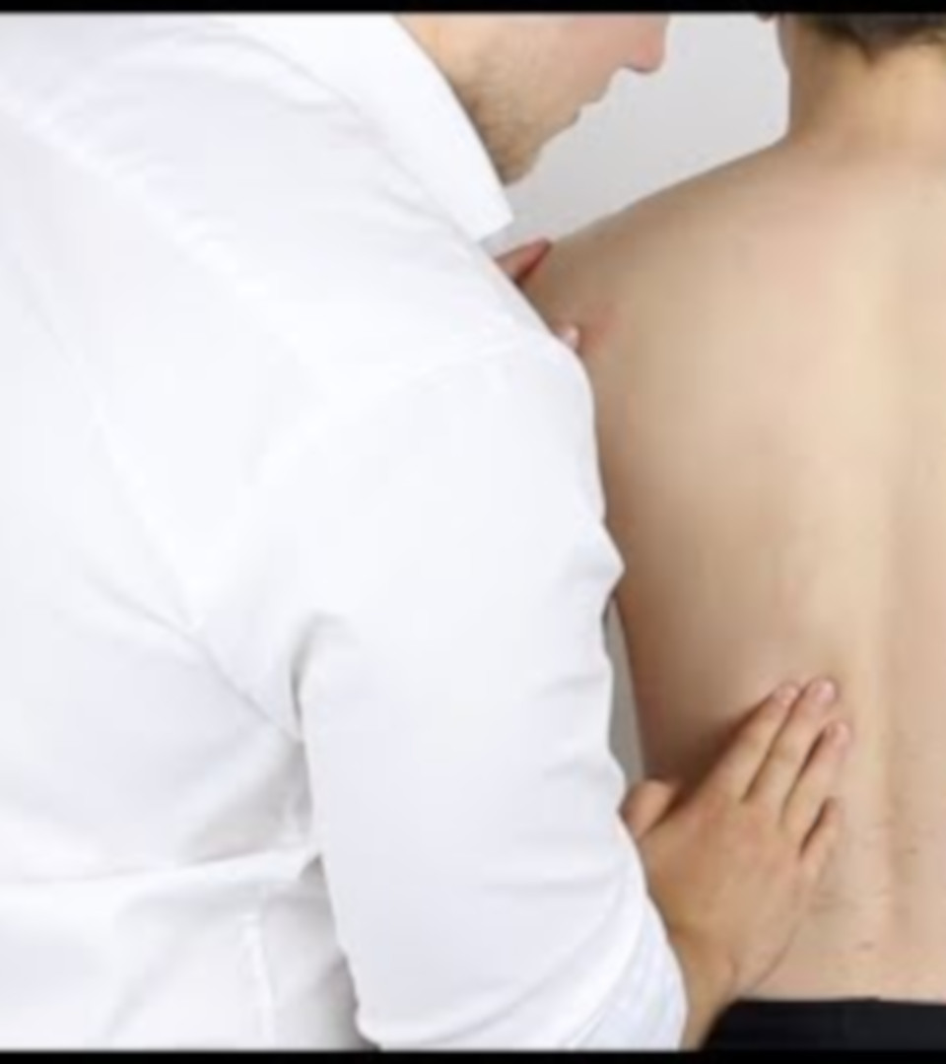
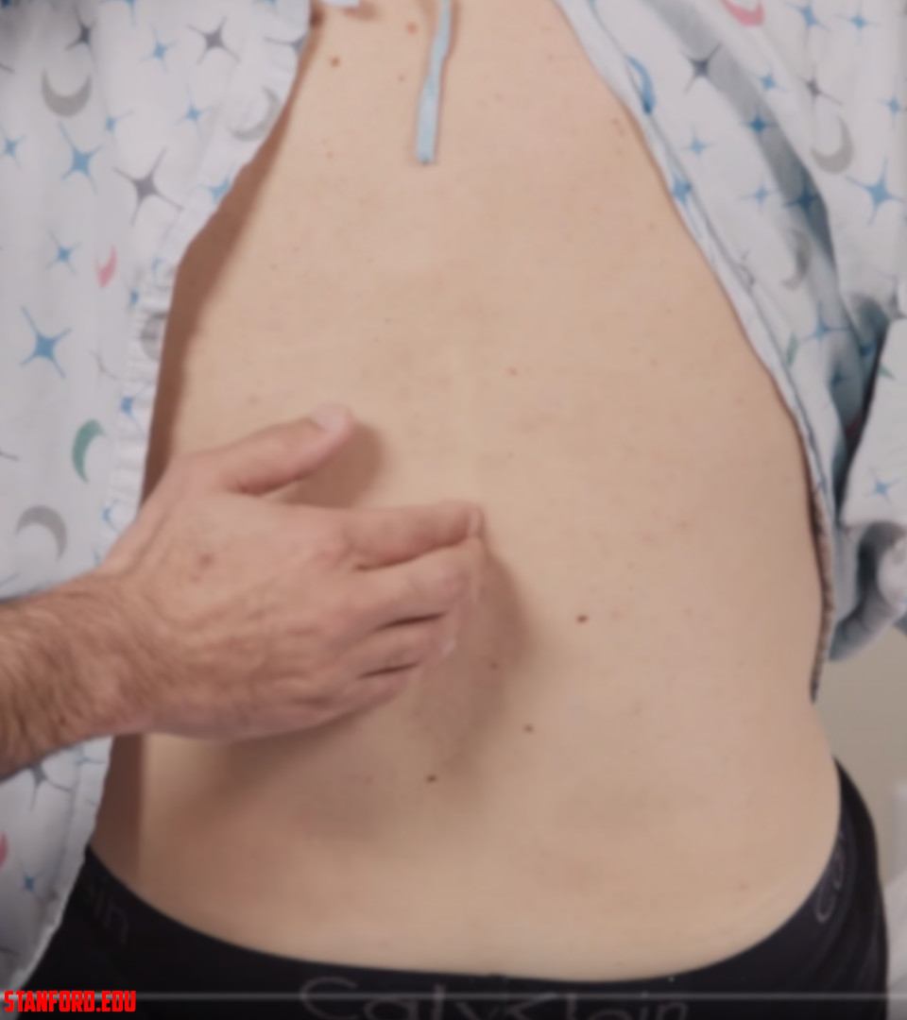

Slide 19
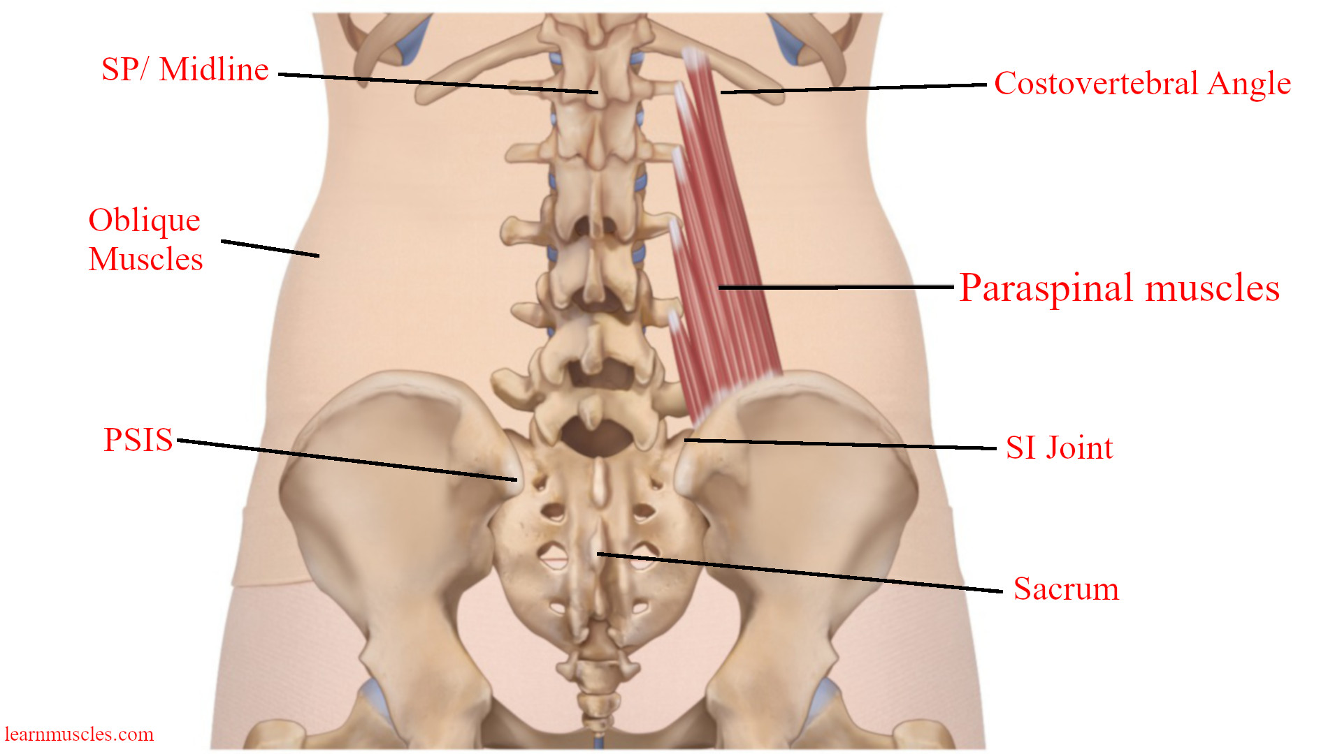
Notes:
Commentary: landmarks of note

Slide 20
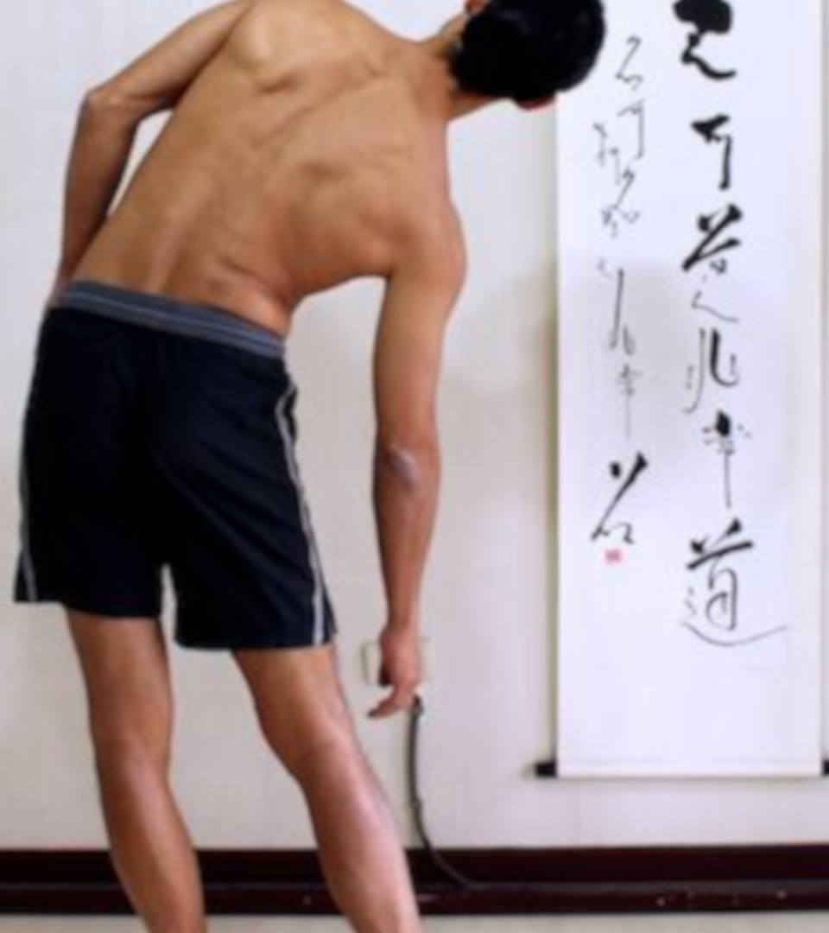
Range of motion
Thoracic
  Flexion: 80 ˚
  Extension: 30 ˚
Lumbar
  Flexion: 40-60 ˚
  Extension: 20-35 ˚
  Rotation: 45 ˚
  Lateral Flexion (sidebending): 25 ˚

Slide 21
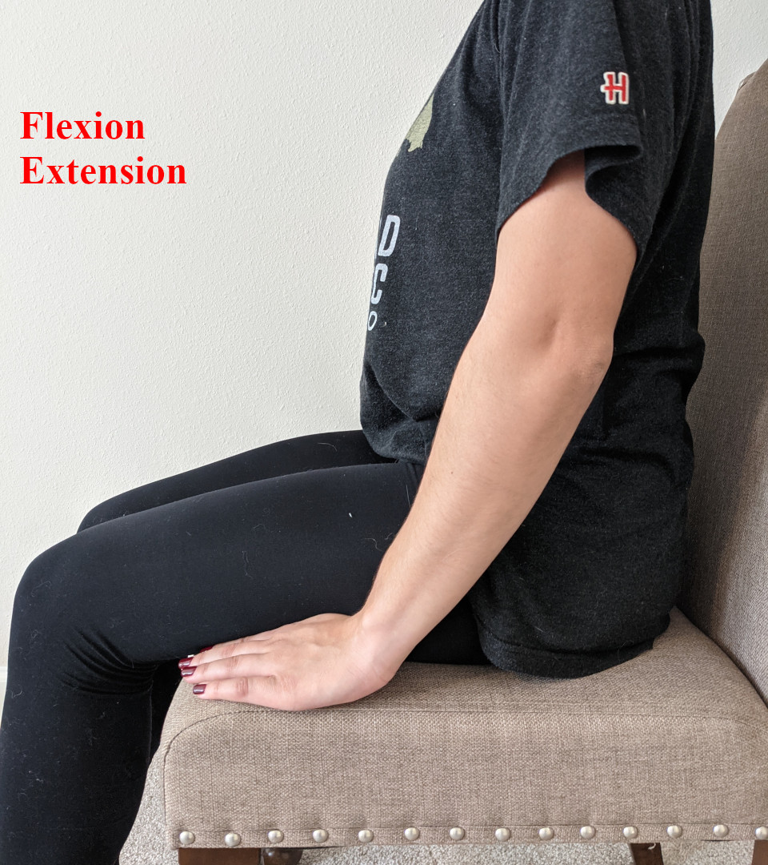
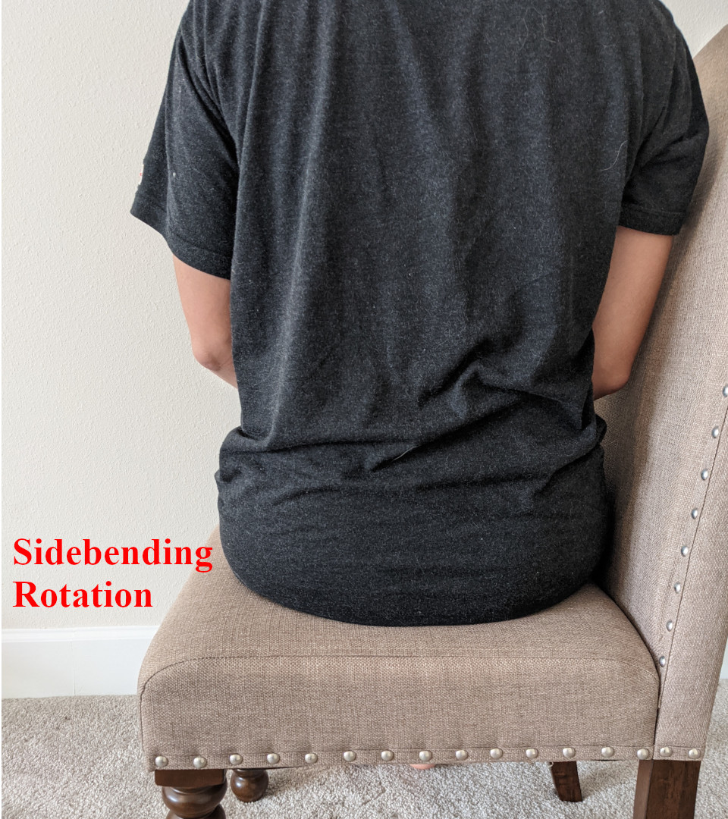

Slide 22
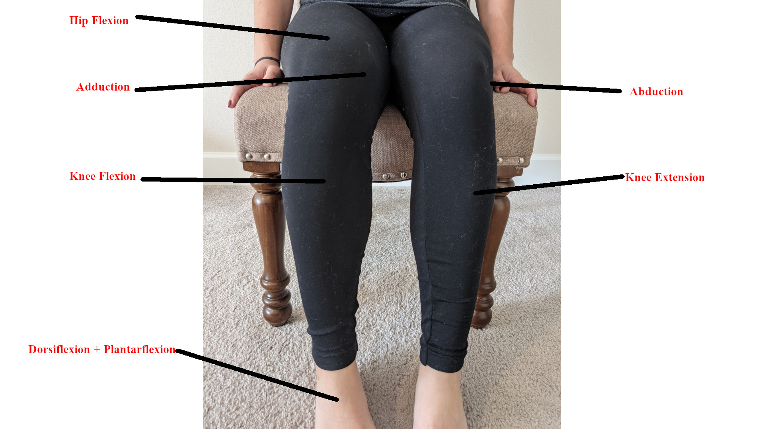
Notes:
Commentary: strength exam (not shown is hip extension)

Slide 23
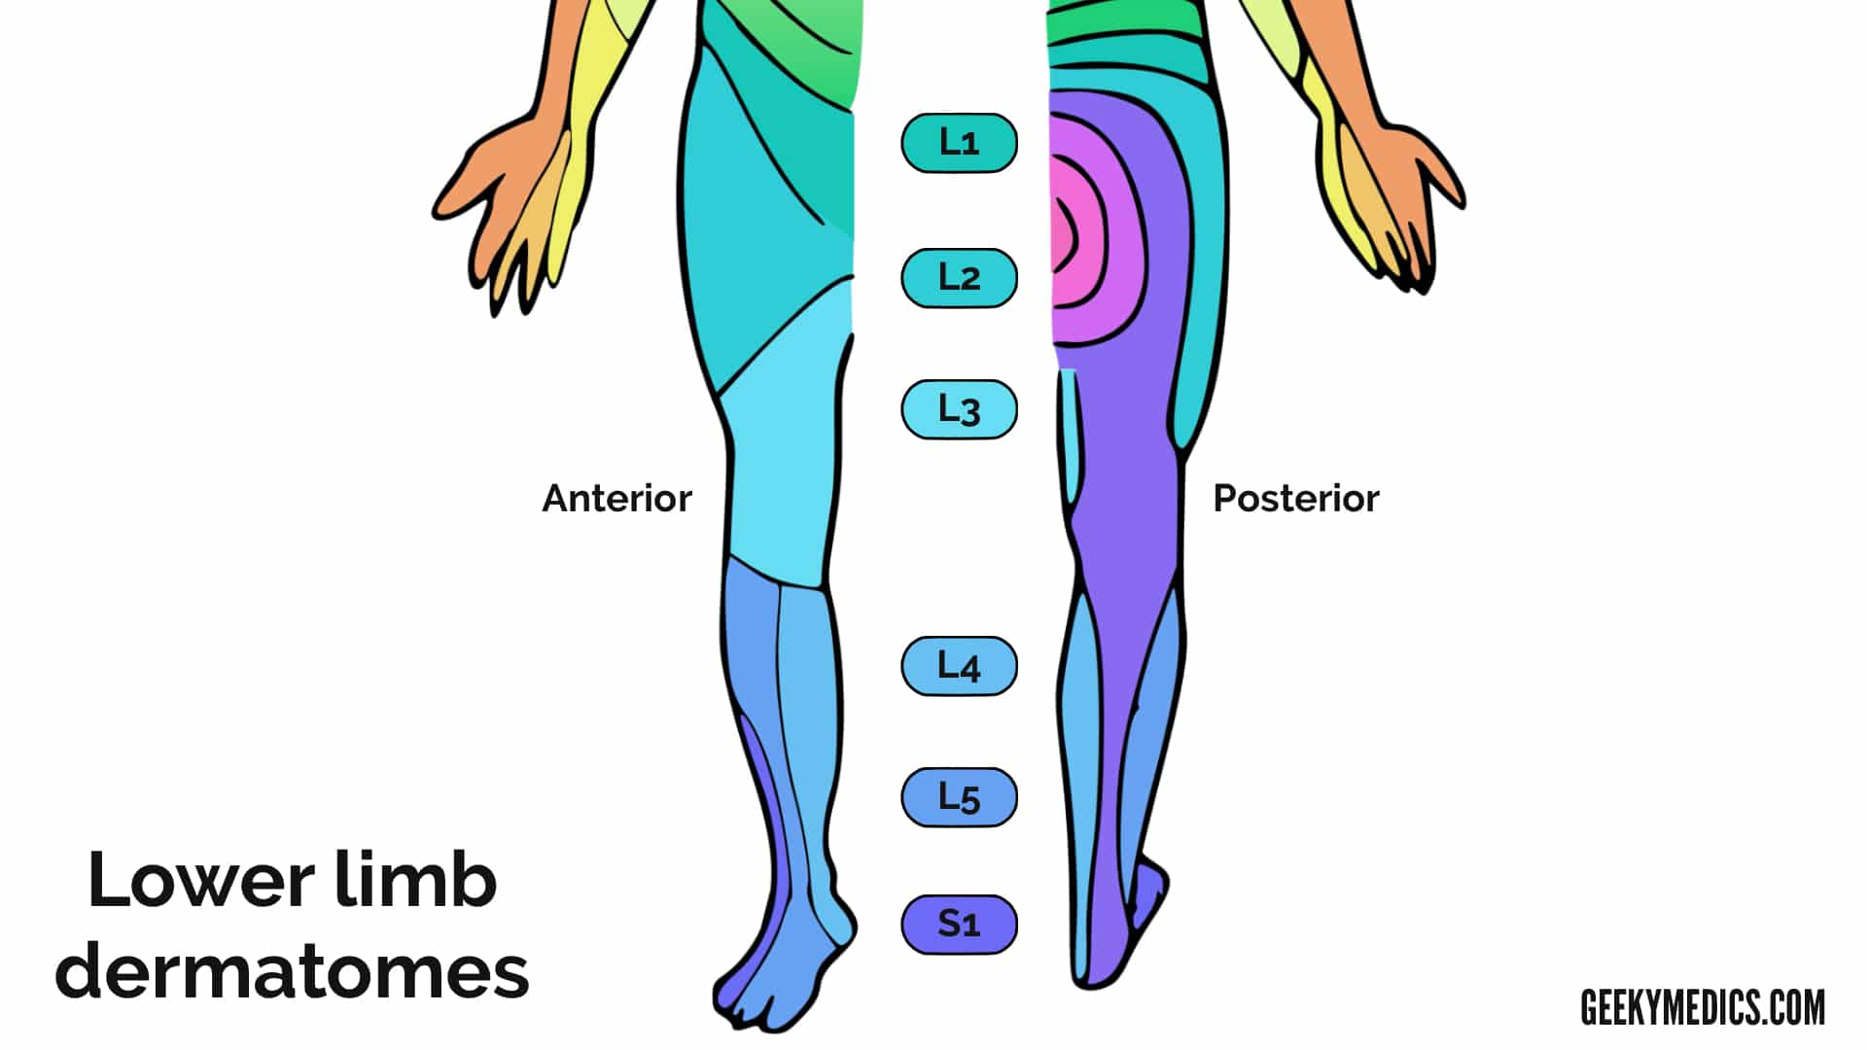
Notes:
Commentary: important to know a few, recommend L4 (crosses the knee), S1 (achilles)

Slide 24
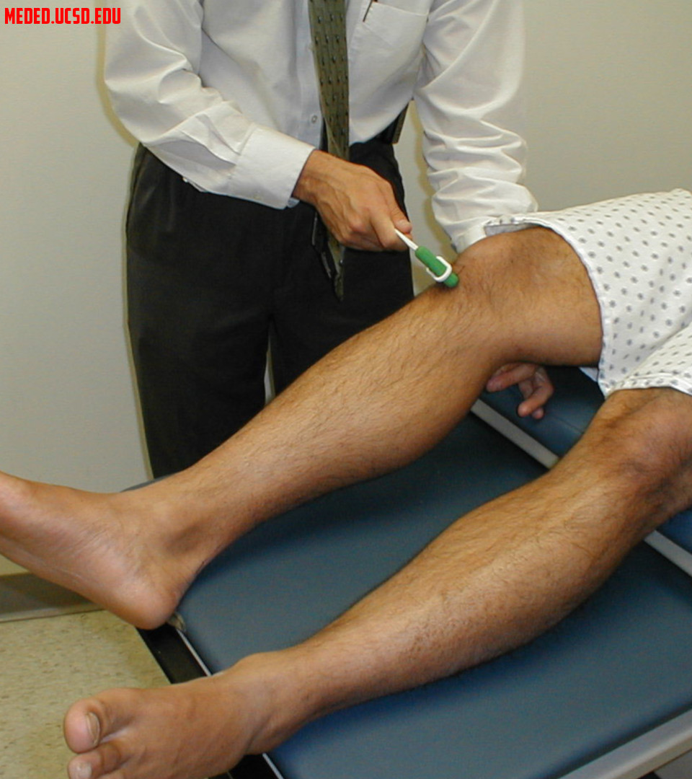
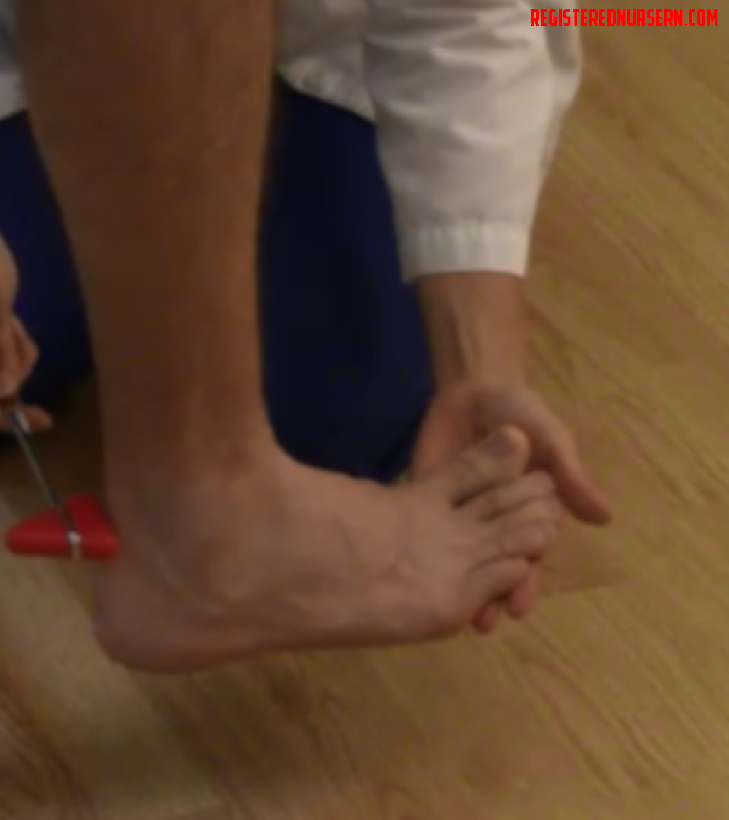
Notes:
Commentary: reflexes

Slide 25
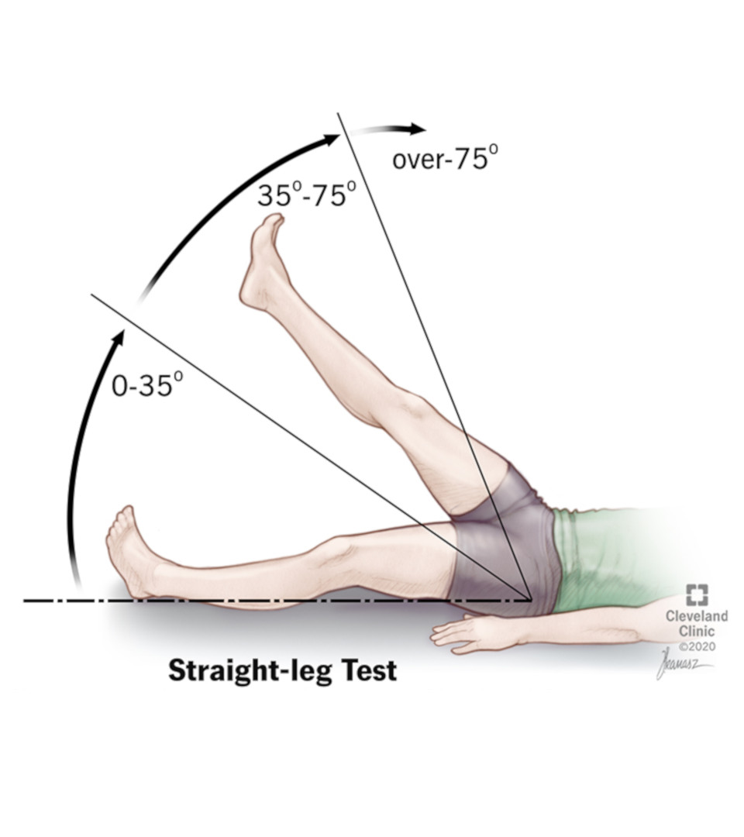
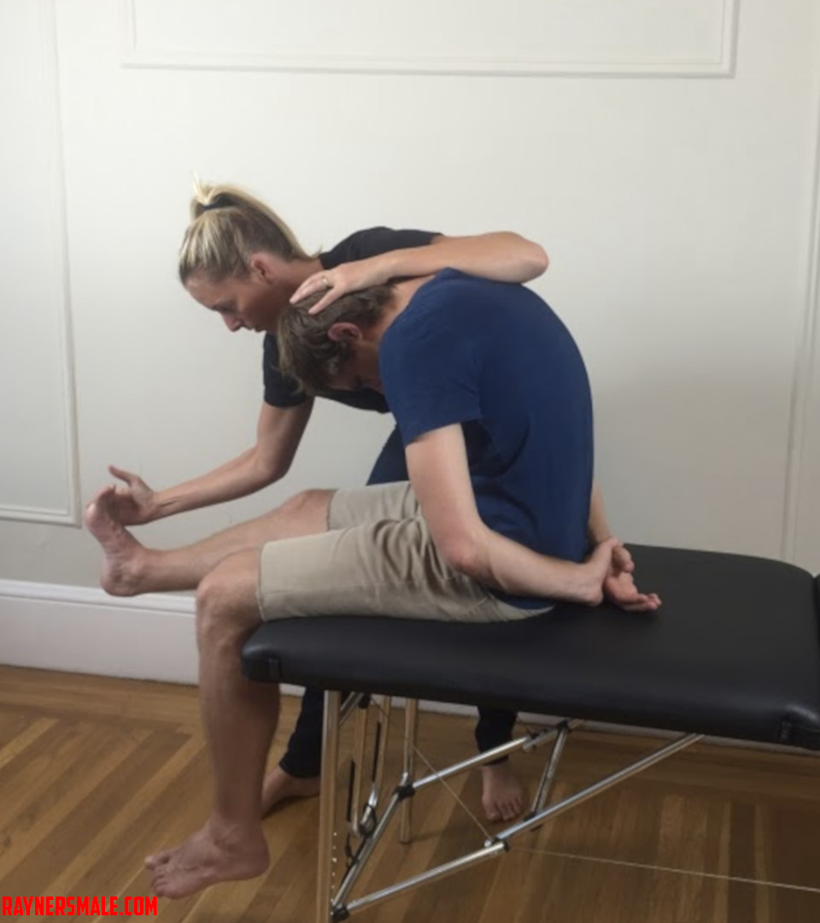
Notes:
Commentary: straight leg or seated straight leg (slump test) both useful to help with radicular back pain. Should be standard in back exam in anyone who can tolerate it.

Slide 26
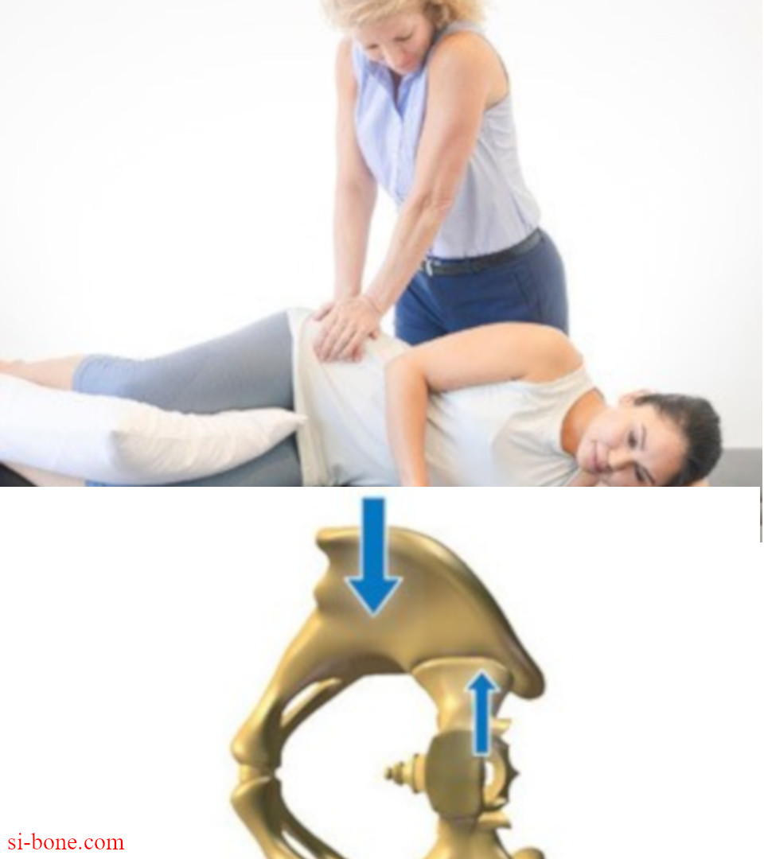
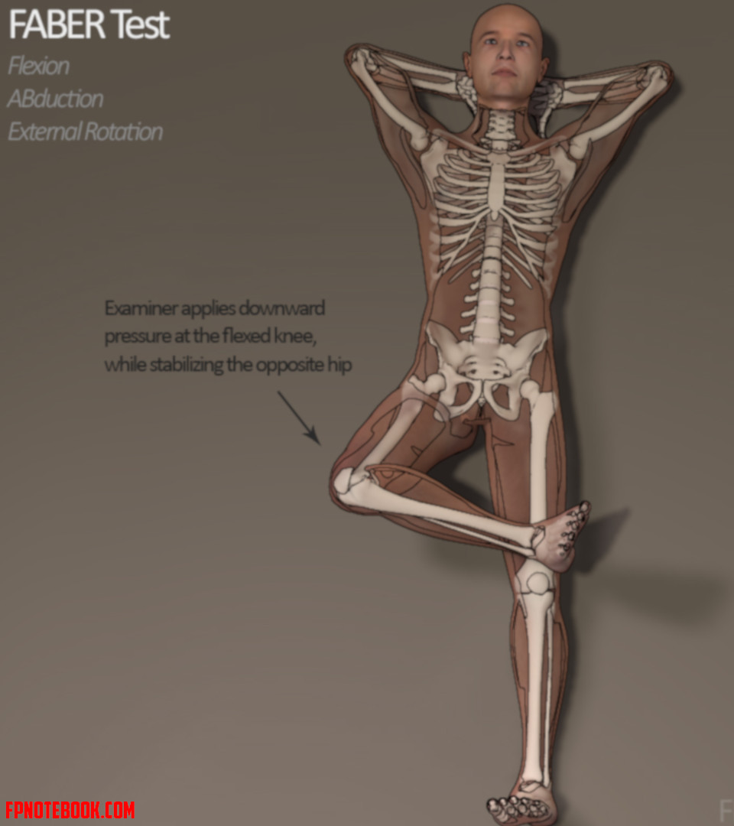
Notes:
Commentary: SI compression test (SI joint) and FABER

Slide 27
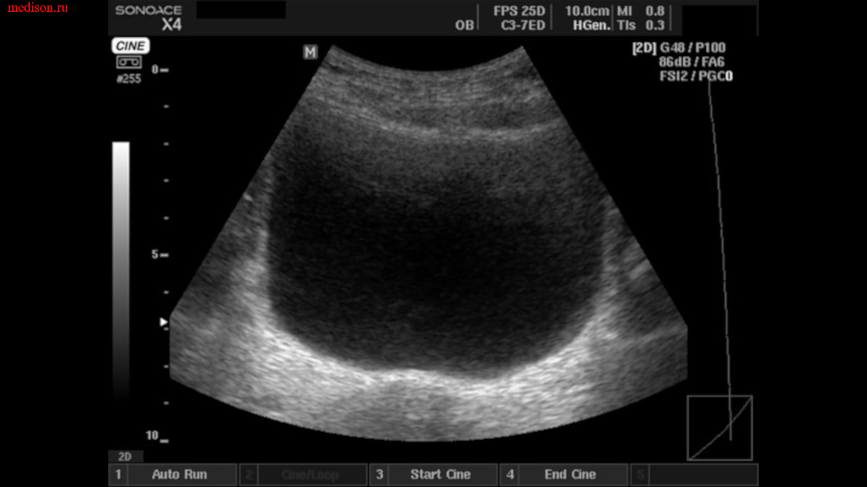
Notes:
Commentary: discuss importance of post void residual, because we do POCUS, I think of it as part of physical exam. Key if any concern about neurological involvement.

Slide 28
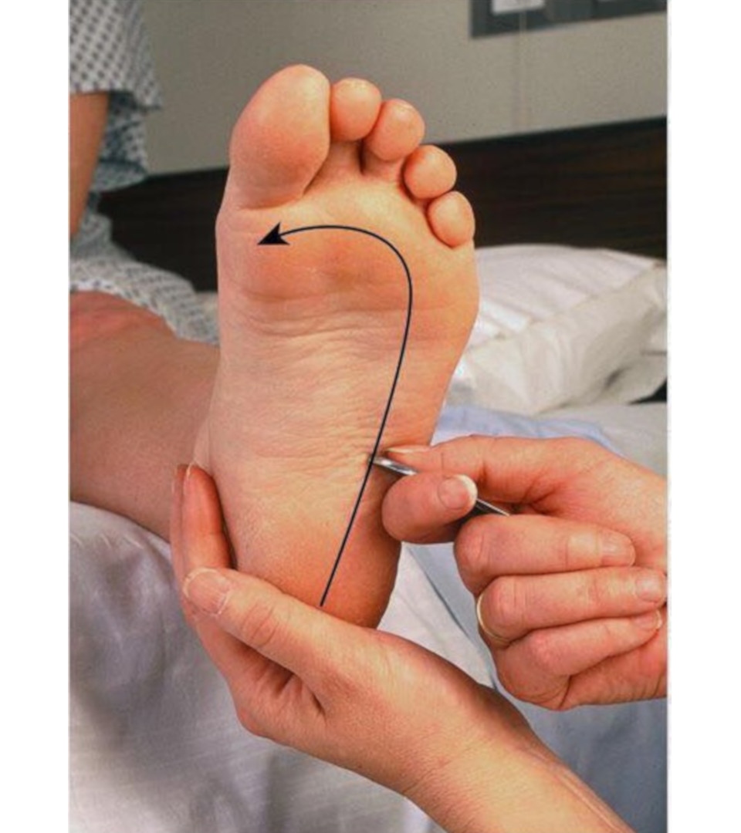
Bulbocavernous Reflex?
Rectal?
Notes:
Commentary: probably not worth getting into, but worth mentioning. Literature on rectal exam is not compelling in terms of sensitive or specificity

Slide 29
Wadells signs
Developed by wadell to predict patients likely to experience poor surgical outcome
  More recently used (misused) to identify non-organic or psychogenic back pain
Tenderness
  Superficial: ttp to light touch over a large area
  Nonanatomic: deep ttp over wide area, doesn’t localize, crosses anatomic boundaries
Simulation
  Axial load: light load over top of skulll skull causes lumbar pain
  Acetabular rotation: pain within first 30 degrees of rotation of shoulder and pelvis as patient stands
Distraction
  Straight Leg Raise: improved SLR test when patient distracted (for example in seated position)
Regional
  Weakness, cogwheeling, buckling of muscles that don’t follow anatomic/ neurologic basis
  Sensory disturbance that doesn’t follow dermatomes
Overreaction
  Exaggerated response to stimulus that is not reproduced when re-tested later
  Disproportionate verbalization, facial expression, muscle tension, tremor, collapsing, sweating
Notes:
Commentary: signs that help predict patients who will not do well surgically and likely have non-organic component of their symptoms.

Slide 30
radiology

Slide 31
Indications
ACEP Choosing wisely/ ACR Appropriateness Criteria for LBP Imaging (category B recommendation)
  Serious concerns
  History of trauma
  Presence of red flags
Harms of imaging
  Increased cost, radiation exposure (Lspine XR exposure 75x that CXR), resource utilization, ED LOS
  Subsequent office visits and testing, increased procedures (Jarvik 2003)
If none of the above present, no imaging indicated for 6 weeks of medical management, physical therapy
In general after 6 weeks
  XR: screening tool
  CT: fracture suspected or identified on XR
  MRI: persistent radicular symptoms, progressive neuro deficits or red flags

Slide 32
Imaging pearls
General
  Approximately 1/3 of patients presenting to ED with LBP get imaging (32% XR, 2.5% CT, <1% MR) (Pakpoor 2019)
  Asymptomatic patients >60 MR: 36% herniated disc, 21% spinal stenosis, 90% degen/ bulging disc (Boden 1990)
  Early imaging: worse overall outcomes and likely to identify minor, clinically irrelevant abnormalities (Patel 2016)
  No difference among patients between XR, MR and CT at 3, 6 and 12 months in the absence of red flags (Chou 2009)
  The presence of low back pain with radicular features is not an indication for early imaging (Chou 2012)
Jarvik et al (2003): Compared early MRI to standard radiographs
  Both modalities resulted in nearly identical outcomes for PCP patients with LBP
  No benefit to early MRI, increased cost of care due to increased number of spine procedures
Henschke et al (2009): surveyed 1,172 LBP patients with 25 red flag questions
  80% (942/1172) had at least one red flag
  0.9% (11/1172) had serious disease
Initial XR vs CT?

Slide 33
Red flags
Neurological
  Saddle anesthesia
  Bowel or bladder dysfunction
B symptoms
  Unexplained weight loss
  Fevers, chills
  Night sweats
History of violent trauma
History of cancer or immunocompromised state
Absence of relief after 6 weeks of treatment
History of IV drug use
Age? Osteoporosis?
Adopted from Downie 2013

Slide 34
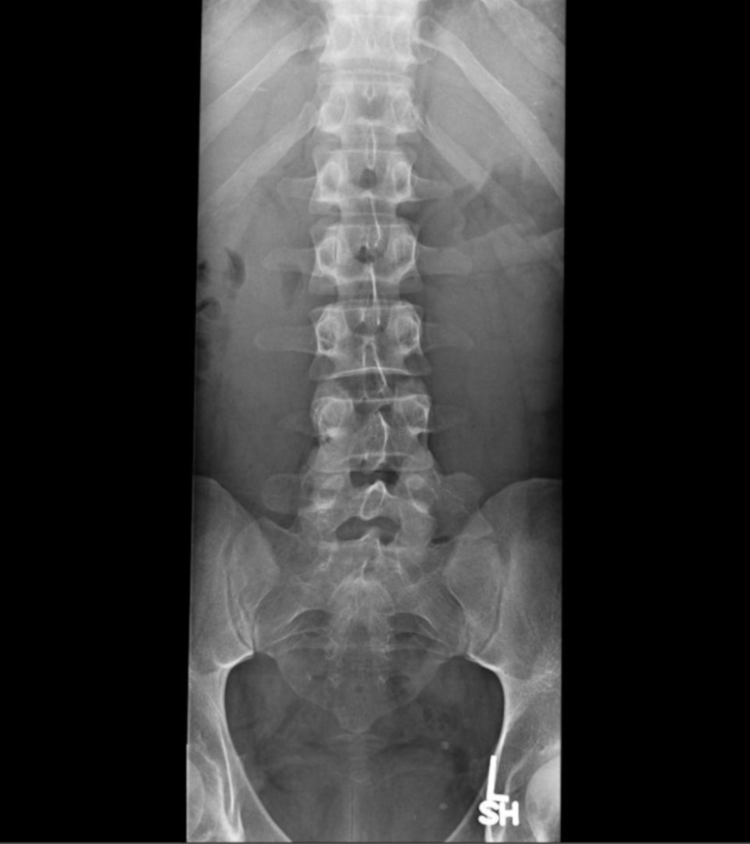
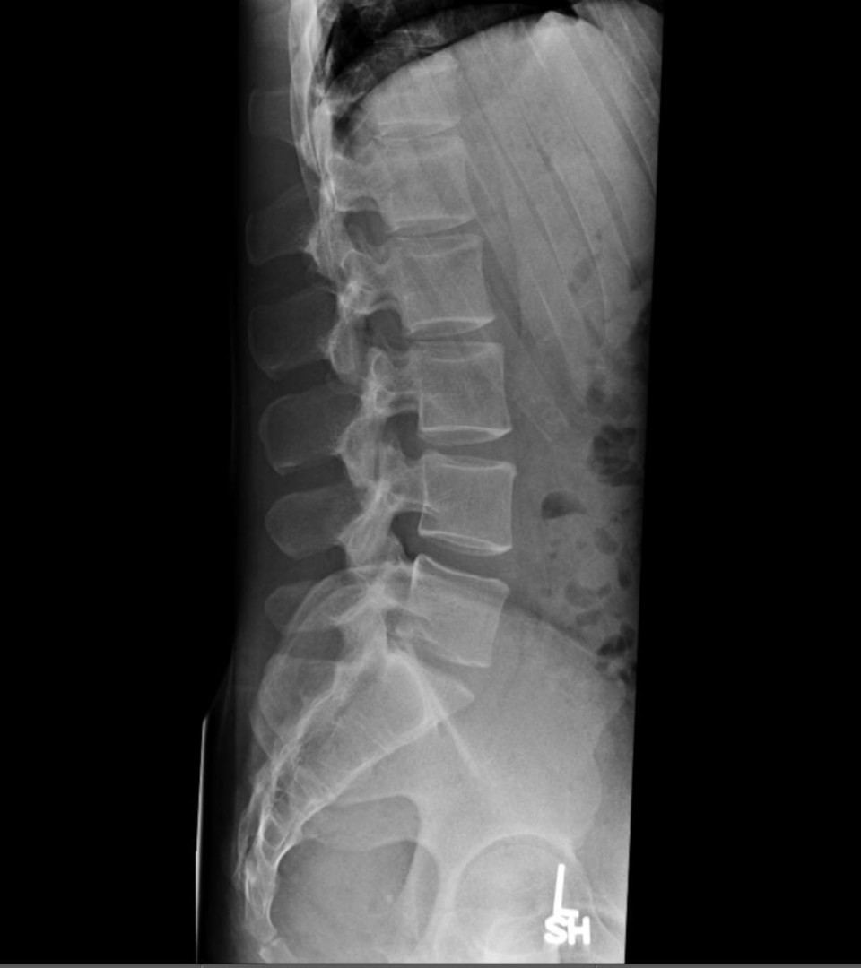
Notes:
Commentary: normal unlabeled

Slide 35
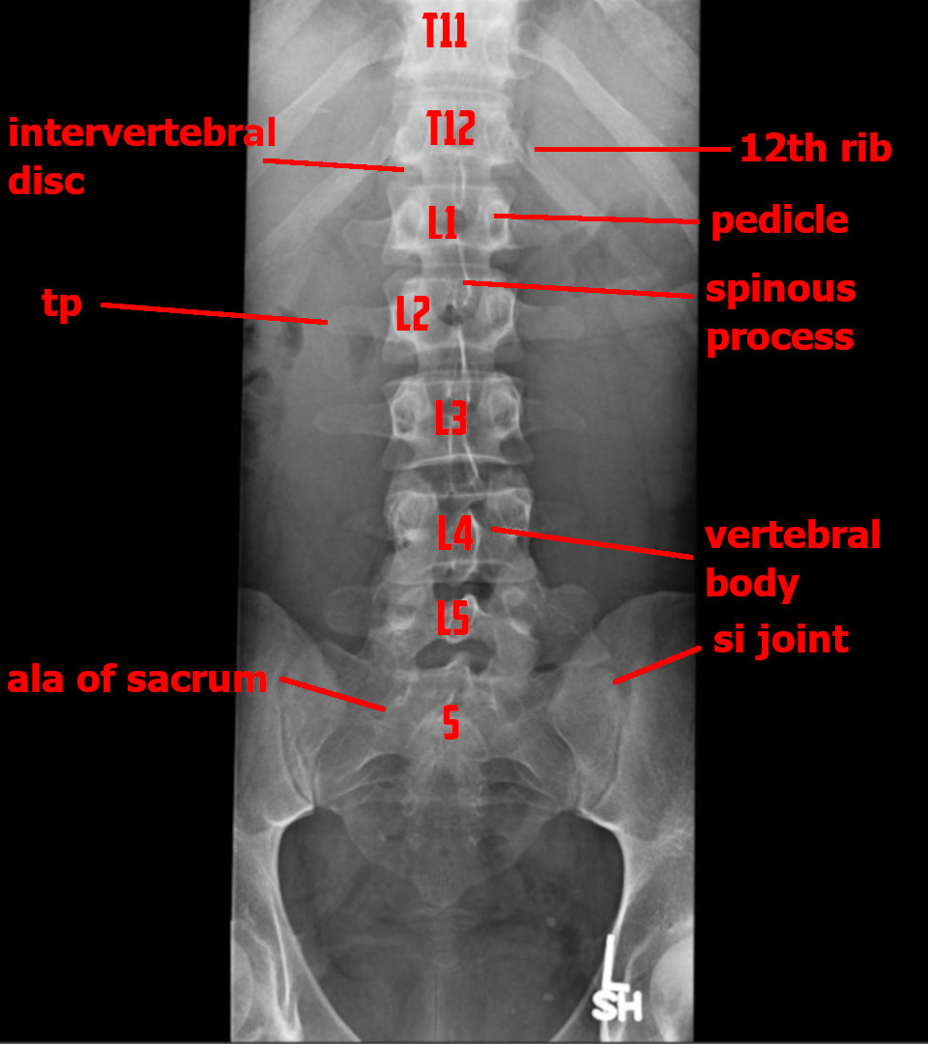
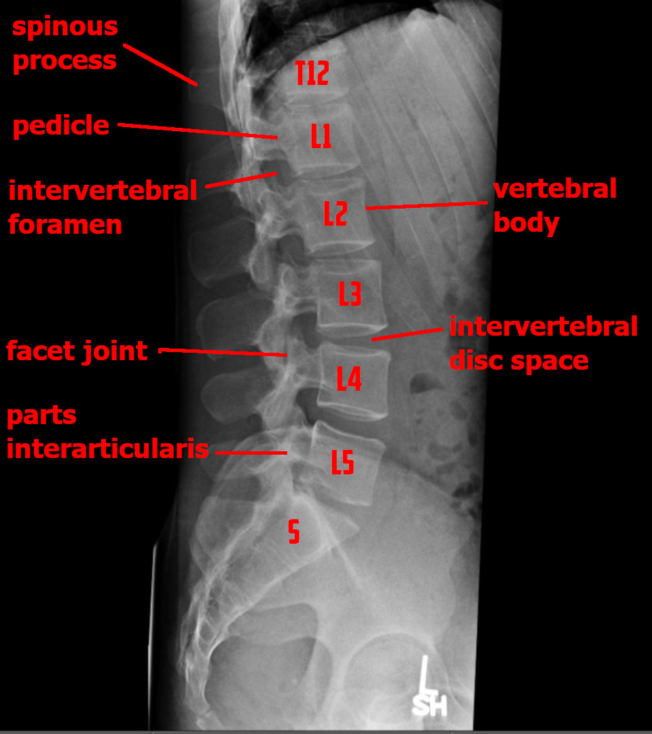
Notes:
Commentary: normal labeled

Slide 36
yellow flags
Predict poor response to basic treatment
  Maladaptive beliefs
  Poor sleep
  Mood disorder
  Job dissatisfaction
  Poor social support
  Compensation and/or litigation issues
  Kinesiophobia
Adopted from Airaksinen 2006
Notes:
Commentary: important to consider for decision making in ED and in follow up

Slide 37
Differential diagnosis

Slide 38
DDx - atraumatic
Musculoskeletal
  Acute muscle strain
  Disk herniation (Sciatica)
  Degenerative joint disease
  Spondylolithesis
  Spondylolisthesis
  Spinal stenosis
Epidural compression syndromes
  Spinal cord compression (non-traumatic)
  Cauda equina syndrome
  Conus medullaris syndrome
  Epidural hematoma (spinal)
Inflammatory/ Autoimmune
  Ankylosing spondylitis
Infectious
  Discitis
  Vertebral osteomyelitis
  Epidural abscess (spinal)
Other
  Cancer metastasis
  Transverse myelitis
  Non-organic low back pain- waddell sign

Slide 39
Differential diagnosis (non-msk)
Renal disease (Kidney stone, Pyelonephritis, Nephrolithiasis)
Intra-abdominal (AAA, PUD, Dissection, Retrocecal appendicitis, LBO, Pancreatitis)
Pelvic disease (PID)
Other (Retroperitoneal hemorrhage/mass, Meningitis)
Notes:
Commentary: important to remember, not covered in lecture

Slide 40
atraumatic

Slide 41
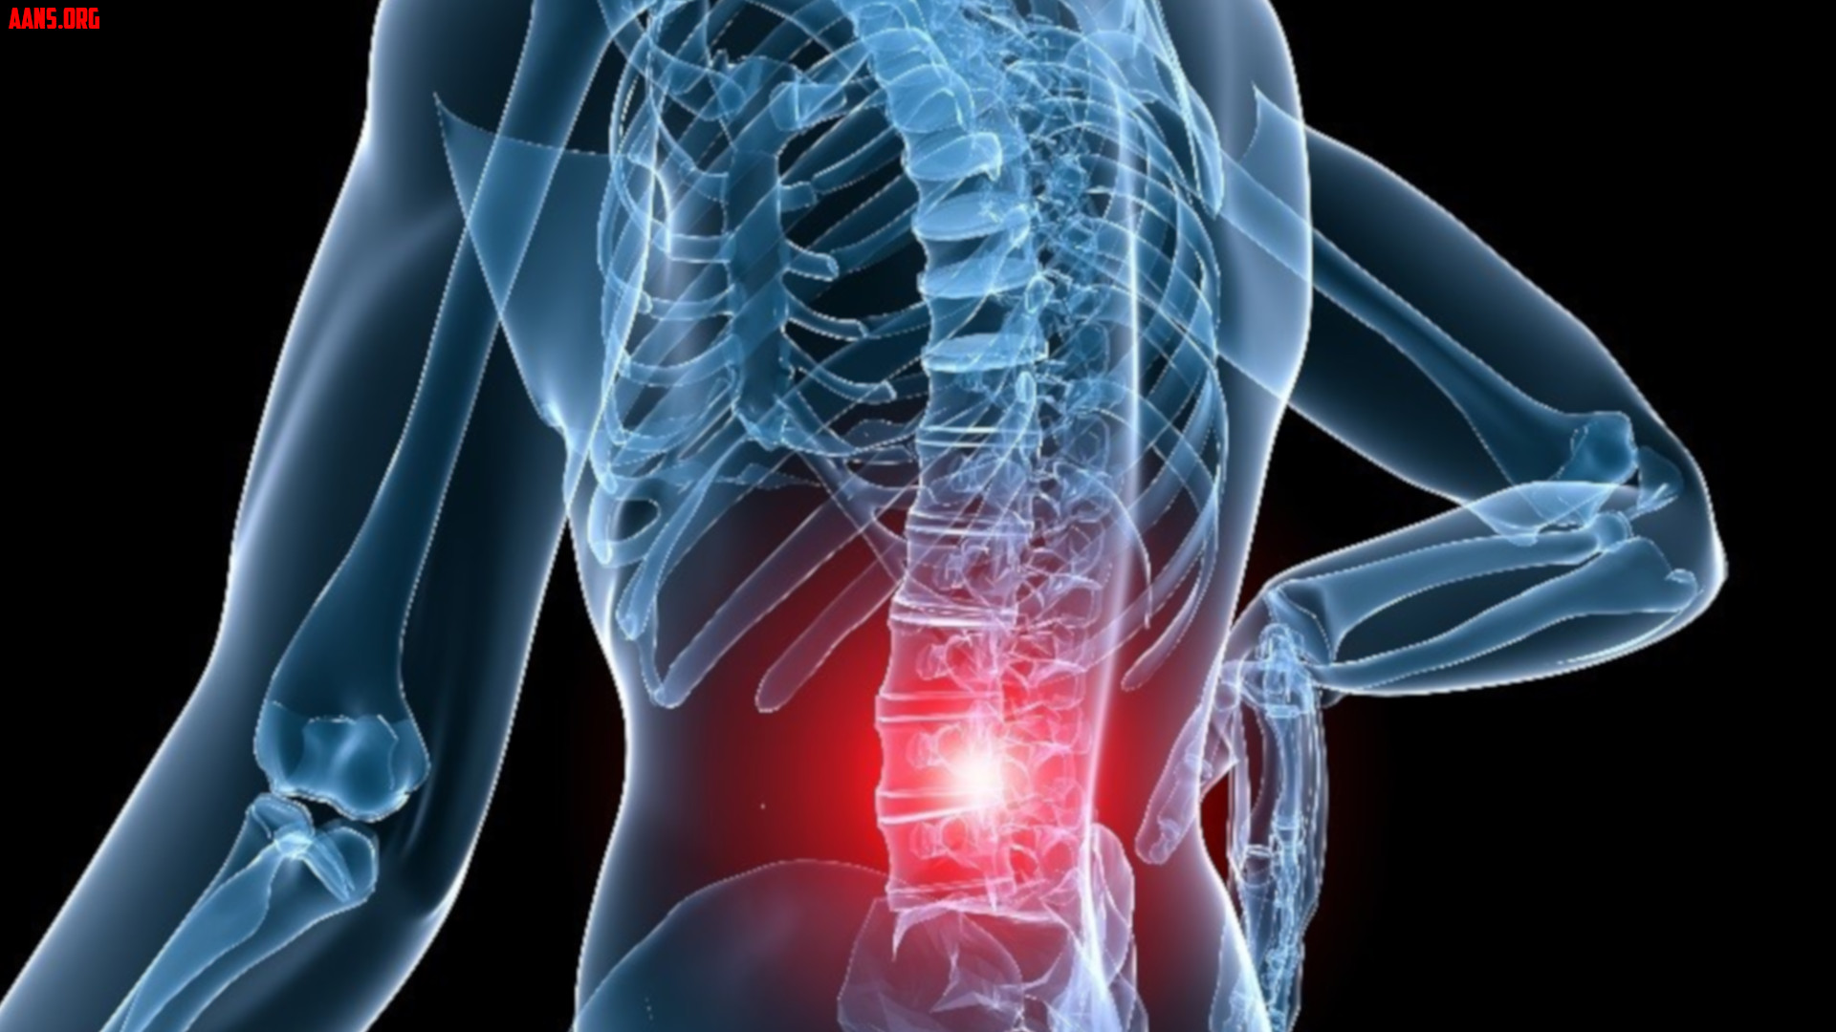
Notes:
Commentary: discuss non specific atraumatic back pain. Call it “mechanical back pain” when there is no obvious or known lesion. Represents most back pain in young and middle age adults. Exam is not impressive, maybe myofascial pain, patients get better with conservative therapy

Slide 42
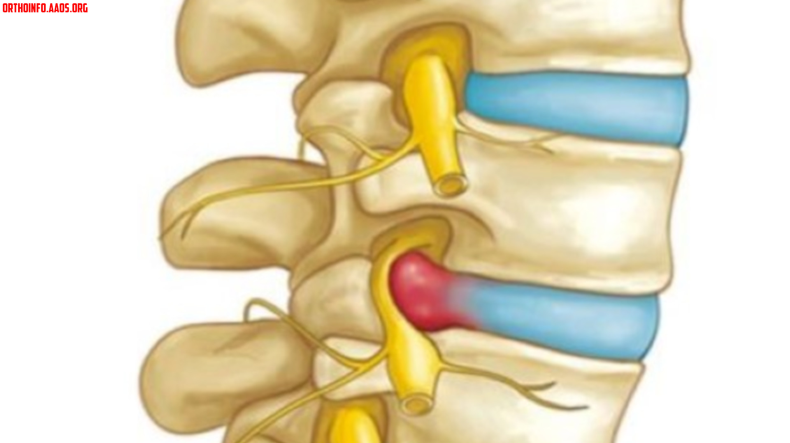
Notes:
Commentary: herniated nucleus pulposis, can cause radicular back pain.

Slide 43
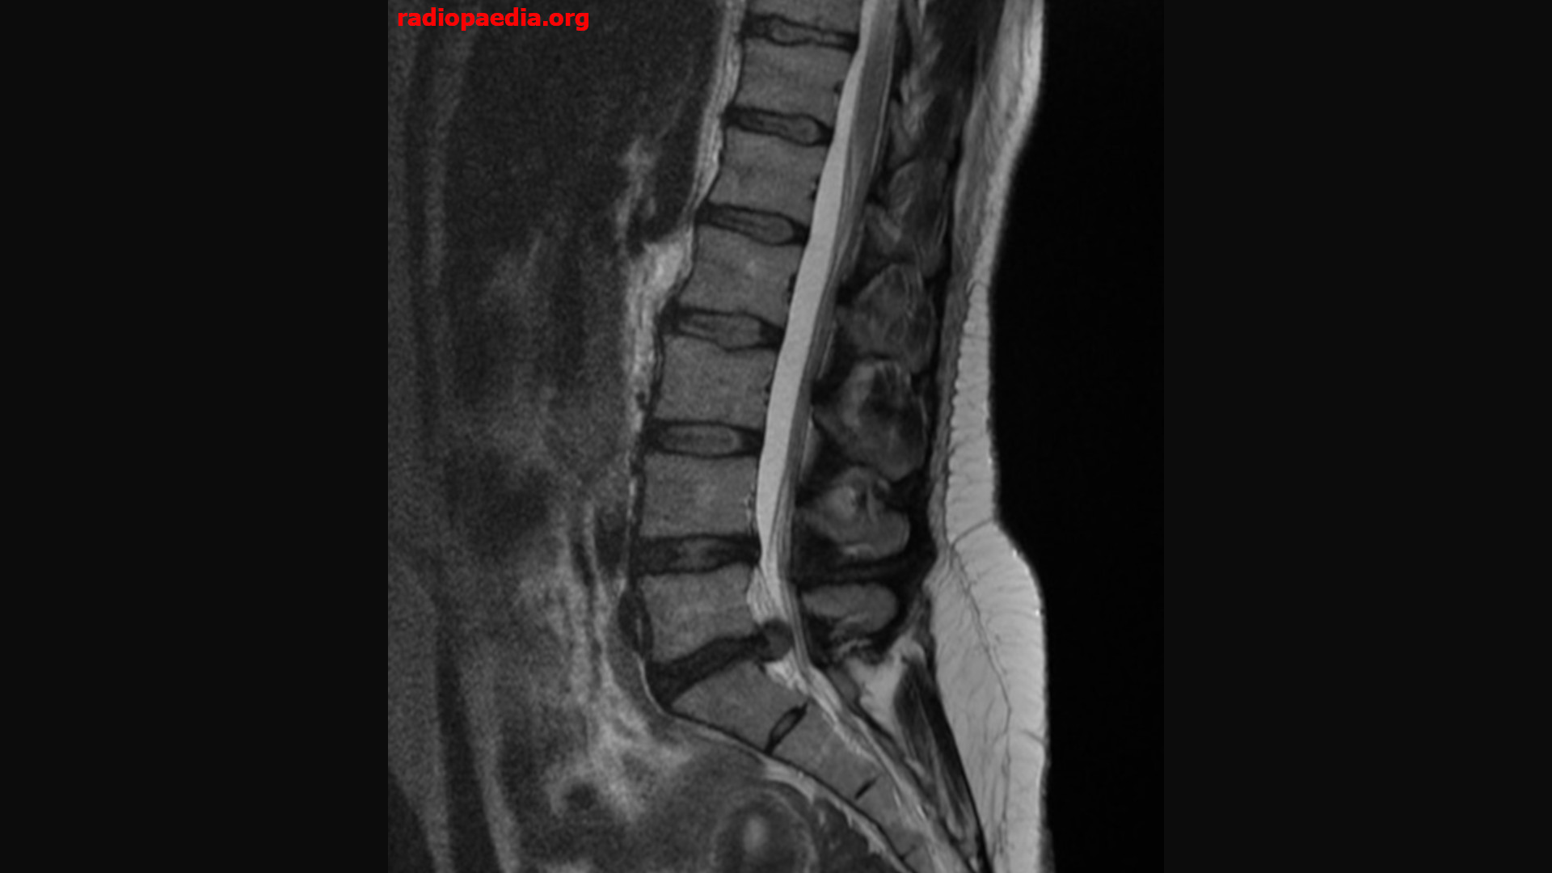
Notes:
Commentary: MRI of what a herniated disc can look like

Slide 44
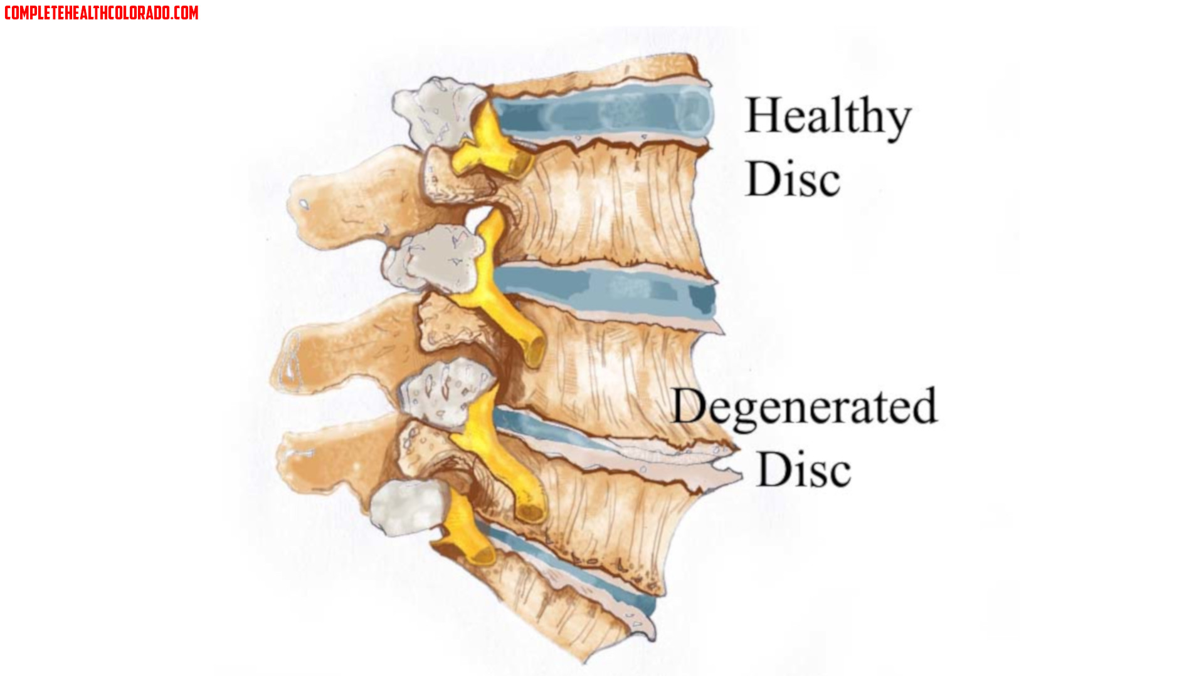
Notes:
Commentary: DDD is arthritis of the spin, insidious, everyone has it, not everyone gets symptoms. Conservative therapy until it fails then can discuss surgical options.

Slide 45
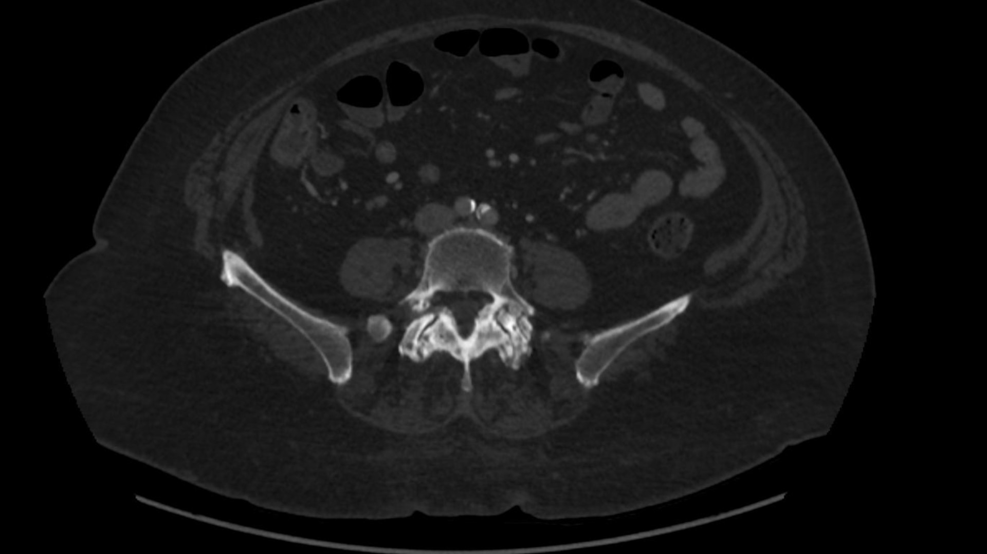
Notes:
Commentary: facet joint arthropathy on axial CT

Slide 46
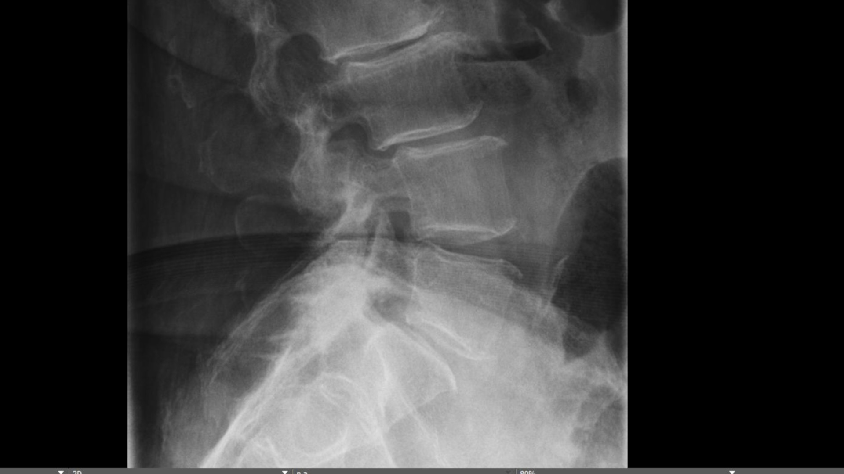
Notes:
Commentary: facet joint arthropathy, also see DDD, mild spondylolisthesis

Slide 47
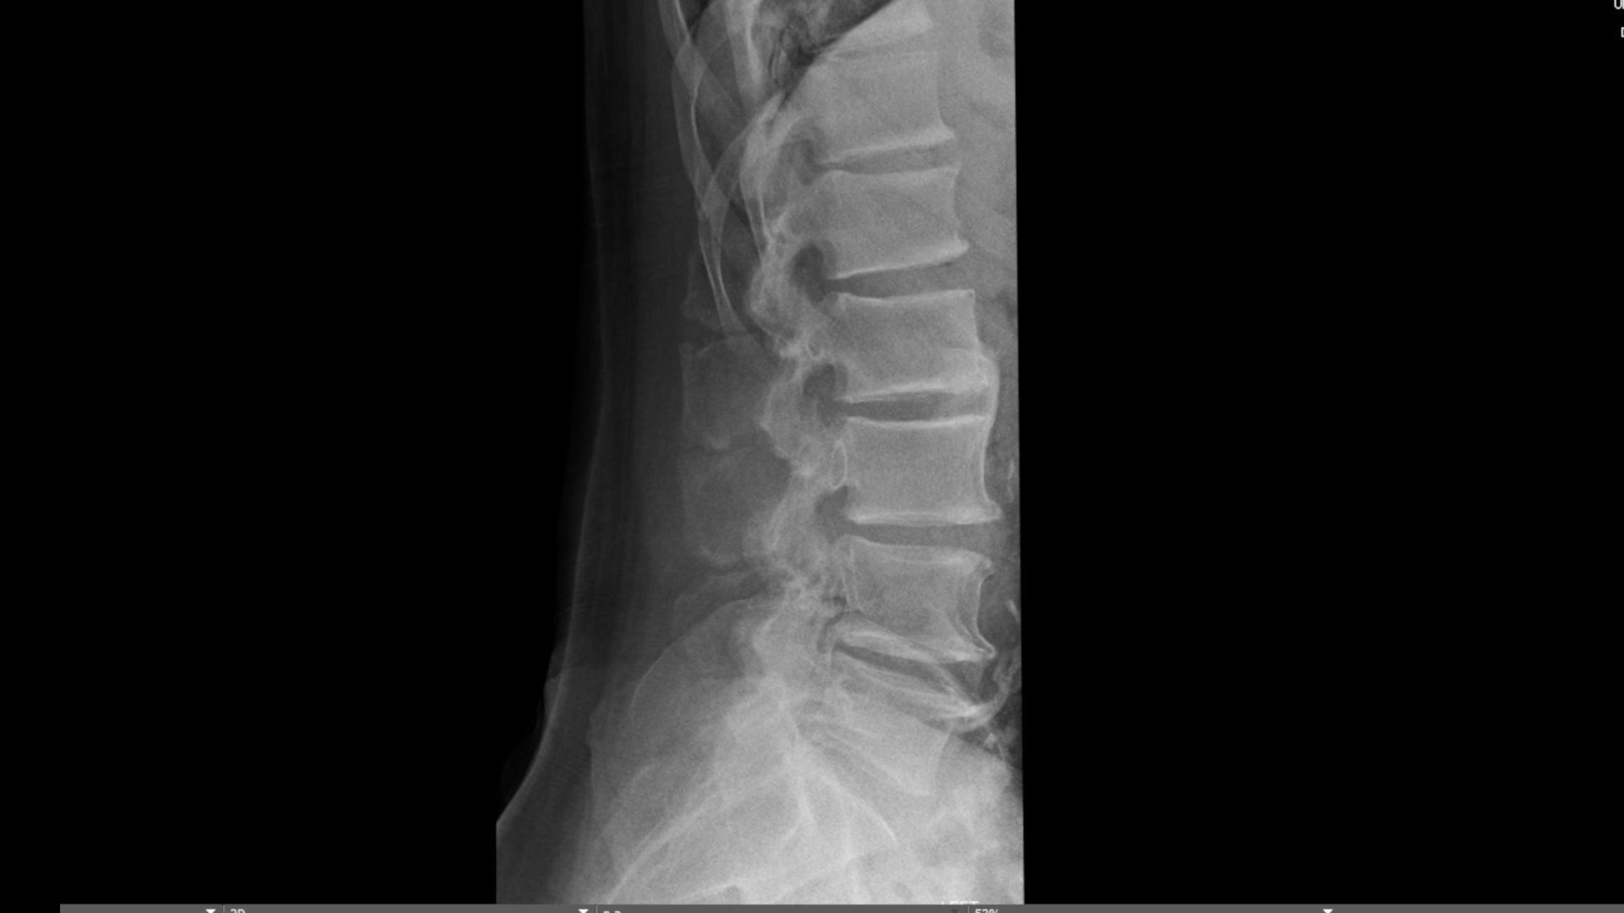
Notes:
Commentary: facet arthropathy worth discussing because its a common cause of back pain. Small joints, get OA. Harder to deal with than large joints. Can see on XR, also noted here is DDD OA with scalloping of the disc space

Slide 48
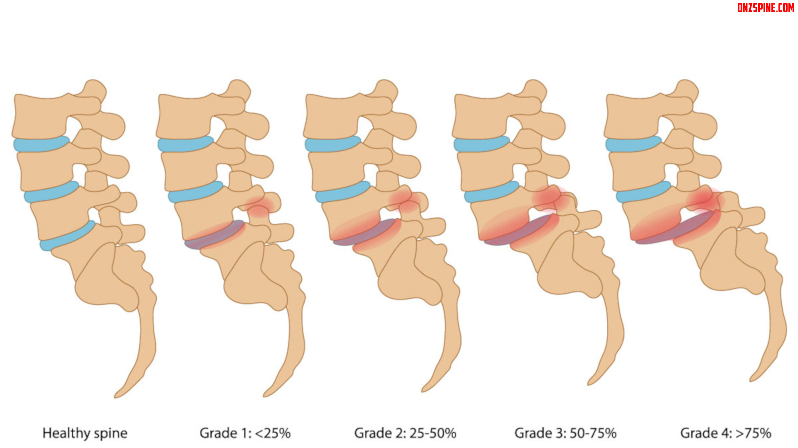
Notes:
Commentary: spondylolisthesis

Slide 49
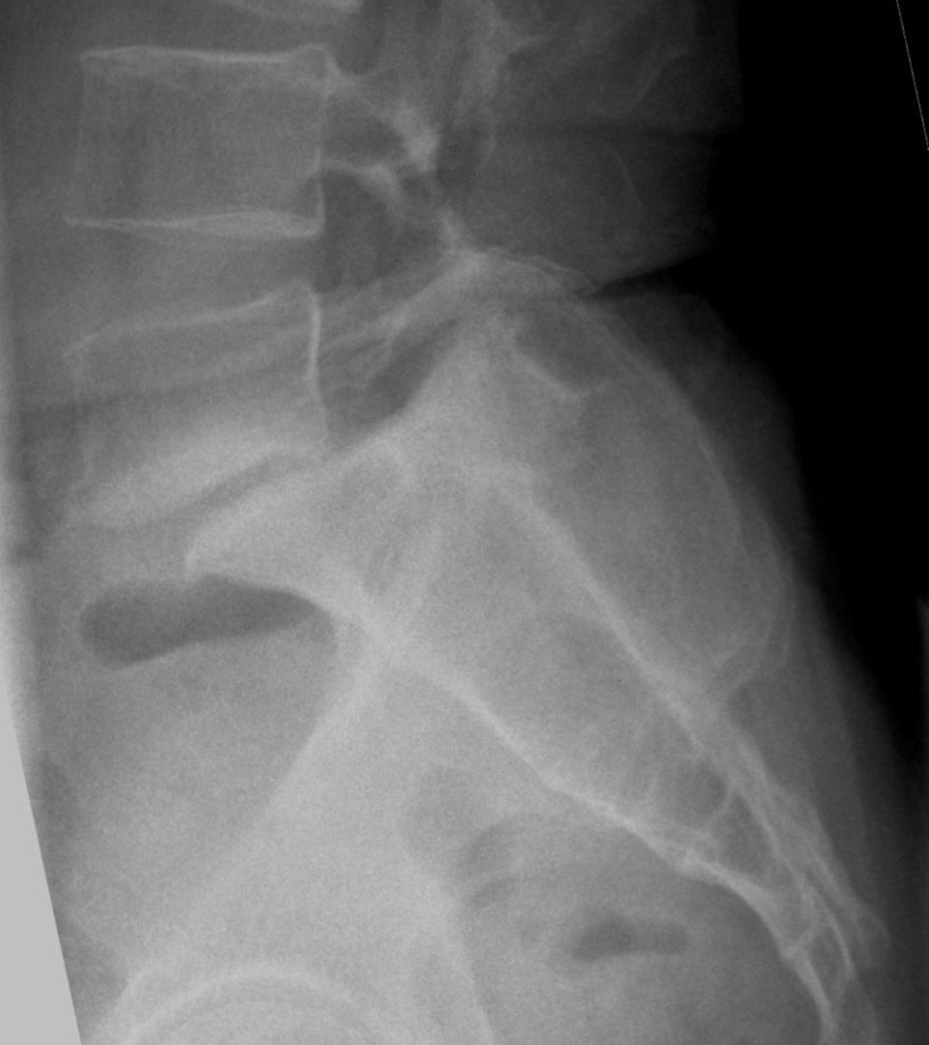
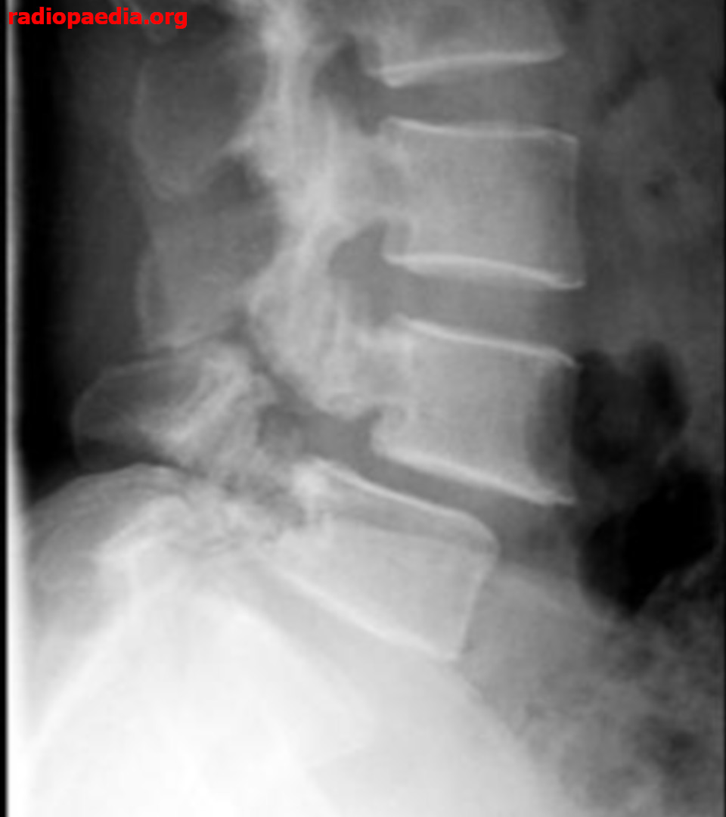
Notes:
Commentary: spondylolisthesis on XR. Symptoms don’t always correlate with grade, but can suggest degree of instability, likelihood of neurological involvement. Also note scotty dog fracture on the right

Slide 50
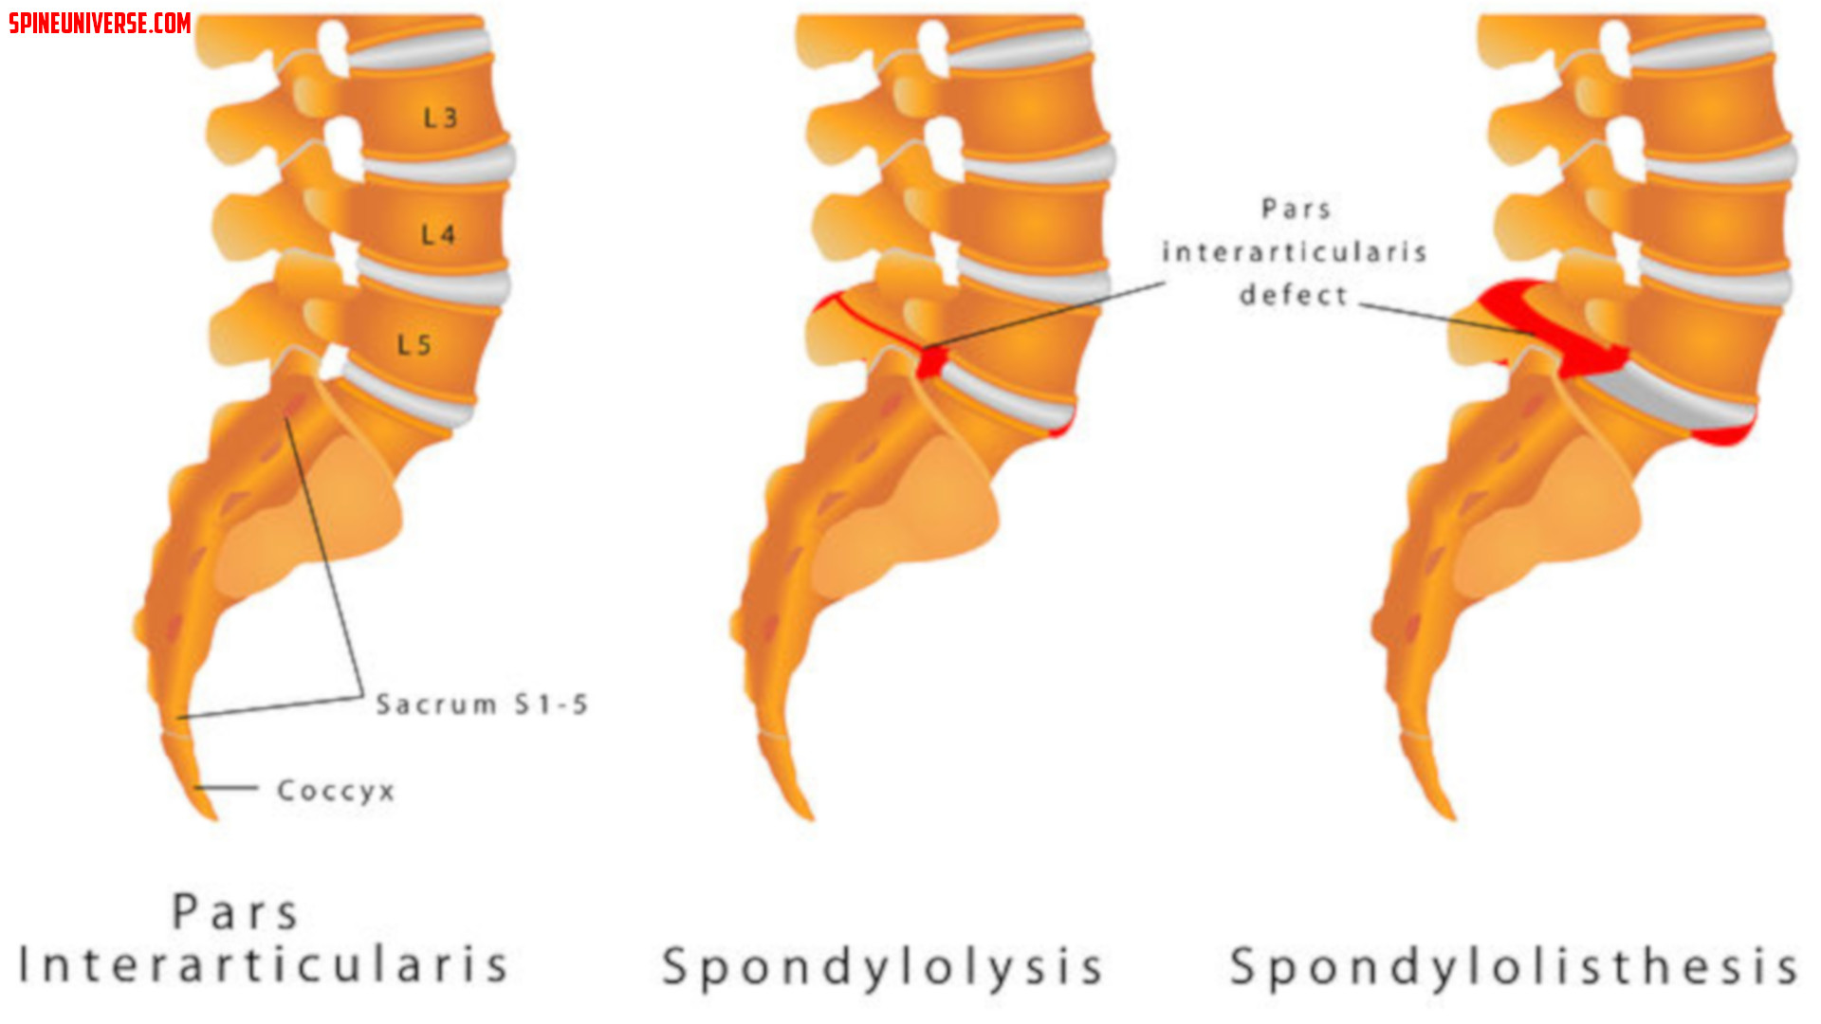
Notes:
Commentary: spondylolysis of the pars which can cause spondylolisthesis. Note that the spondy is usually subacute, bilateral in people with repetitive back action. Think movers, laborers, athletes who do back extension (dancers, gymnists, pitchers, etc)

Slide 51
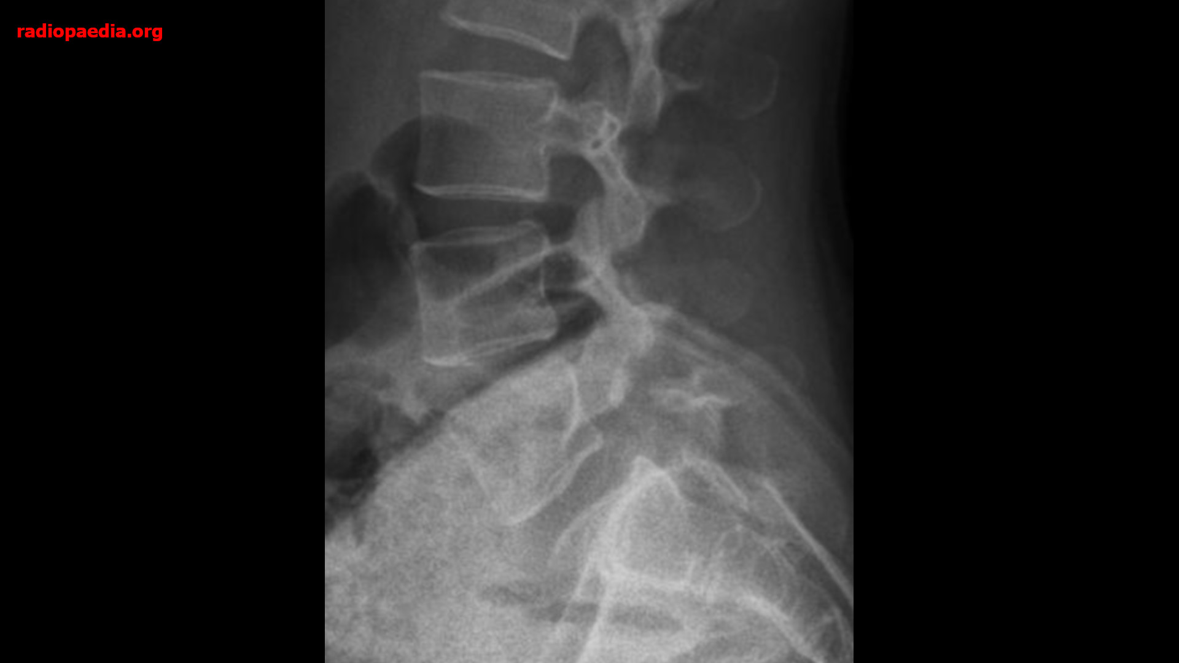

Slide 52
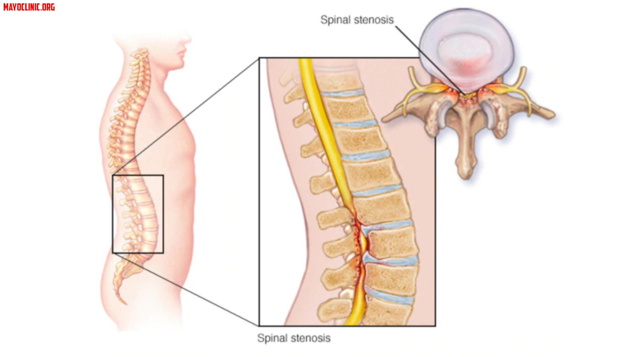
Notes:
Commentary: spinal stenosis, usually degenerative, progressive

Slide 53
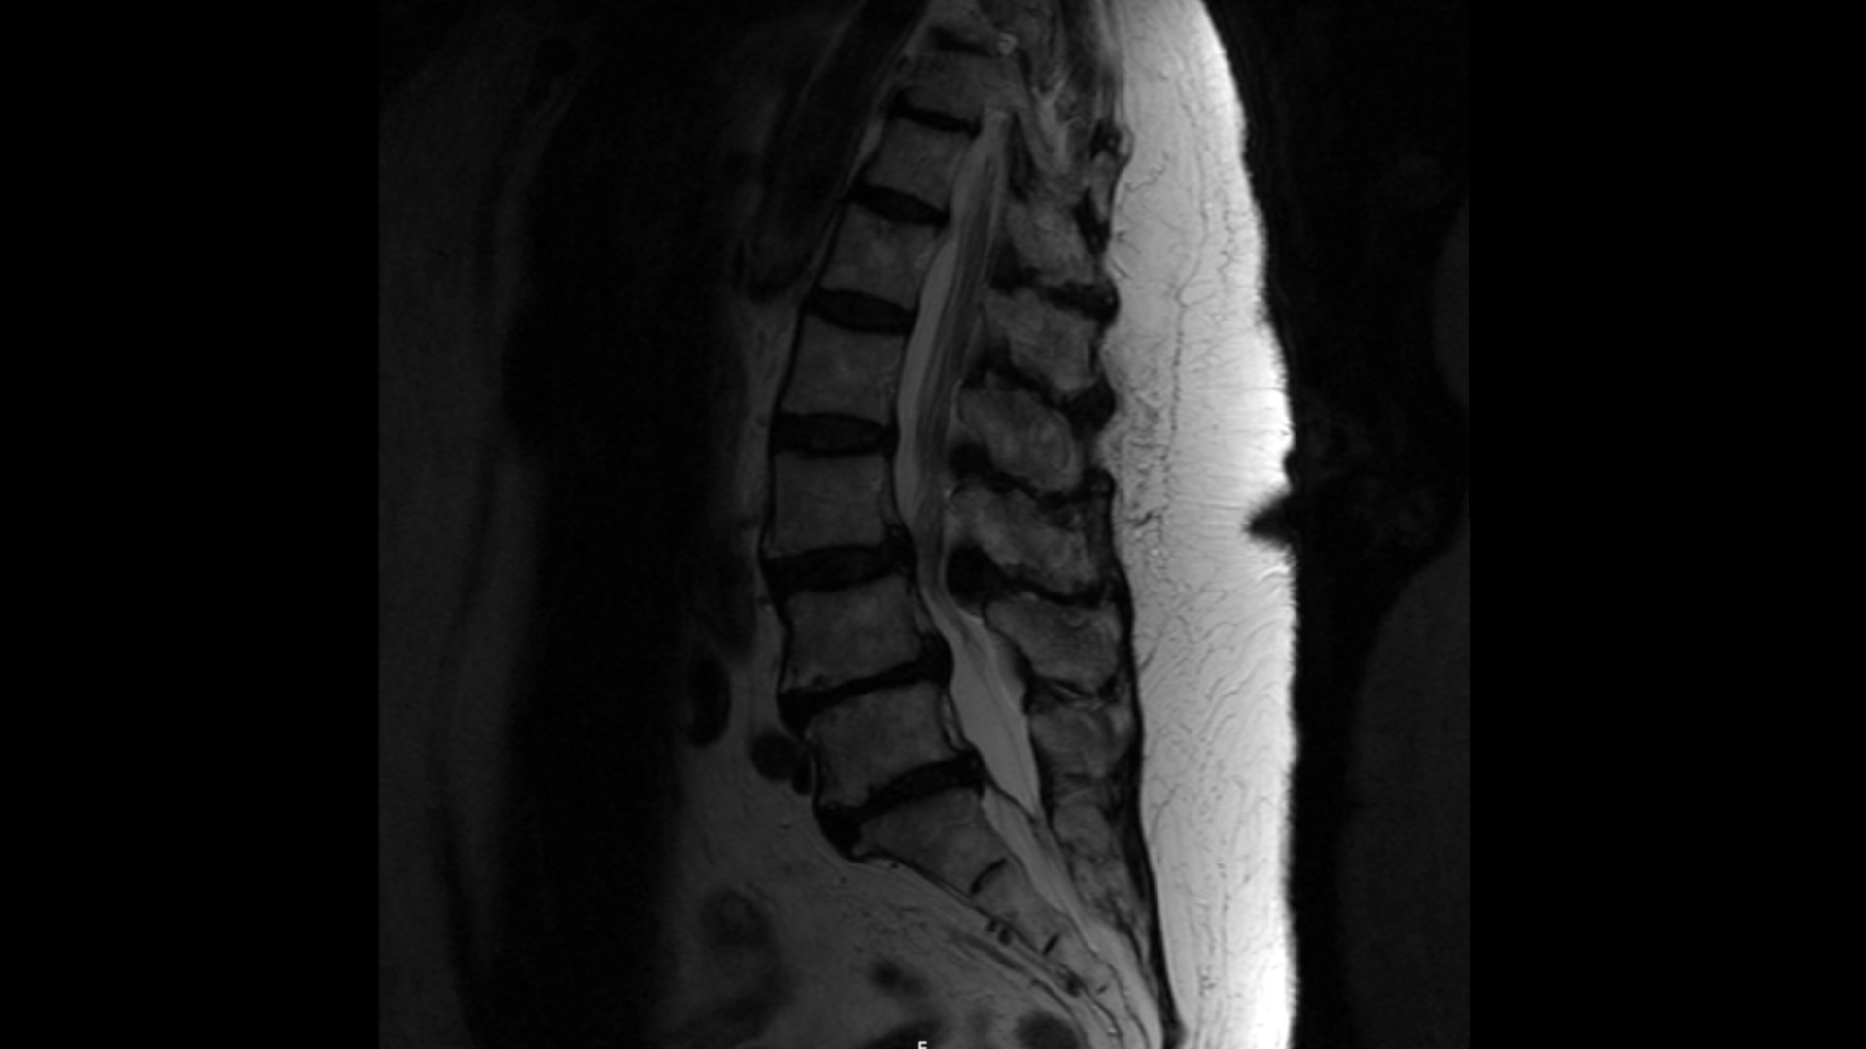
Notes:
Commentary: MRI of spinal stenosis

Slide 54
Clinical pearls - ED
ED Management/Analgesia
  Mild: NSAIDS, Acetaminophen, Lidocaine patch
  Moderate: Gabapentinoids, Dopamine antagonists, PO narcotics
  Severe: Propofol, Ketamine, IV/IM/SubQ narcotics
Evidence based medicine
  Ibuprofen 400 mg = 600 = 800 for acute pain relief (Motov 2019)
  Acetaminophen 650 same NNT as Acetaminophen 975/1000 for post op pain (Barden 2004)
  Ibuprofen 400 mg + Acetaminophen 975 mg = Norco 5 mg = Percocet 5 mg (Chang 2017)
  Gabapentin: Single dose 600 mg helped with postoperative pain following mastectomy (Grover 2009)

Slide 55
Clinical pearls - Discharge
Muscle Relaxants
  No difference compared to placebo (Friedman 2019)
  Cochrane Review (2003): Muscle relaxants are effective in the management of non-specific acute low back pain
  Must discuss side effects with patient! (drowsiness, dizziness, etc)
NSAIDS
  Effective at short term relief without radiculopathy (Saragiotto 2016), but not with radiculopathy (Roelofs 2008)
  NSAIDs reduce pain intensity, disability and increase proportion of patients experiencing global improvement (Long 2020)
    NNT: Pain (14), disability (12), global improvement (13)
  NSAID prescription reduces return rate to ED within 12 months (JACEPOPEN 2020 In Press)
Acetaminophen: Recommend taking with NSAID for synergy (Chang 2017)
Opioids
  Higher rate of harm and higher percentages of severe harms in opioid arms for the management of subacute and chronic LBP (Tucker 2020)
  Patients with opioid prescription more likely to return to ED within 12 months (JACEPOPEN 2020 In Press)
Tramadol: similar risk to opioids, variable pharmacokinetics (Thiels 2019)

Slide 56
Clinical pearls - Discharge
Corticosteroids
  PO (Eskin 2014) or IM (Friedman 2006) no better than placebo for acute back pain
Gabapentinoids
  Insufficient evidence for the use of gabapentin for acute, radicular lower back pain (Chou 2017)
  Moderate-to-high quality evidence ineffective, with high risk for adverse events (Enke 2018)
Topical Agents
  Topical anesthetic (lidocaine patches or cream)
  Topical NSAIDS (voltaren, aspercreme, etc)
  Rubefacients (capsaicin, camphor, menthol, salicylates, oil of wintergreen)
  Topical nitroglycerin (used in tendinopathies, ?back)

Slide 57
Clinical pearls - Discharge
Exercise Therapy (Cochrane 2005)
  Chronic or subacute: decrease pain, improve function, improve absenteeism
  Acute: as effective as no treatment or other treatments
  “AAOS Spine Rehab PDF”
Heat Therapy
  Cochrane 2006: moderate evidence for reducing pain, disability in acute low back pain
  Greatest benefit is first following injury (Mayer 2005), +adding exercise improved benefit
Patient Education
  2 hours of patient education to recommended first-line care for patients with acute low back pain did not improve pain outcomes (Traeger 2019)

Slide 58
Epidural compression syndromes

Slide 59
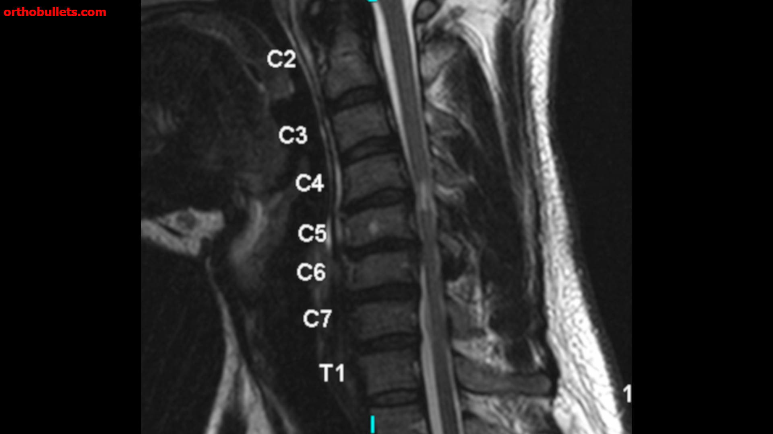
Notes:
Commentary: cervical MRI but it shows increased signal in the cord, aka myelopathy.

Slide 60
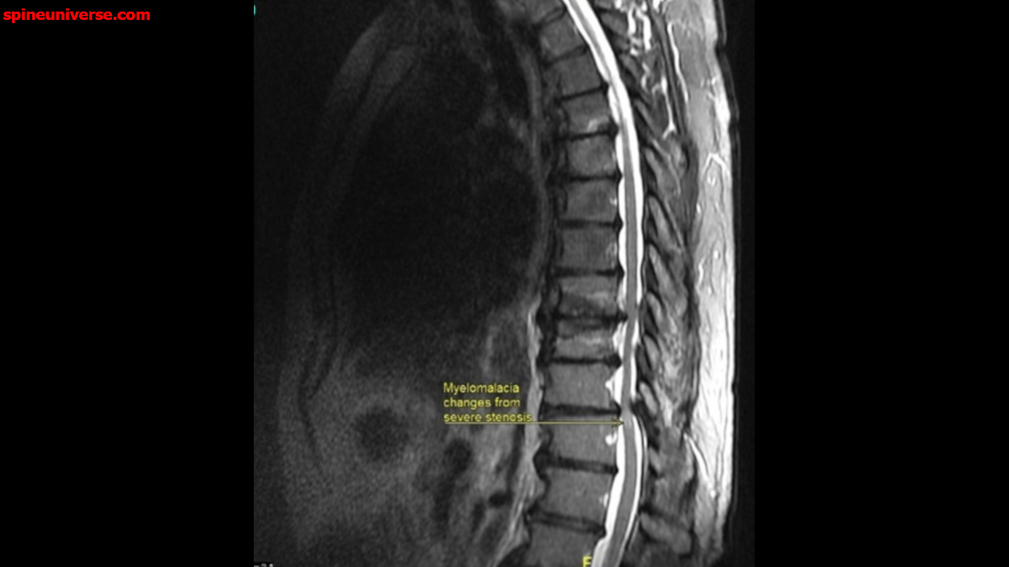
Notes:
Commentary: more myelopathy, in this case rads calls it myelo-malacia meaning there is now a degenerative process. This is occurring secondary to spinal stenosis which is easily seen here (and a reason to get imaging)

Slide 61
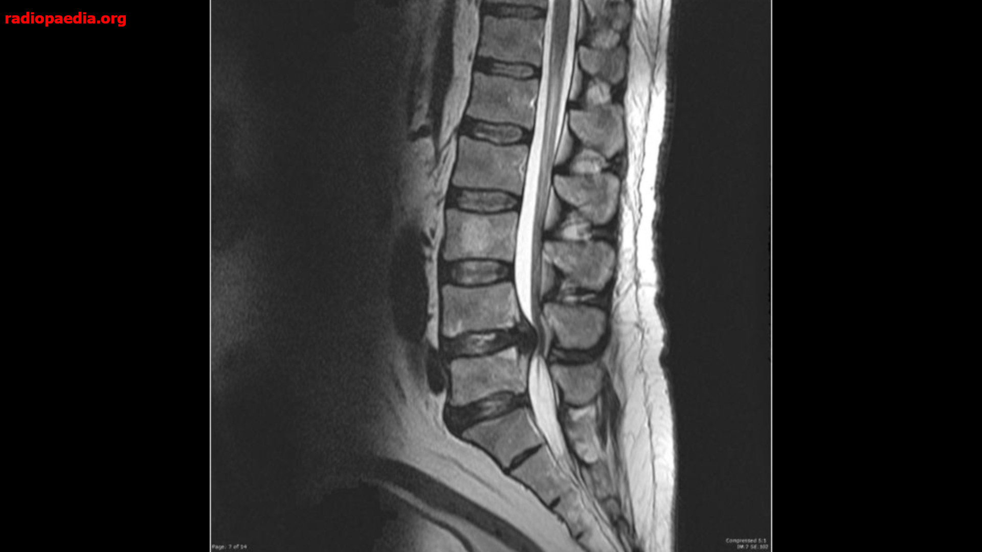
Notes:
Commentary: MRI of cauda equina syndrome. Note compression of the that part of the cord

Slide 62
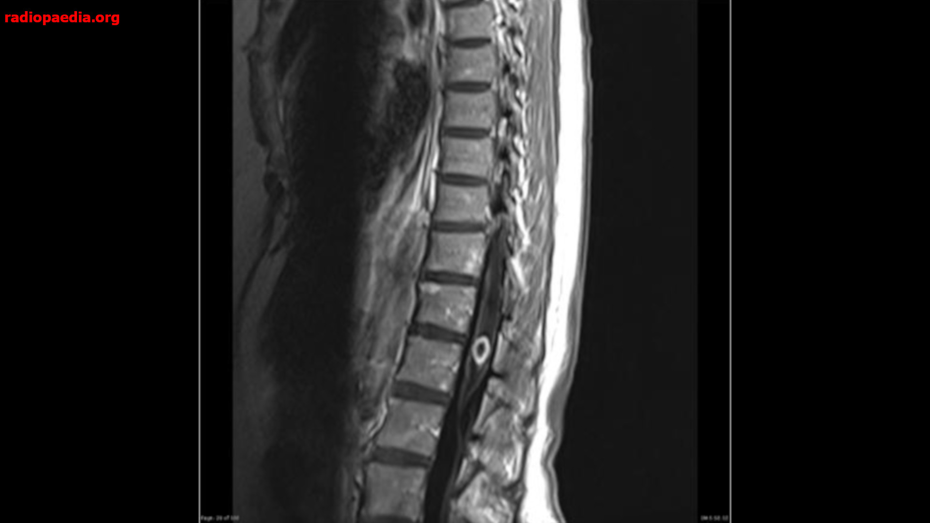
Notes:
Commentary: conus medularis syndrome, technically distinct but similarly presenting entity to cauda equina syndrome

Slide 63

Notes:
Commentary: epidural hematoma can be spontaneous/ atraumatic in patients on anticoagulation

Slide 64
Epidural compression syndromes
Cord Compression/ Myelopathy
  Etiology: spinal stenosis, spontaneous compression fracture (malignancy, osteoporosis)
  Typically insidious, asymmetric with lower extremity weakness, sensory deficits, gait disturbance
  May be thoracic rather than low lumbar
Conus Medullaris Syndrome
  Acute onset, starts at L2, bilateral, symmetric, impaired pain and temp
  Early loss of rectal and urethral sphincter tone, erectile dysfunction
Cauda Equina Syndrome
  Insidious, severe, asymmetric with saddle anesthesia (75%) of patients
  Rectal/bladder sphincter dysfunction late, erectile dysfunction late
  PVR >200 mL (94% Sn, 67% Sp, 29% PPV, 99% NPV) (Katzouraki 2020)
  CT: Thecal sac effacement <50% excludes cauda equina syndrome (Peacock 2016)
Plan
  MRI (CT Myelogram), pain management, spine consult, consider foley
Notes:
Commentary: big things are myelopathies and cauda equina are typically insidious in onset (back pain for a while), PVR is critically useful for cauda equina, there may be a role for CT but MRI is gold standard

Slide 65

Ankylosing spondylitis
Epi: Young male age 20-30
  Associated with HLA-B27 (90%), uveitis (30%)
Natural Progression
  Gradual onset of lumbar pain >3 months
  Worse with rest, improves with activity
  Morning stiffness
No specific test, ESR/CRP neither Sn/Sp
ED
  Treat pain
  Ensure adequate follow up PCP/Rheum
Notes:
Commentary: young male with worsening back pain and morning stiffness. Not much to do from ED. Note that labs are not helpful in the ED.

Slide 66
Infectious

Slide 67

Notes:
Commentary: discitis, note the fluid in the L2L3 disc space, increased signal on T2

Slide 68

Notes:
Commentary: vertebral osteomyelitis seen on T1

Slide 69

Notes:
Commentary: epidural abscess on multiple cuts

Slide 70

Notes:
Commentary: more epidural abscess

Slide 71
Spinal infection
Discitis
  Risks: young kids, post-op, immunocompromised
  S/S: persistent pain, fever (60-70%), neuro deficits (10-50%),
Vertebral Osteomyelitis
  Risks: bacteremia
  S/S: persistent pain, vertebral tenderness, paravertebral spasm
Spinal Epidural Abscess (SEA aka spondylodiskitis)
  Risks: IV drug use, immunocompromised, etoh, cancer, recent surgery, fracture, other infection, foley, ESRD, DM
  S/S: localized persistent back pain, fever (19-32%), neuro deficits often progressive, paralysis
General
  Labs: WBC+ (<50%), ESR (>90%), CRP (>90%), blood cultures, LP? (culture+ in <25%)
  Bugs: staph auerus (#1), strep, pseudomonas, e. coli
  Abx: Vanco + CTX, zosyn, cefepime, ceftazidime (+ flagyl for SEA?)
  SEA needs I&D
Notes:
Commentary: biggest key is know your risk factors! Neither fever nor neurological deficits are sensitive, especially early on!!! Need to image the whole spine, broad spectrum antibiotics, NSG involvement early

Slide 72
Other

Slide 73

Metastatic disease
Breast (16-37%), Lung (12-15%), Prostate (9-15%)
  Bone #3 site for mets (#1 lung, #2 liver)
  #1 Spine (> femur > humerus)
S/S: axial night pain
  Metastatic hypercalcemia
  May present with compression fracture
  Neuro deficits if cord compression
If cancer unknown
  Labs: CBC, ESR, CRP, BMP, LFTS, Alk Phos
  XR, CT Torso
If cancer known
  Pain control
  NSGY if Fx, neuro defecits
Notes:
Commentary: always consider in patients with suspected or known cancer. May also be first indicator of something bad going on. If cancer is not known, work up

Slide 74

Notes:
Commentary: mets to L3 I think

Slide 75

Notes:
Commentary: mets everywhere on this CT

Slide 76

Notes:
Commentary: mets everywhere on this MRI

Slide 77

Transverse myelitis
Inflammatory disorder of transverse section of cord
  Viral (30%), post-vaccine, MS, SLE, Cancer
S/S: neck or back pain + neuro deficits
  Rapidly progressive, bilateral
  Motor, sensory, autonomic, urinary/ rectal dysfunction
Workup
  MRI may be normal
  May show cord edema, hyperintense lesion (T2)
  LP: monocytes, protein, IgG
Management
  Foley
  Neurology
  Corticosteroids (1g methylpred, 200 mg dex)
  Plasma exchange
Notes:
Commentary: biggest thing is it should follow one or two dermatomes/ myotomes. Rapid onset following infection. If suspicious, broad workup and call neurology early.

Slide 78
Questions?

Slide 79
References
Downie A, Williams CM, Henschke N, et al. Red flags to screen for malignancy and fracture in patients with low back pain: systematic review. BMJ. 2013;347
Airaksinen O, Brox JI, Cedraschi C, et al. Chapter 4. European guidelines for the management of chronic nonspecific low back pain. Eur Spine J. 2006;(Suppl 2):192–300
Traeger AC, Lee H, Hübscher M, et al. Effect of Intensive Patient Education vs Placebo Patient Education on Outcomes in Patients With Acute Low Back Pain: A Randomized Clinical Trial. JAMA Neurol. 2019 Feb 1;76(2):161-169.
Friedman BW, Irizarry E, Solorzano C, et al. A Randomized, Placebo-Controlled Trial of Ibuprofen Plus Metaxalone, Tizanidine, or Baclofen for Acute Low Back Pain. Ann Emerg Med. 2019 Oct;74(4):512-520.
van Tulder MW, Touray T, Furlan AD, et al. Muscle relaxants for non-specific low back pain. Cochrane Database Syst Rev. 2003;2003(2):CD004252.
Tucker H, Scaff K, McCloud T, et al. Harms and benefits of opioids for management of non-surgical acute and chronic low back pain: a systematic review. British Journal of Sports Medicine 2020;54:664.
Long B, Gottlieb M. Nonsteroidal Anti-inflammatory Drugs for Acute Low-back Pain. Acad Emerg Med. 2020 Aug 12.
Hayden JA, van Tulder MW, Malmivaara A, Koes BW. Exercise therapy for treatment of non-specific low back pain. Cochrane Database Syst Rev. 2005 Jul 20;(3):CD000335.
Saragiotto BT, Machado GC, Ferreira ML, Pinheiro MB, Abdel Shaheed C, Maher CG. Paracetamol for low back pain. Cochrane Database Syst Rev. 2016;(6):CD012230
Roelofs PD, Deyo RA, Koes BW, Scholten RJ, van Tulder MW. Nonsteroidal anti-inflammatory drugs for low back pain. Cochrane Database Syst Rev. 2008;(1):CD000396.
Chang AK, Bijur PE, Esses D, et al. Effect of a Single Dose of Oral Opioid and Nonopioid Analgesics on Acute Extremity Pain in the Emergency Department: A Randomized Clinical Trial. JAMA. 2017 Nov 7;318(17):1661-1667.
Franke H, Franke JD, Fryer G. Osteopathic manipulative treatment for nonspecific low back pain: a systematic review and meta-analysis. BMC Musculoskelet Disord. 2014;15:286.
Eskin B, Shih RD, Fiesseler FW, et al. Prednisone for emergency department low back pain: a randomized controlled trial. J Emerg Med. 2014;47(1):65–70.
Friedman BW, Holden L, Esses D, et al. Parenteral corticosteroids for emergency department patients with non-radicular low back pain. J Emerg Med. 2006;31:365-370
French SD, Cameron M, Walker BF, Reggars JW, Esterman AJ. A Cochrane review of superficial heat or cold for low back pain. Spine. 2006;31(9):998-1006
Mayer JM, Ralph L, Look M, et al. Treating acute low back pain with continuous low-level heat wrap therapy and/or exercise: a randomized controlled trial. Spine J. 2005;5:395-403
Thiels CA, Habermann EB, Hooten WM, Jeffery MM. Chronic use of tramadol after acute pain episode: cohort study. BMJ. 2019 May 14;365:l1849.
Grover VK, Mathew PJ, Yaddanapudi S, Sehgal S. A single dose of preoperative gabapentin for pain reduction and requirement of morphine after total mastectomy and axillary dissection: randomized placebo-controlled double-blind trial. J Postgrad Med. 2009 Oct-Dec;55(4):257-60.
Motov S, Masoudi A, Drapkin J, Sotomayor C, Kim S, Butt M, Likourezos A, Fassassi C, Hossain R, Brady J, Rothberger N, Flom P, Marshall J. Comparison of Oral Ibuprofen at Three Single-Dose Regimens for Treating Acute Pain in the Emergency Department: A Randomized Controlled Trial. Ann Emerg Med. 2019 Oct;74(4):530-537.
Barden J., Edwards J., Moore A. Single dose oral paracetamol (acetaminophen) for postoperative pain. Cochrane Database Syst Rev. 2004;(1):CD004602.

Slide 80
References
Chou R, Deyo R, Friedly J, et al. Systemic pharmacologic therapies for low back pain: a systematic review for an American College of Physicians clinical practice guideline. Ann Intern Med. 2017;166(7):480–492.
Enke, Oliver, et al. "Anticonvulsants in the treatment of low back pain and lumbar radicular pain: a systematic review and meta-analysis." Cmaj 190.26 (2018): E786-E793.
Katzouraki, Galateia, et al. "A prospective study of the role of bladder scanning and post-void residual volume measurement in improving diagnostic accuracy of cauda equina syndrome." The Bone & Joint Journal 102.6 (2020): 677-682.
Peacock JG, Timpone VM. Doing More with Less: Diagnostic Accuracy of CT in Suspected Cauda Equina Syndrome. AJNR Am J Neuroradiol. 2017 Feb;38(2):391-397. doi: 10.3174/ajnr.A4974. Epub 2016 Oct 27. PMID: 27789449.
Patel ND, Broderick DF, Burns J, et al. ACR Appropriateness Criteria low back pain. J Am Coll Radiol. 2016;13(9):1069–1078.
Chou R, Qaseem A, Owens DK, et al.; Clinical Guidelines Committee of the American College of Physicians. Diagnostic imaging for low back pain: advice for high-value health care from the American College of Physicians [published correction appears in Ann Intern Med. 2012; 156(1 pt 1): 71]. Ann Intern Med. 2011;154(3):181–189.
Jarvik JG, Hollingworth W, Martin B, et al. Rapid magnetic resonance imaging vs radiographs for patients with low back pain: a randomized controlled trial. JAMA. 2003;289(21):2810–2818.
Henschke N, Maher CG, Refshauge KM, et al. Prevalence of and screening for serious spinal pathology in patients presenting to primary care settings with acute low back pain. Arthritis Rheum 2009; 60: 3072–80.
Chou R, Fu R, Carrino JA, Deyo RA. Imaging strategies for low back pain: systematic review and meta-analysis. Lancet 2009; 373: 463–72.
Pakpoor, J. "Use of imaging during emergency department visits for low back pain [published online ahead of print November 19, 2019]." American Journal of Roentgenology.
Boden SD, Davis DO, Dina TS, et al.: Abnormal magnetic-resonance scans of the lumbar spine in asymptomatic subjects. A prospective investigation. J Bone Joint Surg Am. 1990; 72(3): 403–8.
Friedman BW, Chilstrom M, Bijur PE, Gallagher EJ. Diagnostic testing and treatment of low back pain in United States emergency departments: a national perspective. Spine (Phila Pa 1976). 2010 Nov 15;35(24):E1406-11.
Balagué F, Mannion AF, Pellisé F, Cedraschi C. Non-specific low back pain. Lancet. 2012 Feb 4;379(9814):482-91. doi: 10.1016/S0140-6736(11)60610-7. Epub 2011 Oct 6.
Airaksinen O, Brox JI, Cedraschi C, et al.; COST B13 Working Group on Guidelines for Chronic Low Back Pain. Chapter 4. European guidelines for the management of chronic nonspecific low back pain. Eur Spine J 2006; 15(Suppl 2):S192–S300
Pope TL. Harris & Harris' Radiology of Emergency Medicine. Lippincott Williams & Wilkins. (2012) ISBN:145110720X.

