Slide 1

The Child With A Limp

Slide 2

Notes:
No disclosures

Slide 3

Goals and Objectives
List the common differentials for a child with a limp
List the ”can’t miss” diagnosis for a child with a limp
Discuss the evaluation and workup of a child presenting with a limp in the emergency department
Describe treatment plans for the common diagnoses of a child with a limp
Discuss the potential complications of some of the common etiologies for a limping

Slide 4
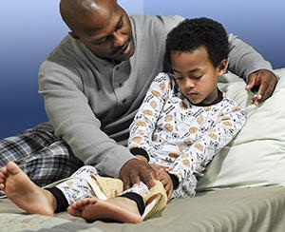
Notes:
A 6-year-old boy presents to your emergency department with difficulty putting weight on his left left for the past few days. There was no known trauma and the child is otherwise healthy.
What would be in your differentials for this child?
- Slipped Capital Femoral Epiphysis (SCFE)
- Septic arthritis
- Transient Synovitis
Lyme arthritis
Congenital dislocation of the hips (though usually caught much younger)
Juvenile Rheumatoid Arthritis (JRA)
Avascular necrosis of the femoral head (Legg-Calve-Perthes disease)
Tibial tubercle apophysitis (Osgood Schlatter’s disease)
Malignancy

Slide 5


Notes:
Let’s pause for a minute and think of the most immediately dangerous causes of a limping child:
- SCFE
- Septic arthritis

Slide 6
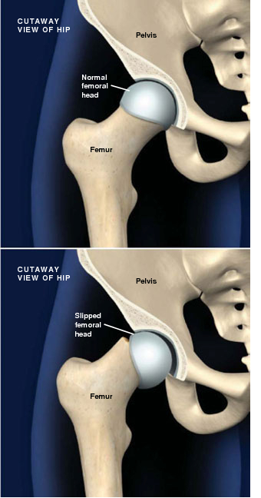
Slipped Capital Femoral Epiphysis
Shearing/slipping of the femoral epiphysis in relation to the rest of the femur
Peak incidence ~12yo
Risk factors: male, obese
Mechanism: normal walking forces on a susceptible physis
Bilateral involvement in ~25% of cases
Notes:
While pain may only be limited to 1 side, a quarter of cases involve both femoral heads. Even if both aren’t involved at the same time, up to 60% of patients will develop bilateral SCFE at some point in their lifetime.
This disease is similar to a Salter Harris Type I injury though with histologic differences and usually not from a singular traumatic event.

Slide 7
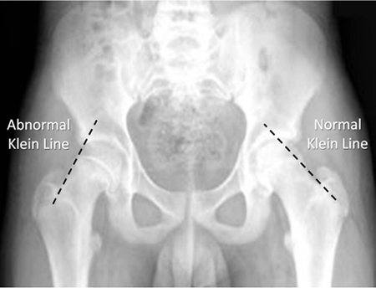
Slipped Capital Femoral Epiphysis
Presentation: isolated groin/hip pain, inability to bear weight, isolated ipsilateral knee pain (15% of cases)
Exam: antalgic gait/inability to bear weight, decreased ROM at the hip
Workup: x-ray (AP, frog leg)
  Klein’s Line on AP x-ray
Treatment: ORIF
Complications: asymmetric/arrested limb growth, chronic arthritis, avascular necrosis of the femoral head
Notes:
There are many radiographic tools to help diagnose SCFE but one of the easiest is the Klein Line (and it rhymes!). This line is drawn from the superior femoral neck border straight through the femoral epiphysis. A normal line will pass THROUGH the femoral epiphysis, while an abnormal line will pass ALONG SIDE the epiphysis. This can also be described as the epiphysis superolateral border is either above (normal) or at/below (abnormal) the Klein Line.
Photo credit: https://painepodcast.com/2019/08/23/ep-paine-nym-98/

Slide 8
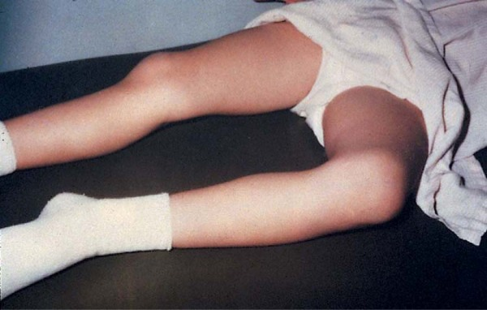
Septic Arthritis
Bacterial infection of the joint with purulent effusion
Peak incidence in children <2yo
Most commonly occurs in the hip or knee
Risk factors: prematurity, invasive procedures
Mechanism: Hematogenous spread or direct inoculation
Group B strep in <2, Staph in >2
Notes:
The photo is of a child with septic arthritis of the hip. This classically shows as an externally rotated, flexed, and abducted joint to maximize the space due to increased pressure.

Slide 9
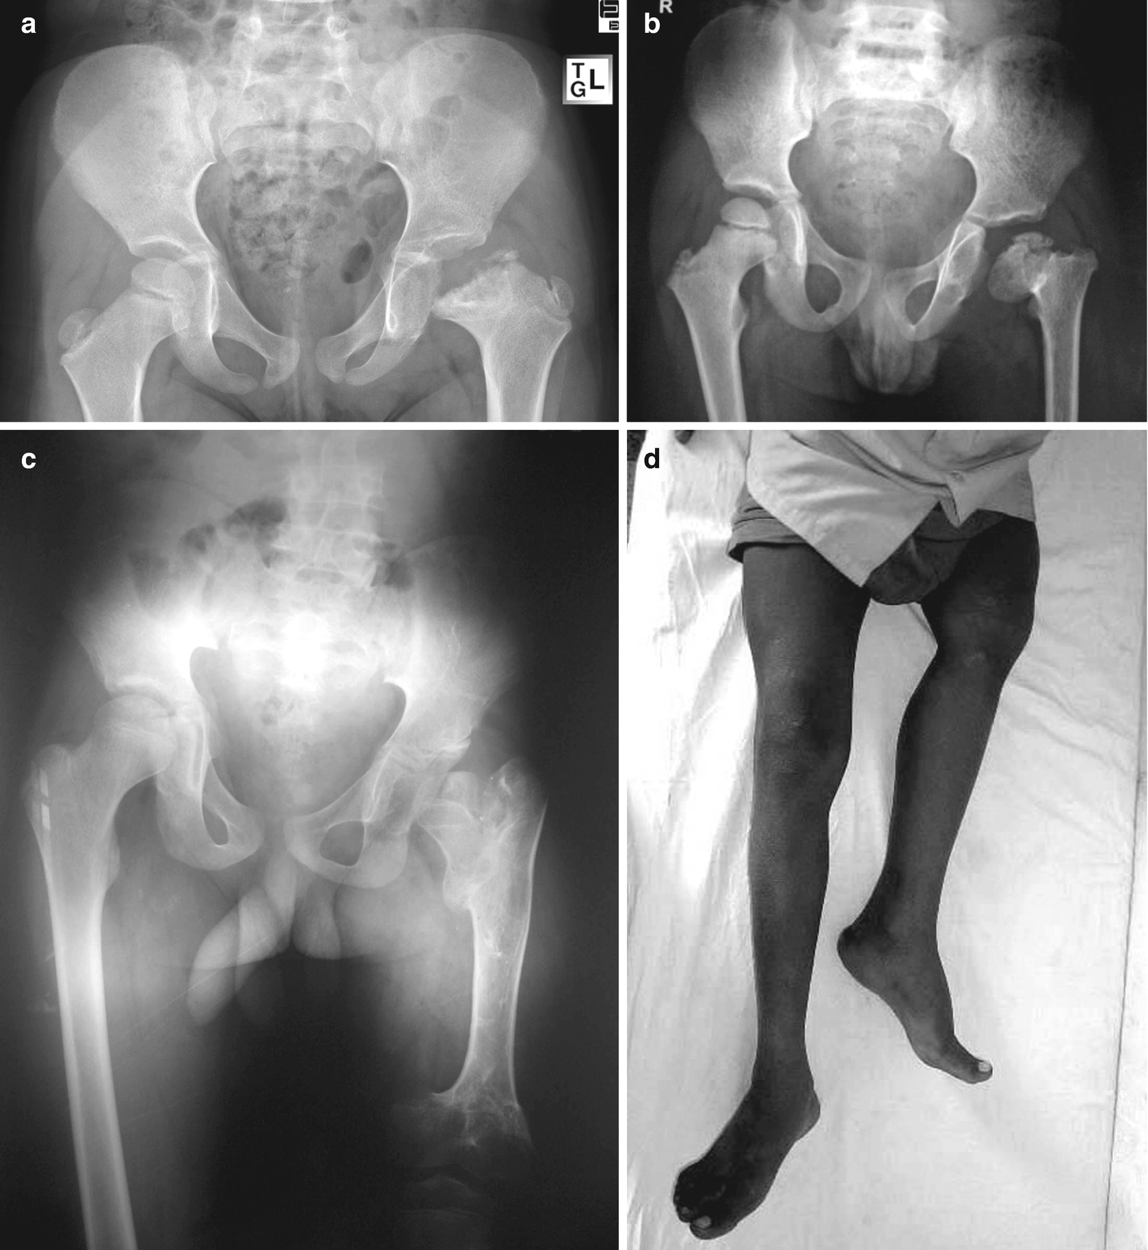
Septic Arthritis
Presentation: acute (hours to days) onset of pain in one joint with systemic symptoms (fever, etc.)
Exam: localized swelling/warmth over joint, possible erythema, severe pain/refusal to range or bear weight
Workup: X-ray, +/- ultrasound, CBC, CRP, ESR, and joint aspiration studies, Kocher Criteria
Treatment: I&D with IV abx, admission
Complications: joint erosion/necrosis, chronic arthritis, arrested limb growth
Notes:
CRP is the most important of the labs. CRP>2 is an independent risk factor, CRP>2 + non-weight bearing gives you a ~75% risk of septic arthritis.
This photo has examples of complications of missed/neglected septic arthritis in various children.
Image Credit:
Spiegel D.A., Banskota A.K., Banskota B. (2020) Neglected Septic Arthritis in Children. In: Gosselin R., Spiegel D., Foltz M. (eds) Global Orthopedics. Springer, Cham. https://doi.org/10.1007/978-3-030-13290-3_30

Slide 10
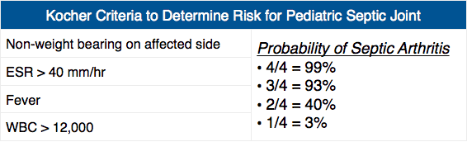
Kocher Criteria
Notes:
There is a nice MD Calc for this
Note, CRP is not on this risk calculator

Slide 11

Notes:
But what about the rest??

Slide 12
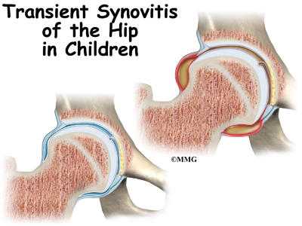
Transient Synovitis
Aseptic inflammatory condition of a joint with a serous effusion
Peak incidence 4-8 y/o
Can affect any joint, most commonly the hip
Risk factors: recent viral infection, male
Mechanism: not entirely known, thought to be a post-reactive inflammatory response
Notes:
Transient (sometimes called toxic inappropriately) synovitis is a very transient benign condition occurring as a post-inflammatory state after a URI or other inflammation-provoking event.
Image credit: http://www.orthohyd.com/home/know-your-disease/transient-synovitis

Slide 13
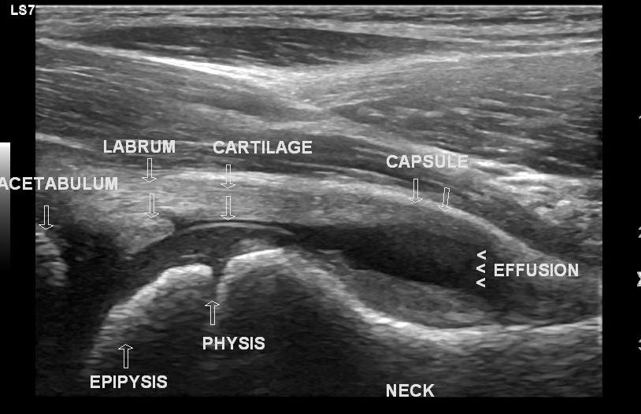
Transient Synovitis
Presentation: acute OR insidious onset of pain at the joint, refusal to bear weight that gets better throughout the day
Exam: limb positioned in way for maximal joint space, limited ROM from pain
Workup: x-ray, ultrasound (if applicable), frequently septic arthritis labs if patient appears toxic/any suspicion (not meeting Kocher Criteria +/- arthrocentesis)
Treatment: self-limited (usually 24-48 hours), rest and NSAIDs as appropriate
Complications: recurrence in ~20%, otherwise benign
Notes:
Transient synovitis is very difficult to distinguish from septic arthritis clinically in most cases and will require lab work to rule out septic arthritis as imaging frequently appears the same in both.
Ultrasound of the joint will show an effusion. The image above is an example of a hip effusion, which could be transient synovitis or septic arthritis.
Image Credit: Case courtesy of Dr Maulik S Patel, Radiopaedia.org, rID: 49743

Slide 14
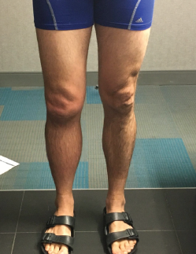
Lyme Arthritis
Late manifestation of Lyme disease when left untreated (among other symptoms)
No specific peak incidence age
Mono- or oligoarthritis favoring knee involvement
Risk factors: geographic location (local Lyme prevalence)
Mechanism: hematogenous spread to synovial cells with the Borrelia Burgdorferi spirochete
Notes:
Lyme arthritis is more common in those with subtle primary Lyme presentations due to the lack of early treatment. Developing secondary Lyme can take months to years of non-treatment and disseminated infection.
Image credit: https://www.the-rheumatologist.org/article/lyme-arthritis-presentation-diagnosis-treatment/3/

Slide 15
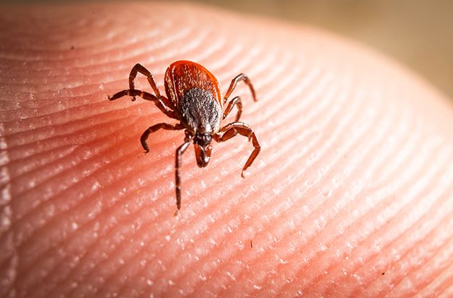
Lyme Arthritis
Presentation: 1 to 2 painful joints with insidious onset, preceded by early Lyme (though symptoms may not be obvious)
Exam: tender and swollen joint with effusion, possible erythema, may have other disseminated Lyme symptoms
Workup: XR, US as appropriate, septic arthritis labs, Lyme titers
Treatment: 28-day course of doxycycline or amoxicillin
Complications: progressive joint destruction, other late disease features
Notes:
The treatment for late/disseminated Lyme disease is the same as early: a prolonged course of antibiotics. The major complications are that of any chronic inflammatory arthritis as well as the many other complications/symptoms of disseminated Lyme including neurologic deficits (Bell’s palsy, etc.) and AV nodal blocks.
Image credit: https://rawlsmd.com/health-articles/lyme-arthritis-how-to-ease-and-prevent-joint-pain-and-swelling

Slide 16
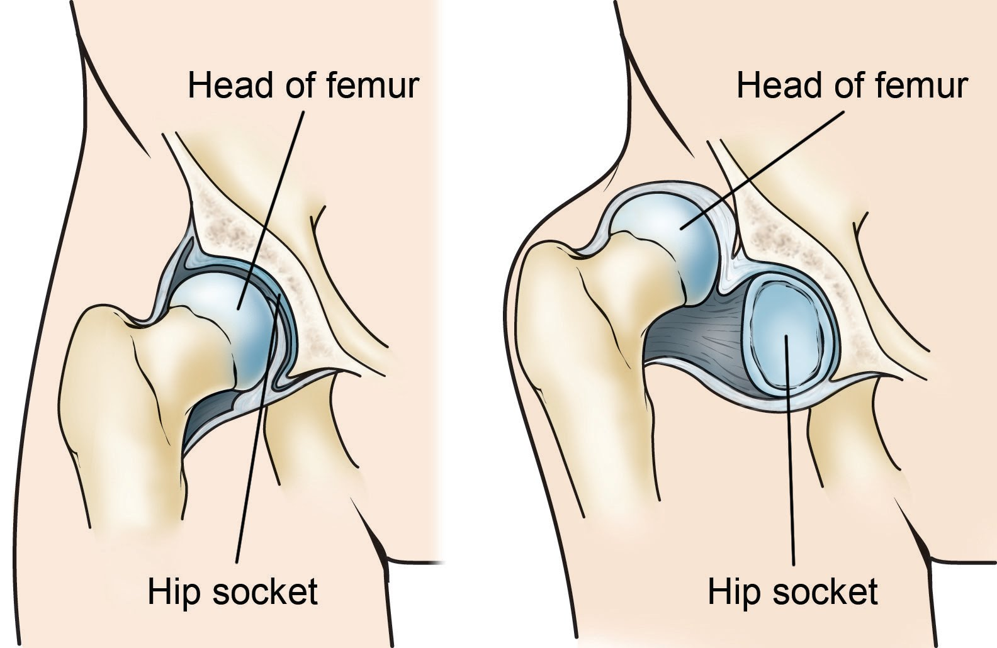
Developmental Dysplasia of the Hip
Congenital disorder of the hip joint with a spectrum from dysplasia to subluxation or dislocation
Peak incidence is within several days post-partum during newborn screening
More common in the left hip, 20% bilateral
Risk factors: firstborn, breech delivery, female, genetic history
Mechanism: ligamentous laxity mixed with malposition or other external forces
Notes:
Developmental dysplasia of the hip (or congenital hip dysplasia) is a disorder from birth with presentations on a spectrum with the acetabulum itself malpositioned. Most are caught on newborn screening while still in the hospital but subtle cases can be missed. Risk factors include firstborn due to a more constrictive uterus, female from inherent ligamentous laxity compared to males, and breech due to positioning among others.
Image credit: https://orthoinfo.aaos.org/en/diseases--conditions/developmental-dislocation-dysplasia-of-the-hip-ddh

Slide 17
Developmental Dysplasia of the Hip
Presentation: varied based on age
  Newborn: possible skin fold asymmetry on the legs
  3mo-1y: difficult to see until child starts walking
  1y-walking age: Trendelenburg gait, lordosis from hip contractures, toe walking
Exam: varies by age
  Newborn: provocative Barlow and Ortolani testing, Galleazi test
  3mo-1y: evaluate for leg length discrepancy, decreased ROM of the hips due to contractures
  1y-walking age: mostly observation based
Notes:
Barlow dislocates a hip hip with adduction and depression of femur. Ortolani reduces a hip by elevation and abduction of hip. Galleazi is an observation with feet flat on bed and hips flexed 90 degrees, a dislocated hip will appear to have a shorter femur.
Image credit: https://www.healthline.com/health/toe-walking

Slide 18
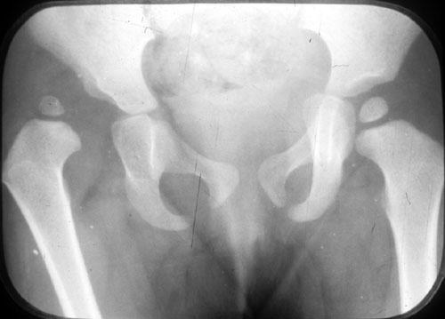
Developmental Dysplasia of the Hip
Workup: ultrasound up until 4mo, XR after ~4-6mo
Treatment: spectrum from bracing to surgical repair
Complications: permanent gait deformities, frequent subluxations/dislocations, femoral head avascular necrosis
Notes:
Treatment is based on severity of dysplasia or existence of recurrent dislocation. Complications are generally avoided the earlier the condition is caught and treated. Most can be treated with bracing/splinting if caught early enough.
Image credit: https://www.orthobullets.com/pediatrics/4118/developmental-dysplasia-of-the-hip-ddh

Slide 19
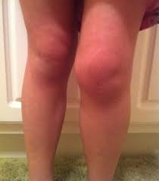
Juvenile Rheumatoid Arthritis
Onset of a rheumatologic disease in childhood with a wide spectrum of presentation
Peak incidence variable but by definition has to occur before 16y/o
Variable joint involvement but usually large joints are the first noticed (knee most common)
Risk factors: female, genetic history
Mechanism: autoimmune inflammation, extremely variable specific factors based on subtypes
Notes:
There are numerous subtypes of JRA with extremely variable presentations.
Image Credit: https://www.omicsonline.org/israel/juvenile-rheumatoid-arthritis-peer-reviewed-pdf-ppt-articles/

Slide 20
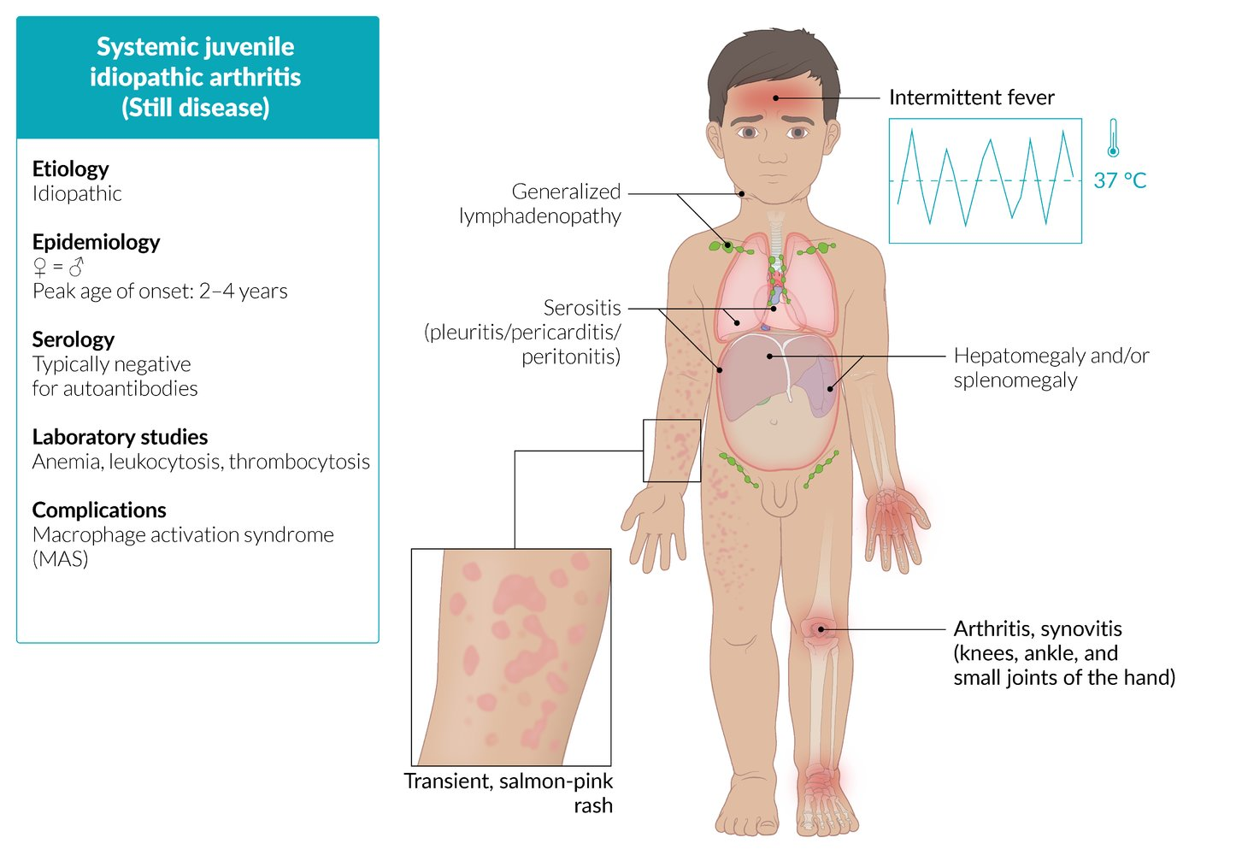
Juvenile Rheumatoid Arthritis
Presentation: variable, usually with large joint arthritis, systemic signs possible with fevers, rashes, serositis, etc.
Exam: swollen tender joint, possible rash, variable other manifestations
Workup: infectious workup, RH factor, other subtype specific markers, XR for joint disruption, MRI to assess for synovitis
Treatment: varied by subtypes, usually NSAIDs, possible DMARDs
Complications: chronic arthritis, joint destruction, systemic manifestations can cause pericarditis/effusions, Stills disease
Notes:
It’s important to look for other symptoms with a red, swollen joint as this can look like septic arthritis and will have similar lab markers. The presence of other inflammatory systemic signs (minus the fever) will point more towards JRA vs septic arthritis. Don’t forget to look out for Still’s disease in the younger children as a specific systemic childhood rheumatoid disease.
Image Credit: https://www.amboss.com/us/knowledge/Juvenile_idiopathic_arthritis

Slide 21
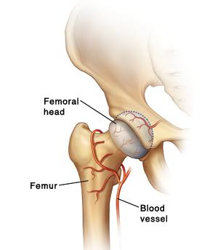
Legg-Calve-Perthes
Idiopathic avascular necrosis of the femoral head
Peak incidence ~4-8y/o
Risk factors: male, lower socioeconomic status, higher latitude on the globe, Caucasian, second-hand smoke, low birth weight
Mechanism: transient ischemia to the femoral epiphysis causing progressive micro collapses of the structure
Notes:
Legg-Calve-Perthes is thought to be associated with various thrombophilic disorders though without great evidence yet. Subsequent intermittent ischemia causes small areas of bone death and remodeling, causing collapse of the structure in those areas. Over time this can lead to the entire epiphysis or even the physis eroding.
Image credit: https://www.fairview.org/patient-education/116256EN

Slide 22
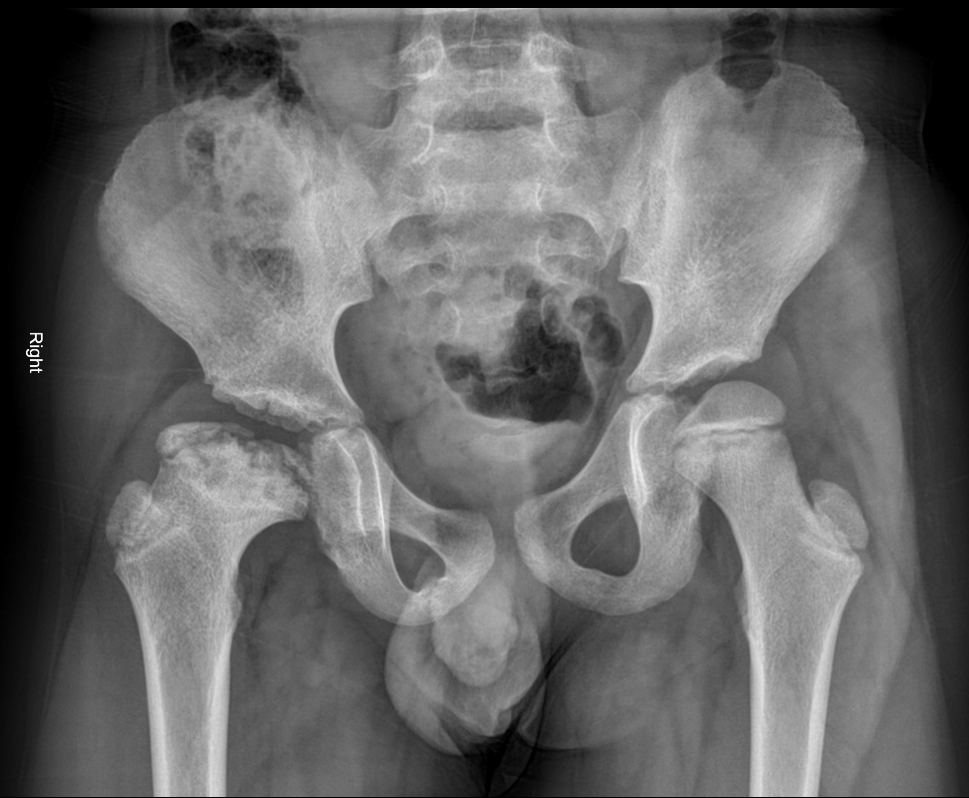
Legg-Calve-Perthes
Presentation: insidious onset, possible painless limp, possible hip/groin pain
Exam: decreased ROM of the affected side, antalgic gait, limb length discrepancy (late finding)
Workup: XR (AP and frog leg)
Treatment: two categories
  <~8yo: non-op, protect with minimizing weight bearing, PT until re-ossification occurs
  >~8yo: operative repair
Complications: destruction of femoral head, limb length discrepancy, severely reduced ROM, chronic arthritis
Notes:
Catching LCPD early is the key to good outcomes.
Image credit: Case courtesy of Dr Mohammad Taghi Niknejad, Radiopaedia.org, rID: 60758

Slide 23
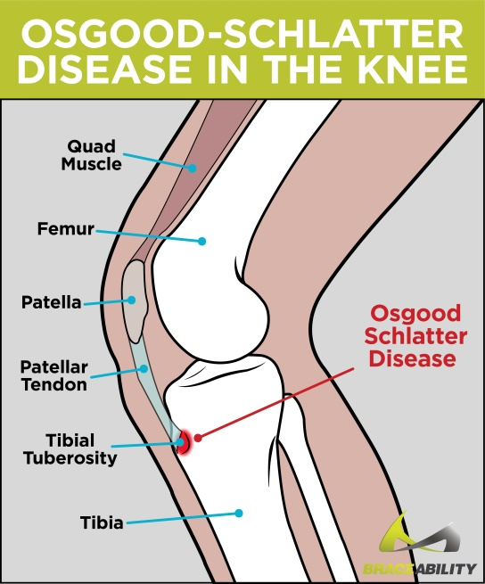
Osgood-Schlatter Disease
Inflammation from repetitive stress injury to the tibial tubercle (tibial tuberosity apophysitis)
Peak incidence 8-15y/o
Risk factors: male, repetitive jumping actions
Mechanism: repetitive stress on the extensor mechanism causes a traction injury
Notes:
Benign disease that is self-limited but can be quite painful.
Image credit: https://www.agnesian.com/blog/osgood-schlatter-disease

Slide 24
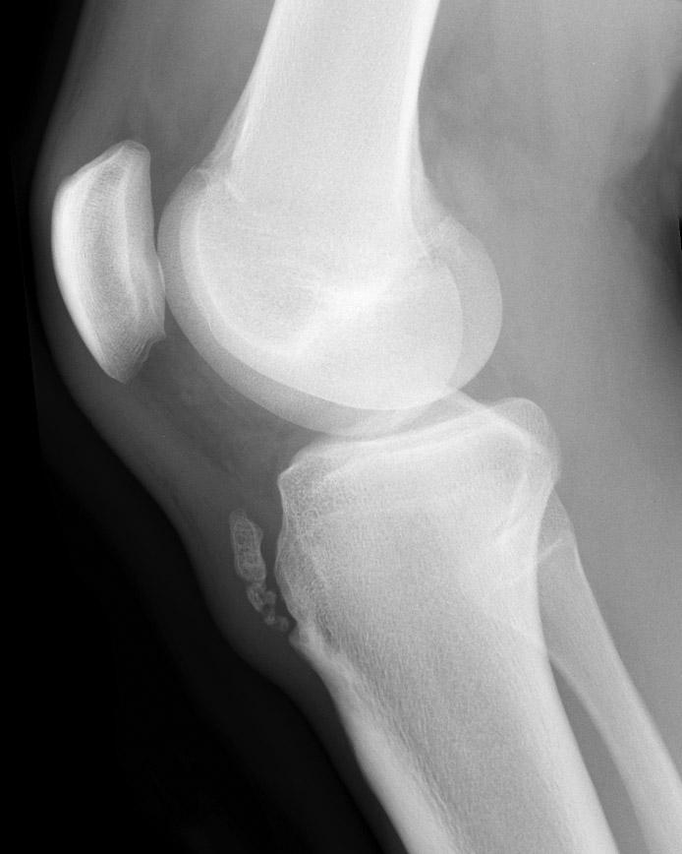
Osgood-Schlatter Disease
Presentation: pain in the anterior knee exacerbated by kneeling or climbing stairs
Exam: tenderness and/or swelling over the tibial tuberosity, pain with knee extension against resistance
Workup: x-ray with fragmentation or enlargement of the tibial tubercle, blurring of the patella tendon
Treatment: NSAIDs, rest, ice, refractory cases potential casting or surgical repair
Complications: mostly from the treatments if necessary to cast or repair
Notes:
Findings on x-ray alone without clinical history do NOT mean they have Osgood-Schlatter’s Disease, they can be secondary ossification centers in the tibial tubercle that are physiologic, not pathologic. This diagnosis is clinically made in a young adult with tenderness over the tubercle with an open physis.
Image credit: Case courtesy of Assoc Prof Frank Gaillard, Radiopaedia.org, rID: 7511

Slide 25
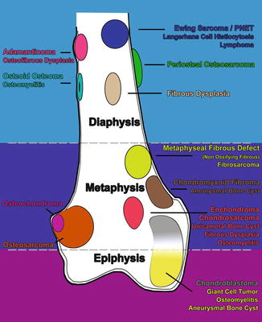
Pediatric Bone Malignancy
Several different types of tumors causing limps but only 3 common malignancies: Ewing Sarcoma, osteosarcoma, and leukemia
Peak incidence varies based on which malignancy
  Leukemia: 2-10yo
  Ewing’s Sarcoma and osteosarcoma: teens to 20s
Risk Factors: genetics
Mechanism: causes pain by primary bone destruction (Ewing and osteosarcoma) vs increased medullary pressure/inflammation (leukemia)
Notes:
There are many types of pediatric primary bone tumors but three commom malignancies.
Image credit: https://link.springer.com/chapter/10.1007/978-3-319-18099-1_2

Slide 26
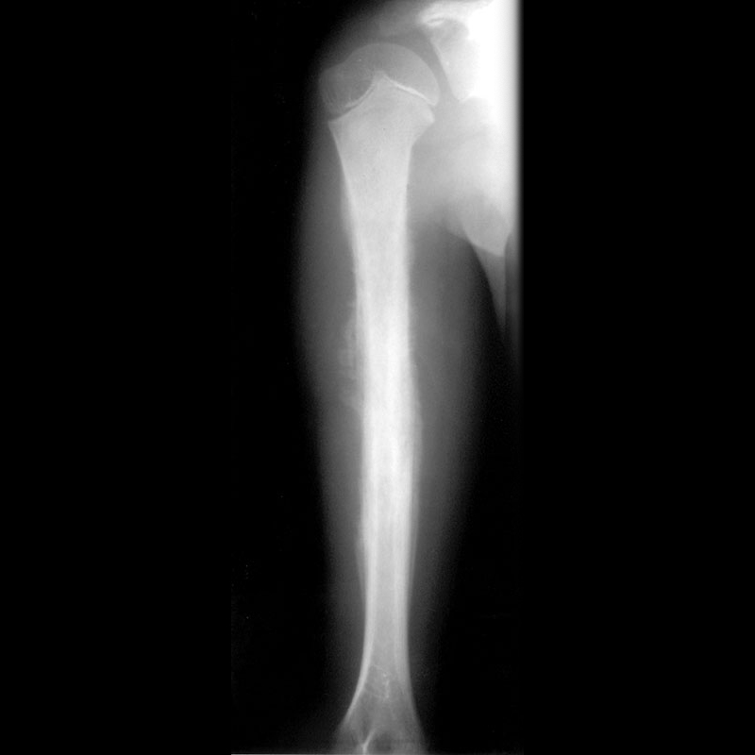
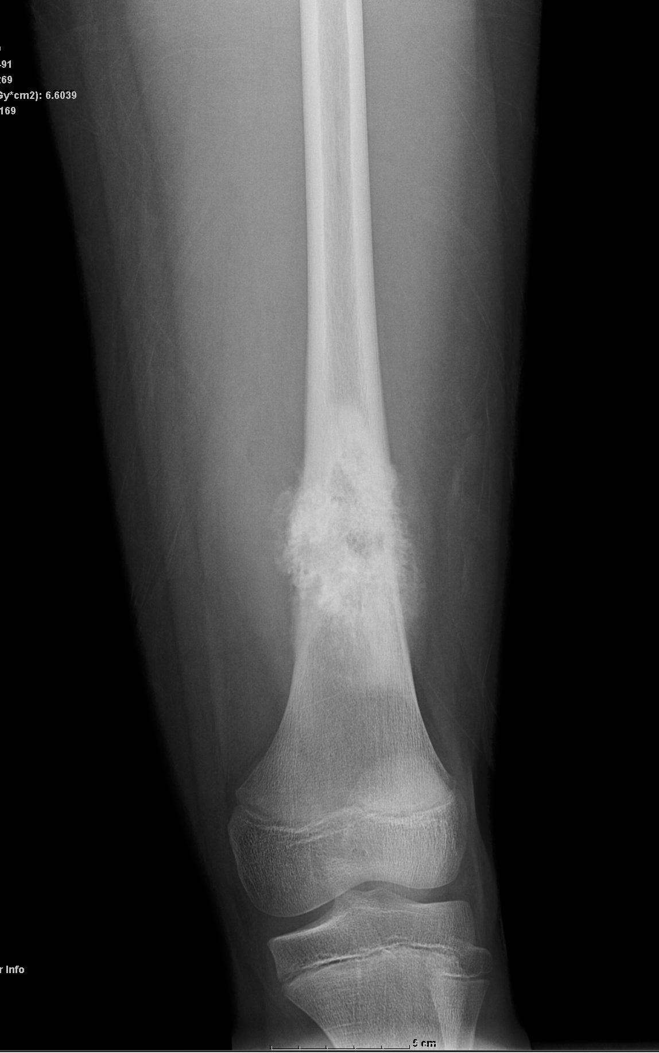
Pediatric Bone Malignancy
Presentation: usually unilateral leg/hip pain, can be intermittent or constant, worse at night preventing sleep, intermittent low-grade fevers also at night
Exam: no specific external findings, antalgic gait
Workup: x-ray, lab work including CBC, possible MRI if indicated
Treatment: chemotherapy, primary resection
Complications: metastatic disease, pathologic fracture, blast crisis/TLS (leukemia)
Notes:
Ewing sarcoma usually has a distinct “onion skin” or “sunburst” appearance on XR. Osteosarcoma usually has a moth-eaten appearance. Keep in mind they can overlap on their radiographic appearance. The left image is a Ewing sarcoma and the R image is an osteosarcoma.
Image credit: Case courtesy of Assoc Prof Frank Gaillard, Radiopaedia.org, rID: 14003
Image Credit: Case courtesy of Dr Kabir Gandhi, Radiopaedia.org, rID: 27266

Slide 27
References
Evan Siegall Eric Shirley, Team O, Sharma A, Khan AQ. Hip Septic Arthritis - Pediatric. Orthobullets. https://www.orthobullets.com/pediatrics/4032/hip-septic-arthritis--pediatric. Published June 8, 2020. Accessed March 7, 2021.
Rachel Goldstein Paul Choi, Lalonde F, Schreiber VM, et al. Slipped Capital Femoral Epiphysis (SCFE). Orthobullets. https://www.orthobullets.com/pediatrics/4040/slipped-capital-femoral-epiphysis-scfe. Published March 3, 2020. Accessed March 7, 2021.
Gaines CB. Slipped Capital Femoral Epiphysis (SCFE). REBEL EM - Emergency Medicine Blog. https://rebelem.com/slipped-capital-femoral-epiphysis-scfe/. Published August 31, 2020. Accessed March 7, 2021.
Edgington J, Abousamra O, Skaggs D. Transient Synovitis of Hip. Orthobullets. https://www.orthobullets.com/pediatrics/4030/transient-synovitis-of-hip. Published April 5, 2020. Accessed March 8, 2021.
STEERE ALLENC. Treatment of Lyme Arthritis. The Journal of Rheumatology. 2019;46(8):871-873. doi:10.3899/jrheum.190320

Slide 28
References
Lindsay Andras Robert Kay, Rachel Goldstein Paul Choi, Robert Kay Deirdre Ryan, et al. Developmental Dysplasia of the Hip (DDH). Orthobullets. https://www.orthobullets.com/pediatrics/4118/developmental-dysplasia-of-the-hip-ddh. Published October 29, 2020. Accessed March 8, 2021.
Giancane G, Consolaro A, Lanni S, Davì S, Schiappapietra B, Ravelli A. Juvenile Idiopathic Arthritis: Diagnosis and Treatment. Rheumatol Ther. 2016;3(2):187-207. doi:10.1007/s40744-016-0040-4
Rachel Goldstein Paul Choi, Robert Kay Deirdre Ryan, Paul Choi Rachel Goldstein, Yousif M, Poptani A. Legg-Calve-Perthes Disease. Orthobullets. https://www.orthobullets.com/pediatrics/4119/legg-calve-perthes-disease. Published December 19, 2020. Accessed March 8, 2021.
Dold A. Osgood Schlatter's Disease (Tibial Tubercle Apophysitis). Orthobullets. https://www.orthobullets.com/knee-and-sports/3029/osgood-schlatters-disease-tibial-tubercle-apophysitis. Published October 6, 2016. Accessed March 8, 2021.
Lefèvre Y, Ceroni D, Läedermann A, et al. Pediatric leukemia revealed by a limping episode: A report of four cases. Orthopaedics & Traumatology: Surgery & Research. 2009;95(1):77-81. doi:10.1016/j.otsr.2008.09.004

