Slide 1
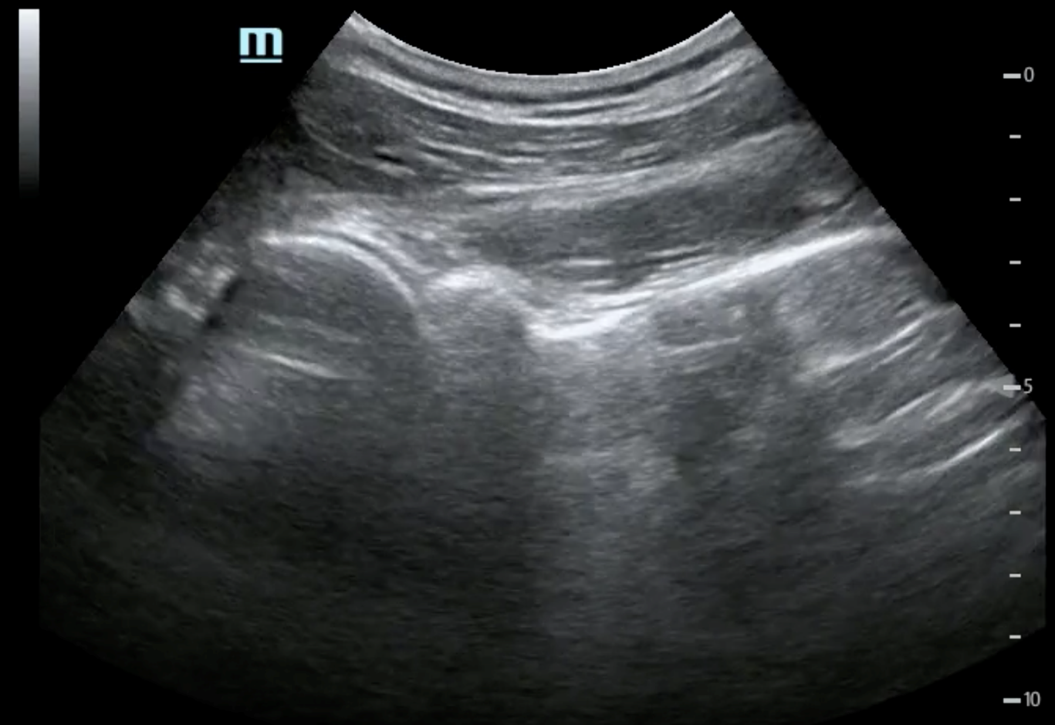
MSK Ultrasound
Post-Tutorial Quiz & Image Review
Lindsay Reardon, MD
University of Vermont Medical Center
Director, Emergency Ultrasound Fellowship

Slide 2
For each slide:
1) What structure(s) does it show?
2) Normal or Abnormal?
3) If abnormal, what is the pathology?

Slide 3
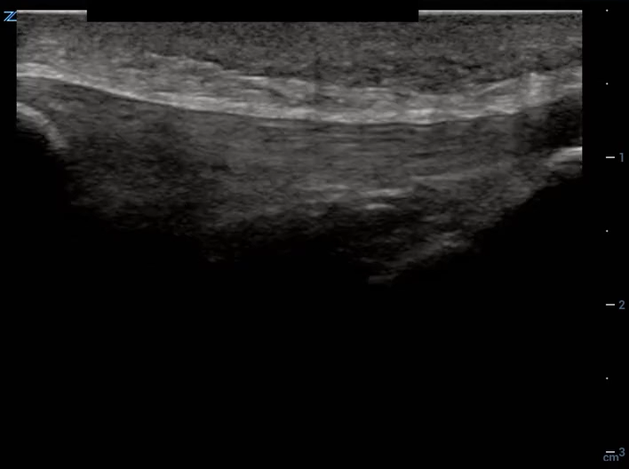
Left Knee
Notes:
1) Patellar Tendon
2) Intact (Normal)
3) N/A

Slide 4
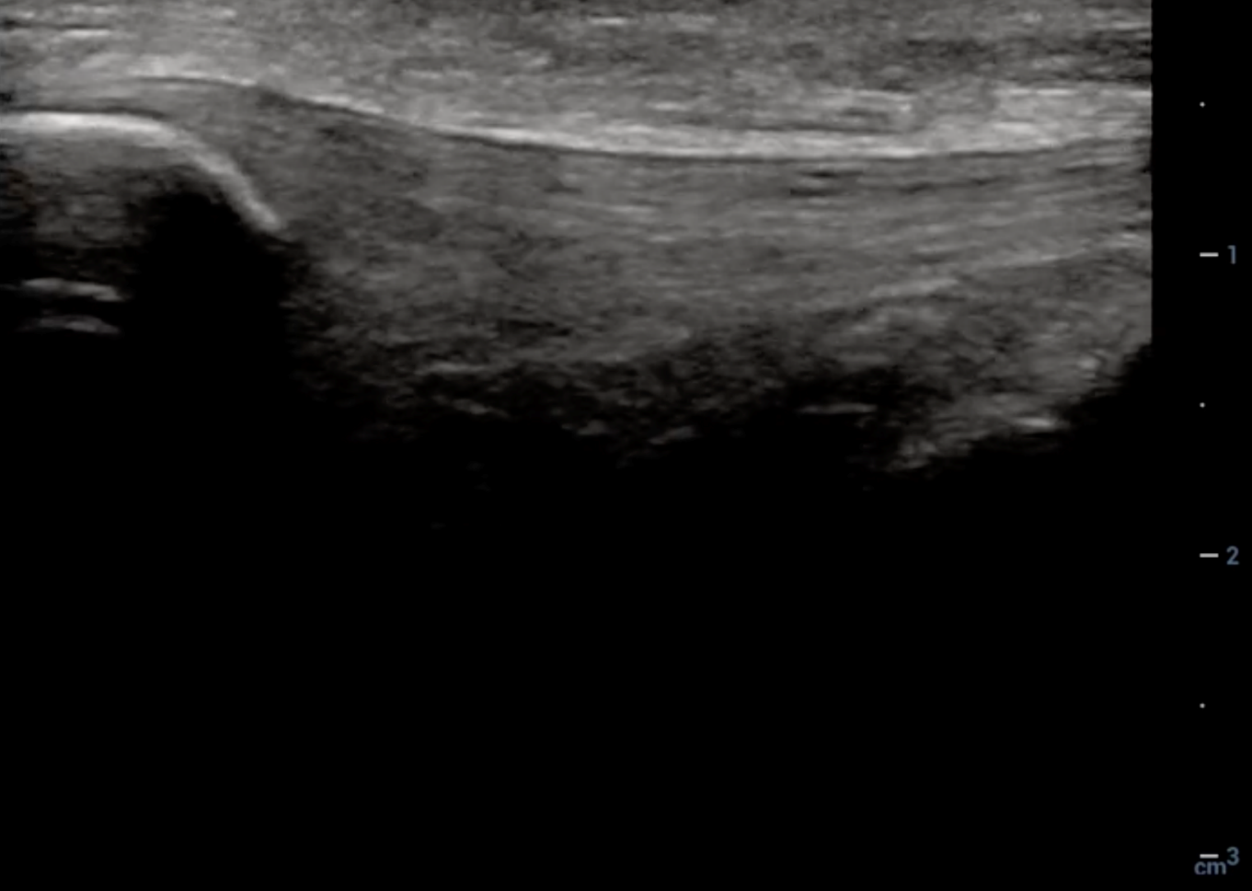
Tendon insertion
Intact patellar tendon
Patella
Notes:
Image Review: Intact patellar tendon

Slide 5
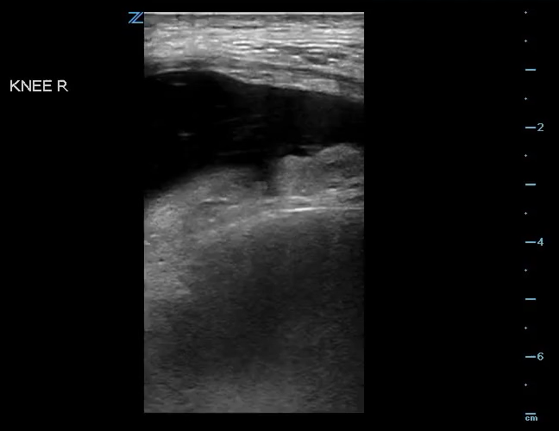
Right Knee
Notes:
1) Right Knee
2) Abnormal
3) Effusion

Slide 6
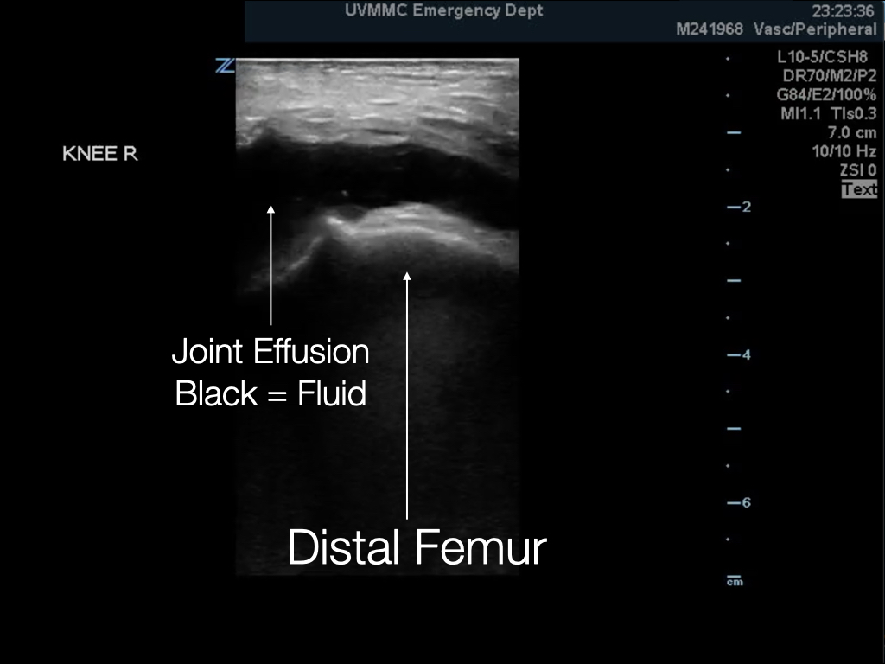
Notes:
Image Review: Knee effusion

Slide 7
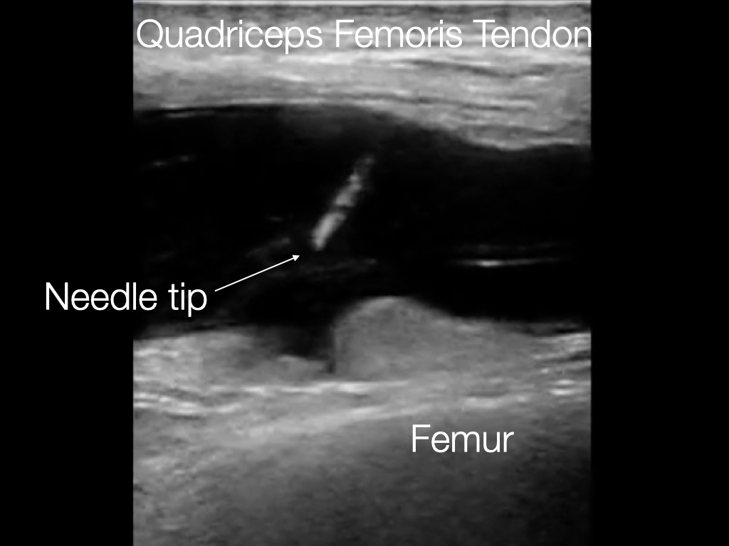
Notes:
Image Review: Arthrocentesis

Slide 8
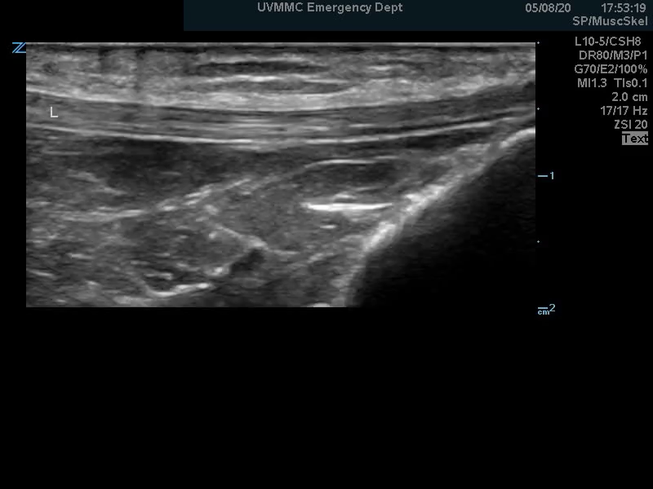
Right Knee
Notes:
1) Patellar Tendon (distal at tibial tuberosity insertion)
2) Normal
3) N/A

Slide 9
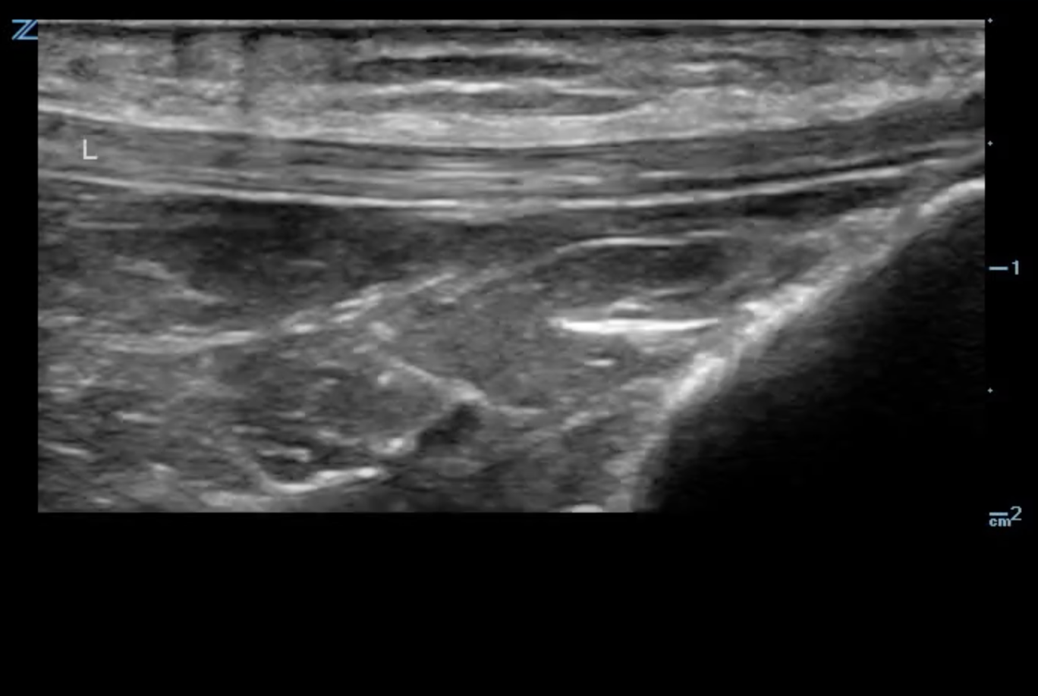
Intact patellar tendon
Infrapatellar bursa & fat pad
Tibial
tuberosity
Notes:
Image Review: Intact patellar tendon

Slide 10
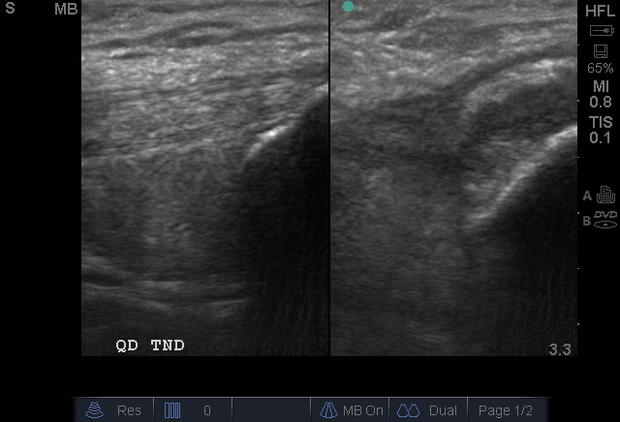
Right Knee
Notes:
Quad Tendon
Left: Normal vs Right: Abnormal
Tendon rupture in right image

Slide 11
Intact tendon
Tendon disruption
Patella
Patella
Notes:
Image Review: Quad tendon

Slide 12
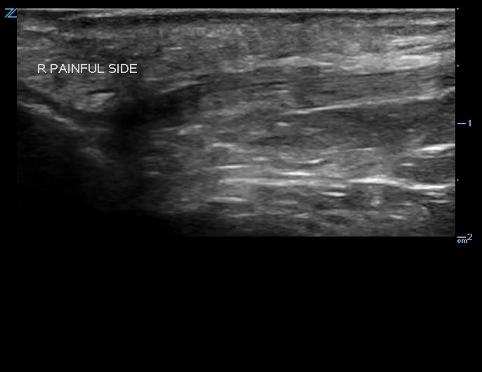
Right Knee
Notes:
Patellar Tendon
Abnormal
3) Tendon disruption at site of patella (dislocation)

Slide 13
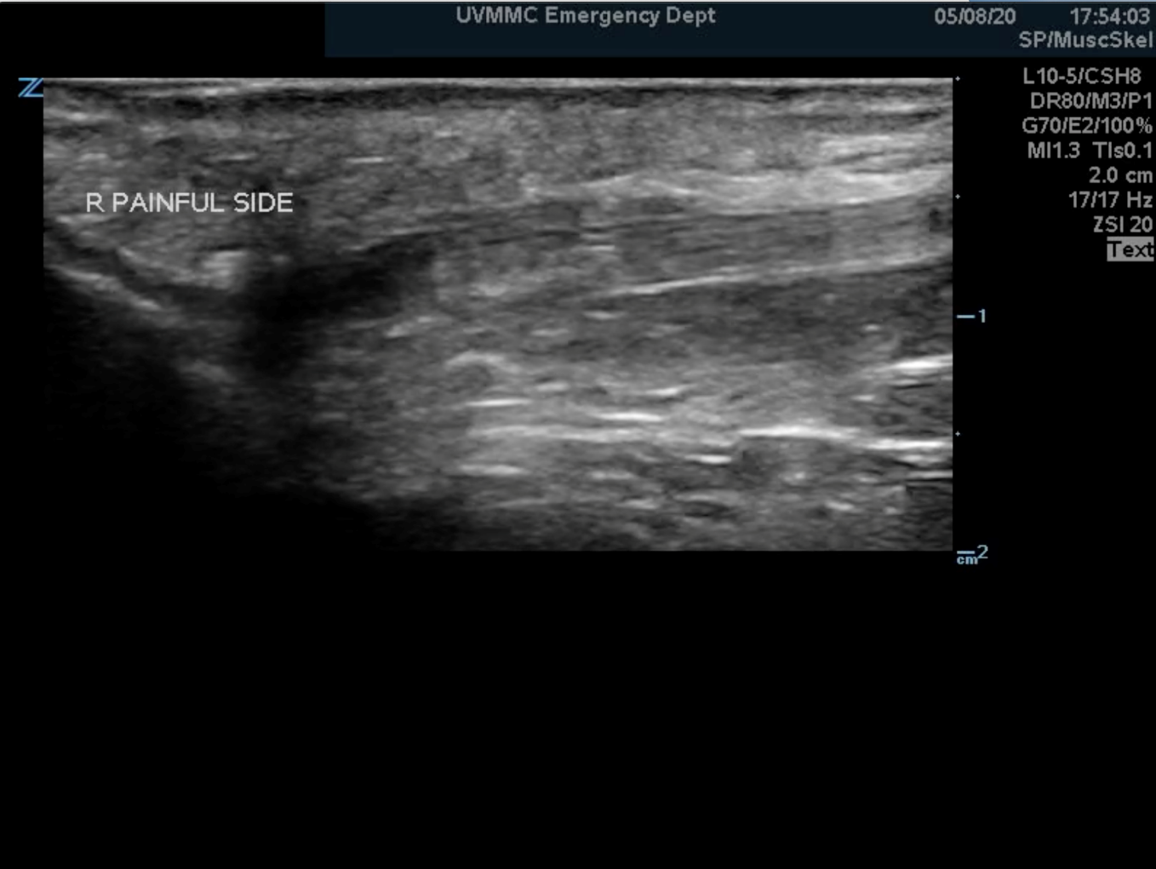
Intact patellar tendon
Tendon disruption
Black = Fluid
Patella
Notes:
Image Review: Patellar tendon disruption

Slide 14
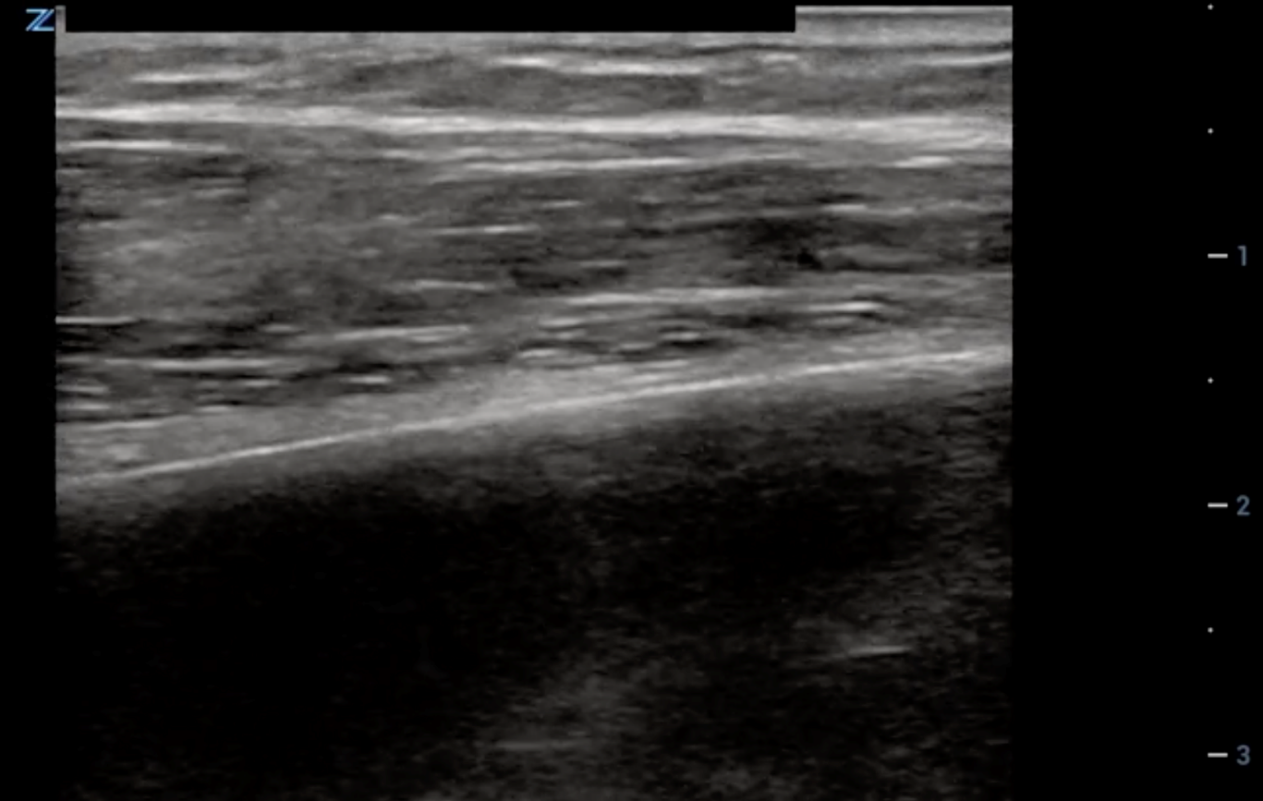
Rib
Notes:
Rib (longitudinal view)
Normal (Intact Cortex)
N/A

Slide 15

Intact bone cortex
Longitudinal view
Notes:
Image Review: Normal intact rib cortex

Slide 16
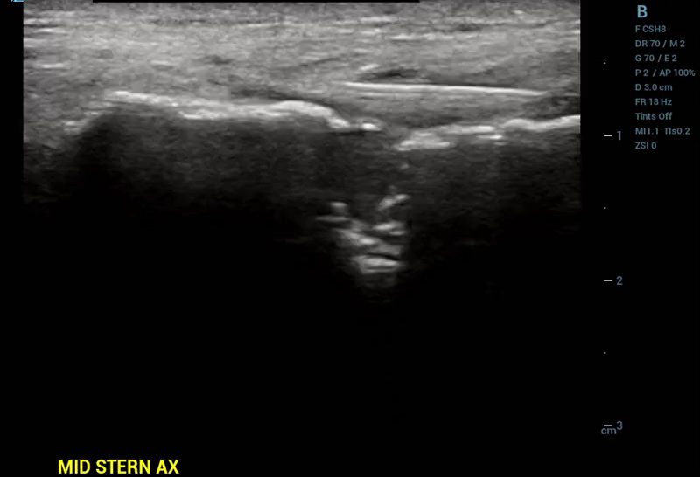
Notes:
Sternum (longitudinal view)
Abnormal
Fracture with mediastinal mass

Slide 17
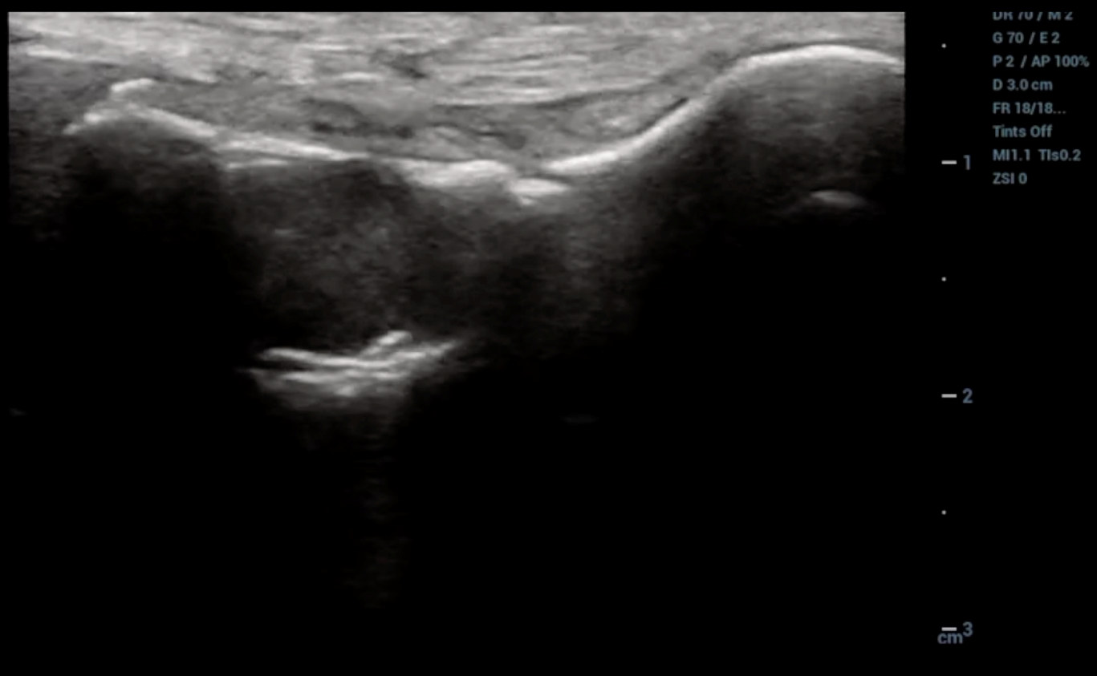
Fracture
Mediastinal mass
disrupting sternal cortex
Notes:
Image Review: Sternal fracture with mediastinal mass

Slide 18
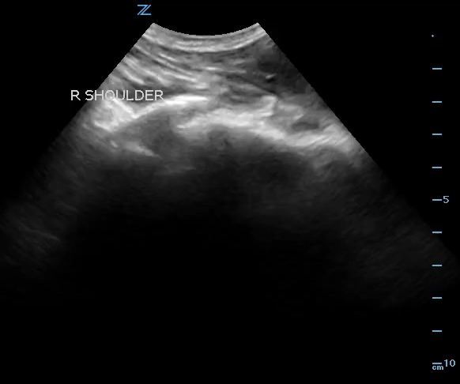
Notes:
Right shoulder
Normal
N/A

Slide 19
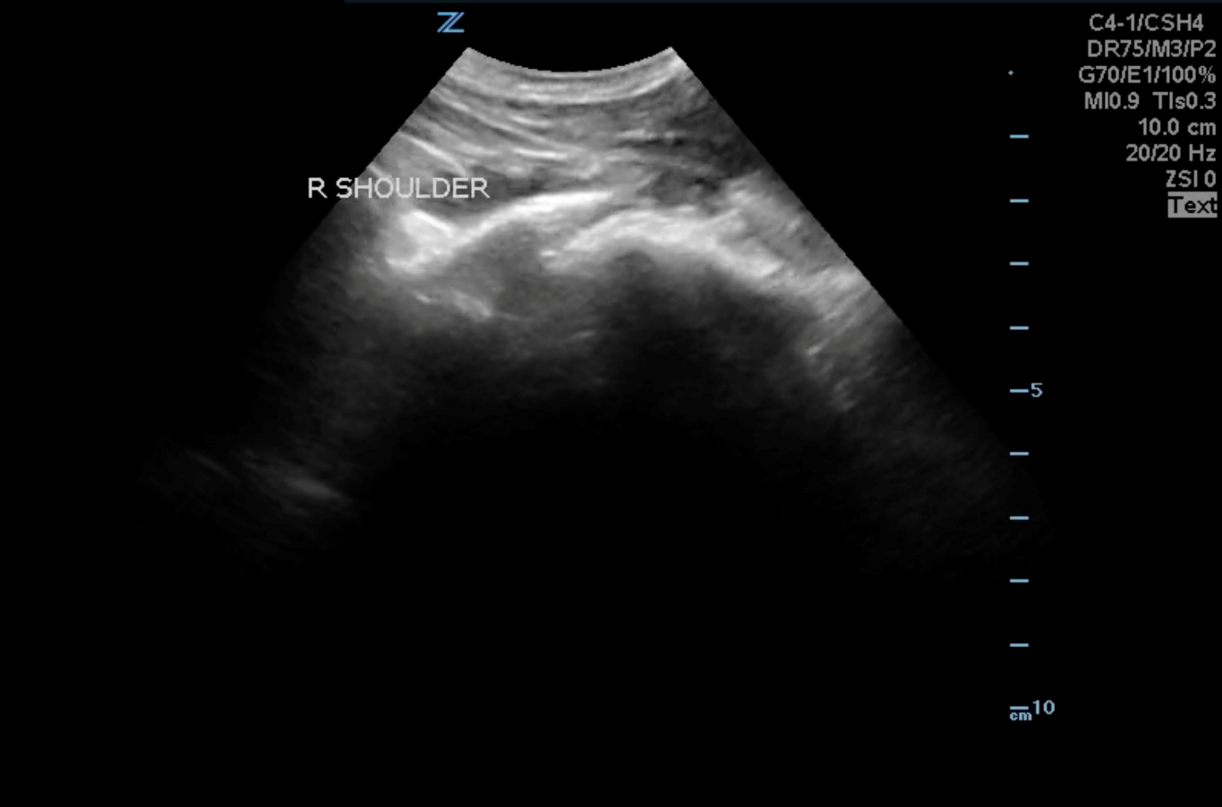
Glenoid
Humeral head
Notes:
Image Review: Normal R Shoulder

Slide 20
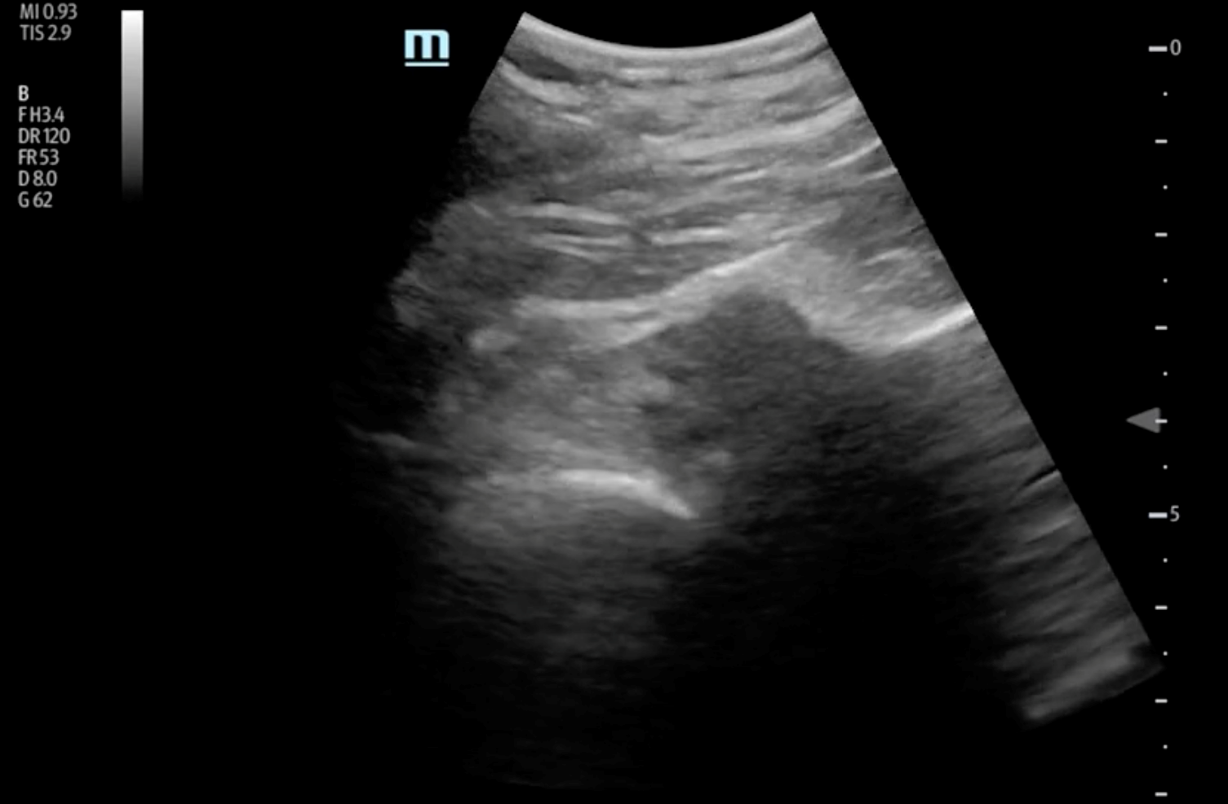
Notes:
Posterior view of shoulder
Abnormal
Anterior shoulder dislocation

Slide 21

(Probe is posterior)
Glenoid
Humeral head is dislocated
ANTERIOR to glenoid
Notes:
Image Review: Anterior shoulder dislocation

Slide 22
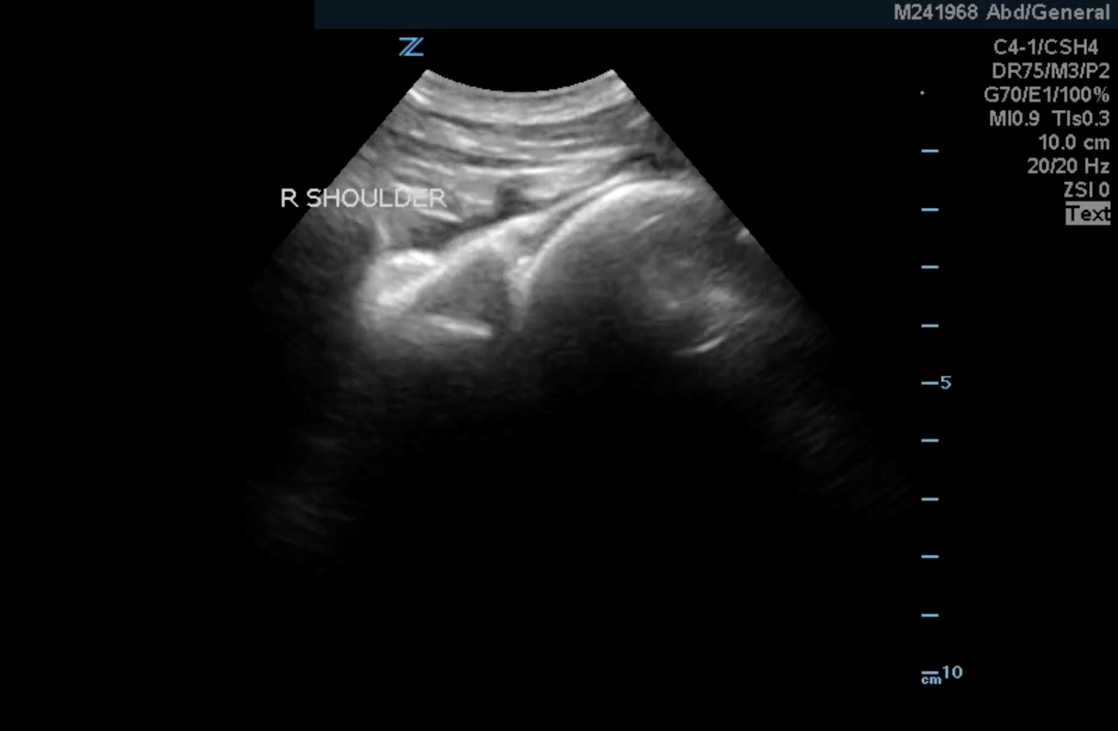
Notes:
Right shoulder
Normal
N/A

Slide 23

Glenoid
Humeral head
Notes:
Image Review: Normal R shoulder

Slide 24
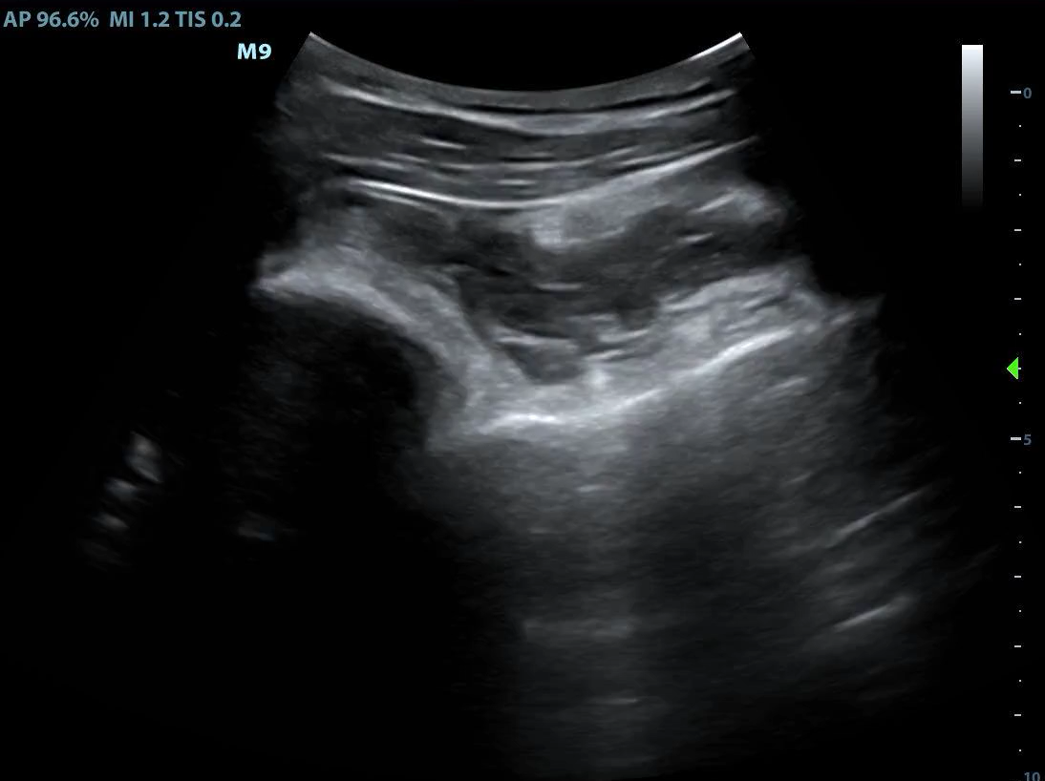
Notes:
Posterior view of shoulder
Abnormal
Posterior shoulder dislocation

Slide 25
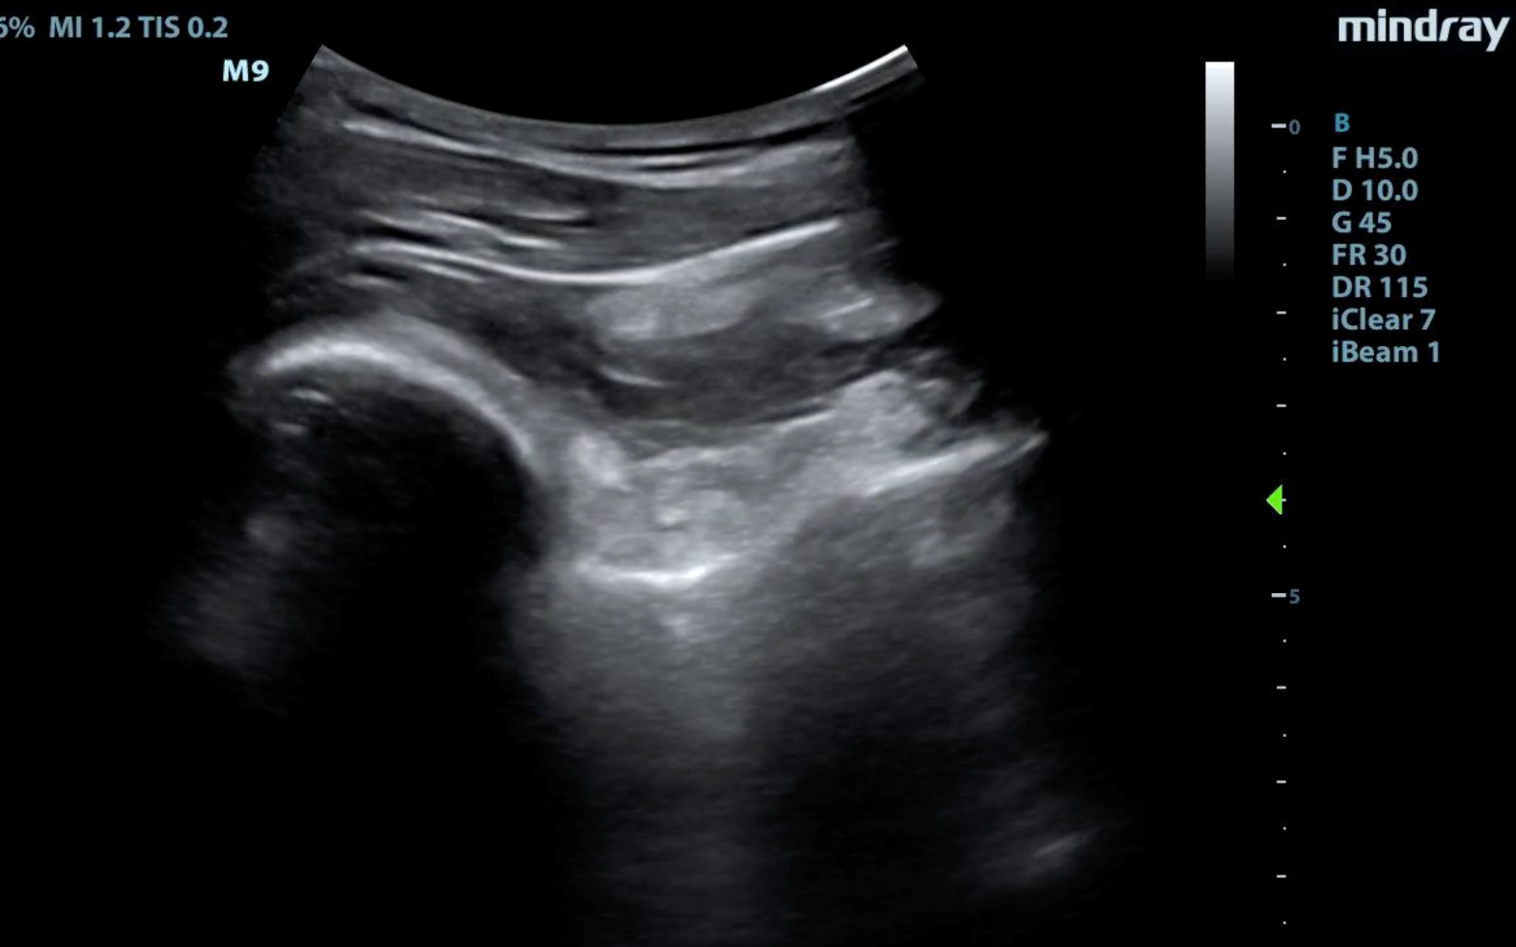
(Probe is posterior)
Glenoid
Humeral head is dislocated
POSTERIOR to glenoid
Notes:
Image Review: Posterior shoulder dislocation

Slide 26
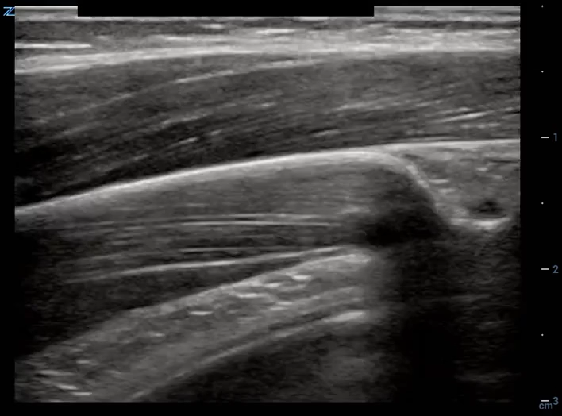
Left Elbow
Notes:
Left elbow longitudinal view medial epicondyle
Normal
N/A

Slide 27
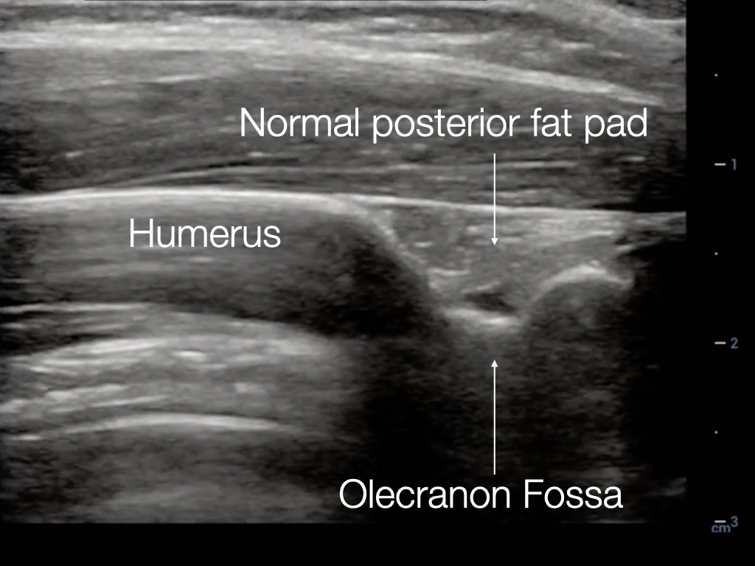
Notes:
Image review: longitudinal elbow (superior to joint)

Slide 28
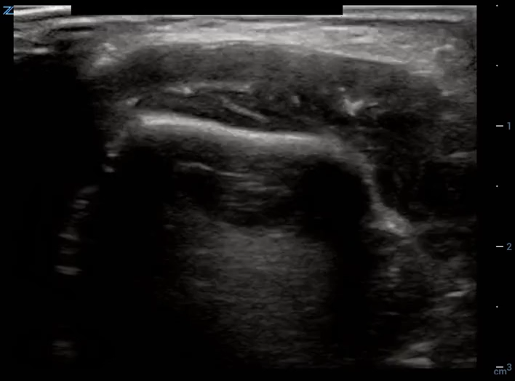
Left Elbow
Notes:
Left elbow transverse view medial & lateral epicondyles
Normal
N/A

Slide 29
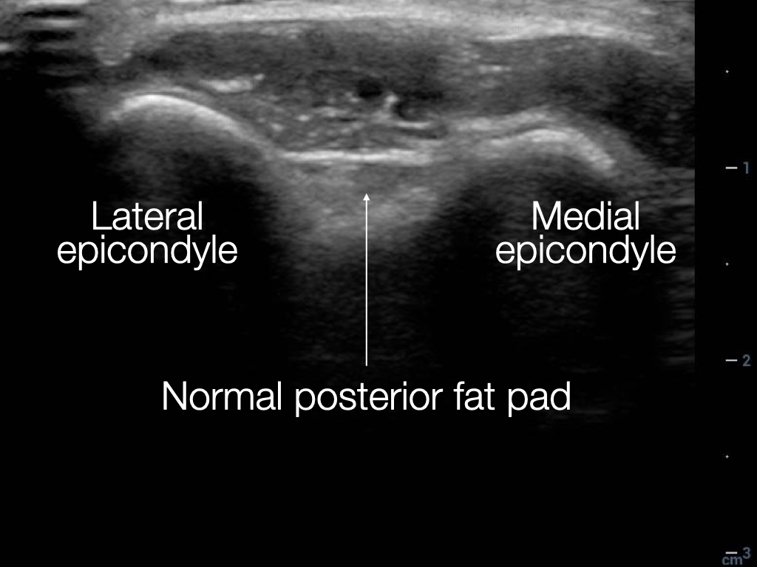
Notes:
Image review: transverse epicondyles (superior to elbow joint)

Slide 30
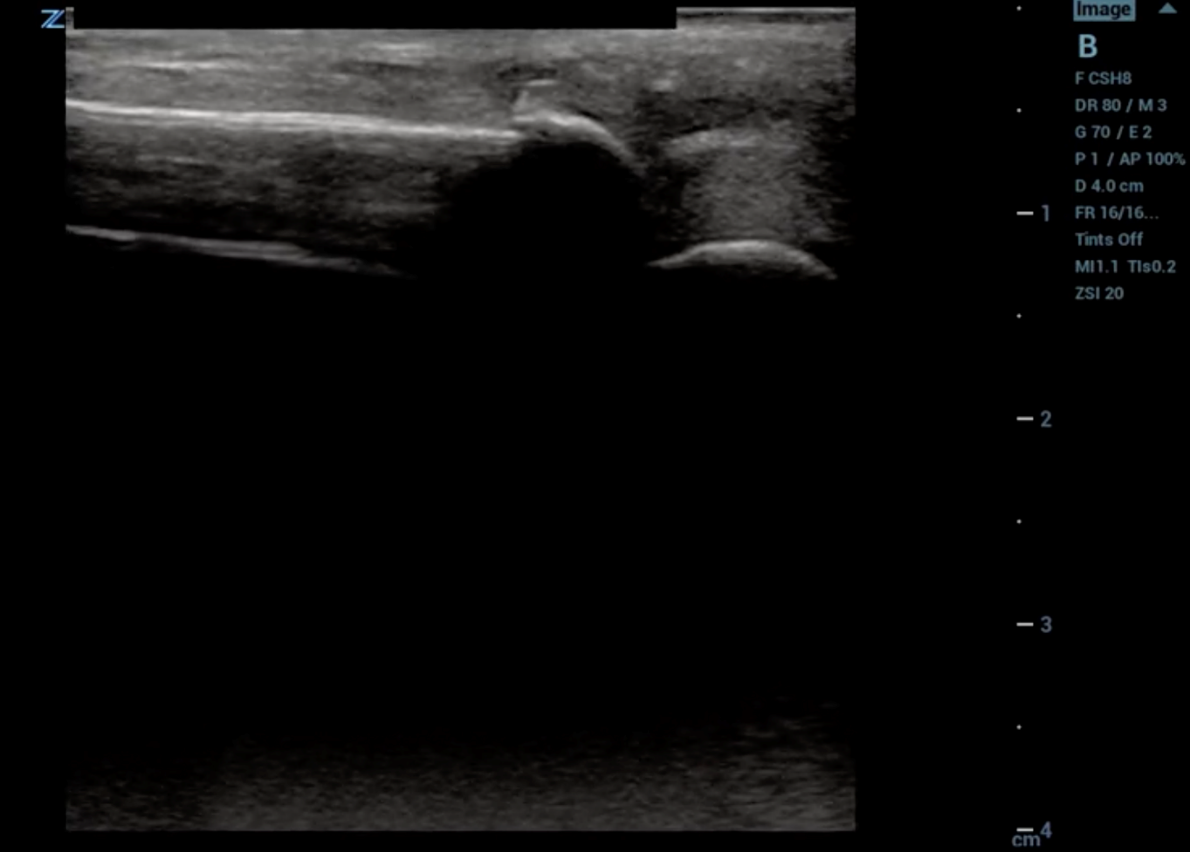
R Humerus (above elbow)
Notes:
R longitudinal humerus
Abnormal
Fracture

Slide 31
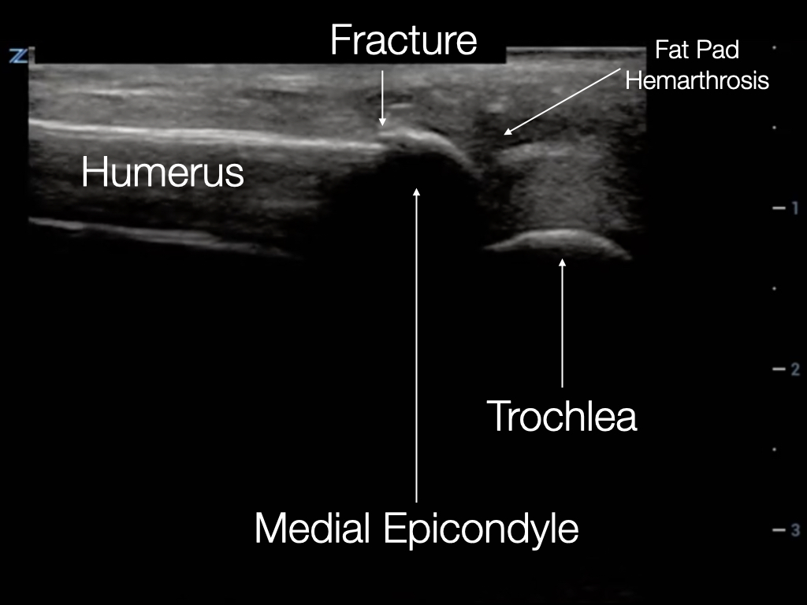
Notes:
Image Review: Supracondylar fracture (distal humerus)

Slide 32
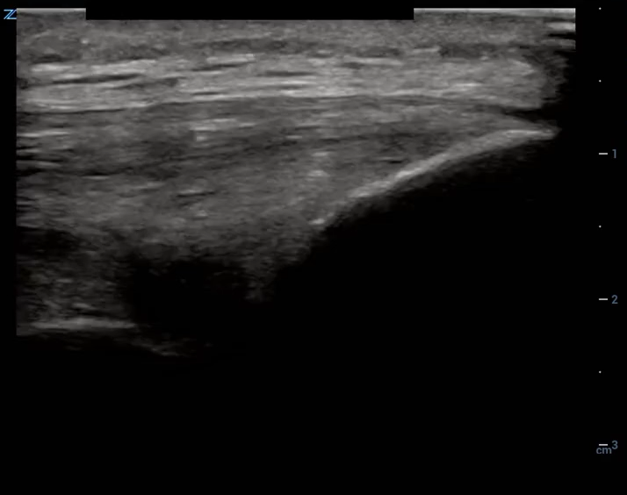
Right Knee
Notes:
1) Patellar Tendon (distal at tibial tuberosity insertion)
2) Normal
3) N/A

Slide 33
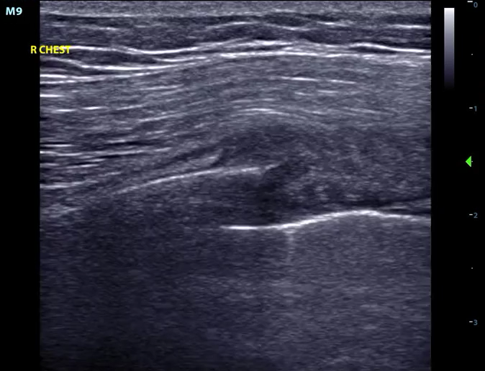
Rib
Notes:
Rib (longitudinal view)
Abnormal
Fracture

