Slide 1

Minor TBI
CORD EM Toolkit
Jake Lehman MD
University of Vermont

Slide 2
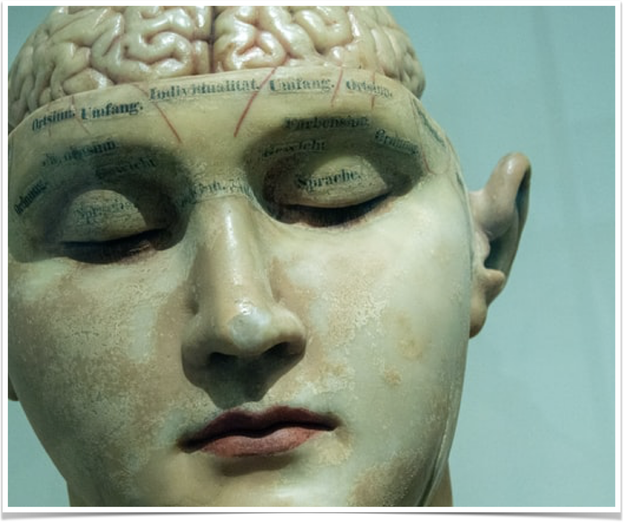
Learning Objectives
Understand epidemiology, pathophysiology and clinical features of head injury
Counsel patients, family members, and coaches about minor head injury
Create framework to answer questions regarding return to play and normal activity

Slide 3
Pre-Test

Slide 4
Question - 1
True or False:
Absence of loss of consciousness in patient presenting with head injury is reassuring and means they can return to play sooner?

Slide 5
Question - 1
FALSE:
Brief LOC in association with concussion does not predict clinical course or long term sequelae or cognitive impairment. By extension, the absence of LOC should not be used to justify return to play sooner

Slide 6
Question - 2
Who has the longest expected course of post-concussive symptoms?
a.) 5 year old male
b.) 12 year old female
c.) 15 year old male
d.) 17 year old female
Bonus: Who will have symptoms for the shortest?

Slide 7
Question - 2
Who has the longest expected course of post-concussive symptoms?
a.) 5 year old male
b.) 12 year old female
c.) 15 year old male
d.) 17 year old female
Adolescents - especially females aged 13-18 - had the longest course of post concussive symptoms
Younger children; aged 5-7; will have most symptoms resolve within 2 weeks. There are no gender differences to recovery in this age group
Notes:
Adolescents - especially females aged 13-18 - had the longest course of post concussive symptoms - with over half not having resolution of symptoms at 12 weeks. This is not the case for males in the same age group. Other age groups show no sex differences and the younger the kid the faster the recovery
About 80% of concussive symptoms were resolved at 2 weeks in the 5-7 year olds while the older children required 4 weeks to get to this point.
https://pubmed.ncbi.nlm.nih.gov/30398522/

Slide 8
Questions - 3
After a concussion, some data suggest recovery time can reduced if:
a.) Patient immediately return to work if they engage in light aerobic activity
b.) 48 hours of rest followed by daily stretching activities
c.) 48 hours of rest followed by light aerobic activity
d.) Gradual return to work/school with minimal to no physical activity

Slide 9
Questions - 3
After a concussion, some data suggest recovery time can reduced if:
a.) Patient immediately return to work if they engage in light aerobic activity
b.) 48 hours of rest followed by daily stretching activities
c.) 48 hours of rest followed by light aerobic activity
d.) Gradual return to work/school with minimal to no physical activity
Notes:
For adolescents there is data to show, return to light aerobic activity after a period of 48 hours of rest, will reduce time of post concussive symptoms.
-13 days v 17 days as compared to light stretching.
This data is not as conclusive in adults although there was no negative effects to engaging in light aerobic exercise.
Children: https://pubmed.ncbi.nlm.nih.gov/33481332/
Adults: https://pubmed.ncbi.nlm.nih.gov/30715132/

Slide 10
Question - 4
What is the pathophysiology behind second impact syndrome?
a.) Intracranial Hemorrhage
b.) Diffuse and rapid cerebral edema leading to herniation
c.) Protein deposits and progression to early onset dementia
d.) Vagal nerve stimulation and prolonged apnea and loss of consciousness

Slide 11
Question - 4
What is the pathophysiology behind second impact syndrome?
a.) Intracranial Hemorrhage
b.) Diffuse and rapid cerebral edema leading to herniation
c.) Protein deposits and progression to early onset dementia
d.) Vagal nerve stimulation and prolonged apnea and loss of consciousness
Notes:
Acute second impact syndrome leads to rapid and diffuse cerebral edema which can lead to death within minutes. This occurs in setting of repeat injury after concussion.

Slide 12
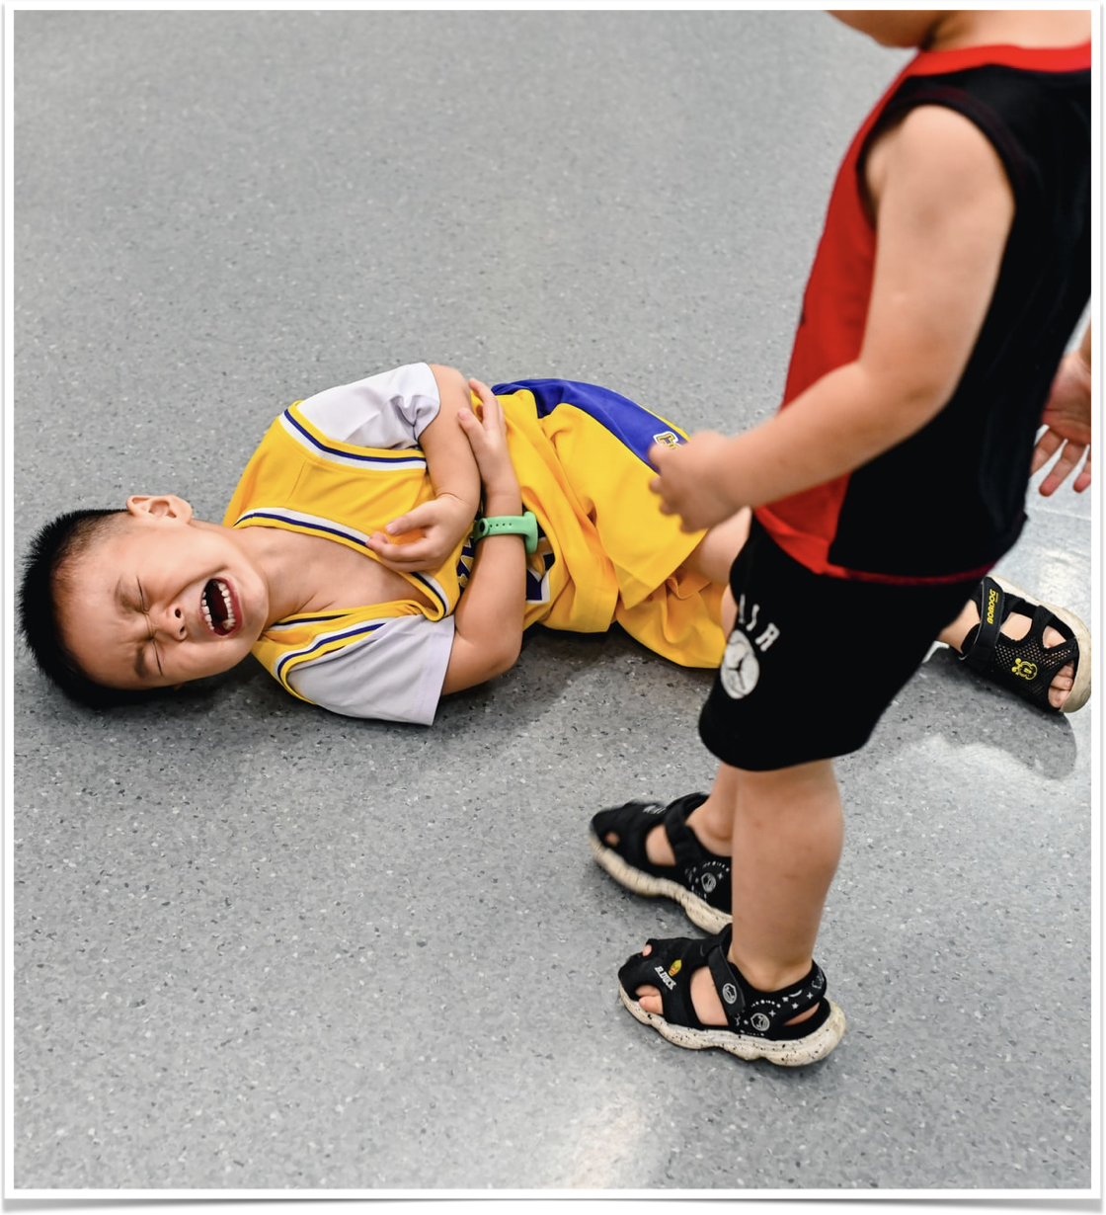
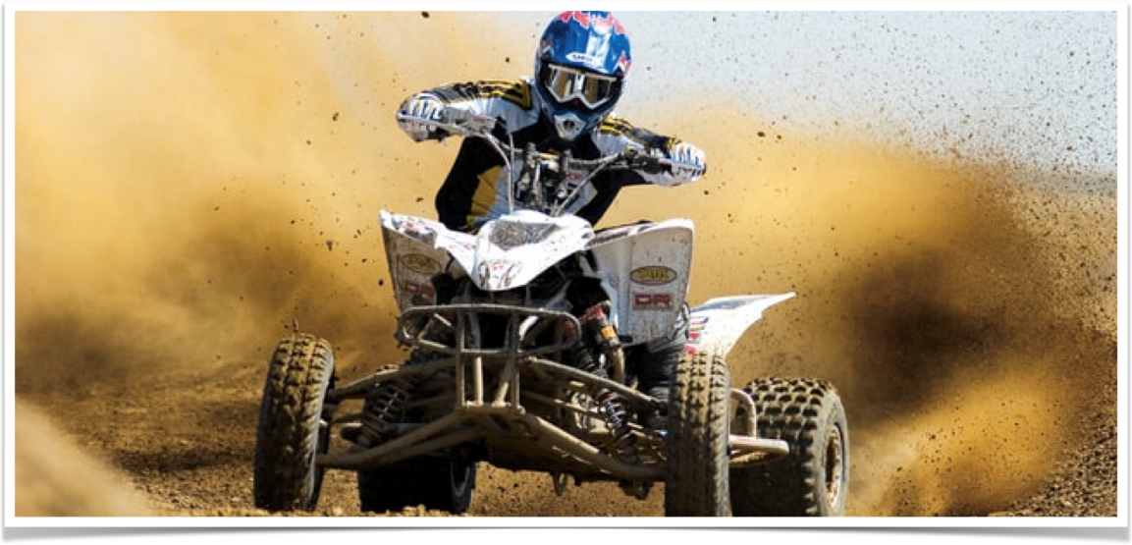
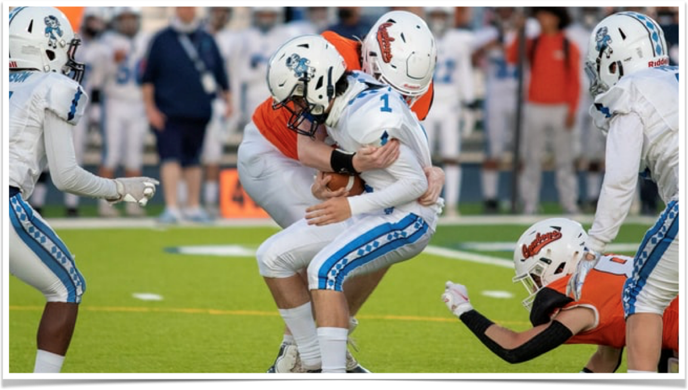
Notes:
How would you counsel each of the patients/family regarding recovery and expectations should they have signs and symptoms of a concussion?

Slide 13
“What does this mean for the football season? Can he/she play next weekend? What effects will this have long term?”
–Concerned Parent in ED

Slide 14
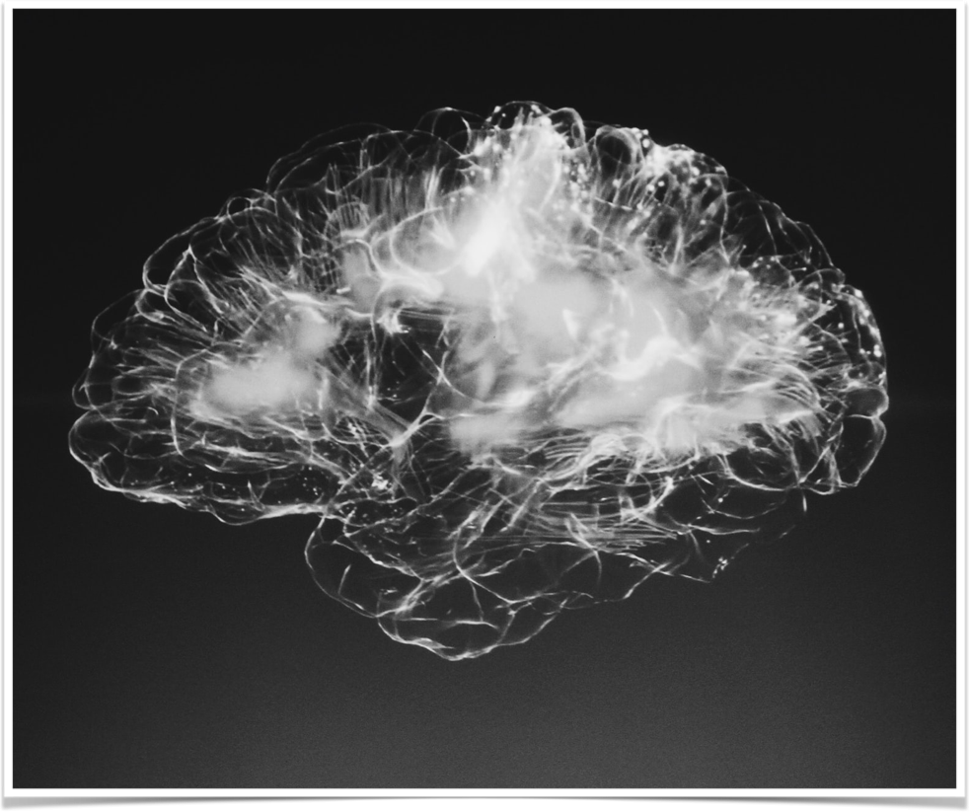
Epidemiology
2.5 Million traumatic brain injuries every year in USA.
  75-95% of these are “mild”
  166 deaths a day due to TBI
In developed countries caused by:
  Motor Vehicle Accidents (20-45%)
  Falls (30-38%)
  Recreational accidents (10%)
  Assault (5-17%)

Slide 15

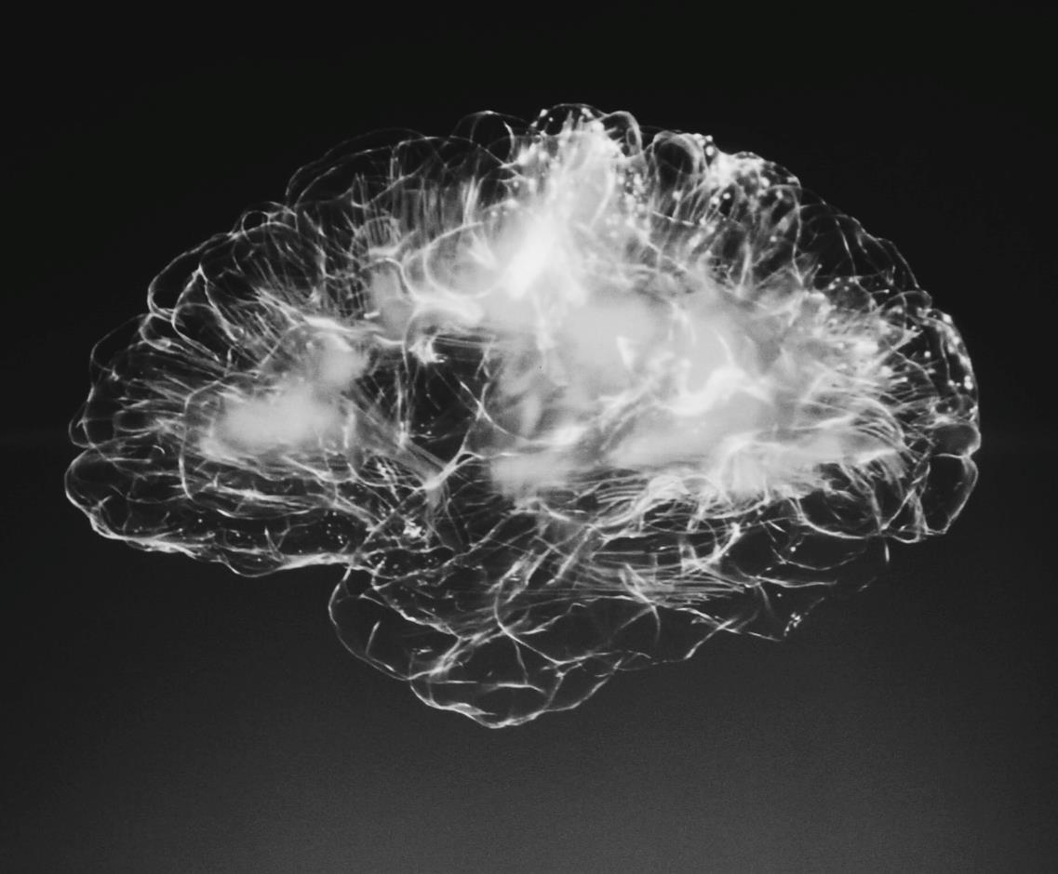
Epidemiology
Sports are large contributor to minor TBI
  Estimated (not reported) 1.6-3.8 million sport related concussions every year
Likelihood of athlete in contact sport experiencing concussion: 20% per season
Increased frequency in:
  Males aged 15-34
  Lower socioeconomic status, lower cognitive function and history of substance abuse
Notes:
American football, ice hockey, soccer, boxing, and rugby have a particularly high incidence

Slide 16
Definitions
  GCS = 14-15 = Mild Head Injury
    Also cannot have LOC > 30 min or other focal neuralgic deficit
  GCS = 9 – 13 = Moderate Head Injury
  GCS < 9 = Severe Head Injury
  Measured 30 minutes after injury
    If longer than 30 minutes since - then at time of initial presentation
Notes:
Measured at approximately 30 minutes after the injury or, if longer than 30 minutes, then at initial presentation

Slide 17
What is a concussion?
  Concussion specifically describes the pathophysiological state which causes symptoms involved in minor TBI
    i.e the clinical symptoms of a TBI
  Mild TBI is “traumatically induced physiological disruption of brain function”
    Any LOC, loss of memory or any alteration in mental state at time of incident

Slide 18
What is a concussion?
Clinical symptoms due to functional changes rather than structural anomalies
  Neuroimaging will be normal
  If imaging obtained for other concerns and contusion or hemorrhage is found the primary diagnosis is no longer mild TBI
    May still develop post-concussion syndrome
Notes:
https://pubmed.ncbi.nlm.nih.gov/23479479/

Slide 19
What is a concussion?
Caused by more than just direct force to the head or neck
  Quick head movement can be caused by transmitted forces from large blow to body
Rapid onset of symptoms which resolves spontaneously
  May worsen over minutes to hours

Slide 20
What is a concussion?
The concussion grading system is no more
  Previously graded based on presence and length of loss of consciousness
Brief loss of consciousness does not predict long term course or outcome
  Absence of LOC doesn't mean “milder” injury and cannot justify earlier return to play
Notes:
https://pubmed.ncbi.nlm.nih.gov/28446457/

Slide 21
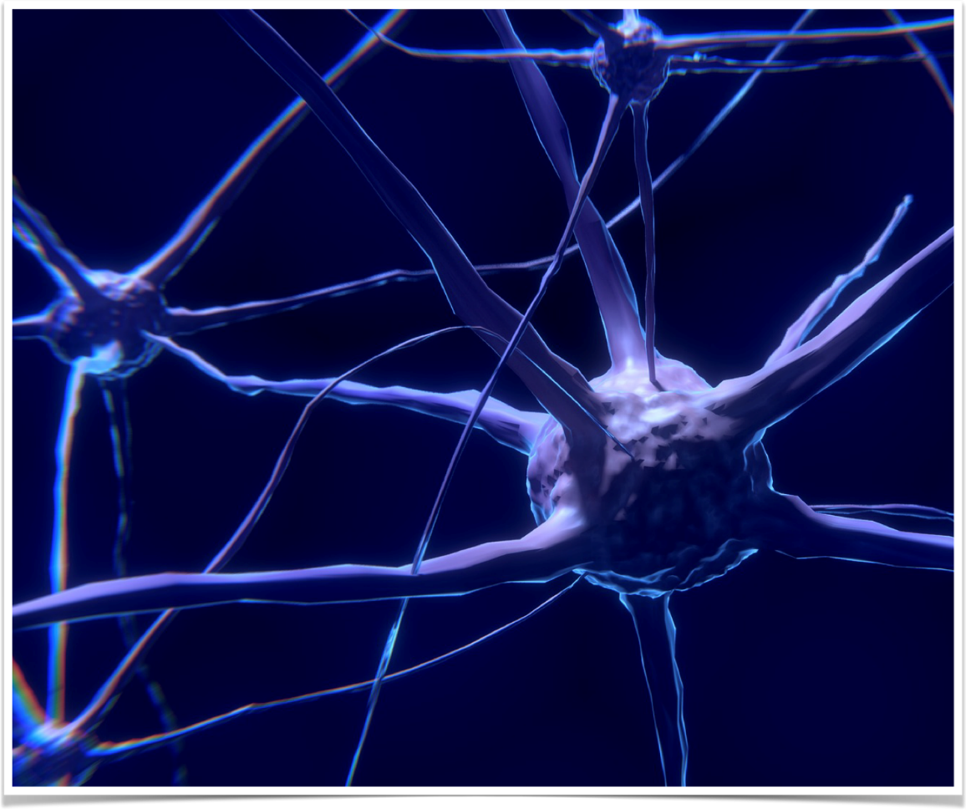
Concussion Pathophysiology
Large blow (to head or body) causes rotational acceleration of brain which causes micro shearing forces at the neuronal level
  Forces cause:
    Neuronal depolarization
    Lactic acid accumulation
    Decreased cerebral blood flow
Other theories exist and is not fully understood currently
Notes:
Neuronal Depolarization
Opening of Na/K_ channels leads to influx of sodium and efflux of potassium. Calcium dependent neurons release glutamate which further depolarizes neurons.
Lactic Acid
The large areas of depolarization as mentioned above require lots of ATP to move the ions through the Na/K pumps. Increase in glycolysis locally causes consumption of glucose and therefore release of lactic acid.
Decrease Cerebral blood flow
Areas affected by the trauma have decreased blood flow. This is problematic as these ares also have consumed much of the glucose as mentioned above. This last days to weeks and contributes to pronged symptoms.
https://pubmed.ncbi.nlm.nih.gov/1977896/
https://pubmed.ncbi.nlm.nih.gov/1797338/
https://pubmed.ncbi.nlm.nih.gov/3249308/

Slide 22

Sideline Assessment
Various sideline tools exist to assess symptoms of concussion
  Standardized concussion assessment (SAC)
  Sport Concussion Assessment Tool (SCAT)
Lower scores associated with concussion but no cutoff has been established for diagnosis
Clinical diagnosis with no gold standard

Slide 23
Sideline Assessment
These tools are not mandatory but can provide valuable information for follow-up
Some argue there should be pre-season baseline testing performed as:
  21-47% of males with psych or migraines and 33-72% of girls with history of psych, ADHD or trauma would score high enough to be considered concussed
Notes:
Iverson, Grant L., Noah D. Silverberg, Rebekah Mannix, Bruce A. Maxwell, Joseph E. Atkins, Ross Zafonte, and Paul D. Berkner. “Factors Associated With Concussion-like Symptom Reporting in High School Athletes.” JAMA Pediatrics 169, no. 12 (December 2015): 1132–40. https://doi.org/10.1001/jamapediatrics.2015.2374.

Slide 24
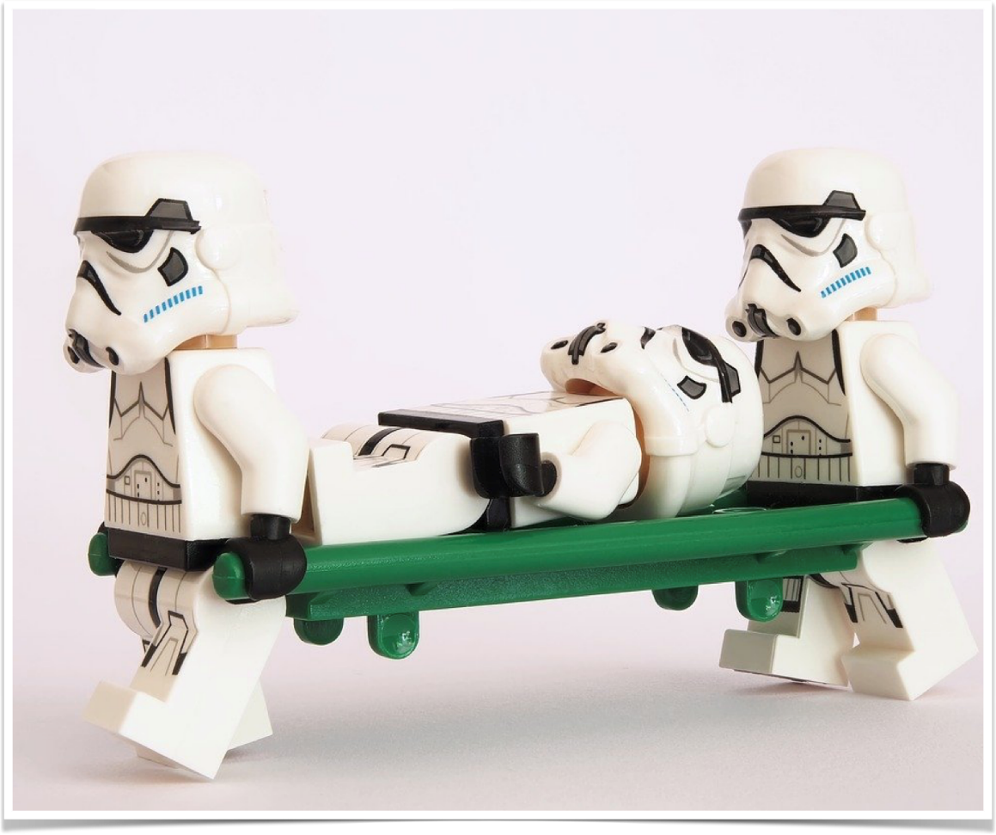
ED Evaluation
Evaluate for other injuries
Consider imaging following usual decision rules - Canadian CT Head Rule or PECARN
Routine imaging is not indicated
  CT or MRI can be used to assess for suspected structural abnormalities
  Imaging not useful in assessment of concussion
Notes:
Can consider imaging for reasons such as:
Focal neuro deficits
Evidence of skull fracture
Impaired GCS
Prolonged LOC
Persistent vomitting

Slide 25
ED Evaluation
Signs and symptoms of concussion
  May be no symptoms at time of presentation
  Confusion
  Blank stare
  Emotional liability
  Poor focus
  Delayed verbal responses
Notes:
Can consider imaging for reasons such as:
Focal neuro deficits
Evidence of skull fracture
Impaired GCS
Prolonged LOC
Persistent vomitting

Slide 26
ED Evaluation
Don’t forget to examine other causes of AMS; even in setting of head trauma
  Dehydration
  Hypoglycemia
  Migraine
  Psyciatric Disorders
Notes:
Keep your differential broad and suspicion high for other causes of AMS or confusion

Slide 27
Complications in Acute Phase
Seizure
  Post-traumatic seizure possible in < 5%
  Reflects changes from the trauma rather than epilepsy
    Most common in fist 24 hours post injury
    Nonetheless at higher risk of developing epilepsy in future
    Seizure prophylaxis not warranted
  Higher risk if have other intracranial pathology
Notes:
Again, unless some other indication as mentioned previously or there is suspicion for other intracranial pathology, no need to routinely image concussion - although may consider in case of first time seizure even in post traumatic setting

Slide 28
Concussive Symptoms after ED
Seen in children and adults
  Headaches
  Dizziness
  Fatigue
  Insomnia
  Loss of concentration
  Irritability
Notes:
50% report personality changes, anxiety and irritability. More susceptible to drugs and alcohol.

Slide 29
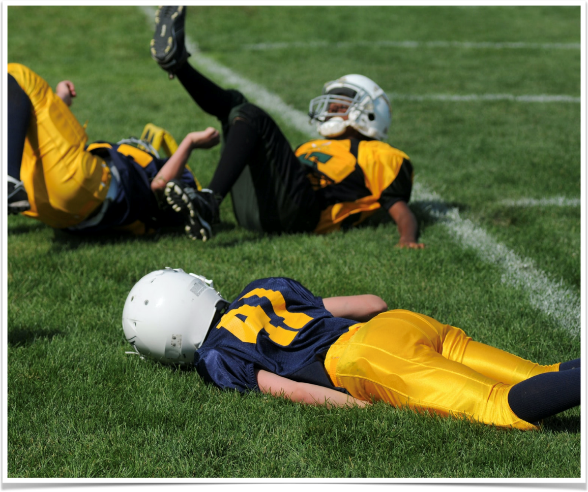
Natural Course of Concussion - Pediatrics
Pediatric EM Concussion Team study
  Prospective cohort of 2700 children from 9 EDs in Canada
    Interested in determining symptom resolution
Youngest children recovered first (5-7 years)
  80% symptom free at 2 weeks; most in 1 wk.
8-12 years old 80% symptom free at 4 weeks
13-18 year old boys 50% no symptoms at 4 weeks
  In this age group only less than 50% of girls had resolution of symptoms by 12 weeks
Notes:
https://www.ncbi.nlm.nih.gov/pmc/articles/PMC6583432/

Slide 30
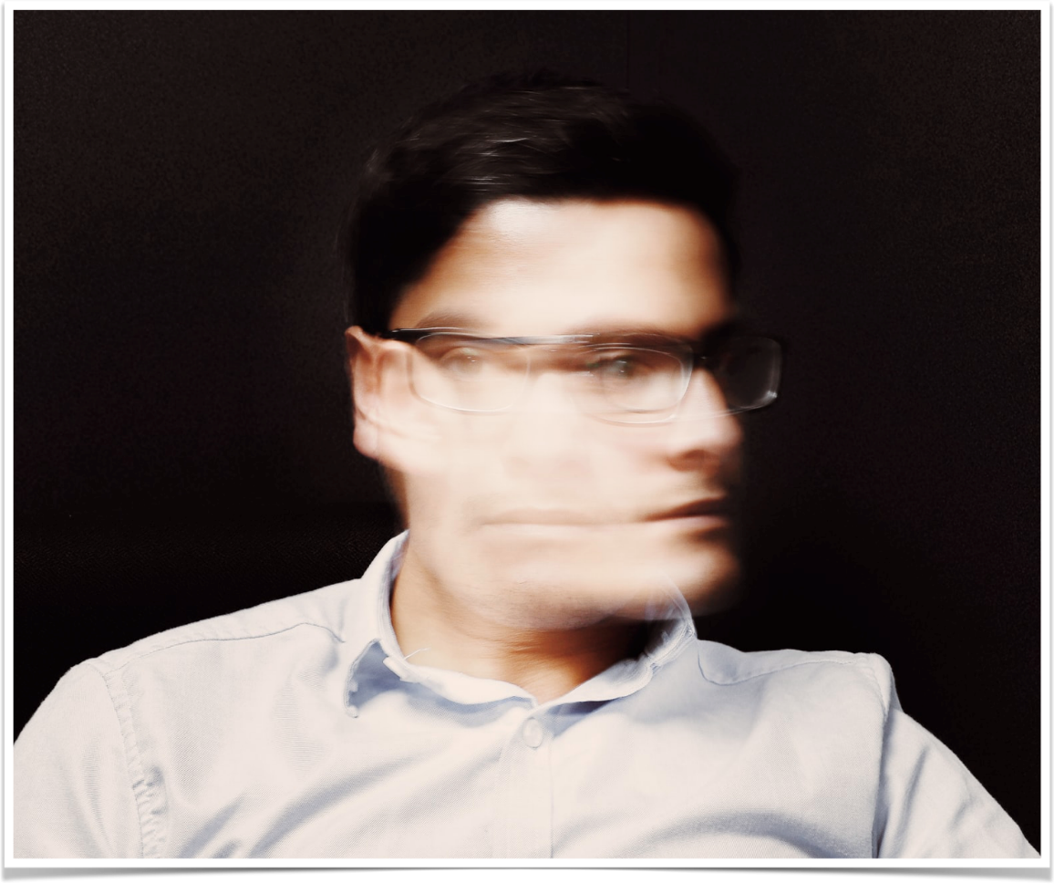
Natural Course of Concussion - Adults
Data on adults not as well understood
  Studies which do exist show peak of post-concussive symptoms 7-10 days
  50% achieve resolution around 4 weeks
  Most cases completely resolved in three months
  Some patients have symptoms for >1 year
Notes:
https://pubmed.ncbi.nlm.nih.gov/22496195/

Slide 31

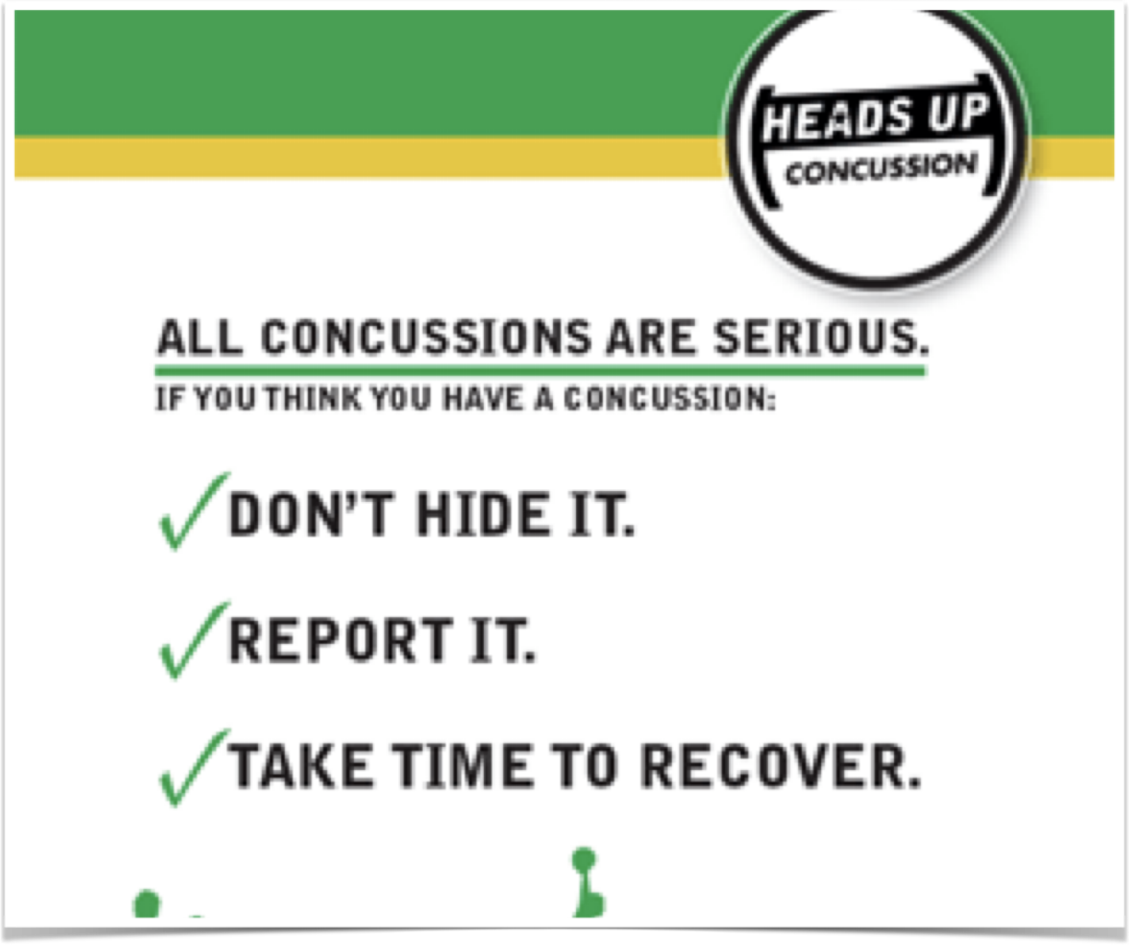
Return to learn? Return to play?
Notes:
https://www.cdc.gov/headsup/basics/return_to_sports.html
CDC has excellent information for parents and physicians regarding return to play protocol. There exists a 6 step protocol to reintroduce student athletes back to play

Slide 32
Road to Recovery
“Rest is best” - No longer the recommendation
  Initial 48 hour period of rest followed by return to light activity
RCT in kids looked at light aerobic activity after 48 hours of rest
  Those in aerobic group recovered 4 days faster as compared control group (stretching)
This does not mean return to sport play
Notes:
https://pubmed.ncbi.nlm.nih.gov/30715132/

Slide 33
Return to Learn
Returning to school should be prioritized in children
Slow return - based on symptoms should occur outside initial 48h period of rest
Rest beyond 48h has shown no benefit and may prolong course
Screen time - prohibited in first 24-48 hours
Notes:
Screen time should be avoided if experience symptoms like nausea, vomiting, headache etc. Patient should take a break from screens or school if they are experiencing these symptoms.
Research looking at 48 hours of cognitive rest versus 5 days showed worse outcomes and prolonged recovery in those resting for 5 days.
https://pubmed.ncbi.nlm.nih.gov/25560439/
https://pubmed.ncbi.nlm.nih.gov/25560444/

Slide 34
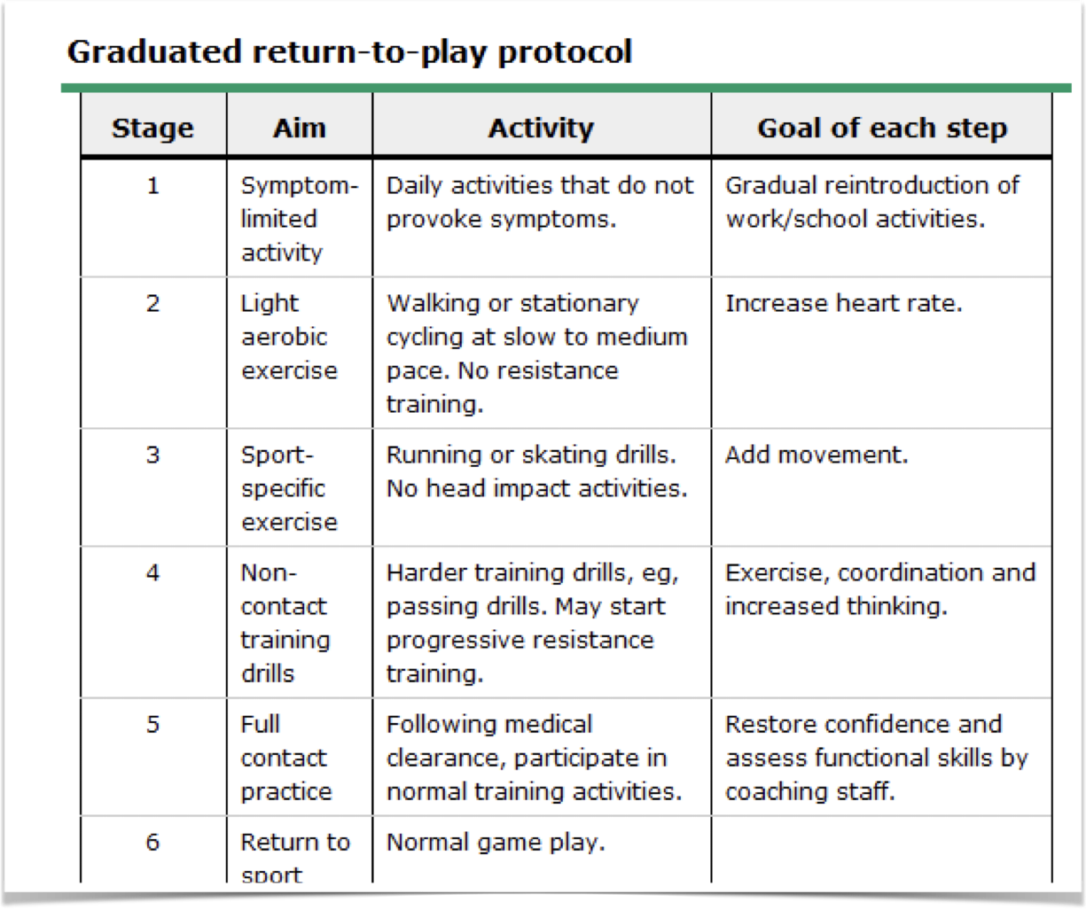
Return to Play
  Consensus Statement on Concussion in Sport from 2012
    Graded return to activity with escalating levels of activity and contact
    If have any symptoms, return to prior level of activity where symptoms did not exist
    Attempt progression every 24 hours
  Children and adolescents should not return to play without approval by health care professional
Notes:
The idea with returning to athletic play is that an athlete should be symptom free by time they return to full contact and activity. That being said the progression to this full activity should take time and occur after initial period of 24-48 hours of rest. This allows the time for Brain to “rest” and allow for identification of symptoms which may peak around day 7-10 but allow for quicker progression if an athlete is not experiencing symptoms.
https://pubmed.ncbi.nlm.nih.gov/23479479/

Slide 35
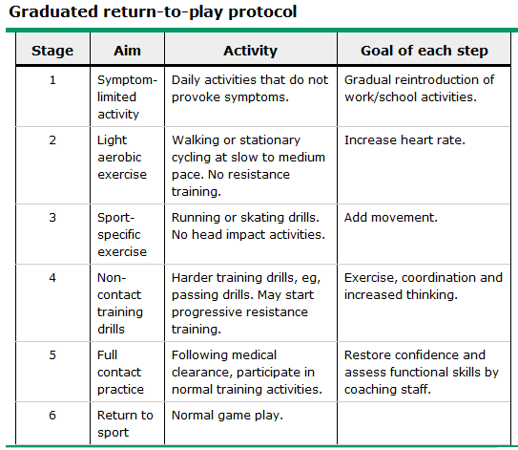

Slide 36
Return to Play - Children and Adolescents
  Minimum of five days to return after 24-48 hour period of initial rest
  Children and adolescents should not return to play without approval by health care professional
  In children with prolonged symptoms or who have had more than one concussion the RTP time may be weeks - months
  Recovery goals should be tailored to the unique needs of patient
Notes:
While adults can progress through these stages and return to activity on their own volition, while professional approval is recommended it is not required.
For children and adolescents it is recommended and some professional organizations say it should be required a child see healthcare professional before returning to play. This can be a primary care, athletic trainer, neurosurgeon or any other health care professional who is well versed in post concussive symptoms. For adolescent athletes with prolonged symptom course or who have had more than one concussion, some experts recommend staying at each stage for 1-2 weeks before progression.

Slide 37
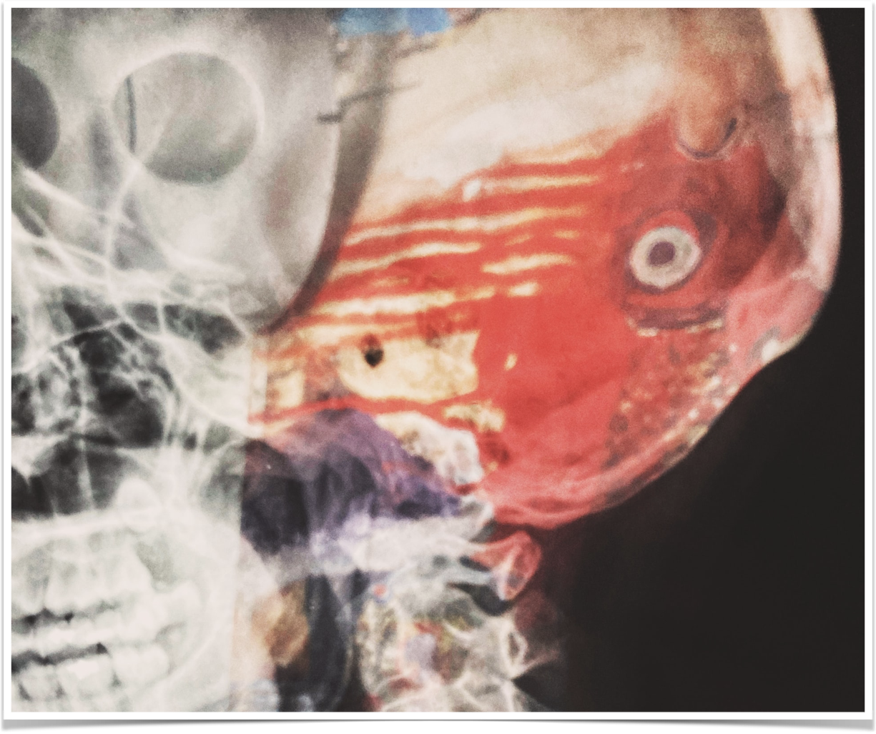
Second Impact Syndrome
Feared complication with second brain injury while in recovery from first
  Metabolic changes from first injury disrupt auto-regulatory mechanisms
Potential for diffuse swelling, brain herniation and death
  Death occur within a few minutes
Treat like other cases of cerebral edema
  Hypertonic saline and intubation for airway protection
Notes:
The reason the guidelines are conservative, especially with children is the feared complication of second impact syndrome. With repeat head injury in the recently concussed athlete the brain has lost much of its auto-regulatory functions in regards to intracranial and cerebral perfusion pressure. The metabolic changes as mentioned on prior slides last as out to 10 days after the initial injury. With a second impact death can occur within 2-5 minutes and causes death much faster than those from an acute epidural hematoma. Because brain swelling is more significant in children initially as compared to adults this is why experts are more conservative in children returning to play.
https://www.ncbi.nlm.nih.gov/pmc/articles/PMC2672291/

Slide 38
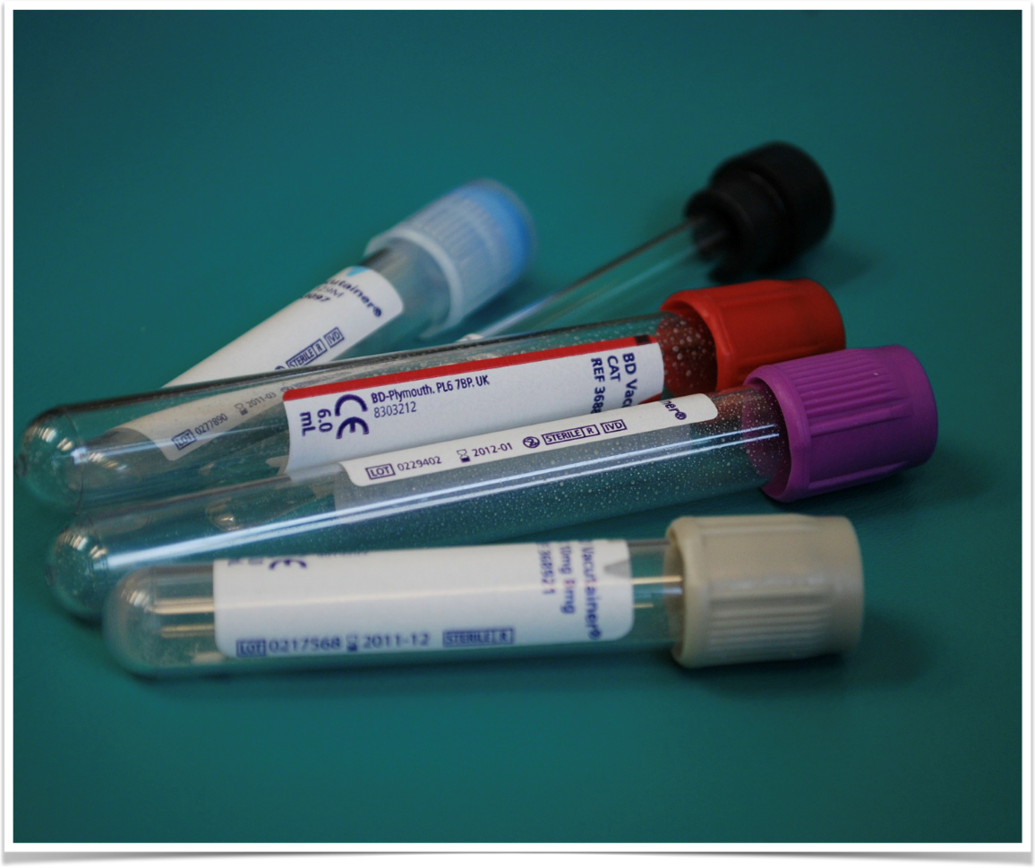
The Future - Biomarkers
In 2018 FDA approved blood test to measure biquitin c-terminal hydrolase L1 and glial fibrillary acidic protein
  Leaky blood brain barrier with injury
  Predict intracranial lesion 97.5% of the time and rule out 99.6%
  Test takes 3-4 hours to result
Potential to determine if concussion present and to track disease resolution and symptom course
Notes:
These test are not ready for prime time currently but may be ubiquitous in the future. May help in deterring if imaging is needed and to track course of symptoms or expected course. These enzymes are released in the setting of TBI as there are small changes in the blood brain barrier during acute injury.

Slide 39
For the next slide, discuss amongst each other or answer aloud how you would counsel the patient and or family regarding return to school, sport and work after a concussion.
  What is the expected time to recovery?
  How long should I rest? What symptoms can I expect?
  What steps should I follow to get get back into activity sooner?
  I have a tournament in 4 days, can my son/daughter play?

Slide 40
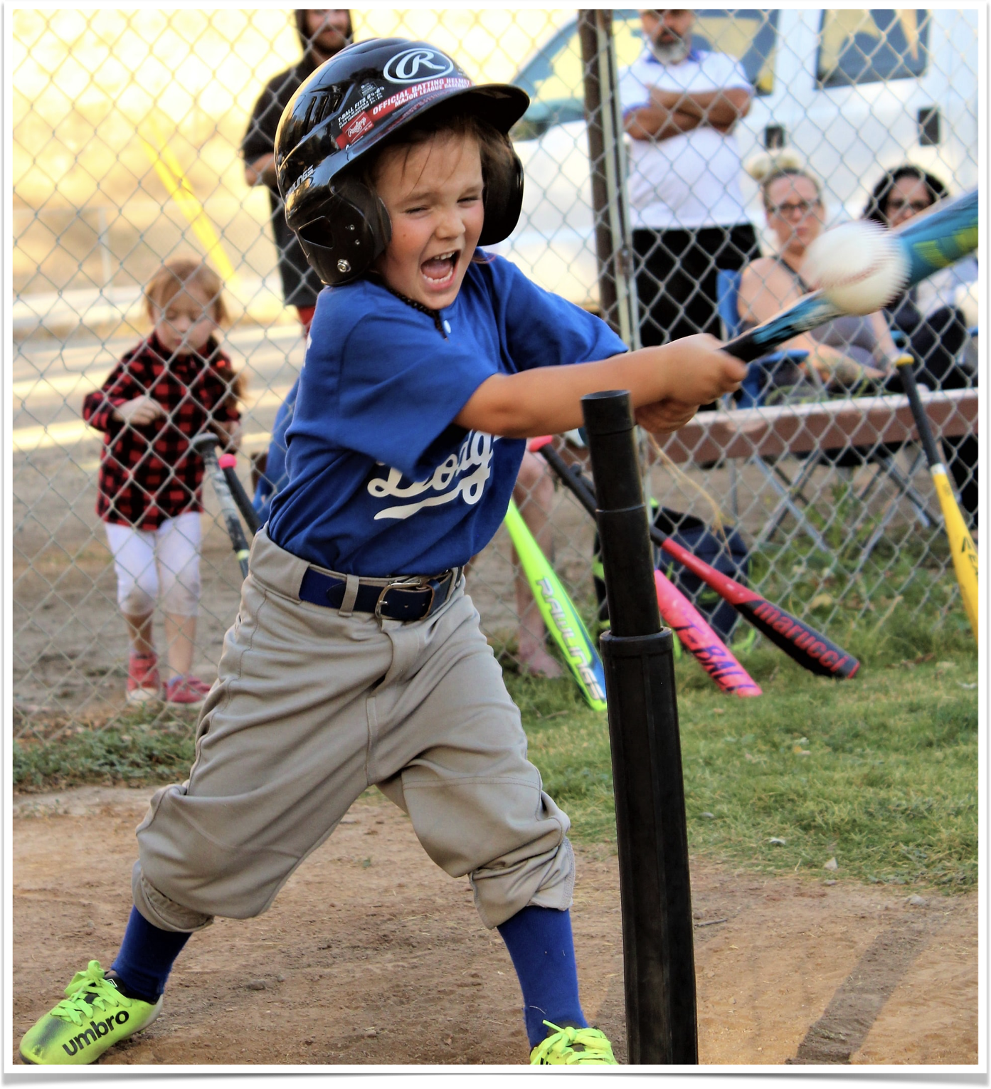

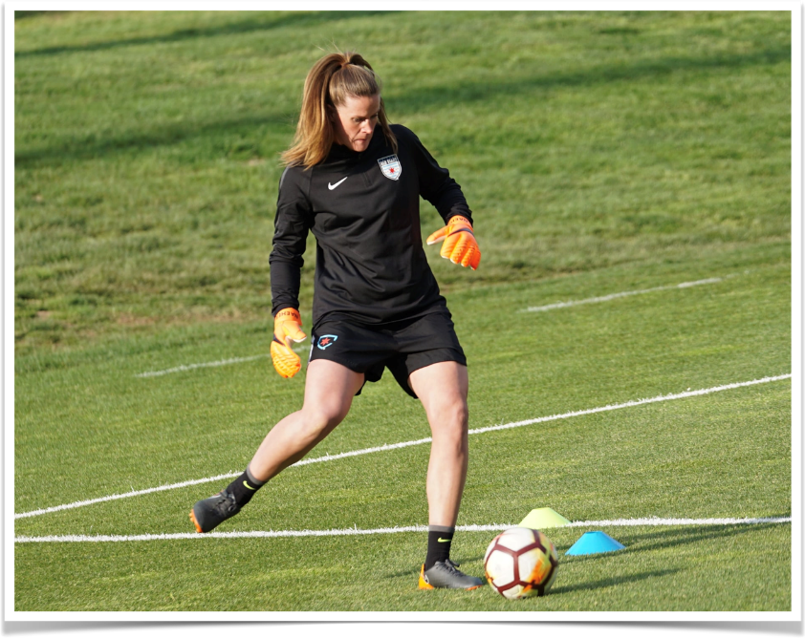
29 year old computer scientist wanting to go back to work
6 year old male tee-ball player in kindergarten
17 year old soccer player with tournament next weekend
Notes:
6 year old male - Younger children tend to recover faster. In this age group large studies have show that in those aged 5-7, 80% will be fully recovered in 2 weeks with most in about a week. In this age group returning to learn and getting back in the classroom should be top priority as opposed to future sport activity. Screen time can be limited as symptoms tolerate. Parent can talk to school and teacher about reducing workload until symptoms improve. Due to risk of second impact syndrome it is best this child not return to sport until cleared by a medical professional and free of symptoms.
29 year old computer scientist - For the next 48 hours should try to limit screen time but can use as tolerated. Symptoms may peak around day 7-10 after injury. Tylenol and ibuprofen can be used for symptom management. Most adults will be symptom free in about 4 weeks but data is lacking. Some may have symptoms much longer and possibly as long as a year. Return to activity and or work should be guided by symptoms.
17 year old female soccer player - Adolescent females shown to have the longest time for full recovery and resolution of symptoms. Less than 50% of girls had resolution of symptoms by 12 weeks. This individual should follow the return to play protocol where activity and return to contact is slowly progressed based on symptoms. Should symptoms arise patient should go back to prior level of symptom free activity.
All age groups - recommended resting period of 48 hours after injury - put no more as this can prolong recovery. After 48 hours return to light aerobic activity has possibly shown mild benefit in expediting recovery process. Nonetheless if experiencing symptoms, rest and try again 24 hours later. Symptoms may include: headache, nausea, vomiting, dizziness, irritability, insomnia, difficulty concentrating

Slide 41
References
Bey, Tareg, and Brian Ostick. “Second Impact Syndrome.” Western Journal of Emergency Medicine 10, no. 1 (February 2009): 6–10.
Dixon, Julia, Grant Comstock, Jennifer Whitfield, David Richards, Taylor W. Burkholder, Noel Leifer, Nee-Kofi Mould-Millman, and Emilie J. Calvello Hynes. “Emergency Department Management of Traumatic Brain Injuries: A Resource Tiered Review.” African Journal of Emergency Medicine 10, no. 3 (September 2020): 159–66. https://doi.org/10.1016/j.afjem.2020.05.006.
Katayama, Y., D. P. Becker, T. Tamura, and D. A. Hovda. “Massive Increases in Extracellular Potassium and the Indiscriminate Release of Glutamate Following Concussive Brain Injury.” Journal of Neurosurgery 73, no. 6 (December 1990): 889–900. https://doi.org/10.3171/jns.1990.73.6.0889.
Korley, Frederick K., Gabor D. Kelen, Courtney M. Jones, and Ramon Diaz-Arrastia. “Emergency Department Evaluation of Traumatic Brain Injury in the United States, 2009–2010.” The Journal of Head Trauma Rehabilitation 31, no. 6 (2016): 379–87. https://doi.org/10.1097/HTR.0000000000000187.
Leddy, John J., Mohammad N. Haider, Michael J. Ellis, Rebekah Mannix, Scott R. Darling, Michael S. Freitas, Heidi N. Suffoletto, Jeff Leiter, Dean M. Cordingley, and Barry Willer. “Early Subthreshold Aerobic Exercise for Sport-Related Concussion: A Randomized Clinical Trial.” JAMA Pediatrics 173, no. 4 (April 1, 2019): 319–25. https://doi.org/10.1001/jamapediatrics.2018.4397.
Ledoux, Andrée-Anne, Ken Tang, Keith O. Yeates, Martin V. Pusic, Kathy Boutis, William R. Craig, Jocelyn Gravel, et al. “Natural Progression of Symptom Change and Recovery From Concussion in a Pediatric Population.” JAMA Pediatrics 173, no. 1 (January 2019): e183820. https://doi.org/10.1001/jamapediatrics.2018.3820.
McCrory, Paul, Willem Meeuwisse, Jiří Dvořák, Mark Aubry, Julian Bailes, Steven Broglio, Robert C. Cantu, et al. “Consensus Statement on Concussion in Sport-the 5th International Conference on Concussion in Sport Held in Berlin, October 2016.” British Journal of Sports Medicine 51, no. 11 (June 2017): 838–47. https://doi.org/10.1136/bjsports-2017-097699.
Meehan, William P., and Richard G. Bachur. “The Recommendation for Rest Following Acute Concussion.” Pediatrics 135, no. 2 (February 2015): 362–63. https://doi.org/10.1542/peds.2014-3665.
“Returning to Sports and Activities | HEADS UP | CDC Injury Center,” February 12, 2019. https://www.cdc.gov/headsup/basics/return_to_sports.html.
Thomas, Danny George, Jennifer N. Apps, Raymond G. Hoffmann, Michael McCrea, and Thomas Hammeke. “Benefits of Strict Rest after Acute Concussion: A Randomized Controlled Trial.” Pediatrics 135, no. 2 (February 2015): 213–23. https://doi.org/10.1542/peds.2014-0966.
Triebel, K. L., R. C. Martin, T. A. Novack, L. Dreer, C. Turner, P. R. Pritchard, R. Raman, and D. C. Marson. “Treatment Consent Capacity in Patients with Traumatic Brain Injury across a Range of Injury Severity.” Neurology 78, no. 19 (May 8, 2012): 1472–78. https://doi.org/10.1212/WNL.0b013e3182553c38.
Varner, Catherine E., Cameron Thompson, Kerstin de Wit, Bjug Borgundvaag, Reaves Houston, and Shelley McLeod. “A Randomized Trial Comparing Prescribed Light Exercise to Standard Management for Emergency Department Patients with Acute Mild Traumatic Brain Injury.” Academic Emergency Medicine: Official Journal of the Society for Academic Emergency Medicine 28, no. 5 (May 2021): 493–501. https://doi.org/10.1111/acem.14215.
Yoshino, A., D. A. Hovda, T. Kawamata, Y. Katayama, and D. P. Becker. “Dynamic Changes in Local Cerebral Glucose Utilization Following Cerebral Conclusion in Rats: Evidence of a Hyper- and Subsequent Hypometabolic State.” Brain Research 561, no. 1 (October 4, 1991): 106–19. https://doi.org/10.1016/0006-8993(91)90755-k.
———. “Dynamic Changes in Local Cerebral Glucose Utilization Following Cerebral Conclusion in Rats: Evidence of a Hyper- and Subsequent Hypometabolic State.” Brain Research 561, no. 1 (October 4, 1991): 106–19. https://doi.org/10.1016/0006-8993(91)90755-k.
Yuan, X. Q., D. S. Prough, T. L. Smith, and D. S. Dewitt. “The Effects of Traumatic Brain Injury on Regional Cerebral Blood Flow in Rats.” Journal of Neurotrauma 5, no. 4 (1988): 289–301. https://doi.org/10.1089/neu.1988.5.289.

Slide 42

Notes:
Burlington Vermont - March 2021

