Slide 1

Pediatric Fractures

Slide 2
Goals and Objectives
List the age of the primary ossification centers in the elbow
Identify the common pediatric fracture patterns
Describe the treatment of fractures in the pediatric population
Name common complications of fracture patterns

Slide 3

Notes:
No financial disclosures

Slide 4
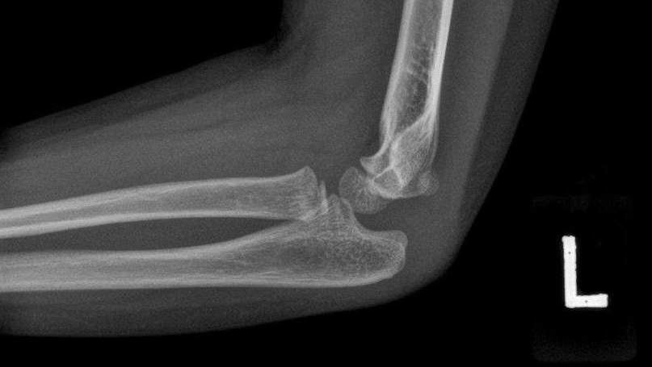
Notes:
This is a lateral elbow x-ray of an adolescent child. What age do you think this child is? Do you you see a fracture in this X-ray?
No fracture, normal ~7-10 y/o
Image credit: case courtesy of Dr Ian Bickle, Radiopaedia.org, rID: 46508

Slide 5
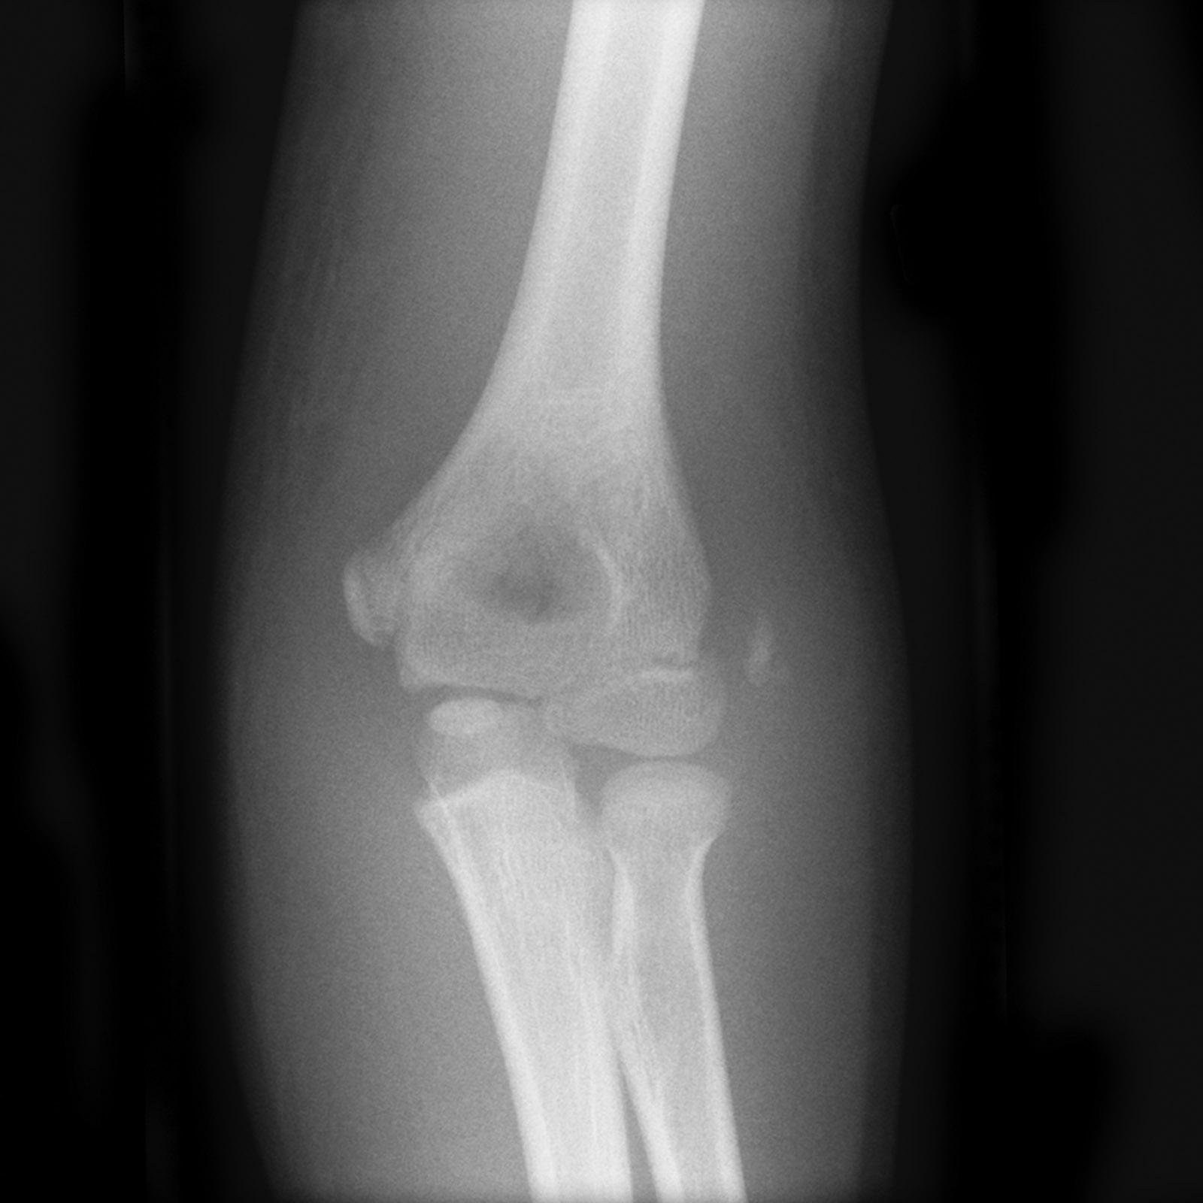
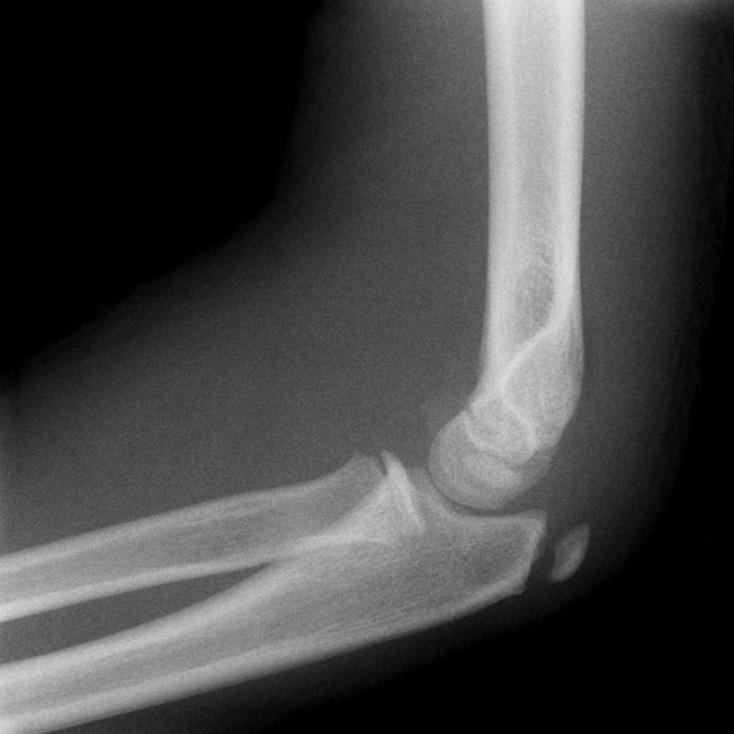
Notes:
Here is another adolescent elbow x-ray. How about this one? Any guesses on the age? Any fractures or other abnormalities?
Lateral epicondyle avulsion fracture in a 10-12 y/o
Image credit: case courtesy of Assoc Prof Frank Gaillard, Radiopaedia.org, rID: 10356

Slide 6
Pediatric Ossification Pattern
No specific pattern to the majority of bone ossification
  Long bones and flat bones mature at various intervals up until around age 21
The elbow has a specific ossification pattern that has a reliable order of appearance
Fusion occurs at a more variable timing

Slide 7
Pediatric Ossification Pattern
The appearance order can be remembered by the mnemonic “CRITOE”
  Capitellum ~1 year old
  Radial head ~ 3 years old
  Internal (medial) condyle ~5 years old
  Trochlea ~7 years old
  Olecranon ~9 years old
  External (lateral) condyle ~11 years old
Boys are usually ossifying about 1 year after females

Slide 8
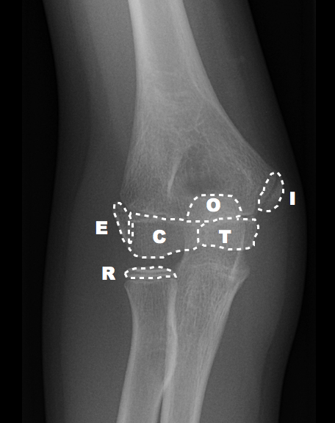
Notes:
11-year-old elbow with the ossification centers outlined
Image credit: case courtesy of Dr Andrew Dixon, Radiopaedia.org, rID: 20908

Slide 9
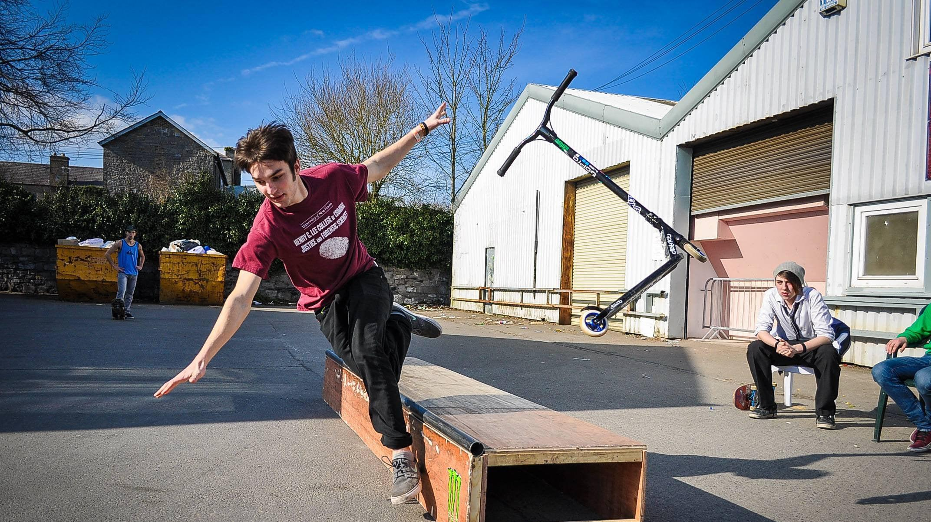
Notes:
A teenager falls in a situation as seen in the photo here.
1. What are some common pediatric fracture patterns?
- Salter Harris fracture
- Supracondylar fracture
- Torus/Buckle fracture
Greenstick fracture
Apophyseal avulsion fracture
Midshaft clavicle fracture
Supracondylar fracture
2. What are some common complications of these fractures if treated incorrectly?
Neurovascular compromise
Asymmetrical bone growth
Malunion/Nonunion

Slide 10
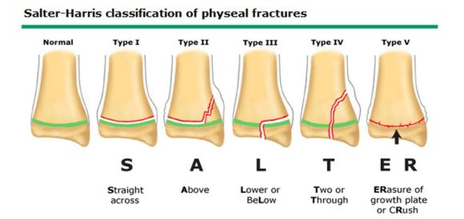
Notes:
The Salter-Harris Classification of pediatric physeal fractures include the mneumonic listed:
Type I- S for Straight across, fractures only go through the physis cartilage without metaphyseal or epiphyseal involvement (rare)
Type II- A for Above, fractures include the metaphysis and the physis involved (most common)
Type III- L for beLow, fractures include the epiphysis and the physis
Type IV- T for Through, fractures include the metaphysis, physis, and epiphysis
Type V- ER for ERasure or cRush, physeal cartilage is compressed/obliterated without calcified bone involvement (rare)
Complications of mistreatment including alteration/halting of the normal bone growth pattern leading to possible angulation, displacement, asymmetrical bone lengths, and/or chronic pain
Image credit: https://www.tylerfootclinic.com/salter-harris-fractures

Slide 11
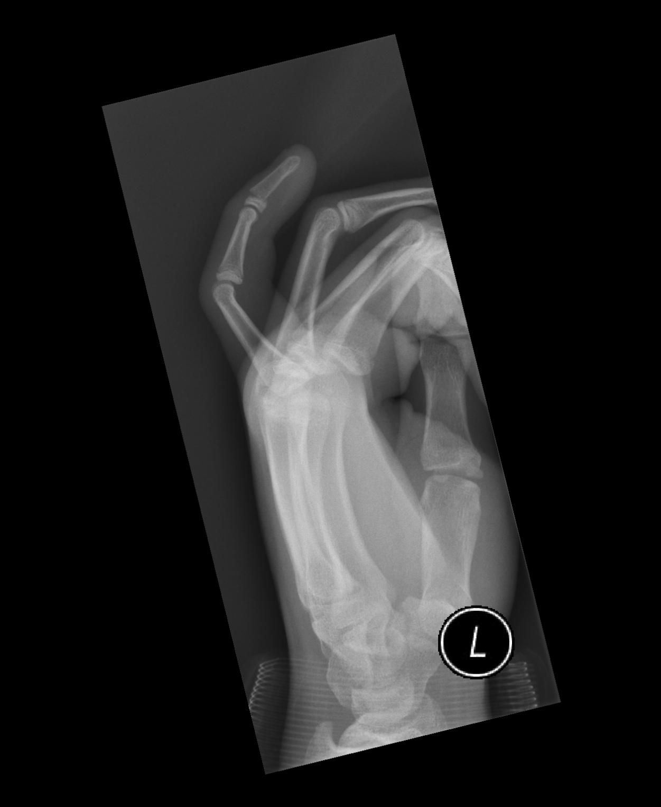
Notes:
Salter Harris Type I
-Notice no obvious fractures through the metaphysis or epiphysis
-Slip injury through the physis
Treatment is usually closed reduction and splinting/casting
- May need ORIF if severely displaced
Prognosis: usually a complete recovery with no growth impact
Image credit: case courtesy of Dr Andrew Dixon, Radiopaedia.org, rID: 30373

Slide 12
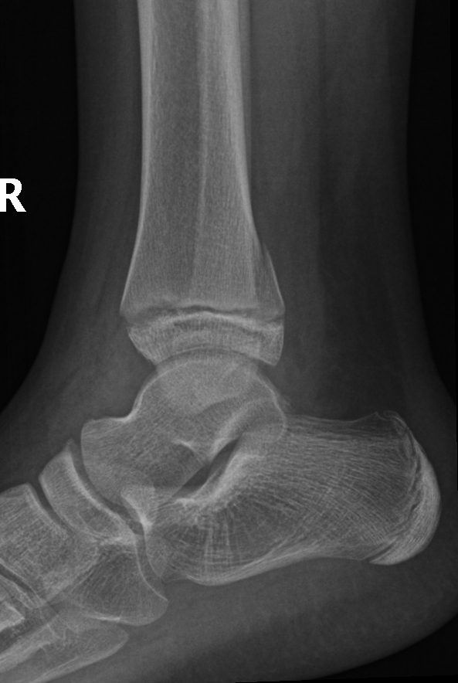
Notes:
Salter Harris Type II
-Fracture through the metaphysis into the physis
Treatment: closed reduction and splinting/casting
-May need ORIF if severely displaced
Prognosis: usually complete recovery without growth impact
Bonus points: a triangular fracture fragment left in the metaphysis of a Salter Harris Type II and Type IV fracture is called a “Thurstan Holland Fragment”
Image credit: case courtesy of Dr Hani Makky Al Salam, Radiopaedia.org, rID: 9687

Slide 13
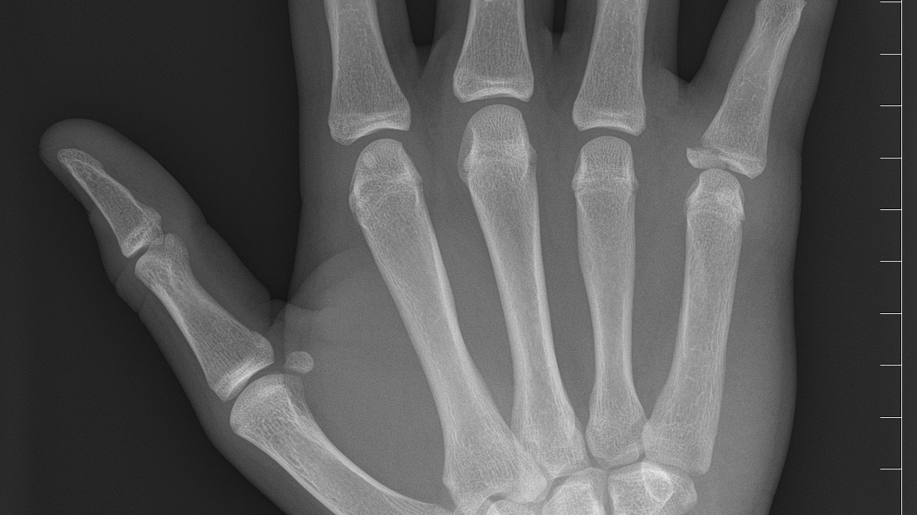
Notes:
Salter Harris Type III
-Fracture line through the physis and then the epihpysis
Treatment: usually requires ORIF due to disruption of germinal matrix in the physis
Prognosis: variable, depends on extent of injury and age of physis at the time of injury
Image credit: case courtesy of Dr Aneta Kecler-Pietrzyk, Radiopaedia.org, rID: 53308

Slide 14
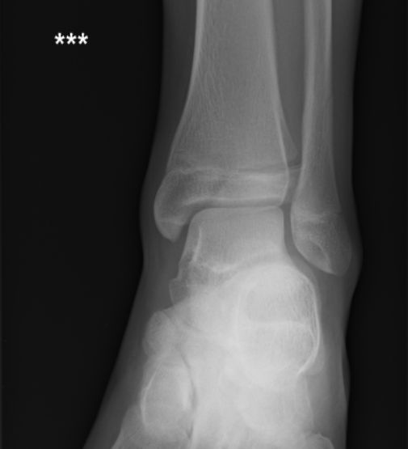
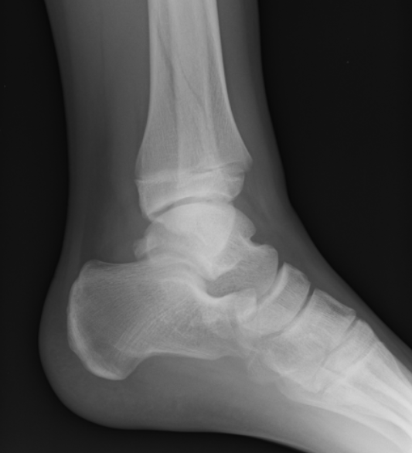
Notes:
Salter Harris Type IV
- Notice the AP view has a fracture line below the physis but the lateral also shows a fracture line above in the metaphysis as well
- May be difficult to see in one plane
Treatment: usually requires ORIF due to disruption of germinal matrix in the physis
Prognosis: variable, depends on extent of injury and age of physis at the time of injury
Image credit: case courtesy of Dr Stefan Lazic, Radiopaedia.org, rID: 51225

Slide 15
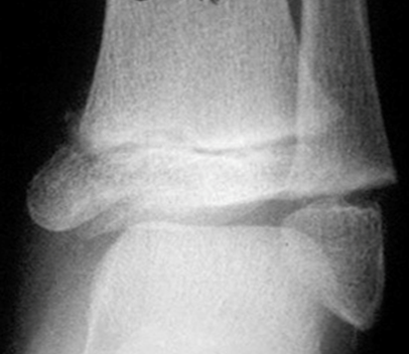
Notes:
Salter Harris V
- Very subtle, usually missed on XR
Often only caught on injury follow up when noticing growth irregularity in the injured bone
Notice the physis appears much narrower than we would expect (compare to the previous distal tibia films!)
Treatment: no definitive treatment as the growth plate is obliterated but ORIF attempted to relieve pressure and salvage whatever germinal matrix remains
Prognosis: extremely poor, usually results in arrest of growth at the affected location
Image credit: https://www.saem.org/cdem/education/online-education/peds-em-curriculum/fractures

Slide 16
Salter Harris Fractures
Found in any bone with a physis
Treatment: varied, Type I and II generally closed reduction and splint, Type III/IV/V more likely to require ORIF
Prognosis: also varied, Type I and II likely full recovery with appropriate reduction, III/IV/V depends on degree of physis disruption and time to repair
  Possible asymmetric growth vs angulation vs complete growth arrest

Slide 17
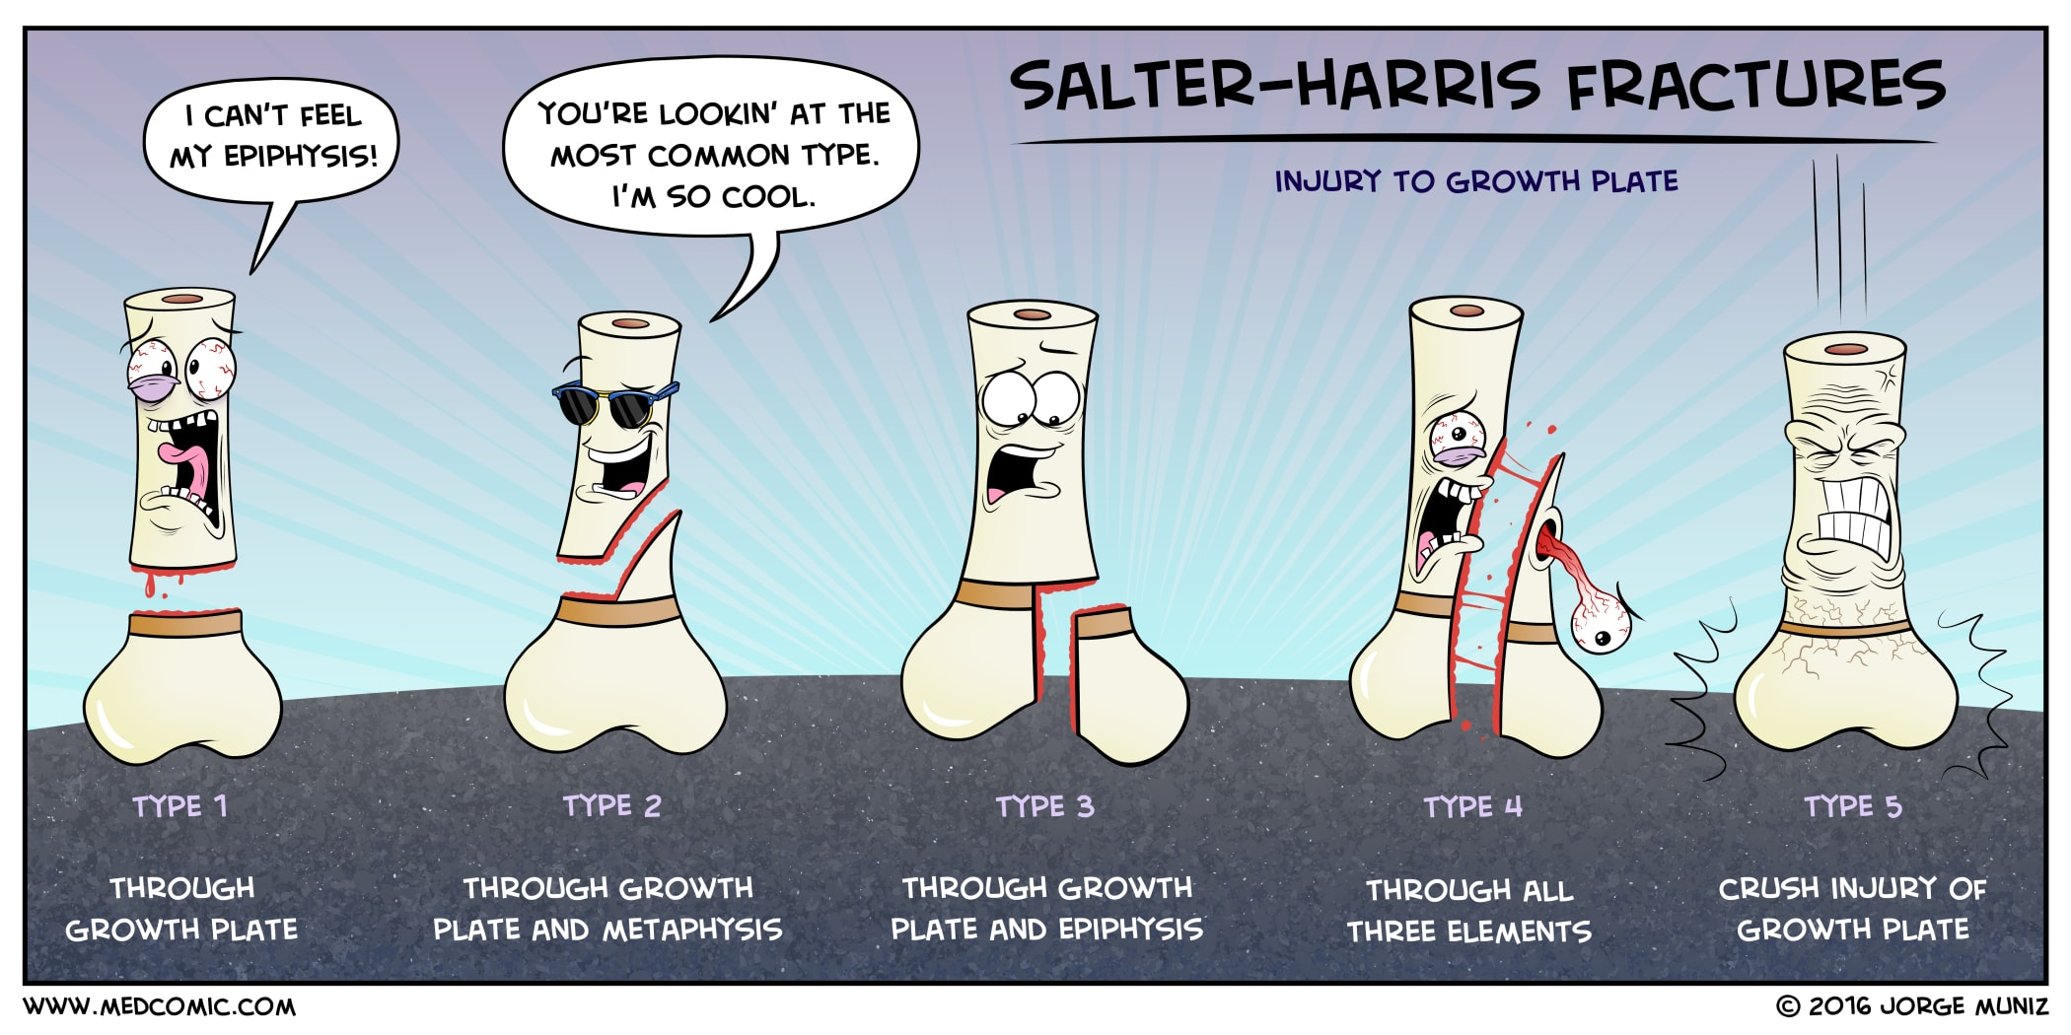

Slide 18

Notes:
Monkey bars– the most dangerous contraption known to children
You have a 7 y/o girl present to your emergency department after a fall from monkey bars. She has left arm pain after the fall with swelling in the mid-forearm. You get an x-ray that shows the following image…

Slide 19
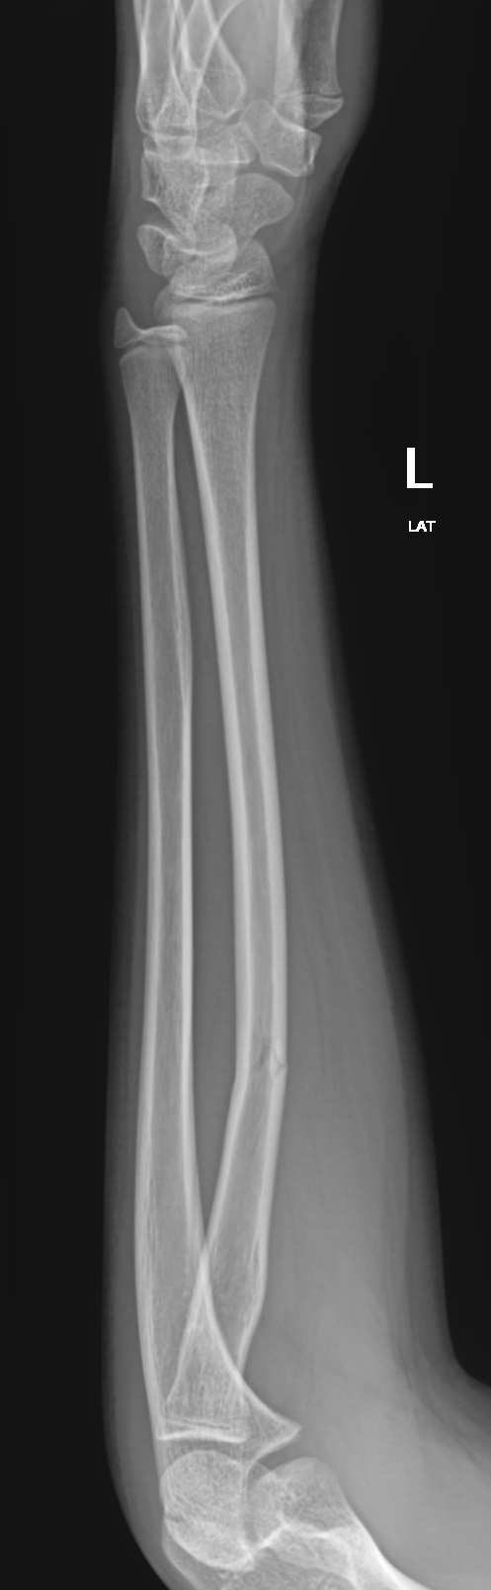
Notes:
What do you see in this image? What kind of fracture is it?
This is a greenstick fracture. You can see the radius has a partial-thickness fracture in the mid-shaft with cortical disruption on one side but not the other. These usually occur in the forearm or lower leg in children under 10 as they still have incompletely ossified cortices that can flex without breaking.
Treatment: closed reduction if significantly angulated (not our case), splinting/casting with ortho follow up
Acceptable angulation for ANY pediatric shaft forearm fracture: <10 y/o=15-20 degrees or less, >10y/o 10 degrees or less
Acceptable DORSAL angulation for a distal radius/ulna fracture: <10y/o=30 degrees or less, >10y/o=20 degrees or less
Prognosis: full recovery if angulation is reduced
Image credit: case courtesy of Dr Servet Kahveci, Radiopaedia.org, rID: 85771

Slide 20
Greenstick Fracture
Occurs in children <10 years old
Primarily occurs in forearm and lower leg
Mechanism: FOOSH/other axial compression injury, less commonly direct blow to the bone
Treatment: reduction if necessary, splint and ortho follow up
Prognosis: full recovery if reduced when necessary

Slide 21
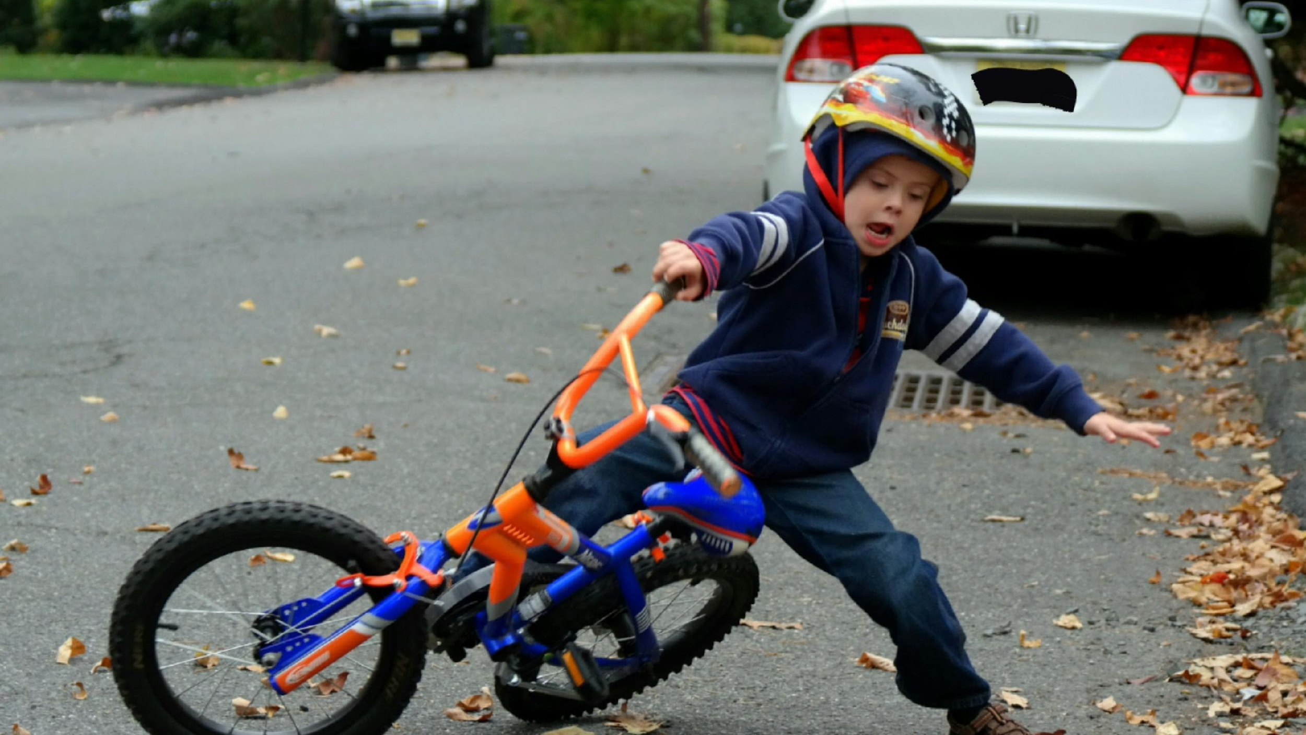
Notes:
Children fall…a lot. This child looks like he may end up with a fall on outstretched hand (FOOSH) injury.
He presents to your emergency department with arm pain and the x-ray on then next slide.

Slide 22
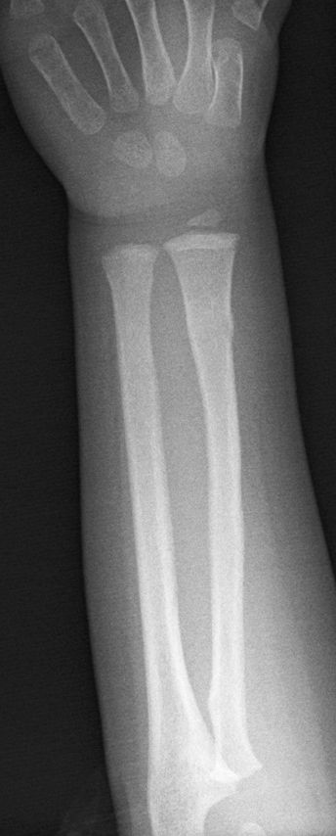
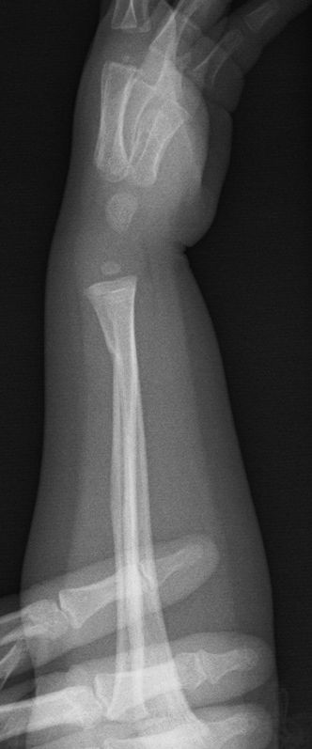
Notes:
What do you see in this image? Any abnormalities?
There is a buckle (torus) fracture of the radial metaphysis. These can be extremely easy to miss as they appear as a simple “bump” on most AP views of the forearm/wrist.
Looking at the lateral view, it becomes much more clear there is a deformity of the cortex in the distal radius with slight angulation.
Buckle fractures occur when the inner trabeculae of the bone compresses and causes a buckling of the cortex without an actual fracture. They usually only occur in children under the age of 10 due to their cortical elasticity. Do not confuse this with a bucket handle fracture, which is a much more sinister entity!
Treatment: recent data has shown that simple removable forearm splints (or lower extremity splints) with PCP follow up is enough for simple buckle fractures, reduction not usually necessary as significant angulation is difficult without a cortical break.
Prognosis: usually full recovery
Image credit: case courtesy of Dr Pir Abdul Ahad Aziz Qureshi, Radiopaedia.org, rID: 60785

Slide 23
Buckle (Torus) Fracture
Occurs <10 years old
Primarily occurs in the forearm and lower leg
Mechanism: FOOSH/other compressive injury
Treatment: usually conservative with a removable splint, PCP follow up
  Normally doesn’t need ortho referral
Prognosis: full return of structure and function

Slide 24
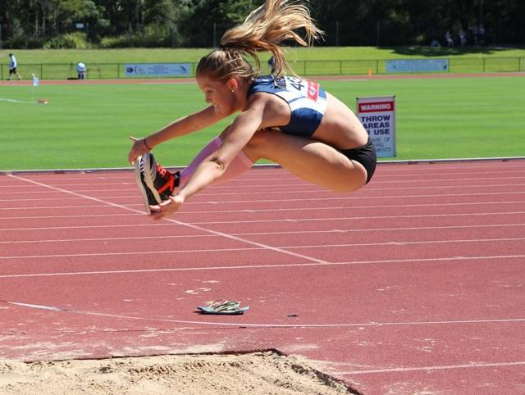
Notes:
Next up, you have a high school long-jumper coming in with L hip pain after her last jump. You see her and her x-ray on the next slide.

Slide 25
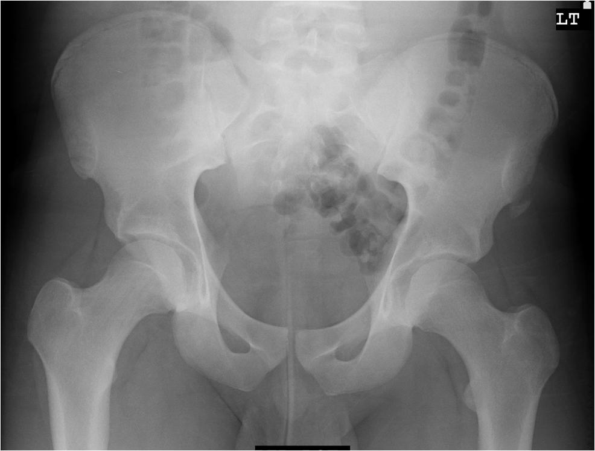
Notes:
What do you see with this AP view of the pelvis?
There is an apophyseal avulsion of the L anterior superior iliac spine (ASIS). You can also see a normal physis at the bilateral ileac crests, which can often be mistaken for a fracture.
Apophyseal avulsion fractures are usually found in the pelvis (though do occur in long bones much less frequently) and are caused by sudden high-force muscle contractions during a kick, jump, etc.
Treatment: usually conservative though ORIF can be done if a there’s a large displacement or if the athlete needs a high-functioning quick return
Prognosis: usually complete return of function with PT
Image Credit: Case courtesy of Dr Mark Holland, Radiopaedia.org, rID: 16820

Slide 26
Apophyseal Avulsion
Occurs between 14-25 years old
Primarily occurs in the pelvis
  More rarely upper and lower extremities
Mechanism: a sudden forceful muscular contraction
  Patients may hear/feel a “pop” and have immediate pain
Treatment: usually conservative
  Operative treatment considered for large displacement or high functional demands (high-level competition athlete)
Prognosis: usually full return of function with PT

Slide 27
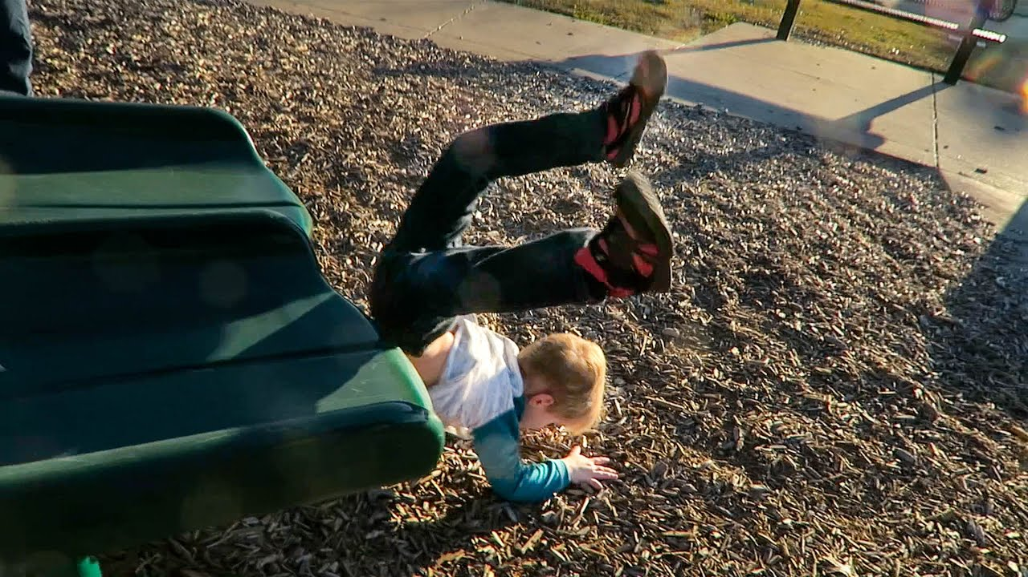
Notes:
Later, a 4-year-old presents with L upper shoulder pain after a fall as seen above.
Image Credit: https://www.youtube.com/watch?v=n5s6sAV3emk

Slide 28
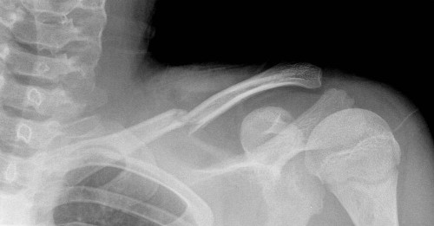
Notes:
The x-ray appears as above. Thoughts?
There is a midshaft clavicle fracture on the left
Treatment: sling for comfort with progressive movement over the next several weeks
Prognosis: usually complete return of function and appearance, though the appearance not return to normal in older children
Image credit: https://www.orthobullets.com/pediatrics/322128/clavicle-shaft-fracture--pediatric

Slide 29
Midshaft Clavicle Fracture
Occurs at any age
Mechanism: FOOSH or direct lateral blow to shoulder
Treatment: conservative
  Sling in the vast majority of patients with progressive movement
  ORIF for skin tenting, significant displacement, or neurovascular compromise
Prognosis: usually complete return of function and appearance
  High remodeling in this area for children

Slide 30
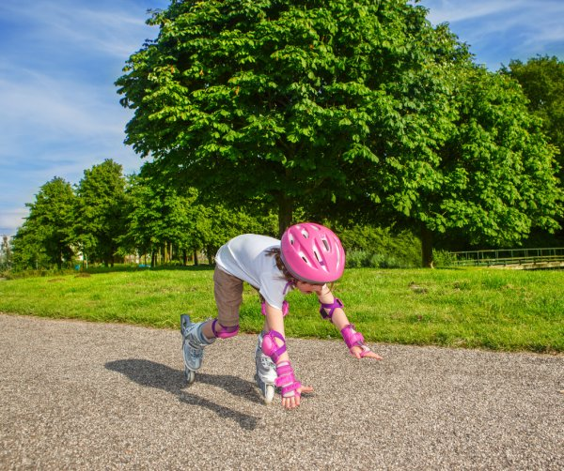
Notes:
Oof…this looks like it could be another FOOSH…and this kid comes in with arm pain and inability to bend the elbow…

Slide 31
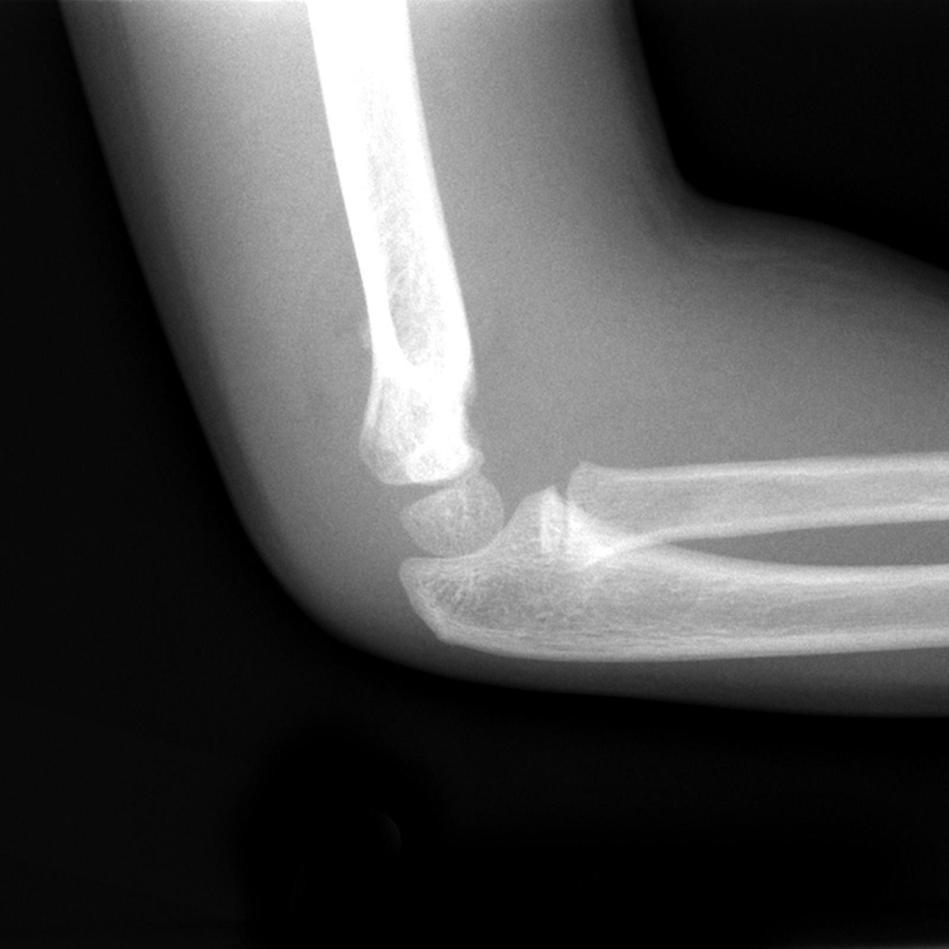
Notes:
Uh oh…so what do we see here?
This looks like a Type I Supracondylar fracture. You can identify this by tracing the anterior humeral line down through the capitellum. In a normal elbow, this line would pass through the middle of the capitellum.
If you look at this film, the line passes along the anterior portion of the capitellum. This indicates a subtle type I supracondylar fracture. There is also a type II (posterior plan intact) and III (posterior and anterior plane disruption) depending on the severity of displacement of the distal fragment
Treatment: Type I treated with long arm cast at 90 degrees of elbow flexion. Type II can be treated similarly if there is no comminution and the anterior humeral line is through the capitellum (unlike above). Type II that doesn’t meet criteria and III will need either ORIF or percutaneous pinning.
Prognosis: usually full recovery if treated correctly
Image credit: Case courtesy of Assoc Prof Frank Gaillard, Radiopaedia.org, rID: 10445

Slide 32
Supracondylar Fracture
Occurs most frequently in ages 4-8
Three main types
  Type I: non-displaced fracture, sometimes can’t see fracture line
  Type II: fracture line through the anterior plan, posterior plan intact
  Type III: complete disruption and displacement of the posterior and anterior fracture planes
Mechanism: FOOSH
Treatment: depends on the type
  Type I: long arm splint/cast at 90 degrees elbow flexion
  Type II: if anterior humeral line passing through capitellum, splint/cast as above, if not needs ORIF/percutaneous pinning
  Type III: ORIF or percutaneous pinning
Prognosis: usually full recovery if treated appropriately

Slide 33
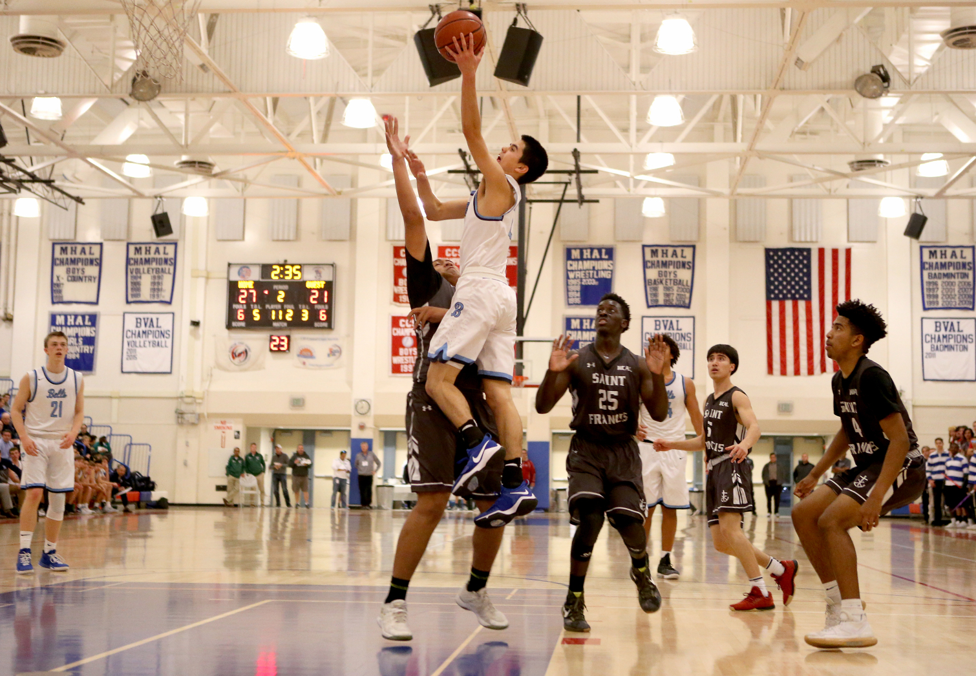
Notes:
Finally, a high school basketball player presents with knee pain after jumping for a shot as seen in the photo…
Image credit: https://www.mercurynews.com/2018/03/03/ccs-basketball-power-outage-at-independence-games-moved/

Slide 34
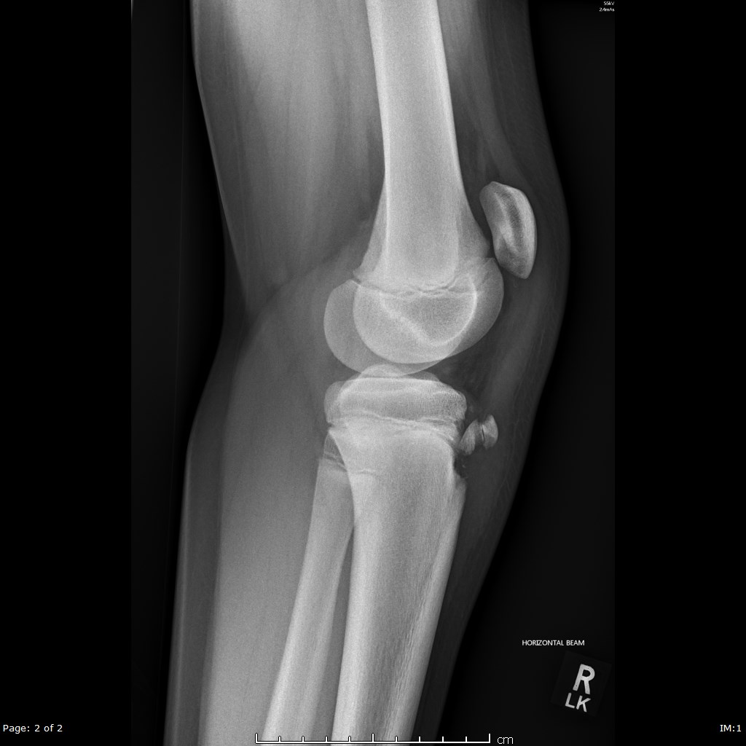
Notes:
You of course get some x-rays because this is a fracture lecture, and you get this film…what are your thoughts?
Somewhat looks like it could be Osgood-Schlatter disease, right? This is actually a tibial tubercle fracture. We make this distinction by the displacement of the fracture/avulsion fragment in the tubercle fracture vs simply fragmenting/irritation in Osgood-Schlatter.
It is important to examine the knee extensor mechanism to evaluate the degree of avulsion and mechanical disability.
There is a classification system based the degree of displacement and the exact fracture pattern. The classifications can get quite complicated (Type I-V), but the major difference is the more distal the fracture line, the less severe the injury.
Treatment: Type 1 (distal ossification center fracture line) and without significant displacement can be casted/splinted, any other type or with significant displacement either needs closed reduction attempt or ORIF.
Prognosis: usually return of full function if treated appropriately
Image credit: Case courtesy of Dr Dayu Gai, Radiopaedia.org, rID: 61578

Slide 35
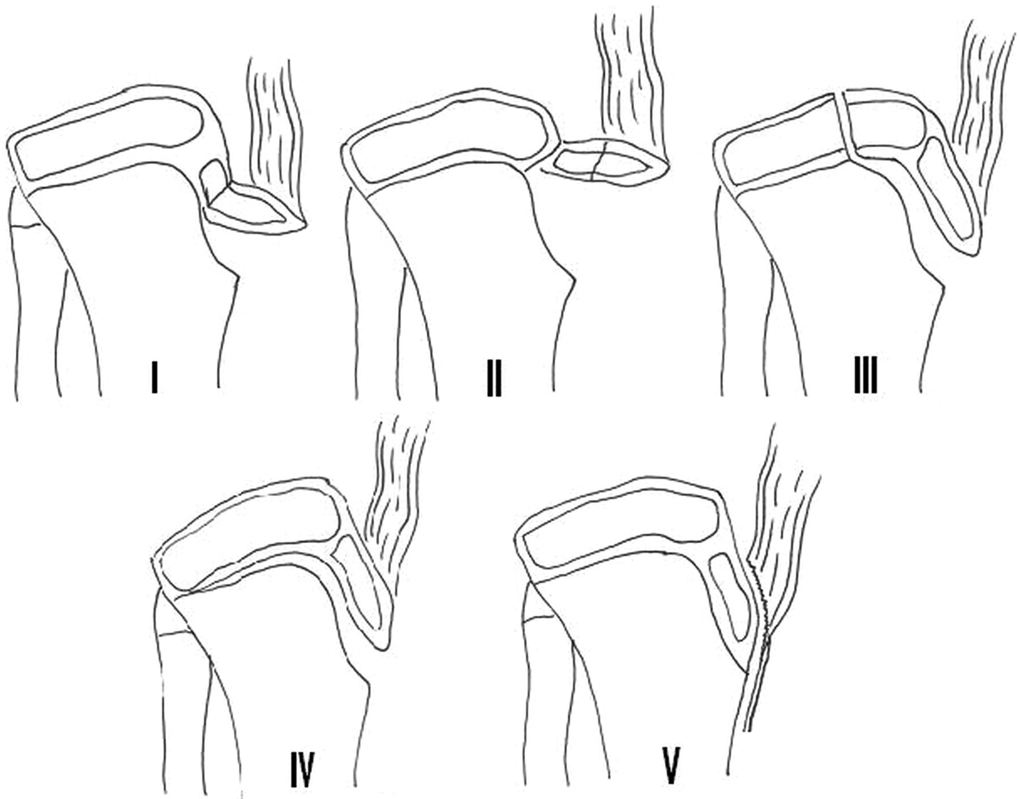
Tibial Tubercle Fracture
Occurs primarily in 14-17 year old’s
  Boys>>Girls
5 main types (see image)
  Type III the most common
Mechanism: significant muscle contraction (jumping) or eccentric contraction against force (landing on feet)
Treatment:
  Type I: minimal displacement=cast/splint
  Type II-V or large displacement: closed vs open reduction and cast
Prognosis: usually full recovery if treated appropriately
Type I: Fracture of the secondary ossification center near the insertion of the patella
Type II: fracture propagates proximally between primary and secondary ossification centers
Type III: coronal fracture extending posteriorly to cross the primary ossification center
Type IV: fracture through the entire proximal tibial physis
Type V: periosteal sleeve avulsion of the extensor mechanism from the secondary ossification center
Notes:
Image credit: https://www.jbjs.org/search.php?sortby=date&sortorder=desc&start=2600&type=imagegroup&query=hip

Slide 36
Summary
Pediatric fractures have specific patterns due to open physes and incompletely ossified bones
Fractures involving the physis have potential for growth deficits if not treated properly
Most other pediatric fractures heal very well even with deformity

Slide 37
References
Musculoskeletal System - Bone Development Timeline. Embryology. https://embryology.med.unsw.edu.au/embryology/index.php/Musculoskeletal_System_-_Bone_Development_Timeline. Accessed March 6, 2021.
Levine RH. Salter Harris Fractures. StatPearls [Internet]. https://www.ncbi.nlm.nih.gov/books/NBK430688/. Published February 10, 2021. Accessed March 6, 2021.
Atanelov Z. Greenstick Fracture. StatPearls [Internet]. https://www.ncbi.nlm.nih.gov/books/NBK513279/. Published August 26, 2020. Accessed March 6, 2021.
Ben-Yakov M, Boutis K. Buckle fractures of the distal radius in children. CMAJ. 2016;188(7):527. doi:10.1503/cmaj.151239
Eberbach H, Hohloch L, Feucht MJ, Konstantinidis L, Südkamp NP, Zwingmann J. Operative versus conservative treatment of apophyseal avulsion fractures of the pelvis in the adolescents: a systematical review with meta-analysis of clinical outcome and return to sports. BMC Musculoskelet Disord. 2017;18(1):162. Published 2017 Apr 19. doi:10.1186/s12891-017-1527-z

Slide 38
References
Andras L, Shirley E, Skaggs D. Clavicle Shaft Fracture - Pediatric. Orthobullets. https://www.orthobullets.com/pediatrics/322128/clavicle-shaft-fracture--pediatric. Published August 18, 2018. Accessed March 16, 2021.
Nina Lightdale Lindsay Andras, McMichael JC, Sabatini C, Frick SL, Andras L, Schulte S. Supracondylar Fracture - Pediatric. Orthobullets. https://www.orthobullets.com/pediatrics/4007/supracondylar-fracture--pediatric. Published November 26, 2020. Accessed March 16, 2021.
Triplet J, Poulios P, Chueire AF. Tibial Tubercle Fracture. Orthobullets. https://www.orthobullets.com/pediatrics/4023/tibial-tubercle-fracture. Published April 6, 2020. Accessed March 17, 2021.

