Slide 1
The Female Athlete
Disordered Eating in Athletes
HEIDI SUFFOLETTO, MD, FACEP

Slide 2
Female Athlete Issues for the Team Physician – 2017 update
Collaborative effort (6 organizations, 13 physicians)
AAFP
AAOS
ACSM
AMSSM
AOSSM
AOASM

Slide 3
Conditions Unique/Specific to
Female Athletes
Musculoskeletal Conditions
Medical Conditions
ACL Injuries
Patellofemoral Pain
Shoulder Injuries
Bone Stress Injuries
Concussion
Female Athlete Triad/REDS
  Low Bone Mass/Osteoporosis
  Low Energy Availability/Disordered Eating
  Menstrual Dysfunction
Pregnancy/Contraception
Lifespan Participation

Slide 4
ACL Injuries – The Skinny
NON-CONTACT mechanism 2-6 x higher in females (contact similar)
HIGH RISK sports = those with pivoting, cutting, twisting
  Basketball, gymnastics, lacrosse, skiing, soccer
DEMOGRAPHICS – late teens, early 20s
Increased risk of CONTRALATERAL ACL injuries
  Need to educate athletes

Slide 5
ACL injuries - Pathophysiology
Sudden stop or change in direction
  Knee extended, flat foot, off-balance body position
Other causes
  Environmental: surface/shoes
  Anatomical: increased Q-angle, narrow intercondylar notch, increased posterior tibial slope
  Hormone differences (?)
  Neuromuscular factors: Increased Quad/Hamstring strength ratio, gluteal weakness
Increased risk of post-traumatic osteoarthritis

Slide 6
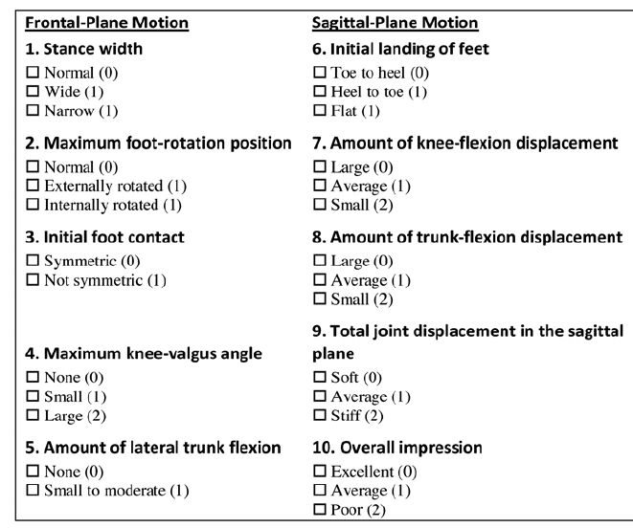
ACL - Prevention
Neuromuscular training
  Increased competence in landing/cutting positions and hip/core strength
  Box-Drop testing/training
    Abnormal = valgus, seated posture, foot dominance
    LESS (landing-error score system) – see image
ACL injury prevention programs
  Dynamic stretching/strengthening
  Functional balance/agility
  Plyometrics
Preseason protocol (to be continued in season)
  >10 min, 3x weekly for 8 weeks

Slide 7
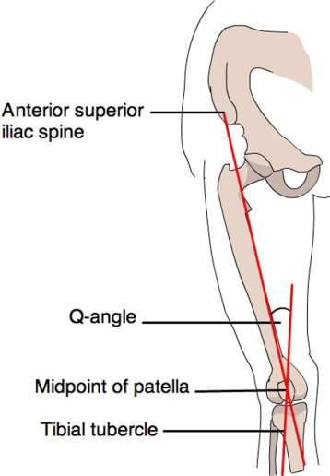
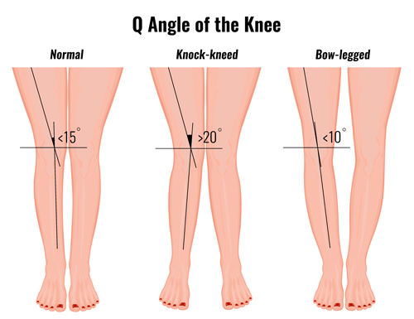
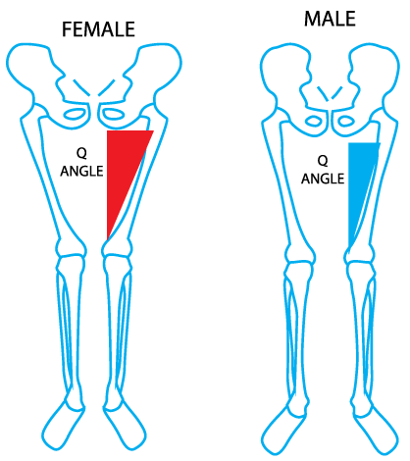
Q-angle (affects ACL and PFD)
How to measure
Anatomic Differences
Female vs. Male

Slide 8
Patellofemoral Pain Syndromes
Anatomy – Patella alta, trochlear dysplasia. Knee can be structurally normal or abnormal
OCDs
Instability/soft tissue factors – flexibility, hypermobility, poor neuromuscular control (Box-Drop/LESS apply here as well)
Malalignment of hip/knee/ankle/foot – VALGUS DISPLACEMENT
  Box-drop test
Trauma or overuse
TRAINING ERRORS – volume, intensity, EARLY SPORT SPECIALIZATION

Slide 9
Shoulder Injury – The Skinny
OVERHEAD SPORTS (all ages, all skill levels)
  SOFTBALL/SWIMMING > tennis/volleyball
Most common shoulder injuries
  Impingement/Rotator Cuff Injury
  Labral Tears
  Glenohumeral instability

Slide 10
Shoulder Injury –
Pathophysiology and Prevention
Neuromuscular training
Overload/overuse – increased training/games, decreased rest intervals
MSK risk factors – muscle fatigue, hip/core weakness, rotation deficits, scapular dyskinesis
Poor technique
  Dropped elbow in throwing/tennis
  Altered hand entry in swimming
Hyperlaxity is not an independent risk factor
Key is training/rest/off-season conditioning

Slide 11
Bone Stress Injuries-
When repletion exceeds ability to repair (stress reaction->stress fx->fx)
Common Sites
High-risk Sites
Foot
Tibia (Medial)
Fibula
Femur
Pelvis
Sacrum
Olecranon
Scaphoid
Tension-side femoral neck
Patella
Tibia (Anterior)
Medial Malleolus
Talus
Navicular
5th Metatarsal proximal metaphysis
Great toe Sesamoids

Slide 12
Bone Stress Injuries (BSI) – Risk Factors
Extrinsic
  Repetitive loads – exercise intensity, volume, type
  Overuse (?post-COVID restart)
  Surface and footwear
Intrinsic
  Biomechanics
  Strength and balance
  Limb alignment
Medical/Psychological
  Previous BSI
  Low energy availability/poor nutrition
  Poor bone mineral density
  Low Body Weight
  Disordered eating

Slide 13
Bone Stress Injuries
Image as needed
Multiple or high risk BSI should trigger medical workup
  DEXA
  Labs – CBC, CMP, Ca, Mg, TSH, PTH, Vit D
  Consider gynecology referral (PCOS/prolactinoma)
Treatment of Calcium/Vitamin D deficiency
STOP SMOKING!

Slide 14
DEXA Testing – Identifying patients at risk for fragility fractures
Z-scores used in children/adolescents, premenopausal women, men < 50
  Low radiation exposure (5-6 milli-Sievers)
  Sites: L1-L4 and whole body
  Compares to age/sex/race/ethnicity match. Abnormal if < 2 SD (20% decrease in BMD)
  Guide Calcium/Vitamin D replacement therapy
T-scores used in adults
  Definitions of osteopenia (BMD 1-2.5 SD (10-25%) less than healthy 30 yo)/osteoporosis (< 2.5 SD (25%) BMD relative to healthy 30 yo)
  Most accurate if trended/compared to prior tests
  Automatically calculated
  Guide Calcium/Vitamin D and other medication management

Slide 15
Vitamin D/Calcium deficiency
Who to Treat?
How to Treat?
Definitions
  Vitamin D Deficiency < 20 ng/mL
  Vitamin D Insufficiency <20-30 ng/mL
Risk: Age >65, dark skin, limited sunlight, AED, steroids, obese, sedentary
1/3 idiopathic (no identifiable risk factor)
Low Vitamin D levels
  200 IU/day if at risk (age < 51), 400 IU/day (age 51-70), 600 IU/day (age >70)
  50000 IU/week if deficient
  Not if patient has TB, bone mets, sarcoidosis, Williams syndrome
Oral Calcium Repletion: 1-2 g daily divided 2-4 times daily
  Not with PPIs, beware constipation
  “Take 2 Tums and call me in the morning”

Slide 16
Concussion
Higher rate in sports with the same rules
Higher rate of reporting
Cultural differences
Cervical spine muscle strength/stiffness
Hormonal differences
WOMEN: more likely due to contact with stick/ball (men more likely player to player contact)

Slide 17
Female Athlete Triad/REDS
Bone Mineral Density (normal BMD-low BMD-osteoporosis)
Menstrual Dysfunction (eumenorrhea-oligomenorrhea-amenorrhea)
Disordered Eating (LEA-ED) = REDS (relative energy deficiency in sport)
SCREENING necessary at the beginning of season
SURVEILLANCE necessary throughout season
Need for education and multi-disciplinary treatment team/plan

Slide 18
Low Bone Mass/Osteoporosis –
The Skinny (no pun intended)
Osteoporosis = Low bone mass
Low energy availability suppresses normal bone metabolism
Peak Bone mass attained at 20-30 years of age
  60-80% dependent on genetic factors
  Weight-bearing exercise, lean body mass, hormones, nutrition contribute
  Decreased by tobacco, alcohol, renal disease, hyperparathyroidism
  Medications that decrease BMD include corticosteroids/SSRIs
Fragility fractures = high morbidity/mortality
Effect of weight-bearing exercise most pronounced during adolescence

Slide 19
Low Bone Mass/Osteoporosis
Screening and education are paramount
DEXA/labs (already discussed)
If oligomenorrheic or amenorrheic, ACSM recommends:
  Z-score < 1 = dietary referral
  Z-score < 2 = comprehensive medical evaluation
Treatment most advantageous in 1st year of amenorrhea
Non-pharmacologic interventions before pharmacologic
  Be cautious about meds in premenopausal women

Slide 20
Menstrual Dysfunction
2-3 times more common than in the non-athlete
Primary amenorrhea – no menarche by 15 (normal age 11-14)
Secondary amenorrhea – no menses x 3 months after menarche
  Suppression of hypothalamic-pituitary-ovarian axis without structural cause
Oligomenorrhea – 6-9 cycles/year or cycle length > 35 days
Anovulation – “regular bleeding” without ovulation
Luteal phase deficiency – decreased progesterone levels
Must rule out pregnancy, thyroid disorder, prolactinoma, PCOS
May trigger bone health evaluation

Slide 21
Low Energy Availability
Disordered Eating
Energy Availability (EA) – amount of energy available for physiological processes and ADL after subtracting energy used for exercise
EA = dietary energy intake – energy expenditure/kg fat-free mass
Low EA is a MISMATCH
Spectrum
  Unintentional low intake ->intentional weight control measures ->”classic” ED
ANY ATHLETE/ANY SPORT
  Higher risk in sports that emphasize aesthetics, endurance, weight class
Female athletes are at higher risk than non-athletes

Slide 22
Disordered Eating/Eating Disorders
Medical Consequences
Electrolyte abnormalities
Decreased bone health
Hormone suppression (metabolic/reproductive/growth)
GI problems – gingival bleeding, ulcers, bloating, constipation
CV problems – arrhythmia/heart block, endothelial dysfunction
Impaired immune system – increased risk of infection (low IgA)
Anemia – downstream effects on oxygen capacity
Psychiatric problems – depression/anxiety, suicide
HIGH RISK OF MORBIDITY/MORTALITY

Slide 23
IOC Consensus Statement 2018
RED-S = Relative Energy Deficiency in Sport
  Impaired physiologic function due to RED
    Can be with or without eating disorder
    Impairments in metabolic rate
    Menstrual dysfunction
    Abnormal bone health
    Impaired immunity
    Decreased protein synsthesis
    Abnormalities in cardiovascular health

Slide 24
IOC Consensus Statement 2018
Potential performance consequences of Low EA
  Decreased strength, endurance, performance
  Increased rate of injury
  Decreased training response
  Impaired coordination, concentration, judgment
  Irritability, depression, anxiety
  Decreased glycogen stores

Slide 25
IOS Consensus Statement 2018
Males
Para-athletes
Cyclists
Jockeys
Rowers
Runners
Weight class athletes
?Effect on male sex hormones
Wheelchairs - ?decreased energy expenditure
SCI – ?increased weight restriction
Movement disorders - increased energy expenditure
Amputees – increased energy expenditure
Benefits of training on at-risk bone density

Slide 26
IOS Consensus Statement 2018
Prevention/detection
  <50% of sports medicine personnel can name all 3 components of the triad
  19% of high school nurses
EDUCATION
  2/28 Olympic IFs have training programs
  Peer-led models are promising
  Audience: medical team, Ats, coaches, athletes, families, administrators
Treatment
  Multidisciplinary
  Nutrition education -> change eating/exercise/CBT/?meds

Slide 27
IOC Consensus Statement 2018
ED – When to send to ED
Future research
Severe bradycardia
Hypotension
Orthostasis (?)
Electrolye imbalance
Refusal to comply with recommendations
Identifying at-risk athletes
Prevention
Male athletes
Racial diversity
Health & Performance consequences
Treatment
Return to play

Slide 28
The Pregnant Athlete
Exercise generally safe/recommended in pregnancy
  ACOG guidelines/FAQ
  https://www.acog.org/Patients/FAQs/Exercise-During-Pregnancy?IsMobileSet=false
Risks
  Environmental exposure
  Dehydration
  Physical trauma
    High impact/high strain exercises during implantation may lead to miscarriage
    Blunt abdominal trauma in late pregnancy may lead to placental abruption
    No SCUBA diving – fetus not protected from decompression
  Travel to areas with endemic infection (Zika)

Slide 29
The Pregnant Athlete
Musculoskeletal Changes
  Increased ligamentous laxity
  Displaced center of gravity
  Changes in spinal posture
  Anterior rotation of pelvis on femur
  Abduction of shoulders
Medical Changes
  Weight Gain
  Increased HR/SV/CO
  Increased blood volume/respiratory rate
  Decreased residual volume, expiratory reserve volume
  Thermoregulation
Increased Nutritional Needs
  Calcium, iron, folate, calories
Metabolic Changes
  Exercise at higher VO2max (>90%) may raise core temperature
Positional Changes
  Beware supine exercise (decreased venous return)
Beware banned substances
  Antiemetics, antidepressants
Can hormonal contraception affect bone health?

Slide 30
The Pregnant Athlete – NCAA Policy
http://www.ncaa.org/about/resources/inclusion/pregnant-parenting-student-athletes
Very few schools have specific policies
Pregnancy rate significantly lower than in non-athlete counterparts
Participation generally safe in athletes < 14 weeks EGA
No discrimination allowed
  Scholarships cannot be at risk
  Treatment the same as male parent
  Cannot influence reproductive decision making
  Provision of support system is necessary

Slide 31

Title IX
Title IX of the Education Amendments Act of 1972 is a federal law that states: "No person in the United States shall, on the basis of sex, be excluded from participation in, be denied the benefits of, or be subjected to discrimination under any education program or activity receiving Federal financial assistance."

Slide 32
Lifespan Considerations
CDC recommends exercise > 30 min daily on most/all days
Childhood (Age 4-10) – beware environmental injuries/overuse injuries
  Rest period, hydration, acclimatization
  Pitch counts, strength & technical training
Adolescence (Age 11-17) – overuse injuries/FAT/ACL injury/PFS
Adults (Age 18-49) – pregnancy, pelvic floor dysfunction (20-80%)
  Jumping, running, high-impact landing
Older Adults (Age 50+) – fall prevention, disease management/prevention
  target balance, strength, flexibility
  Again, beware heat illness

Slide 33
References
Female Athlete Issues for the Team Physician – 2017 update. CJSM 17(5):163-171. May 2018.
Health-Related Concerns of the Female Athlete:A Lifespan Approach. AFP 79(6):489-495. March 2009.
Bone Densitometry in Children and Adolescents. Pediatrics 138(4):e1-e7. September 2016.
Recognition and Management of Vitamin D Deficiency. AFP 80(8):841-846. October 2009.
http://www.ncaa.org/about/resources/inclusion/pregnant-parenting-student-athletes

