Slide 1
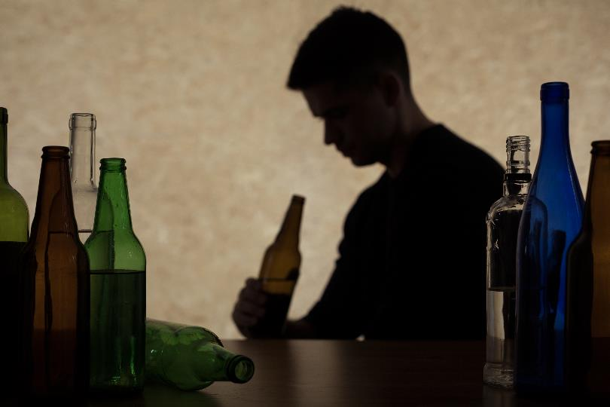
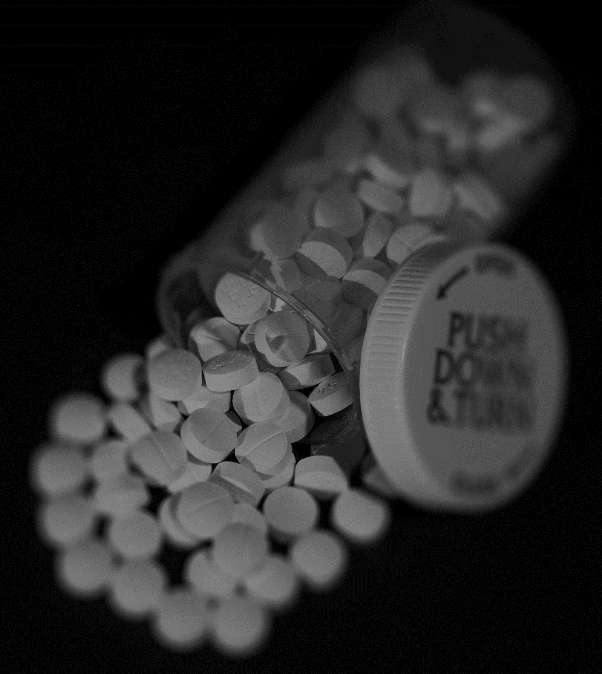
Module #5
Alcohol and Benzodiazepines:
Unhealthy Use and Use Disorders
Module Primary Author
Ryan McCormack
Authoring Group
Steven L. Bernstein, Kathryn Hawk, Lindsey Jennings, Lucinda Lai, Alexis LaPietra, Ryan McCormack, Lewis S. Nelson, and Reuben Strayer
Funding for this initiative was made possible (in part) by grant no. 1H79FG000021-01 from SAMHSA. The views expressed in written conference materials or publications and by speakers and moderators do not necessarily reflect the official policies of the Department of Health and Human Services; nor does mention of trade names, commercial practices, or organizations imply endorsement by the U.S. Government.

Slide 2


Learning Objectives
Explain the scope of the problem with unhealthy drinking and alcohol use disorder (AUD).
Identify AUD and assess patients for AUD.
Describe prevention of and treatment interventions for AUD.
Discuss alcohol and benzodiazepine withdrawal, including clinical features, timeline, and treatment.
List medications for AUD.
2

Slide 3

Treatment Gap
Only 2.3 million people (11.1%) with SUD that need treatment receive it.
Excessive drinking costs society $249 billion per year.
Concurrent medical-psycho-social complexities, lack of other sources of care, and stigma limit access to treatment.
The ED could play an important role in bridging the treatment gap.
Of the 20.3 million people diagnosed with SUD in the past year, 14.8 million (73.0%) have AUD.
3
Notes:
According to the 2018 National Survey on Drug Use and Health (SAMHSA), 20.3 million People Aged 12 or Older have current diagnosis of SUD (all drugs/alcohol)
The vast majority - 14.8 million people have AUD (73% of those with SUD).
Only 11.1% received specialty SUD Treatment in the past year among people ≧ 12 years of age who needed SUD treatment in the past year.
Additional information and References:
https://www.cdc.gov/features/costsofdrinking/index.html
The costs reached $249 billion in 2010, or about $2.05 per drink. Most (77%) were due to binge drinking. Binge drinking is defined as drinking four or more alcoholic beverages per occasion for women or five or more drinks per occasion for men.
White, et al. Trends in Alcohol-Related ED Visits in the United States…Alcohol Clin Exp Res. 2018: The rate of alcohol-related ED visits increased by 47% between 2006 and 2014. The total annual costs of alcohol-related visits increased from $4.1 billion to $15.3 billion during this time.
Many references for alcohol and ED (D’Onofrio, Bernstein, etc.)

Slide 4
An Overview of Alcohol Use and Evidence-Based Interventions
Increasing Consumption and Consequences
Delaying the age of initiation and promoting social wellness is effective prevention.
Brief interventions can change trajectory and prevent progression.
Medications and more intensive treatment are effective for higher severity but are underutilized.
Recommended Interventions
Moderate
to severe use
Risky or problematic use
Low-risk use
Abstinence
Refer for AUD treatment
Medicate for AUD
Unhealthy Drinking
Give brief advice or intervene
Assess further
4
Notes:
This diagram depicts the spectrum of alcohol consumption.
In the triangle, each segment moving from the bottom to the top, represents increasing drinking severity, consumption, and consequence associated with drinking.
Above the black dotted line is unhealthy drinking, which has a wide range of severity: (risky - hazardous/problematic – mild-severe AUD)
Intervention should be proportional with level of severity.
Mild-Moderate: Brief advice and brief intervention (BI) are appropriate and effective in reducing consequence of drinking and AUD progression.
Moderate-Severe: BI alone has not been shown to be effective in ED patients More substantive intervention is indicated and effective. Consider AUD pharmacotherapy and referral.
Diagram based on work from Barbor (AUDIT), Saitz (NEJM), McNeely, and McCormack, and others
ED effectiveness reviews include : Schmidt et al. Addiction 2016; Barata, West J EM 2017

Slide 5

Example Quick Screening and Assessment
How many times in the past year have you had X* or more alcoholic drinks in a day?
Never
Reinforce
Monthly (less than weekly)
Give brief advice or brief intervention (BI)
Weekly to daily
Assess for treatment (referral or medication)
Frequency can help guide the need for further assessment and the intensity of intervention.
*5 for males and 4 for females; Validated by Smith et al., 2009
5
Notes:
Validated Screening question (Smith et al 2009) or AUDIT-C is recommended by US Preventive Task Force.
How many times in the past year have you had [X] or more alcoholic drinks in a day?
Males: X = 5 drinks
Females: X = 4 drinks
A standard drink= one can of beer, 5oz glass of wine, a shot of liquor.
Any (non-zero) heavy drinking days is a positive screen for unhealthy drinking.
There is a wide spectrum of unhealthy drinking: from risky to severe AUD.
This slide shows how the reported frequency of heavy drinking can be used as an indicator of severity to differentiate between patients who should receive brief advice/BI versus a more substantive intervention.
Other tools for further assessment of degree of unhealthy drinking include the AUDIT, DSM-5 AUD criteria, or simply quantifying frequency of heavy drinking days.
Other notes:
Safe drinking limits (NIAAA):
Males: up to 14 drinks/week; no more than 4 drinks/day
Females: up to 7 drinks/week; no more than 3 drinks/day
-Anything more is unhealthy drinking.
-Women have higher BAC than men per drink, because of absorption/metabolism even if same weight.
References: Smith et al. 2009, Dawson 2010, Saitz 2014, McCormack 2017

Slide 6
Brief Intervention (BI)
Based in motivational interviewing – empathetic, nonjudgmental approach
Not sure how to talk to patients about alcohol/drug use?
  The BI structure can help
  There are many online resources (“ED SBIRT”)
Keep it brief!
  Small treatment effect
Raise the subject.
Provide feedback without judgment.
Enhance motivation.
“One a scale of 1 to 10, how ready are you to stop using, cut back, or enroll in a program?” … “Why didn’t you pick a lower number?”
Negotiate a goal.
Meet the patient “where they are” and try to make a goal that is acceptable to them.
Notes:
Many studies have shown that providers and other staff don’t ask about or address unhealthy drinking because they feel uncomfortable or inadequately trained
Many resources available, including:
BMC BNI-ART: https://www.bu.edu/bniart/
Yale ED SBIRT: https://medicine.yale.edu/sbirt/
SAMHSA : https://www.integration.samhsa.gov/clinical-practice/sbirt
Not sufficient (alone) for higher severity AUD

Slide 7
Pathophysiology – Part 1
Alcohol has opposing effects on inhibitory and excitatory neurotransmitters.
It activates the inhibitory GABA receptor.
It suppresses the excitatory NMDA subtype of the glutamate receptor.
It acutely decreases brain activity and energy.
It chronically causes GABA downregulation and NMDA upregulation.
  There is a new baseline of autonomic excitability and psychomotor agitation that is mitigated/suppressed by continuous alcohol ingestion.
  Acute cessation leads to alcohol withdrawal syndrome.
Notes:
The effects of chronic alcohol consumption on neurotransmitter function best explains the clinical findings.
γ-aminobutyric acid (GABA)
N-methyl-D-aspartate (NMDA) subtype of glutamate receptor
Reference: Goldfrank’s Toxicology summarizes many sources of data for alcohol pathophysiology, withdrawal, and other complications, as well as treatment options.

Slide 8
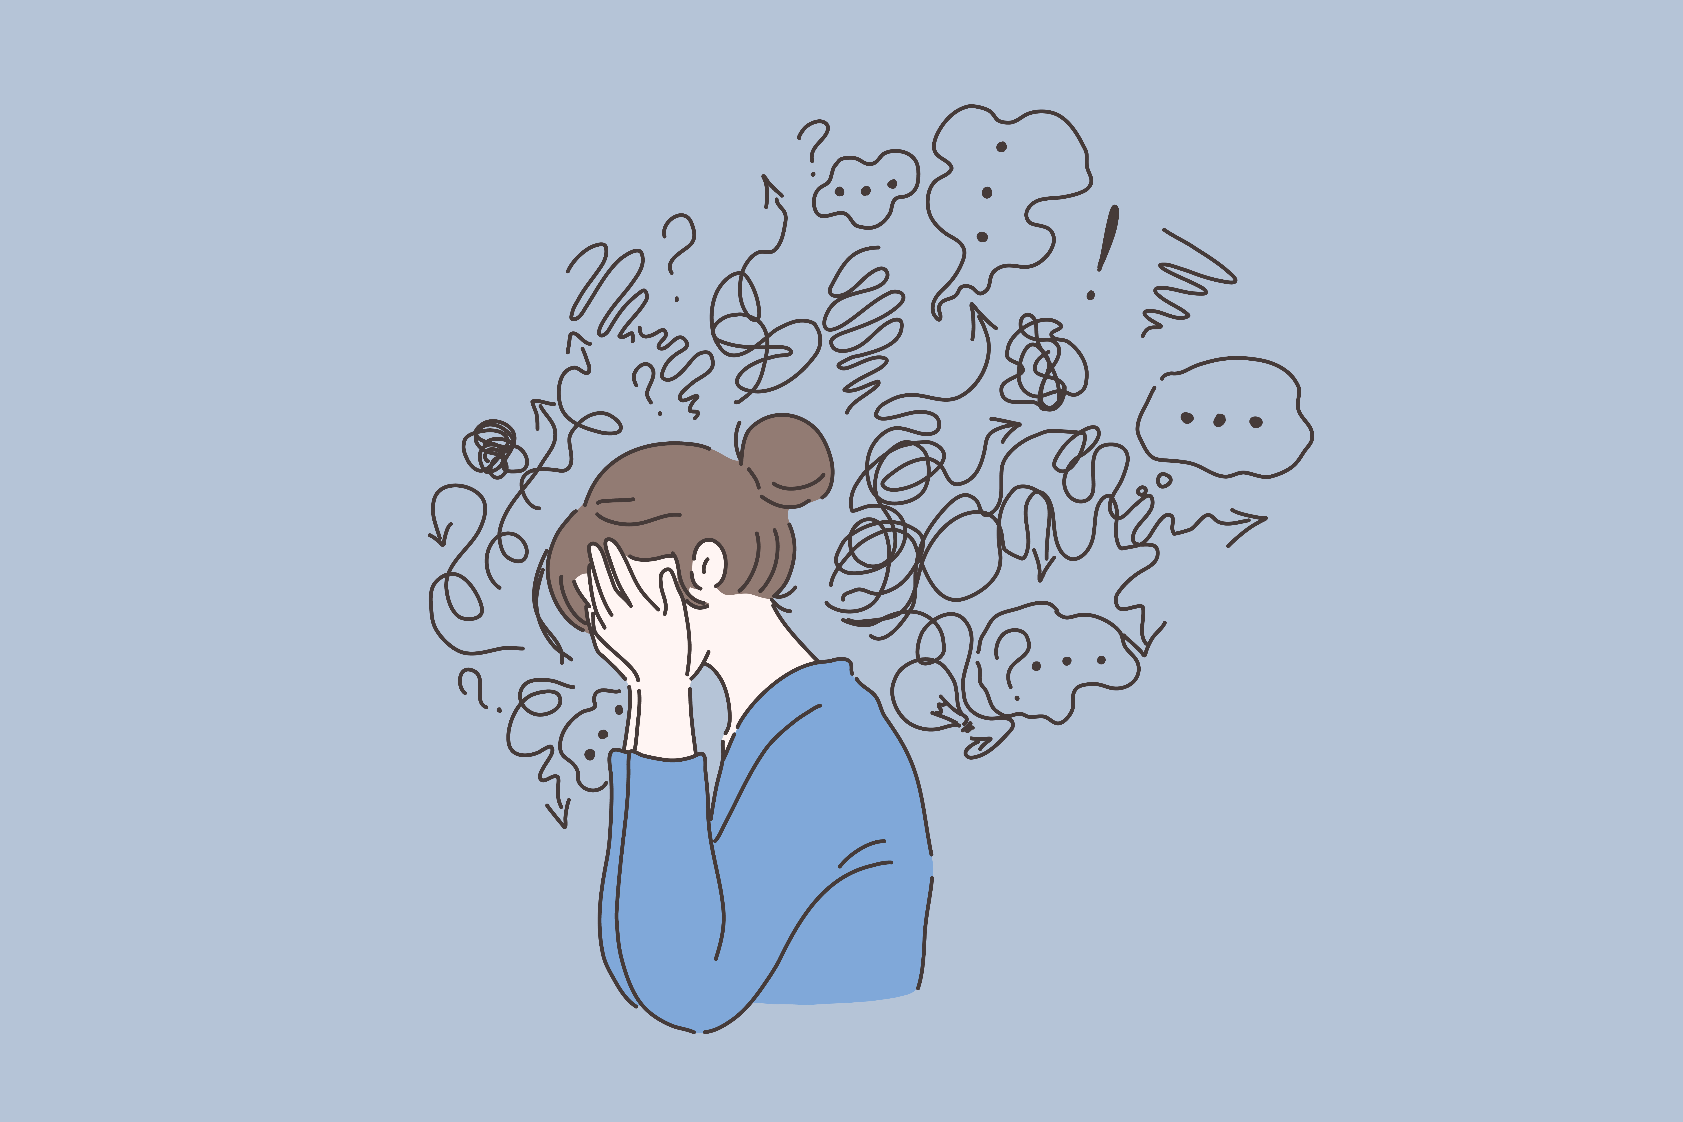
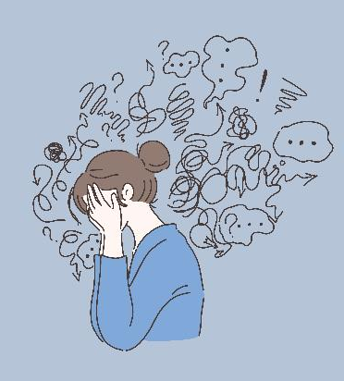
Alcohol Withdrawal
Early symptoms begin 6+ hours after cessation:
Anxiety, irritability, insomnia, restlessness, psychomotor agitation
Autonomic hyperactivity
  Tachycardia, hypertension, tremor, diaphoresis, nausea, etc.
Alcoholic Hallucinosis (25%)
  Typically transient tactile (ie, itching) or visual
  Not predictive of progression to DTs
Seizures (10%)
  Typically brief, generalized tonic-clonic with short post-ictal period
  40% isolated/single seizure
  Antiepileptics are not indicated or effective for AWS seizures; however, patients with AUD have a higher prevalence of seizure disorders (repeated head trauma and other predisposing factors)
8
Notes:
25% = almost 25% of those with AWS develop hallucinosis.
Reference: Goldfrank’s Toxicology summarizes many sources of data for alcohol pathophysiology, withdrawal, and other complications, as well as treatment options.

Slide 9

Delirium Tremens (DTs)
Begins 48 to 96 hours after the cessation of drinking, which is about when the early symptoms end
Lasts for up to 2 weeks
Mortality is substantially reduced by effective treatment
Clinical features include:
The early withdrawal signs and symptoms but more severe
- PLUS -
Altered consciousness (ie, delirium; may see characteristic picking activity)
Cognitive impairment
9
Notes:
Severe AWS is not DTs. True DTs is rarely seen (more frequently mis-classified) and requires to the stated criteria/timeline.
Reference: Goldfrank’s Toxicology summarizes many sources of data for alcohol pathophysiology, withdrawal, and other complications, as well as treatment options.

Slide 10
Tools to Assess AWS
None is great for all settings or severities.
Clinical Institute Withdrawal Assessment of Alcohol Scale, Revised (CIWA-Ar)
Glasgow Modified Alcohol Withdrawal Scale (GMAWS)
Assessing the level of sedation-agitation and vital signs is the primary focus in the ED.
Richmond Agitation Sedation Scale (RASS)
Riker Sedation Anesthesia Scale (SAS)
10
Notes:
RASS and SAS may be more appropriate for ICU settings as they don’t require patient participation.

Slide 11

Who will develop complicated Alcohol Withdrawal Syndrome?
Prediction of Alcohol Withdrawal Severity Scale (PAWSS)
Greater than or equal to 3 criteria is high risk for moderate to severe AWS:
  Lifetime history of AWS, AWS seizure, DTs, AUD treatment (rehab, AA, etc.), and blackouts
  In the last 90 days has ever used alcohol with benzodiazepines or alcohol with any drug of abuse
  Today blood alcohol content greater than 200 or evidence of withdrawal
11
Notes:
Past h/o AWS, DTs, as well as family history of AWS (not in PAWS) are strong predictors of the development of AWS.
THE PAWSS is this is the most evidence-based instrument to predict complicated withdrawal. (90% sensitivity)
Reference: Maldonado et al. Alcohol and Alcoholism. 2015
Available on MD Calc

Slide 12
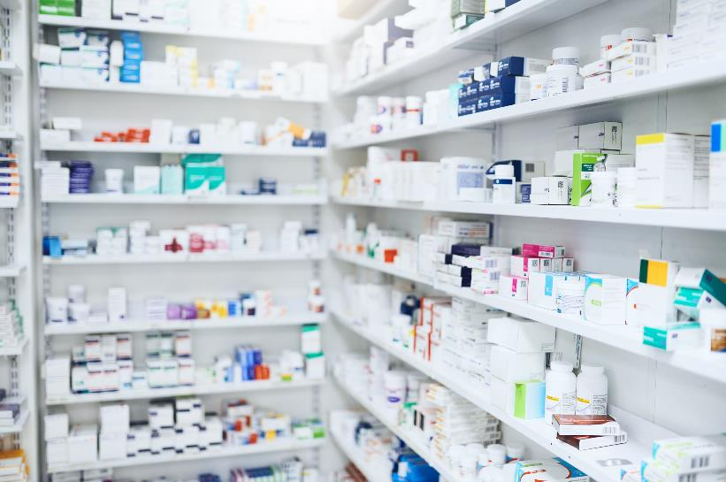
Treatment of Alcohol Withdrawal Syndrome
Benzodiazepines
First line and most studied
  Particularly good for complicated AWS
Match pharmacology
  Onset, peak, absorption, and metabolism
Dose and frequency is dependent on the pharmacology of the specific benzodiazepine and should be informed by the patient’s past requirements
  Learn the pharmacology of the benzodiazepines on formulary and/or that you plan to use
When treating AWS, consider initiating treatment for the underlying AUD!
12
Notes:
Benzos
First line treatment for all AWS, particularly for anyone with history of severe AWS, AWS seizure, or DTs.
No benzos have been shown to be more effective than others but some are likely more rewarding/addictive. Also, time to onset, peak, and metabolism should be considered. (e.g. fast onset for initial treatment; avoid repeated doses of benzos with slow peak concentration because staked doses could result in overmedicating/oversedation;
For the next few slides:
Benzo choice for immediate stabilization should have a rapid onset and peak, such as Midazolam (IV/IM) or diazepam (IV only). Diazepam IV is ideal because rapid onset and long acting to serve as initial treatment and basal treatment..
For prophylaxis or treatment when immediate stabilization is not necessary. The benzo of choice should have a longer acting with active metabolites to produce long effect and “autotaper” effect with less risk of rebound withdrawal (e.g., chlordiazepoxide).
Patients with severe liver function impairment: Use benzos that are less dependent on hepatic metabolism (e.g., lorazepam), particularly if active liver failure, encephalopathy, dementia, and in older patients.
Reference: many individual references. The following summarize many sources of data related to alcohol pathophysiology and management of withdrawal, AUD, and other complications:
Goldfrank’s Toxicology
Soyka et al. (2016) WFSBP Treatment Guidelines for biological treatment of substance use and related disorders, part 1: Alcoholism, first revision

Slide 13
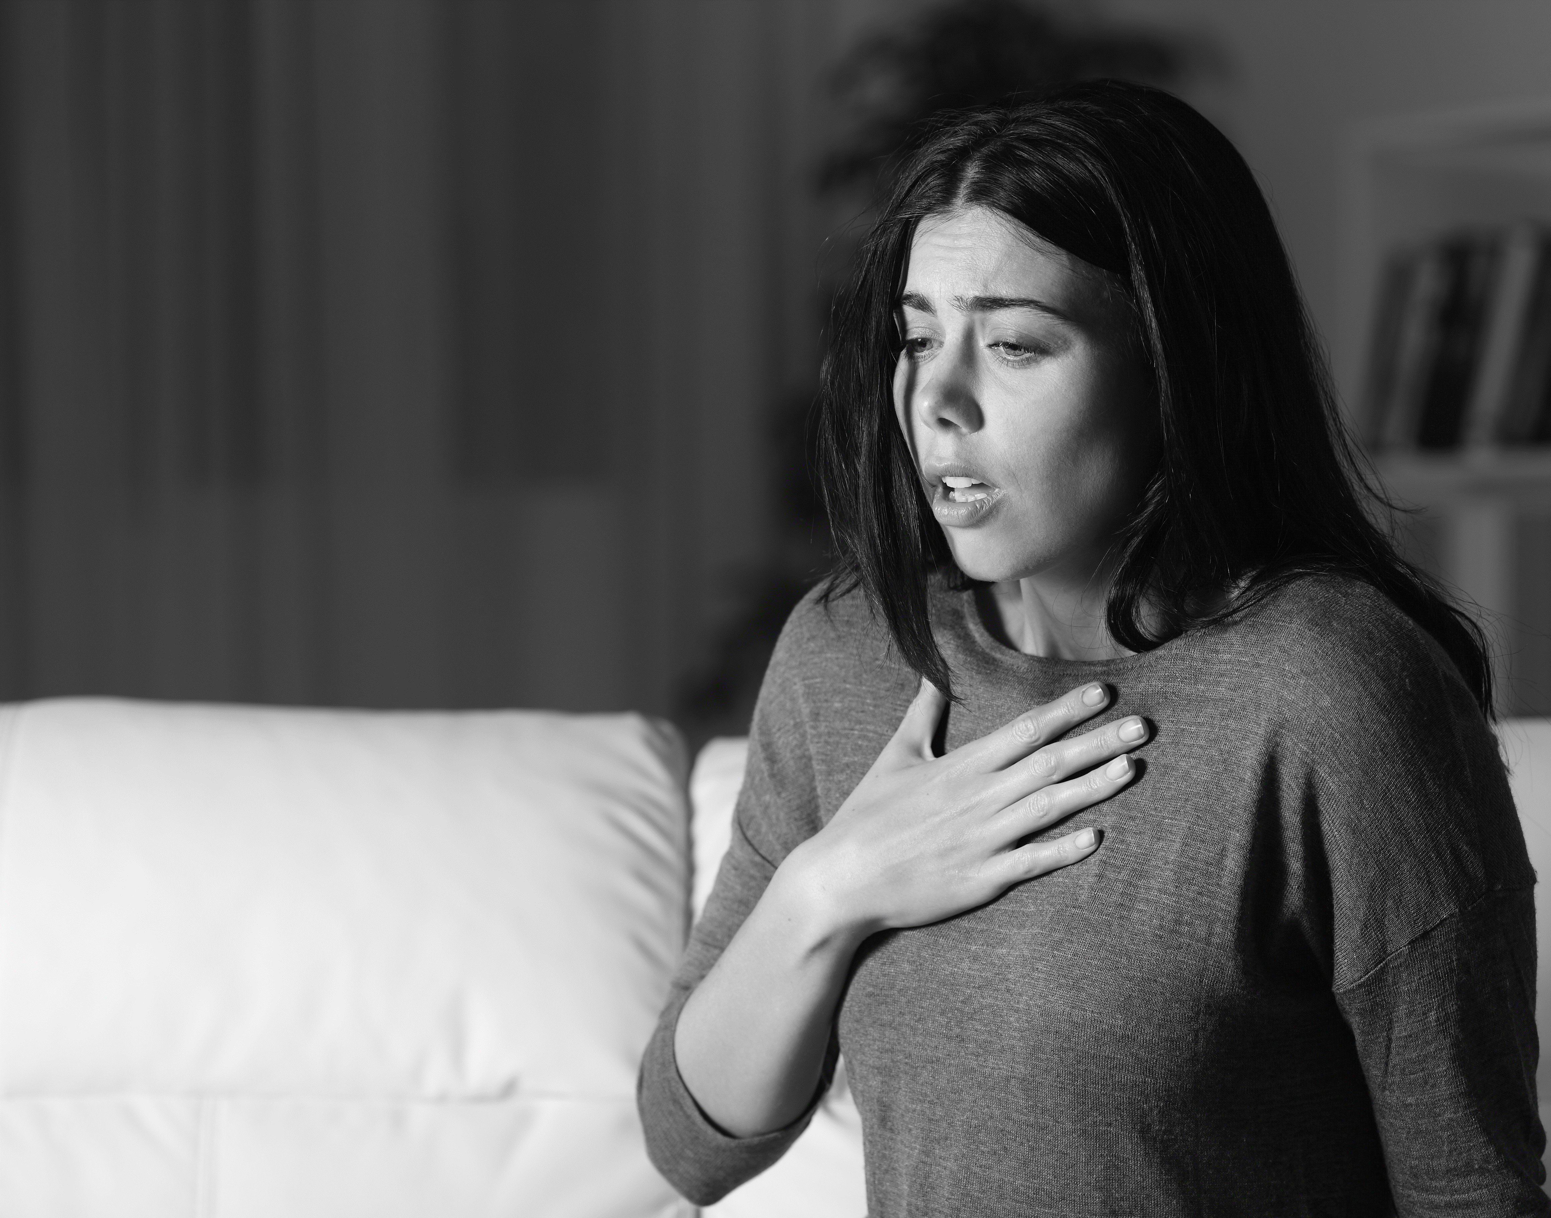

Scenario 1
Patient with severe acute AWS
Agitated
Tachycardic
Hypertensive
Sweating
How would you treat this patient?
13
Notes:
Benzos
First line treatment for all AWS, particularly for anyone with history of severe AWS, AWS seizure, or DTs.
No benzos have been shown to be more effective than others but some are likely more rewarding/addictive. Also, time to onset, peak, and metabolism should be considered. (e.g. fast onset for initial treatment; avoid repeated doses of benzos with slow peak concentration because staked doses could result in overmedicating/oversedation;
For the next few slides:
Benzo choice for immediate stabilization should have a rapid onset and peak, such as Midazolam (IV/IM) or diazepam (IV only). Diazepam IV is ideal because rapid onset and long acting to serve as initial treatment and basal treatment..
For prophylaxis or treatment when immediate stabilization is not necessary. The benzo of choice should have a longer acting with active metabolites to produce long effect and “autotaper” effect with less risk of rebound withdrawal (e.g., chlordiazepoxide).
Patients with severe liver function impairment: Use benzos that are less dependent on hepatic metabolism (e.g., lorazepam), particularly if active liver failure, encephalopathy, dementia, and in older patients.
Reference: many individual references. The following summarize many sources of data related to alcohol pathophysiology and management of withdrawal, AUD, and other complications:
Goldfrank’s Toxicology
Soyka et al. (2016) WFSBP Treatment Guidelines for biological treatment of substance use and related disorders, part 1: Alcoholism, first revision

Slide 14
Scenario 1
Patient with Severe Acute AWS
Stabilizing critical AWS: Diazepam (IV) or Midazolam (IM/IV)
Both have rapid onset/peak effect and reliable absorption allowing titration q2-5 minutes.
The peak effect corresponds to peak respiratory depression, which is a safer choice when rapid titration is critical.
Example dosing: Diazepam 10 mg IV q2-5 minutes until goal sedation is reached; double the dose after 3 doses or if little response is achieved.
Bonus: Diazepam’s long-acting metabolites provide an extended symptomatic control without an abrupt rebound.
NOT recommended:
Oral benzodiazepines
Lorazepam (PO/IM/IV)
  It crosses BBB slower.
  The peak CNS effect is greater than 20 to 30 minutes
  There is a risk of delayed oversedation as repeated doses are given before the peak effect occurs.
14
Notes:
Benzos
First line treatment for all AWS, particularly for anyone with history of severe AWS, AWS seizure, or DTs.
No benzos have been shown to be more effective than others but some are likely more rewarding/addictive. Also, time to onset, peak, and metabolism should be considered. (e.g. fast onset for initial treatment; avoid repeated doses of benzos with slow peak concentration because staked doses could result in overmedicating/oversedation;
For the next few slides:
Benzo choice for immediate stabilization should have a rapid onset and peak, such as Midazolam (IV/IM) or diazepam (IV only). Diazepam IV is ideal because rapid onset and long acting to serve as initial treatment and basal treatment..
For prophylaxis or treatment when immediate stabilization is not necessary. The benzo of choice should have a longer acting with active metabolites to produce long effect and “autotaper” effect with less risk of rebound withdrawal (e.g., chlordiazepoxide).
Patients with severe liver function impairment: Use benzos that are less dependent on hepatic metabolism (e.g., lorazepam), particularly if active liver failure, encephalopathy, dementia, and in older patients.
Reference: many individual references. The following summarize many sources of data related to alcohol pathophysiology and management of withdrawal, AUD, and other complications:
Goldfrank’s Toxicology
Soyka et al. (2016) WFSBP Treatment Guidelines for biological treatment of substance use and related disorders, part 1: Alcoholism, first revision

Slide 15

Scenario 2
Patient with multiple alcohol detox admissions starting to feel anxious and mildly tremulous
How would you treat this patient?
15
15
Notes:
Benzos
First line treatment for all AWS, particularly for anyone with history of severe AWS, AWS seizure, or DTs.
No benzos have been shown to be more effective than others but some are likely more rewarding/addictive. Also, time to onset, peak, and metabolism should be considered. (e.g. fast onset for initial treatment; avoid repeated doses of benzos with slow peak concentration because staked doses could result in overmedicating/oversedation;
For the next few slides:
Benzo choice for immediate stabilization should have a rapid onset and peak, such as Midazolam (IV/IM) or diazepam (IV only). Diazepam IV is ideal because rapid onset and long acting to serve as initial treatment and basal treatment..
For prophylaxis or treatment when immediate stabilization is not necessary. The benzo of choice should have a longer acting with active metabolites to produce long effect and “autotaper” effect with less risk of rebound withdrawal (e.g., chlordiazepoxide).
Patients with severe liver function impairment: Use benzos that are less dependent on hepatic metabolism (e.g., lorazepam), particularly if active liver failure, encephalopathy, dementia, and in older patients.
Reference: many individual references. The following summarize many sources of data related to alcohol pathophysiology and management of withdrawal, AUD, and other complications:
Goldfrank’s Toxicology
Soyka et al. (2016) WFSBP Treatment Guidelines for biological treatment of substance use and related disorders, part 1: Alcoholism, first revision

Slide 16
Scenario 2
Patient with multiple detox admissions starting to feel anxious and mildly tremulous
Early/Mild AWS or Prophylaxis: Oral, long-acting benzodiazepines
Chlodiazepoxide 50 mg q1-2 hours prn
  Dose may be lower for older/frailer patients or those with less risk of complex AWS
  May give 2 to 3 times that in patients with severe AUD
Notes:
Benzos
First line treatment for all AWS, particularly for anyone with history of severe AWS, AWS seizure, or DTs.
No benzos have been shown to be more effective than others but some are likely more rewarding/addictive. Also, time to onset, peak, and metabolism should be considered. (e.g. fast onset for initial treatment; avoid repeated doses of benzos with slow peak concentration because staked doses could result in overmedicating/oversedation;
For the next few slides:
Benzo choice for immediate stabilization should have a rapid onset and peak, such as Midazolam (IV/IM) or diazepam (IV only). Diazepam IV is ideal because rapid onset and long acting to serve as initial treatment and basal treatment..
For prophylaxis or treatment when immediate stabilization is not necessary. The benzo of choice should have a longer acting with active metabolites to produce long effect and “autotaper” effect with less risk of rebound withdrawal (e.g., chlordiazepoxide).
Patients with severe liver function impairment: Use benzos that are less dependent on hepatic metabolism (e.g., lorazepam), particularly if active liver failure, encephalopathy, dementia, and in older patients.
Reference: many individual references. The following summarize many sources of data related to alcohol pathophysiology and management of withdrawal, AUD, and other complications:
Goldfrank’s Toxicology
Soyka et al. (2016) WFSBP Treatment Guidelines for biological treatment of substance use and related disorders, part 1: Alcoholism, first revision

Slide 17

Scenario 3
Elderly patient with acute AWS who also has end-stage liver disease and encephalopathy
How would you treat this patient?
17
Notes:
Benzos
First line treatment for all AWS, particularly for anyone with history of severe AWS, AWS seizure, or DTs.
No benzos have been shown to be more effective than others but some are likely more rewarding/addictive. Also, time to onset, peak, and metabolism should be considered. (e.g. fast onset for initial treatment; avoid repeated doses of benzos with slow peak concentration because staked doses could result in overmedicating/oversedation;
For the next few slides:
Benzo choice for immediate stabilization should have a rapid onset and peak, such as Midazolam (IV/IM) or diazepam (IV only). Diazepam IV is ideal because rapid onset and long acting to serve as initial treatment and basal treatment..
For prophylaxis or treatment when immediate stabilization is not necessary. The benzo of choice should have a longer acting with active metabolites to produce long effect and “autotaper” effect with less risk of rebound withdrawal (e.g., chlordiazepoxide).
Patients with severe liver function impairment: Use benzos that are less dependent on hepatic metabolism (e.g., lorazepam), particularly if active liver failure, encephalopathy, dementia, and in older patients.
Reference: many individual references. The following summarize many sources of data related to alcohol pathophysiology and management of withdrawal, AUD, and other complications:
Goldfrank’s Toxicology
Soyka et al. (2016) WFSBP Treatment Guidelines for biological treatment of substance use and related disorders, part 1: Alcoholism, first revision

Slide 18
Scenario 3
Elderly patient with acute AWS who also has end-stage liver disease and encephalopathy
Here is when lorazepam shines!
All benzodiazepines are metabolized in the liver, but lorazepam and oxazepam have fewer active metabolites and are less dependent on the liver.
NOTE: Using short-acting benzodiazepines without active metabolites increases the risk of rebound complications (ie, seizure).
Lorazepam may also be preferred to treat alcohol withdrawal seizures.
18
Notes:
Benzos
First line treatment for all AWS, particularly for anyone with history of severe AWS, AWS seizure, or DTs.
No benzos have been shown to be more effective than others but some are likely more rewarding/addictive. Also, time to onset, peak, and metabolism should be considered. (e.g. fast onset for initial treatment; avoid repeated doses of benzos with slow peak concentration because staked doses could result in overmedicating/oversedation;
For the next few slides:
Benzo choice for immediate stabilization should have a rapid onset and peak, such as Midazolam (IV/IM) or diazepam (IV only). Diazepam IV is ideal because rapid onset and long acting to serve as initial treatment and basal treatment..
For prophylaxis or treatment when immediate stabilization is not necessary. The benzo of choice should have a longer acting with active metabolites to produce long effect and “autotaper” effect with less risk of rebound withdrawal (e.g., chlordiazepoxide).
Patients with severe liver function impairment: Use benzos that are less dependent on hepatic metabolism (e.g., lorazepam), particularly if active liver failure, encephalopathy, dementia, and in older patients.
Reference: many individual references. The following summarize many sources of data related to alcohol pathophysiology and management of withdrawal, AUD, and other complications:
Goldfrank’s Toxicology
Soyka et al. (2016) WFSBP Treatment Guidelines for biological treatment of substance use and related disorders, part 1: Alcoholism, first revision

Slide 19
Other AWS Treatments
Gabapentin (300 mg q6)
Effective and safe alternative to benzodiazepines for mild withdrawal.
Not shown to be effective in preventing AWS seizures or DTs.
Also effectively treats AUD by reducing cravings, anxiety, insomnia, and other psychological distress.
Phenobarbitol
Recommended when there is inadequate sedation despite high-dose benzodiazepines (benzo-resistant AWS).
Less evidence to support it as an initial treatment.
Propofol
Recommended when intubation is required.
Has effects on both GABA and NMDA.
19
Notes:
References:
Mason 2018 Expert Opin Investig Drugs – (Gabapentin)
Leung 2019 Psychosomatics – (Gabapentin)
Reviews: Goldfrank’s Toxicology; Soyka et al 2016

Slide 20
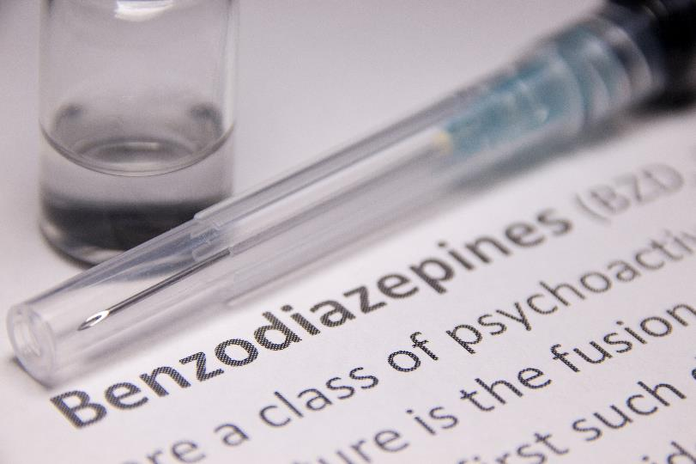
Benzodiazepine Withdrawal
Benzodiazepine withdrawal has the same features as AWS via the primary reaction on GABA receptors.
The timeline of onset and duration differs from AWS:
  Later onset, longer duration, more insidious onset for longer acting benzodiazepines.
The treatment for benzodiazepine withdrawal is similar to that for AWS:
  Substitute using long-acting benzodiazepines, then taper.
20

Slide 21


Pathophysiology – Part 2
Chronic alcohol use (or any substance of abuse) causes several well-documented brain changes that can last for several weeks or months.
Decreased reward
  Requires increasingly larger doses to feel good (or even not bad).
Anxiety, irritability, insomnia
  Higher levels of hormones and transmitters are associated with stress.
Cue responsiveness
  Exaggerated craving and stimulation from cues (ie, seeing an image of a beer).
Reduced impulse control and executive functioning
  Caused by a hypoactive frontal cortex.
These changes make it extremely hard to stop drinking and stay stopped! Medications can help!
21
Notes:
George Koob’s Youtube is excellent
Nora Volkow articles

Slide 22
Medications for AUD
Naltrexone
Typically, it is the best option for the ED.
  It effectively reduces cravings and heavy drinking (and health costs).
  Give 50 mg orally daily or 380 mg IM monthly.
    It has better adherence than other AUD medications.
  Safe for patients who are still drinking.
Do not give to patients who are still taking or require opioid agonists.
  It is a mu-opioid receptor antagonist (like naloxone).
  Confirm that the patient is not physically dependent on or in need of opioid treatment.
    If in doubt, do an antagonist challenge with a test dose of naloxone.
    NOTE: Standard UTOX will miss synthetic opioids.
  Avoid giving it to patients with acute liver failure.
22
Notes:
Naltrexone is an option to reduce cravings for the treatment of AUD; it does not treat AWS. As it is an opioid receptor antagonist (acts like naloxone), t must not be given to anyone with opioid use, dependence, or requirements. It is a great choice for someone with OUD in full remission and not on opioid agonist treatment (BUP or MMT). If you are uncertain about opioid use, you can confirm by doing a naloxone challenge prior to administering. Also, caution in anyone with severe liver disease (not recommended for anyone with AST or ALT more than 5x upper limit of normal = approx 200).
No sedation risk. No abuse risk. May continue to drink while taking.
Dose 50mg po qday or long acting injection 380mg q28days.
References:
Kranzler et al. JAMA 2018. Diagnosis and Pharmacotherapy of Alcohol Use Disorder (Review)
Additional subsequent trials support Gabapentin (Rentsch et al. 2019)
Up to Date articles by Saitz and Hoffman provide refrerenced reviews.
Naltrexone in ED patients (McCormack)

Slide 23
Other AUD Medication Options
Gabapentin (Off-label for AUD tx)
It is effective and safe at high doses for both AWS and AUD.
It reduces cravings, withdrawal symptoms, and drinking.
The side effects are dizziness and drowsiness.
Give up to 2400 mg daily divided TID/QID.
Acamprosate
It is efficacious – reduces cravings.
Its effectiveness is limited by poor adherence (TID dosing).
It is safe to take even if the patient is still drinking.
Give 666 mg PO q8.
Disulfiram (Antabuse)
Generally, NOT a good option for ED use.
It is an acetaldehyde dehydrogenase inhibitor.
It is NOT safe to take if the patient is actively drinking.
Consider initiating AUD treatment in the ED and refer for ongoing care!
Notes:
References:
Kranzler et al. JAMA 2018. Diagnosis and Pharmacotherapy of Alcohol Use Disorder (Review)
Additional subsequent trials support Gabapentin (Rentsch et al. 2019)
Up to Date articles by Saitz and Hoffman provide refrerenced reviews.
Naltrexone in ED patients (McCormack)

Slide 24

Behavioral Treatment
Alcoholics Anonymous (AA)
It is widely available, is free of charge, is not run by doctors/health professionals, and provides peer support.
  It is an abstinence-based, 12-step program.
  It promotes social networking in a supportive community to learn from one another.
  People learn how to live (and not be miserable or alone) without alcohol.
Counseling
  Specific modalities are evidence based.
Medical Management
  Primary care-based medication management itself without specialty referral is effective.
Other Support Groups
  Faith-based groups, social networking, etc.
24
Notes:
Counseling: some types of counseling that have been shown to help people with alcohol problems:
Cognitive-Behavioral Therapy
Motivational Enhancement Therapy
Marital or Family Counseling
Counseling can be combined with medications or support groups.
Costs may or may not be covered by insurance.
References: Many options, including summary in Soyka et al. (2016) WFSBP Treatment Guidelines

Slide 25
Other Important Notes
Treatment of alcohol-related agitation:
Antipsychotics (ie, haloperidol) are preferred for isolated alcohol intoxication to minimize the risk of oversedation.
Benzodiazepines are preferred if there is co-occurring stimulant/substance use, seizures, unstable vitals, and/or alcohol withdrawal.
Monitor the airway positioning and ventilation.
Interpret BAC or the finding of “alcohol on breath” with caution:
Neither confirms alcohol intoxication.
Patients with severe, chronic AUD may exhibit alcohol withdrawal with an elevated BAC due to tolerance.
The scent of alcohol on the breath or a person may be long lasting.
The attribution of clinical findings to alcohol intoxication/withdrawal is a common pitfall.

Slide 26

Other High-Risk Concerns
Have a high level of suspicion for co-occurring problems.
Examples:
  Diminished reliability in assessing for injury (ie, C-spine)
  Why did this person stop drinking? Is this person now in withdrawal due to underlying illness (ie, pancreatitis)?
  Altered level of awareness may be from a head injury (CT if not improving as expected).
  High prevalence of homelessness and housing instability means amplified risk of thermal injuries, nutritional deficits, metabolic derangements, and skin/soft tissue infections, infestations, and injuries.
Fluids/electrolytes/nutrition of patients with chronic, severe AUD.
Thiamine replacement
  100 to 200 mg IM/IV for patients with chronic AUD; PO absorption is unreliable.
  Higher, frequent dosing if there are signs of Wernicke.
Alcohol ketoacidosis, hypoglycemia, hypomagnesemia, and other metabolic derangements are beyond the scope of this presentation.
26
Notes:
References include Goldfrank’s Toxicology
Remember thiamine replacement in patients with chronic AUD. Magnesium and other vitamins/minerals may also be deficient.

