Slide 1



Module #8
Special Populations
Module Primary Authors
Lindsey Jennings
Authoring Group
Steven L. Bernstein, Kathryn Hawk, Lindsey Jennings, Lucinda Lai, Alexis LaPietra, Ryan McCormack, Lewis S. Nelson, and Reuben Strayer
Funding for this initiative was made possible (in part) by grant no. 1H79FG000021-01 from SAMHSA. The views expressed in written conference materials or publications and by speakers and moderators do not necessarily reflect the official policies of the Department of Health and Human Services; nor does mention of trade names, commercial practices, or organizations imply endorsement by the U.S. Government.

Slide 2

Learning Objectives
Discuss appropriate management of opioid use disorder in adolescents.
Describe appropriate management of opioid use disorder during pregnancy.
Outline considerations affecting the use of medications for addiction treatment in older patients.
2

Slide 3

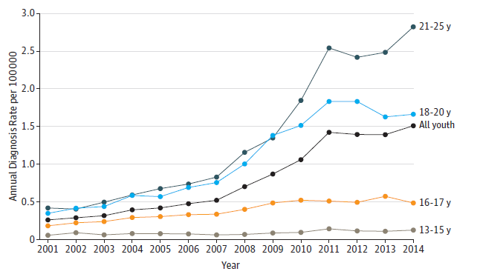
Incidence of Opioid Use Disorder, Ages 13 to 25
Hadland, et al. 2017.
3

Slide 4

Opioid Use Disorder in Youth
Heroin use has been increasing since 2012.
In 2017, an estimated 14,000 adolescents in the US used heroin within the prior year and 769,000 adolescents misused prescription pain medication.
An estimated 120 new cases of youth OUD occur per day.
Fatal drug overdoses have increased 3.5 times from 1999 to 2014 for patients 15 to 24 years old.
OUD continues to be undertreated in youth.
  In one study, only 2.4% of adolescents in treatment for heroin use received MAT.
Hadland, et al. 2017.; Martin S, et al. 2002.; Saloner, et al. 2017.; Yule A, et al. 2018.; Mental Health Annual Report: Substance Abuse and Mental Health Services Administration, Center for Behavioral Health Statistics and Quality. 2015.; Feder, et al. 2017.; Camena, et al. 2019.; Parker, et al. 2015.
4

Slide 5
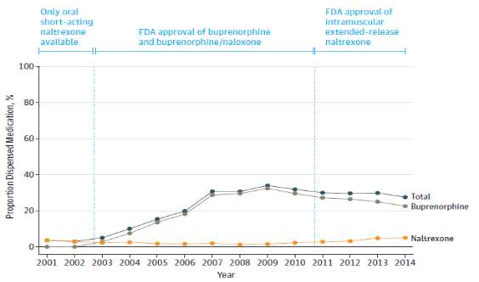
Proportion of Youth Receiving Treatment within Six Months of Diagnosis
Hadland, et al. 2017.
5

Slide 6

Initiating Treatment for OUD in Adolescents
American Academy of Pediatrics
The AAP advocates for increasing resources to improve access to MOUD for adolescents and young adults.
The AAP also recommends offering MOUD to adolescent and young adult patients with severe OUD or referring them for MOUD.
AAP. 2016.; Fishman, et al. 2010.; Kampman, et al. 2015.; Woody, et al. 2008.; CFR 42. 2017.; DATA. 2000.
6
Notes:
And because clonidine, ibuprofen and phenergan don’t address the problem, which is a billion screaming mu receptors, they don’t work well, so trying to make the patient comfortable enough to be discharged often doesn’t work unless you sedate the patient to unconsciousness, at which point they still can’t be discharged because they’re unconscious and you end up with these 5, 10, 15 hour ED stays where everyone is miserable, the patient, the nurse, the doctor, the other patients…

Slide 7

Initiating Treatment for OUD in Adolescents (cont’d.)
FDA approved medications:
Buprenorphine is approved for patients at least 16 years old.
  It is often considered to be the first choice.
  It significantly decreases the use of opioids and cocaine.
  It has much better treatment retention in comparison to no MOUD.
  It decreases injecting.
  It decreases the need for additional treatment while patients are on medication.
Methadone is approved for patients at least 18 years old.
  42 CFR § 8.12 offers an exception for patients 16 to 17 years old with a documented history of at least two prior unsuccessful withdrawal management attempts and that have parental consent.
Naltrexone ER is approved for patients at least 18 years old.
Age of consent for MOUD varies by state; make sure you are familiar with your state’s regulations.
AAP. 2016.; Fishman, et al. 2010.; Kampman, et al. 2015.; Woody, et al. 2008.; CFR 42. 2017.; DATA. 2000.
7

Slide 8
Learning Objectives
Discuss appropriate management of opioid use disorder in adolescents.
Describe appropriate management of opioid use disorder during pregnancy.
Outline considerations affecting the use of medications for addiction treatment in older patients.
8

Slide 9
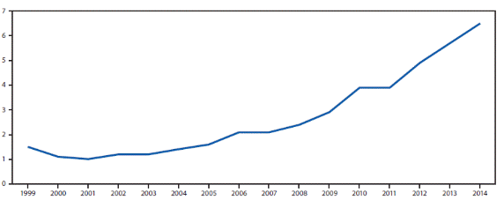
Opioid Use Disorder in Pregnancy
From 1999 to 2014, the prevalence of OUD increased 333%
There were 1.5 cases of OUD per 1,000 delivery hospitalizations in 1999 and 6.5 cases per 1,000 delivery hospitalizations in 2014.
Opioid abuse and dependence is associated with an increased risk of maternal death of over 4 times.
National prevalence of opioid use disorder per 1,000 delivery hospitalizations in the US from 1999 to 2014.*
Cases per 1,000 delivery hospitalizations
Year
*National Inpatient Sample (NIS), Healthcare Cost and Utilization Project (HCUP)
Hand, et al. 2017.; Patrick, et al. 2015.; Maeda, et al. 2014.; Haight, et al. 2018.

Slide 10

Opioid Use Disorder in Pregnancy
The American College of Obstetrics and Gynecology (ACOG) recommends:
  Screening for substance use as part of comprehensive obstetric care
  Opioid agonist pharmacotherapy for patients with OUD over medically supervised withdrawal
Do NOT delay treatment of patients with OUD from the ED.
ACOG. 2017.
10

Slide 11
Benefits of Opioid Agonist Treatment OUD for Pregnant Patients
There is a clear benefit to opioid agonist therapy in patients with intravenous and/or heroin use due to an increased risk of relapse.
  41% to 95% of patients relapsed or converted to methadone if opioid agonist therapy is discontinued.
  Discontinuation of agonist therapy is associated with poor obstetric outcomes related to relapse.
  Patients have longer retention in treatment rates, have higher attendance at obstetric care visits, and are more likely to deliver in a hospital.
Studies about opioid agonist therapy compared to medication-assisted withdrawal for pregnant patients using non-intravenous prescriptions are less clear.
The recommendation is opioid agonist therapy.
Discuss the risks and benefits of each option with patients and allow for individualized treatment plans.
Boyars, et al. 2018.
11

Slide 12
Buprenorphine vs. Methadone for Pregnant Patients with OUD
Buprenorphine (Mono-Product) | Methadone
Same efficacy as methadone Same rates of adverse events at methadone Lower risk of overdose Fewer drug interactions Less frequent NAS and milder abstinence symptoms in neonates Significantly decreased morphine dose required Significantly shorter hospital stay Significantly shorter duration of treatment | More structure – better for patients in unstable situations Decreased risk of diversion More long-term data about outcomes
Fischer, et al. 1998, 1999.; Jones, et al. 2010.; Kakko, et al. 2008.; Kraft, et al. 2017.
12

Slide 13
Comparison of Neonatal Opioid Withdrawal Syndrome: Maternal Methadone vs. Buprenorphine
Jones, et al. 2010.

Slide 14
Methadone Treatment for OUD in Pregnancy
Use high enough doses to block cravings.
Pregnancy-related pharmacokinetic changes:
  During the second and third trimesters, the dosage and frequency of doses may need to be increased due to increased metabolism and circulating blood volume.
  The half-life of methadone falls from 22 to 24 hours in non-pregnant women to 8.1 hours in pregnant women.
Kampman, et al. 2015.

Slide 15
Buprenorphine Treatment for OUD in Pregnancy
During pregnancy, no significant dosage increases are needed, but split dosing may be needed in the third trimester.
Formulation of buprenorphine during pregnancy:
  Buprenorphine without naloxone is recommended for pregnant opioid-dependent patients as the first option.
  The FDA labels the combination of buprenorphine and naloxone product as Category C in pregnancy.
  There is increasing evidence that the buprenorphine and naloxone combination product is safe in pregnancy.
  The misuse of the buprenorphine mono-product may be an indication for the buprenorphine and naloxone combination in pregnancy.
Lund, et al. 2013.
15

Slide 16

Neonatal Opioid Withdrawal Syndrome (NOWS)
Epidemiology:
  Incidence increasing
  Occurs in 70-95% of newborns born to opioid-dependent women
Symptoms:
  Irritability, fever, diarrhea, hyperreflexia, seizures
  Begins 24 to 72 hours after birth, peak symptoms occur after 4 days and last about 1 week
Treatment:
  Opioid agonist therapy (morphine, methadone), clonidine, rooming-in with parent
Kakko, et al. 2008.; Patrick, et al. 2015.; Smith, et al. 2017.; Holmes, et al. 2016.; Hudak, et al. 2012.
16

Slide 17
Breastfeeding
Not contraindicated for mothers on MOUD
Transferred amounts of methadone or buprenorphine are NOT sufficient to prevent NOWS
Levels in human milk are low with calculated infant exposures of the maternal weight-adjusted dose being
  Less than 3% for methadone
  2.4% for buprenorphine
Sachs, et al. 2013.

Slide 18
Learning Objectives
Discuss appropriate management of opioid use disorder in adolescents.
Describe appropriate management of opioid use disorder during pregnancy.
Outline considerations affecting the use of medications for addiction treatment in older patients.
18

Slide 19
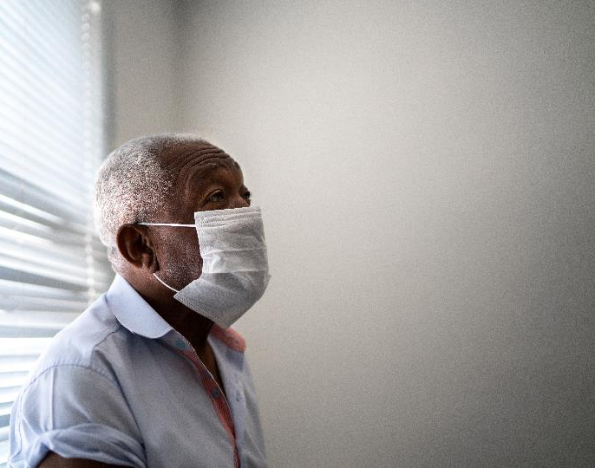
Older Adults
Populations of older adults continue to increase.
  In the United States, 20% of residents will be 65 or older by 2030.
The prevalence of substance use disorders in older adults equals about 1 million patients total.
  There are 978,000 people with alcohol use disorder.
  There are 161 people with illicit drug use disorder.
  The total number is expected to increase to 5.7 million individuals by 2020.
Maree, et al. 2016.; Mattson, et al. 2017.; West, et al. 2015.; Wu, et al. 2014.
19

Slide 20
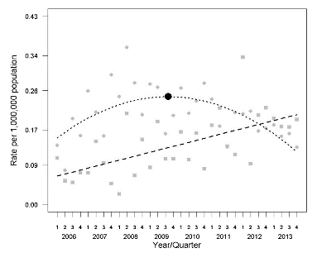
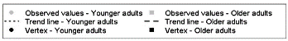
Death Rates of Older Adults Due to Opioids
Death rates due to abuse or misuse of prescription opioids per 1 million of the population by age group
2.8 times the increase in death rates for older adults (60+ years) from 2006 to 2011
West, et al. 2015.

Slide 21
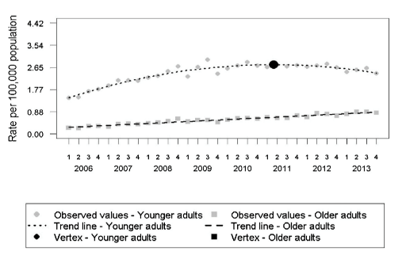
Older Adults and Opioid Use
Physiologic changes are a decreased metabolism and an increased elimination time of medications.
Polypharmacy is more likely in older adults.
There are increased morbidities.
There is a high prevalence of chronic pain in older adults.
Intentional self-poisoning is reported as a frequent mechanism of suicide and is gradually increasing.
West, et al. 2015.
21

Slide 22
Treatment Considerations for Older Adults
Screen for OUD and assess for suicidality.
Medications for OUD in older adults:
  Buprenorphine
    First line, partial agonism of buprenorphine is safer due to the increased susceptibility of the elderly to respiratory compromise.
    Start low and go slow with dosing.
    Maintenance dosing may be lower than in younger patients due to a slowed hepatic metabolism.
  Methadone
    Methadone has many drug interactions.
    Include QT prolongation-additive when patients are taking other QT prolonging medications.
    It has a higher overdose risk.
Chau, et al. 2008.; West, et al. 2015.; Wu, et al. 2014.
22

Slide 23

Key Points
Adolescents
  Buprenorphine is approved for individuals over 16 years old.
  Naltrexone ER and methadone are approved for individuals 18 years and older.
Pregnant Women
  Buprenorphine and methadone should be used to treat pregnant women with OUD during pregnancy.
Older Adults
  Buprenorphine should be considered the first line for older adults with OUD, but patients will likely require lower doses than younger patients would.
23

Slide 24
References
AAP Committee on Substance Use and Prevention. Medication-Assisted Treatment of Adolescents With Opioid Use Disorders. Pediatrics. 2016;138(3):e20161893.
American College of Obstetricians and Gynecologists (ACOG) and American Society of Addiction Medicine (ASAM). Opioid Use and Opioid Use Disorder in Pregnancy. 2017. https://www.acog.org/-/media/Committee-Opinions/Committee-on-Obstetric-Practice/co711.pdf?dmc=1&ts=20171105T2029443754.
Boyars L, Guille C. Treatment of Perinatal Opioid Use Disorder. Obstet Gynecol Clin North Am. 2018;45(3):511-524.
Chau DL, Walker V, Pai L, and Cho LM. Opiates and elderly: Use and side effects. Clin Interv Aging. 2008;3(2): 273–278.
Hadland SE, Wharam JF, Schuster, et al. Trends in Receipt of Buprenorphine and Naltrexone for Opioid Use Disorder Among Adolescents and Young Adults, 2001-2014. JAMA Pediatrics. Published Online 2017. Accessed 11/11/19.
Hand DH, Short VL, Abatemarco DJ. Substance use, treatment, and demographic characteristics of pregnant women entering treatment for opioid use disorder differ by United States census region. J Subst Abuse Treat. 2017;76:58-63.
Haight SC, Ko JY, Tong VT, Bohm MK, Callaghan WM. Opioid Use Disorder Documented at Delivery Hospitalization — United States, 1999–2014. MMWR Morb Mortal Wkly Rep. 2018;67:845–849. DOI: http://dx.doi.org/10.15585/mmwr.mm6731a1
Holmes AV, Atwood EC, Whalen B, et al. Rooming-In to Treat Neonatal Abstinence Syndrome: Improved Family-Centered Care at Lower Cost. Pediatrics. 2016;137(6):e20152929.
Hudak ML, Tan RC, and the Committee on Drugs and the Committee on Fetus and Newborn. Neonatal Drug Withdrawal. Pediatrics. 2012;129(2);e540–560.
Feder K, Krawczyk N, Saloner B. Medication-Assisted Treatment for Adolescents in Specialty Treatment for Opioid Use Disorder. J Adolesc Health. 2017;60(6):747-750.
Fishman MJ, Winstanley EL, Curran E, et al. Treatment of opioid dependence in adolescents and young adults with extended release naltrexone: Preliminary case-series and feasibility. Addiction. 2010;105(9): 1669–1676.
Jones HE, Kaltenbach K, Heil SH, et al. Neonatal abstinence syndrome after methadone or buprenorphine exposure. N Engl J Med. 2010;363(24): 2320–2331.

Slide 25
References
Kakko J, Heilig M, Sarman I. Buprenorphine and methadone treatment of opiate dependence during pregnancy: Comparison of fetal growth and neonatal outcomes in two consecutive case series. Drug and Alcohol Dependence. 2008;96(1-2) 69–78.
Kampman K, Comer S, Cunningham C, et al. National Practice Guideline for the Use of Medications in the Treatment of Addiction Involving Opioid Use. Chevy Chase, MD: American Society of Addiction Medicine. 2015.
Lund IO, Fischer G, Welle-Strand GK, et al. A Comparison of Buprenorphine + Naloxone to Buprenorphine and Methadone in the Treatment of Opioid Dependence during Pregnancy: Maternal and Neonatal Outcomes. Subst Abuse. 2013;7:61–74.
Maeda A, Bateman BT, Clancy CR, Creanga AA, Leffert LR. Opioid abuse and dependence during pregnancy: temporal trends and obstetrical outcomes. Anesthesiology. 2014;121(6):1158-65.
Maree RD, Marcum ZA, Saghafi E, et al. A Systematic Review of Opioid and Benzodiazepine Misuse in Older Adults. Am J Geriatr Psychiatry . 2016;4(11): 949–963.
Martins S, et al. Prescription opioid use disorder and heroin use among 12–34 year-olds in the United States from 2002 to 2014. Addict Behav. 2002;65:236–41.
Mattson M, Lipari RN, Hays C, and Van Horn SL. A day in the life of older adults: Substance use facts. The CBHSQ Report: May 11, 2017. Center for Behavioral Health Statistics and Quality, Substance Abuse and Mental Health Services Administration, Rockville, MD.

